Slide 1
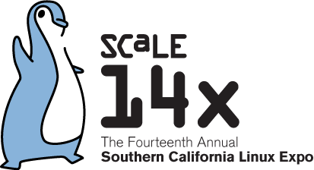
Trademarks and FOSS: Entirely the Same and Entirely Different
Chestek Legal
Raleigh, North Carolina
22 January 2016

Slide 2
What's different about trademarks for open source?
Nothing
Everything
Notes:
Will be looking at it from two viewpoints, the project's and the user's

Slide 3
Basic Legal Concepts
A trademark is a symbolic representation of the sum of information about a product or service (in marketing terms, the "brand")
It points to a unique single source, but its use can signal many types of relationships
The law only prohibits a situation where there is confusion about the relationship being signaled
It is not the same thing as "attribution" contemplated in open source licenses

Slide 4
From the project perspective
Notes:
For our purposes, a project name = trademark, so everyone has one

Slide 5
Tensions for the project
Notes:
A general mistrust of IP
The concept of a trademark as identifying a single source of origin versus the concept of a decentralized development model
Trademark's control requirement versus open source's freedom to modify

Slide 6
But it is important for the
health of the project ...
Notes:
Community-building
Assurance of known characteristics for the software
Stop bad actors

Slide 7
It's not the Wild, Wild West
There is a canonical source, just like any product developed in more traditional ways
There is organizational structure, and the organization will likely own the trademark
Notes:
Who owns the trademark?
It really is owned by someone, that's sort of the definition of a trademark
Foundation, e.g. GNOME, OpenStack, Apache
Corporate owner, e.g. Fedora,Ubuntu
Fiscal sponsor, e.g. Debian
Founder, Linus Torvalds
Unincorporated association
These organizations range from no money at all, to charitable non-profit, to well-funded trade associations, to corporate funding
The situation with open source isn't that different from other types of looselly-organized groups, like church or neighborhood events, band names

Slide 8
From the project perspective
Here's the conundrum (for me): the trademark is often underrated and underfunded. But it is the only thing that distinguishes what may be identical products.

Slide 9
From the project perspective
"Registration is critical."
– Pamela Chestek
Notes:
It forces the community to decide who owns the trademark
It is public notice to the world of the rights that would otherwise be ignored
It shows the world open source software is a legitimate, commercial business

Slide 10
From the project perspective
Register in as many countries as you can afford, but at least one.

Slide 11
From the project perspective
A word about naming ...
Notes:
It used to be that names often indicated their relationship to another project, e.g., NHIBERNATE is a porting of HIBERNATE to the .net platform
Where's the confusion line?
Homage is always in the eye of the beholder
This practice seems to be abating as projects get more educated on trademark

Slide 12
From the project perspective
A bad legal fit
Notes:
To ensure the trademark rights aren't lost, the project has to meet the standards of a legal system that developed in a traditional manufacturing environment

Slide 13
From the user perspective
Another conundrum – how much does the project want others to use its name?
  Some say "yes, yes, yes!"
  Some say "now, wait a minute …"

Slide 14
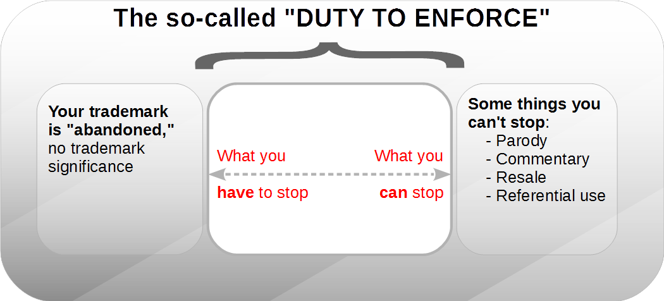
The Trademark
Enforcement Continuum
Notes:
Abandonment
Becomes the generic name, best way to avoid it is to use it correctly yourself
Naked licensing – this is the biggest risk

Slide 15
From the user perspective
Can the trademark be applied to exact copies?
Yes and No.
Notes:
But likely this is something that the project will be in favor of, even if the law would allow the project to prohibit it

Slide 16
From the user perspective
Can the trademark be applied derivative works? (i.e., I want to fork)
No.*
Notes:
There is a limit, which is probably reached if demanding removal of the trademark will substantially impair the functionality of the software.
Trademark law allows use of a trademark in a "functional" way Sega v. Accolade ("Trademark Security System" that looked for bytes of data consisting of the letters S-E-G-A was functional use and therefore could be used by competitors)

Slide 17
From the user perspective
1. There is no license, express or implied, in any free software license.*
2. There are no US cases.
3. Analogous law suggests that the answer is "no."
Notes:
We can argue about the Apache license, which says "This License does not grant permission to use the trade names, trademarks, service marks, or product names of the Licensor, except as required for reasonable and customary use in describing the origin of the Work and reproducing the content of the NOTICE file."
No precedent in the US, a few cases in Europe
Closest analogous areas of law are:
Repaired goods
Parallel imports
Nominative fair use

Slide 18
From the user perspective
But!
The project can always grant a trademark license for some uses
A project's trademark policy will give you guidance

Slide 19
Resources

Slide 20
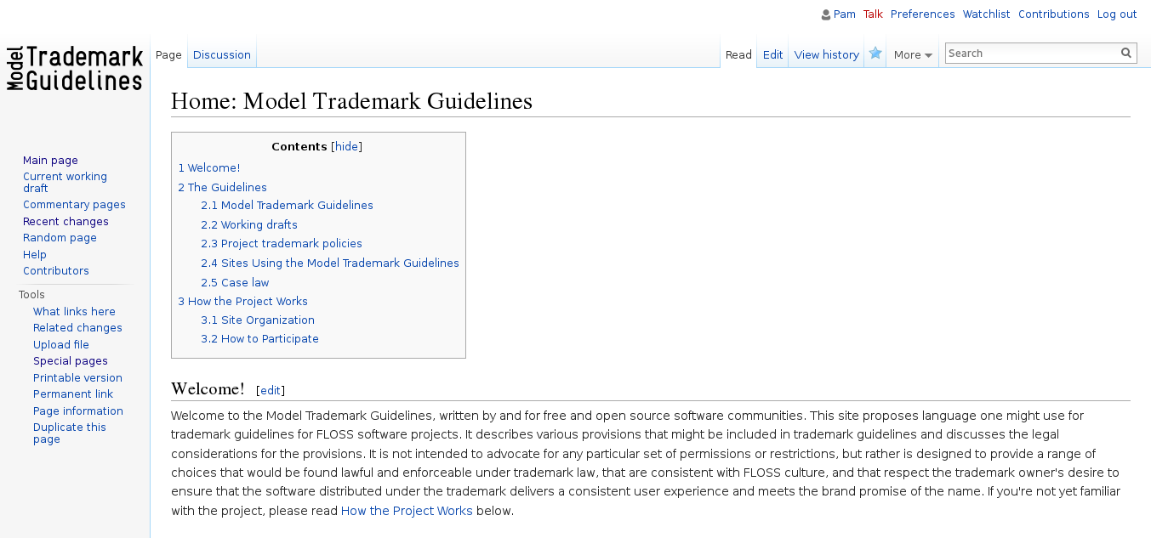

Slide 21
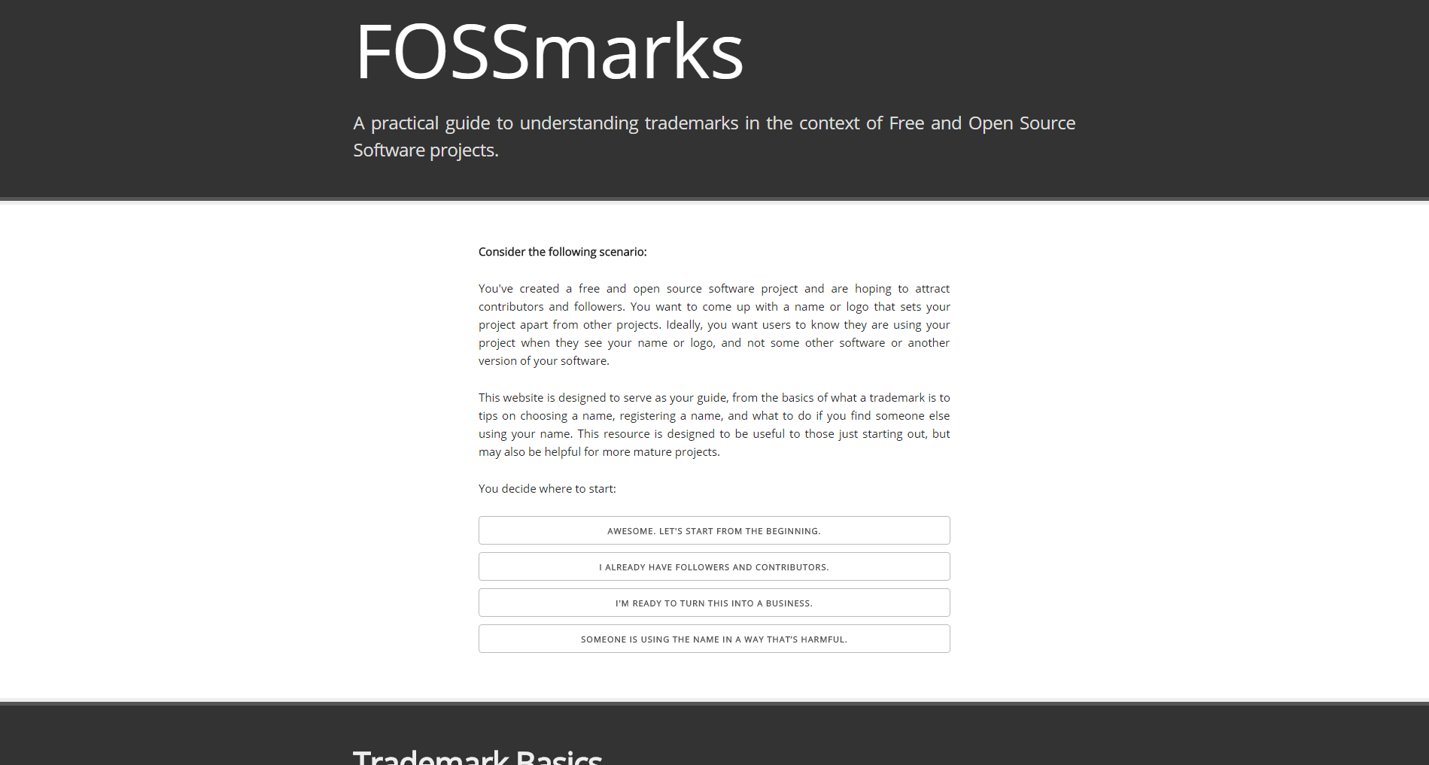

Slide 22
Reference materials
Who Owns the Project Name?, International Free and Open Source Software Law Review, 5(2), pp 105 – 120, DOI: 10.5033/ifosslr.v5i2.87
The Uneasy Role of Trade Marks in Free and Open Source Software: You Can Share My Code But You Can’t Share My Brand, 7 J. Intell. Prop. Law & Prac. 126 (2012)
Why Licenses Requiring the Use of Trademarks are Non-Free, FOSDEM 2014 Legal and Policy Issues devroom, http://chesteklegal.com/wp-content/uploads/2013/01/FOSDEM-2014-preso.pdf
Commentary: Let’s Kill the “Naked License” Defense, 104 Trademark Rep. 924 (2014)
Robert Young, Giving It Away, How Red Hat Software Stumbled Across a New Economic Model and Helped Improve an Industry, published in Open Sources: Voices from the Open Source Revolution (1999), http://www.oreilly.com/openbook/opensources/book/young.html
John Mark Walker, How to Make Money from Open Source Platforms, Linux.com (May-June 2015)
  http://www.linux.com/news/software/applications/831018-how-to-make-money-from-open-source-platforms
  http://www.linux.com/news/software/applications/831645-how-to-make-money-from-open-source-platforms-part-2/
  http://www.linux.com/news/software/applications/833312-how-to-make-money-from-open-source-platforms-part-3
  https://www.linux.com/news/software/applications/833939-how-to-make-money-from-open-source-platforms-part-4
Sega Enters. v. Accolade, Inc., 977 F.2d 1510 (9th Cir. 1992) (functionality)
Autodesk, Inc. v. Dassault Systemes Solidworks Corp., 685 F. Supp. 2d 1001 (N.D. Cal. 2009) (functionality)
FreecycleSunnyvale v. Freecycle Network, 626 F.3d 509 (9th Cir. 2010) (abandonment)

