Slide 1
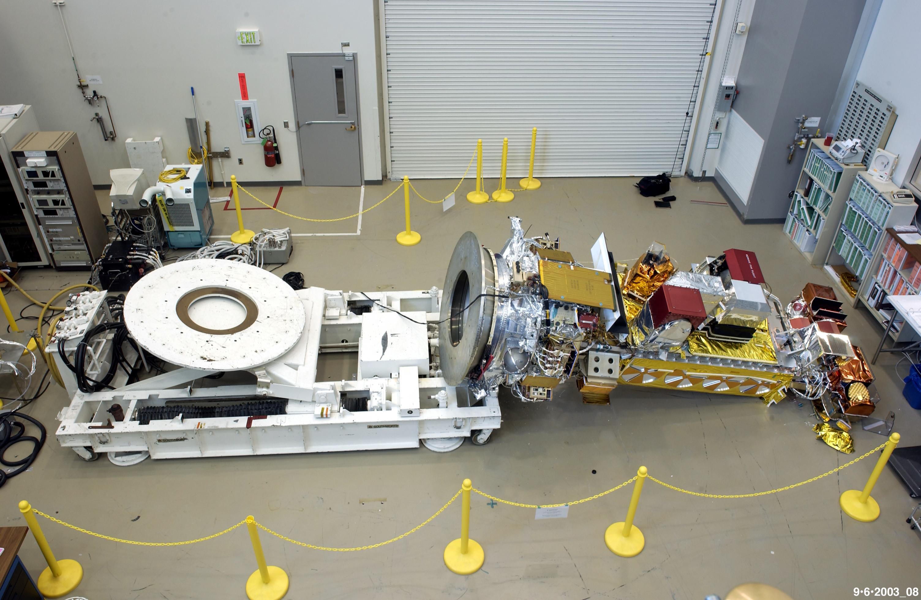
Hardware is Hard
A software perspective on building hardware
J
Photo Courtesy of NASA
John “Warthog9” Hawley
warthog9@eaglescrag.net

Slide 2

Survey time!
Cute baby animals want to know, so be truthful!
Notes:
Who builds software?
Who builds hardware?
Who's backed / pre-ordered something and it's been delayed? Never got it?
Who thinks that build hardware is easy?

Slide 3

I build software
What I REALLY mean – is I write a lot of bugs…
… that I fix later ……….. maybe ...

Slide 4
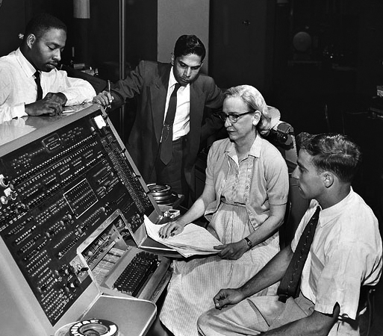
Compilation time
By Unknown (Smithsonian Institution) - Flickr: Grace Hopper and UNIVAC, CC BY 2.0

Slide 6
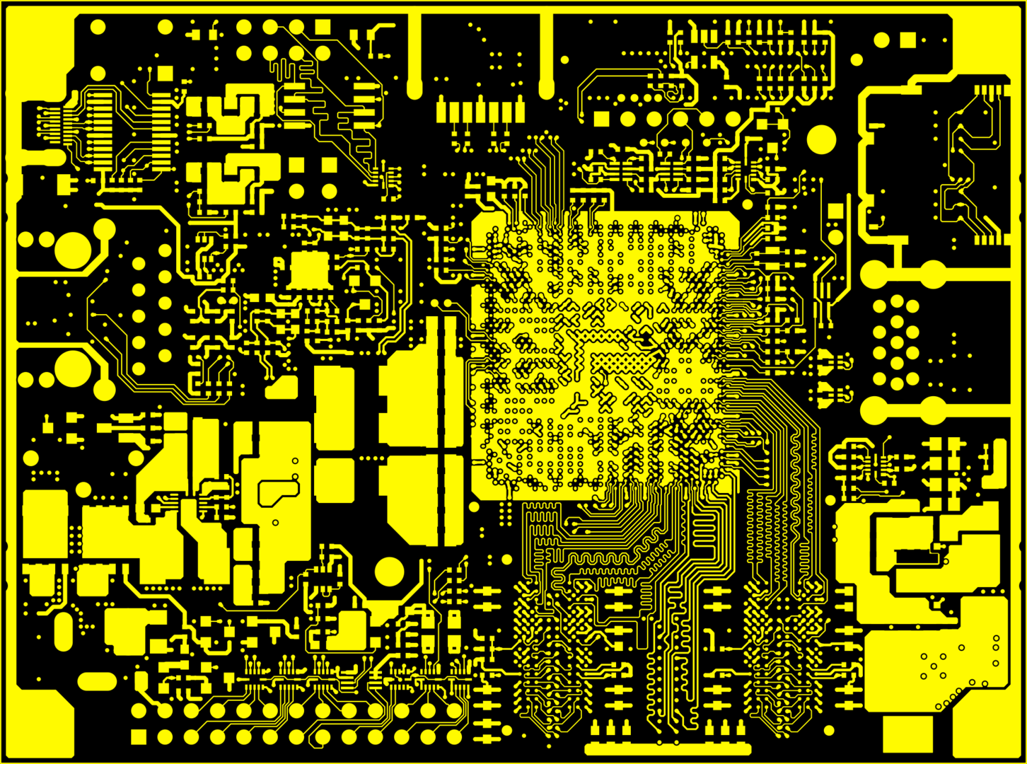

Slide 7
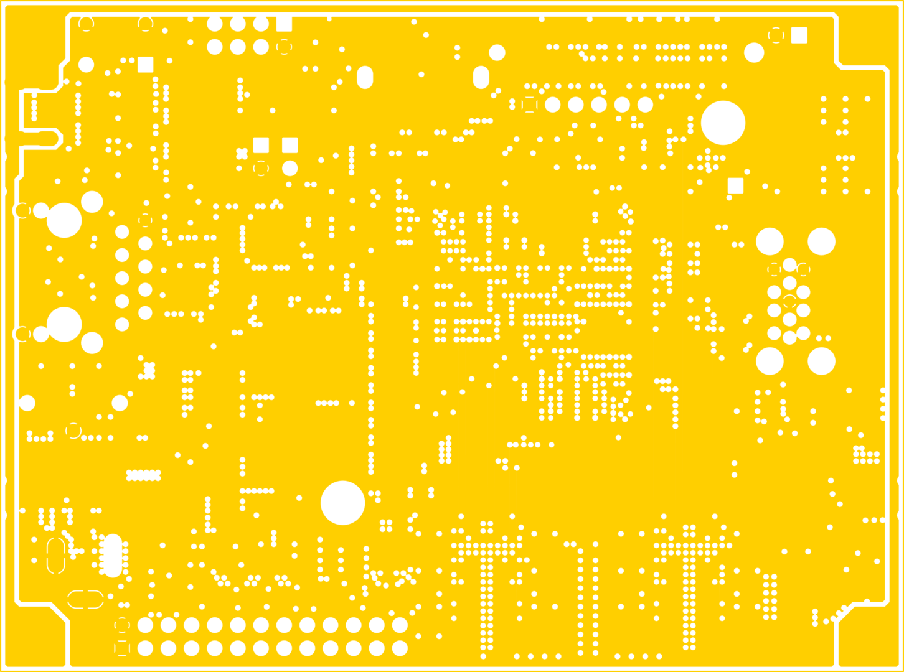

Slide 8
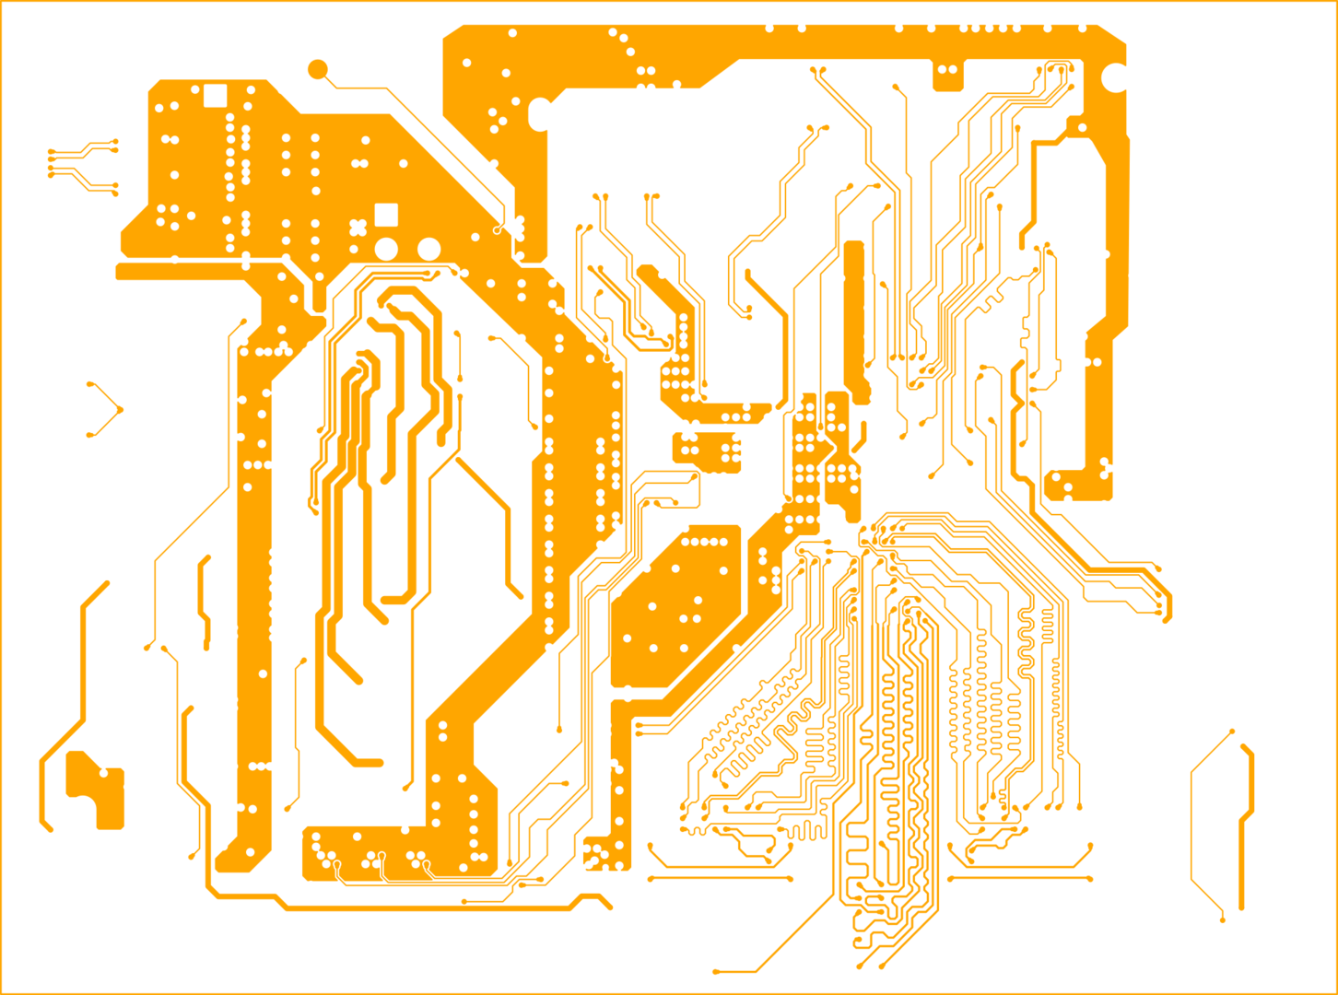

Slide 9
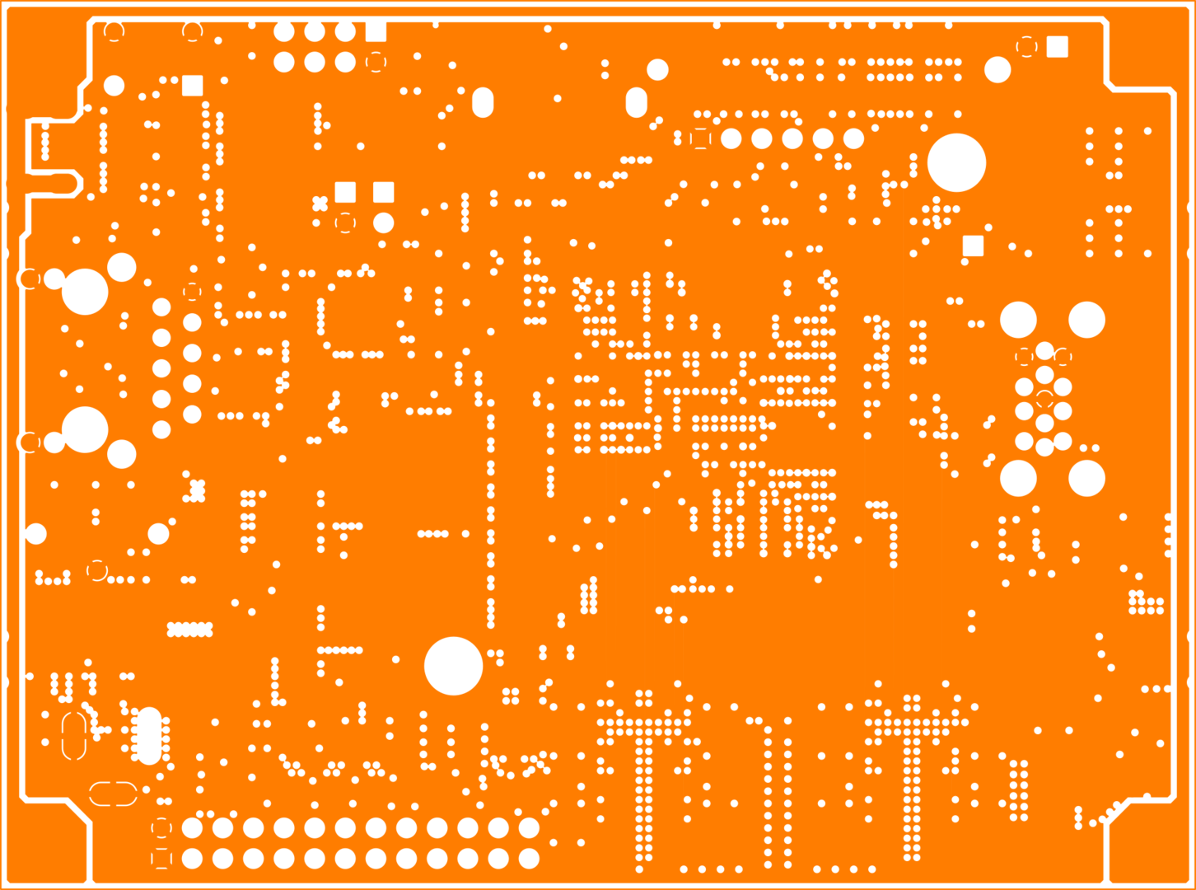

Slide 10
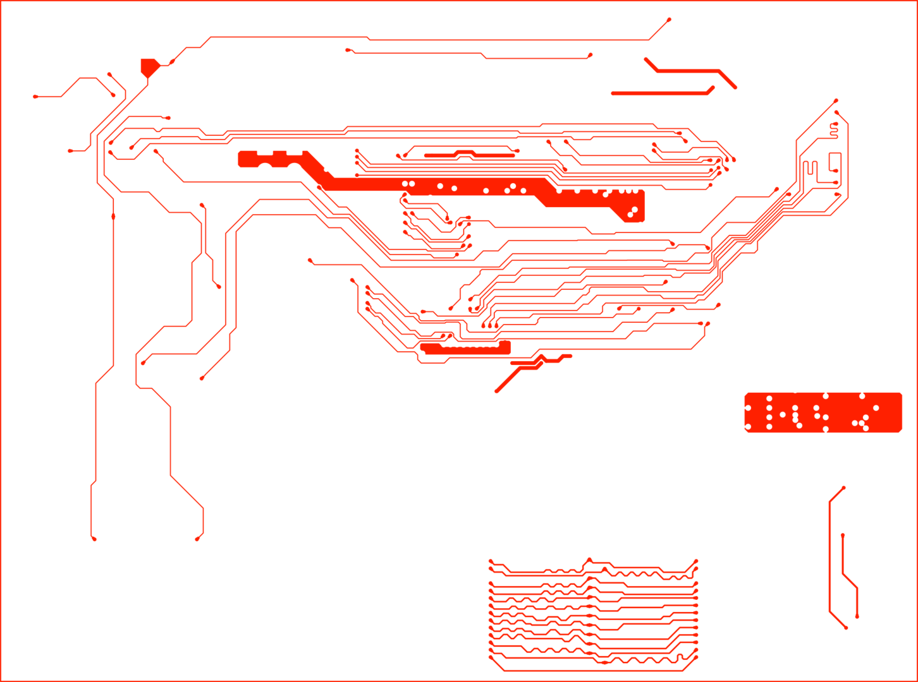

Slide 11
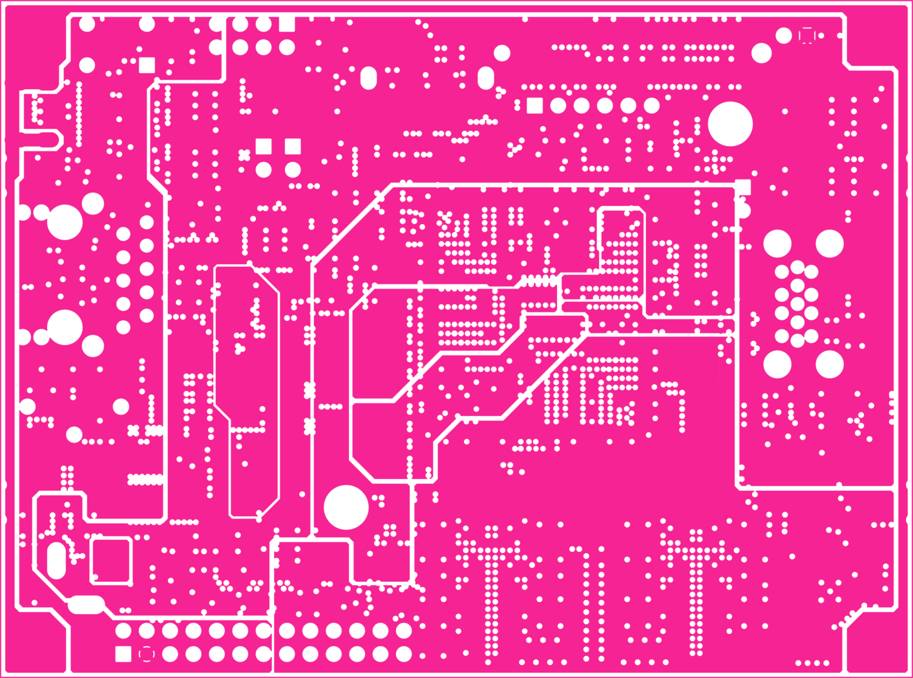

Slide 12
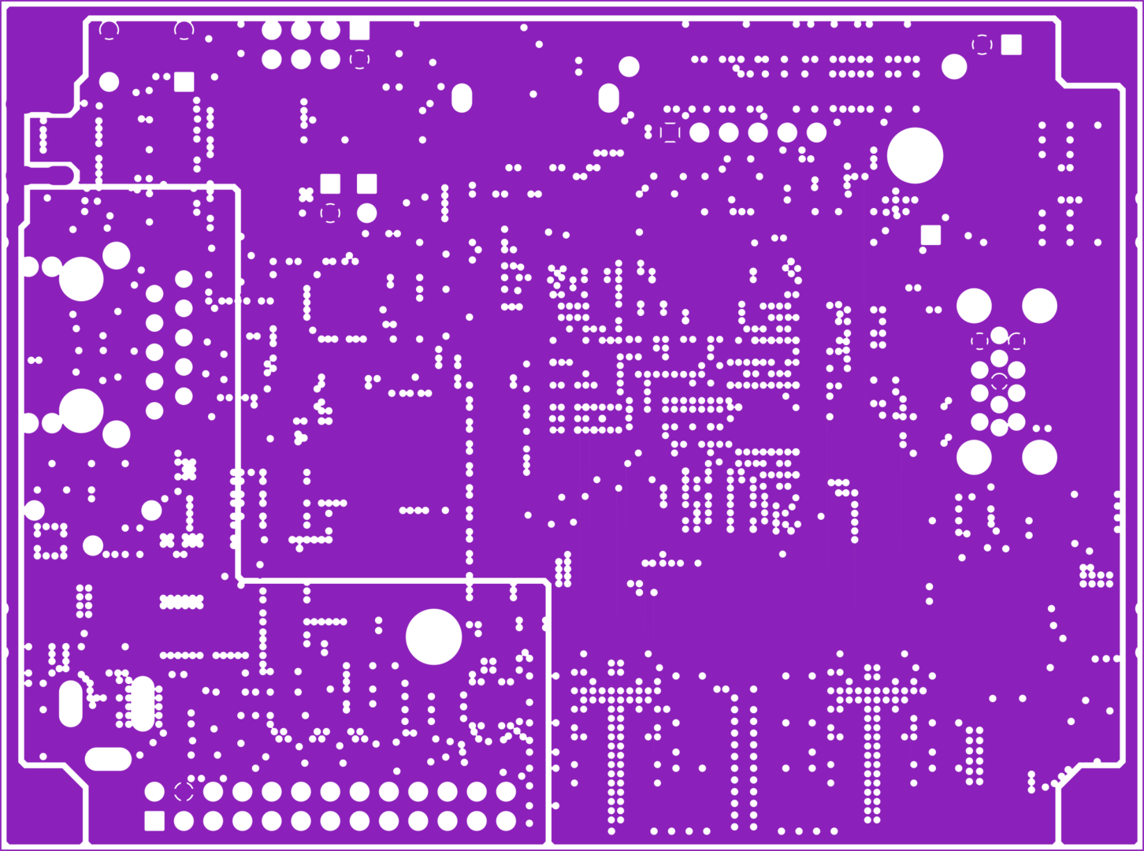

Slide 13
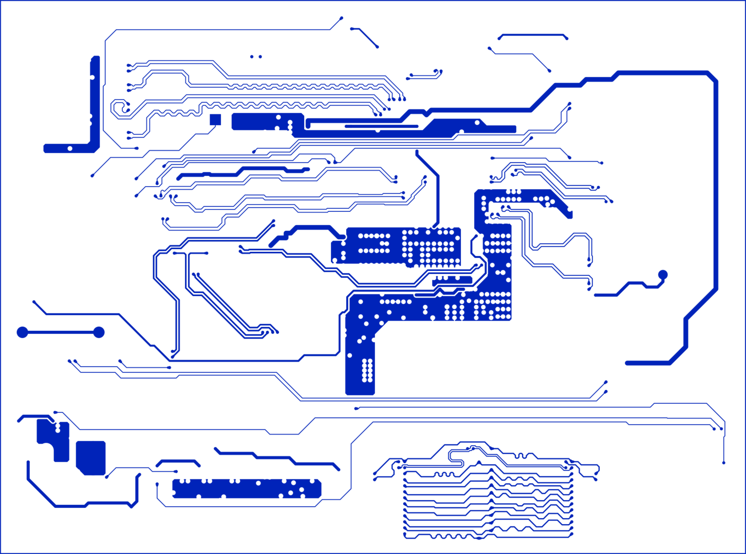

Slide 14
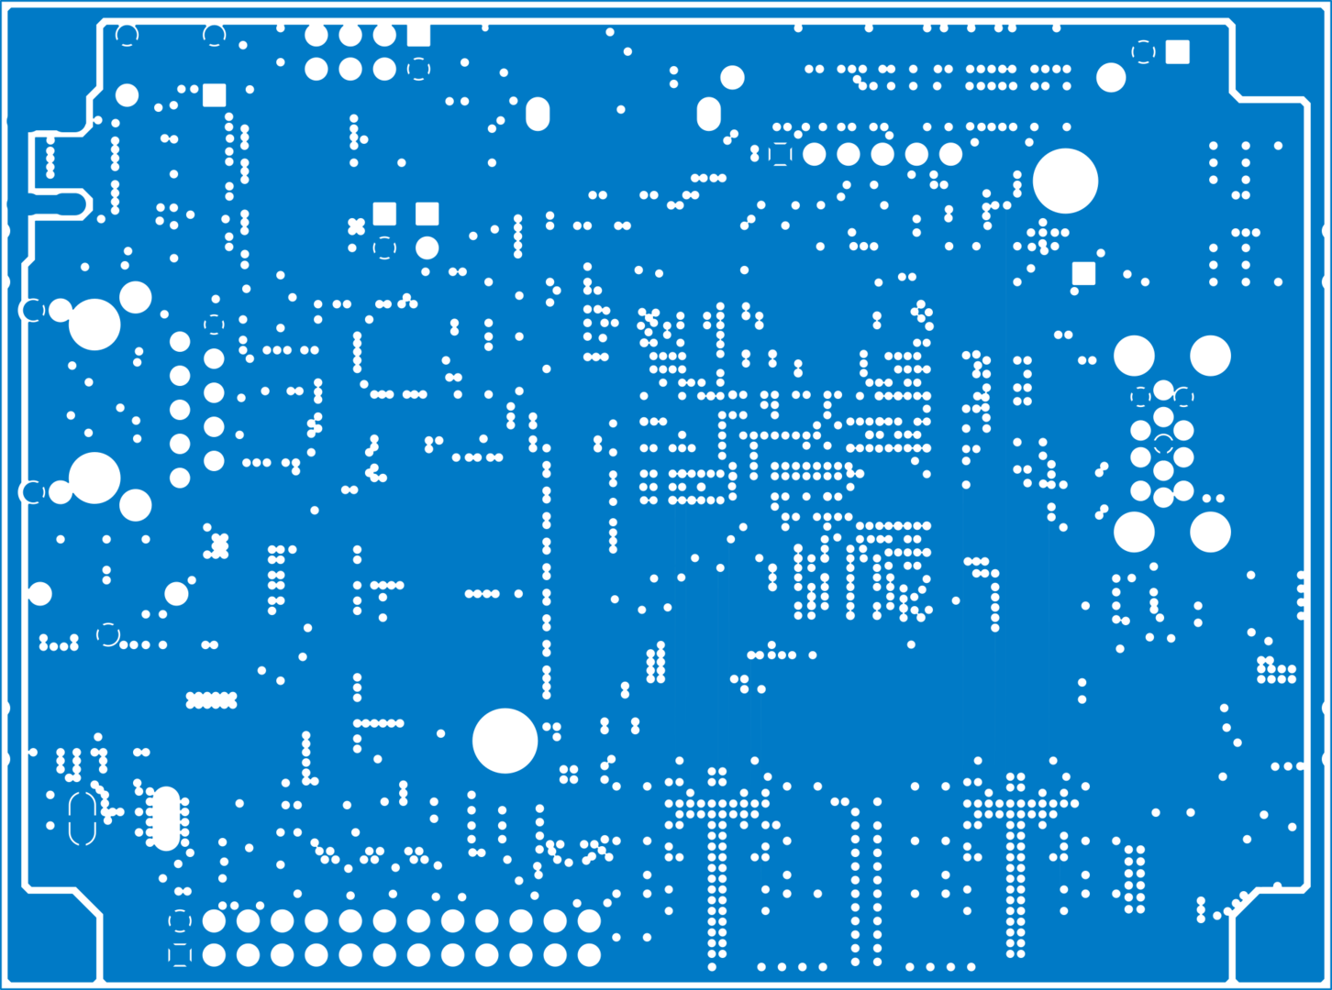

Slide 15
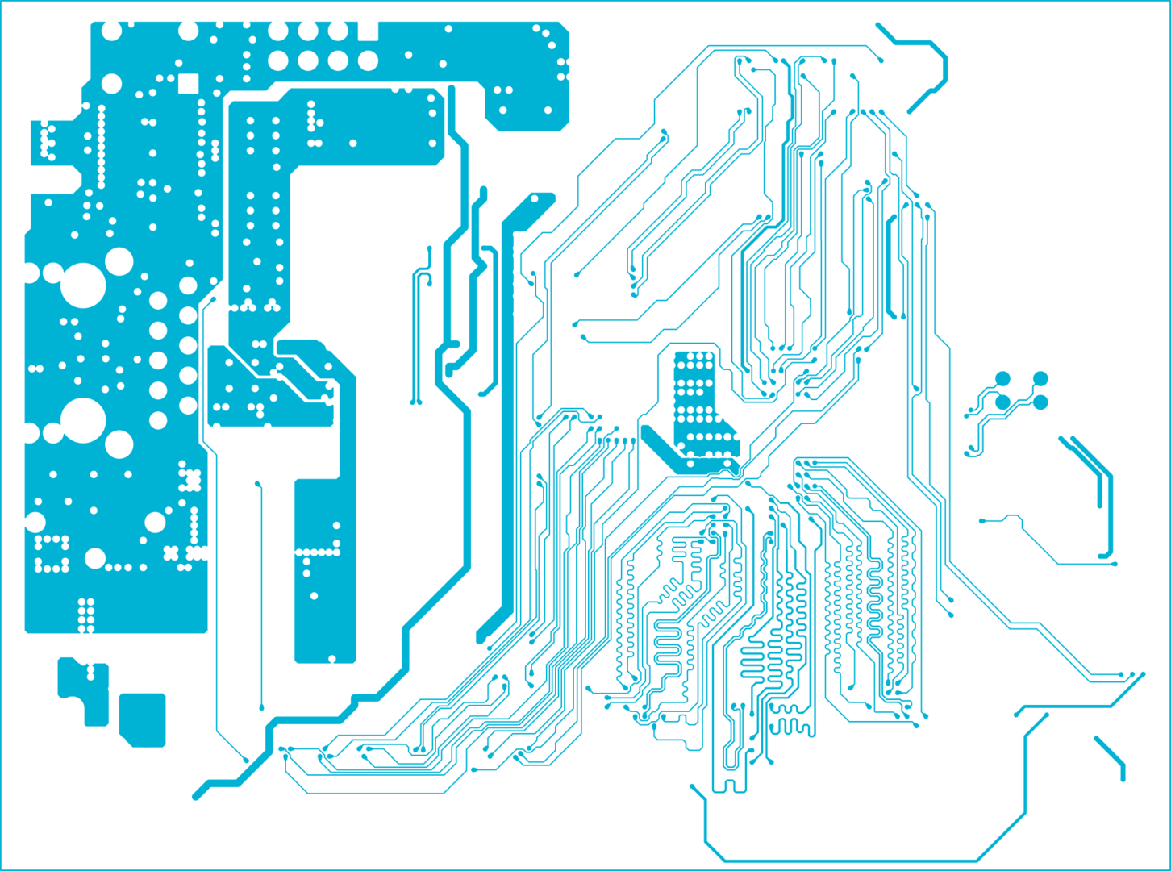

Slide 16
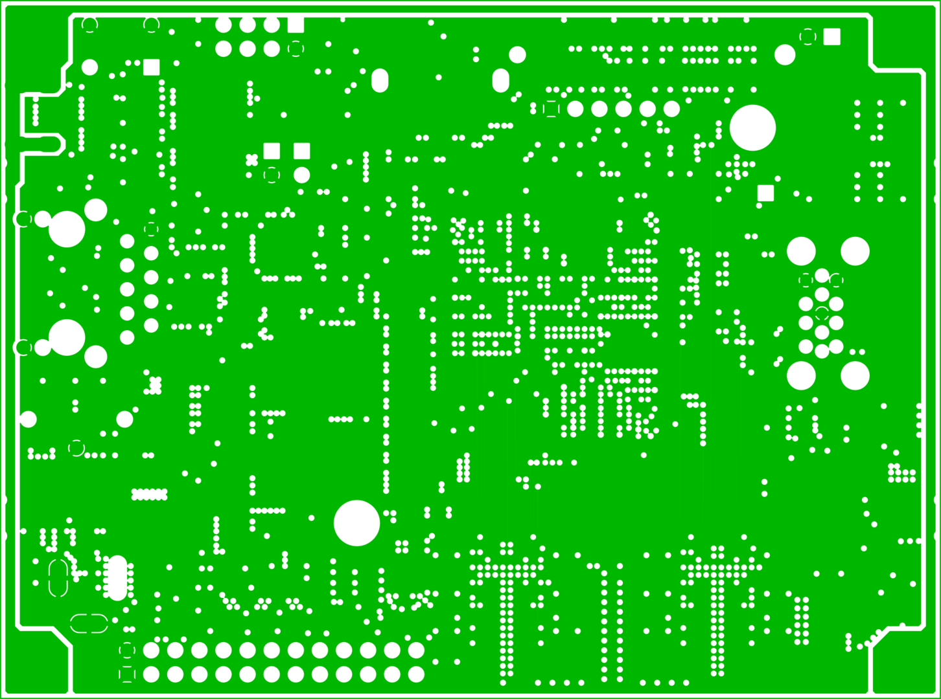

Slide 17
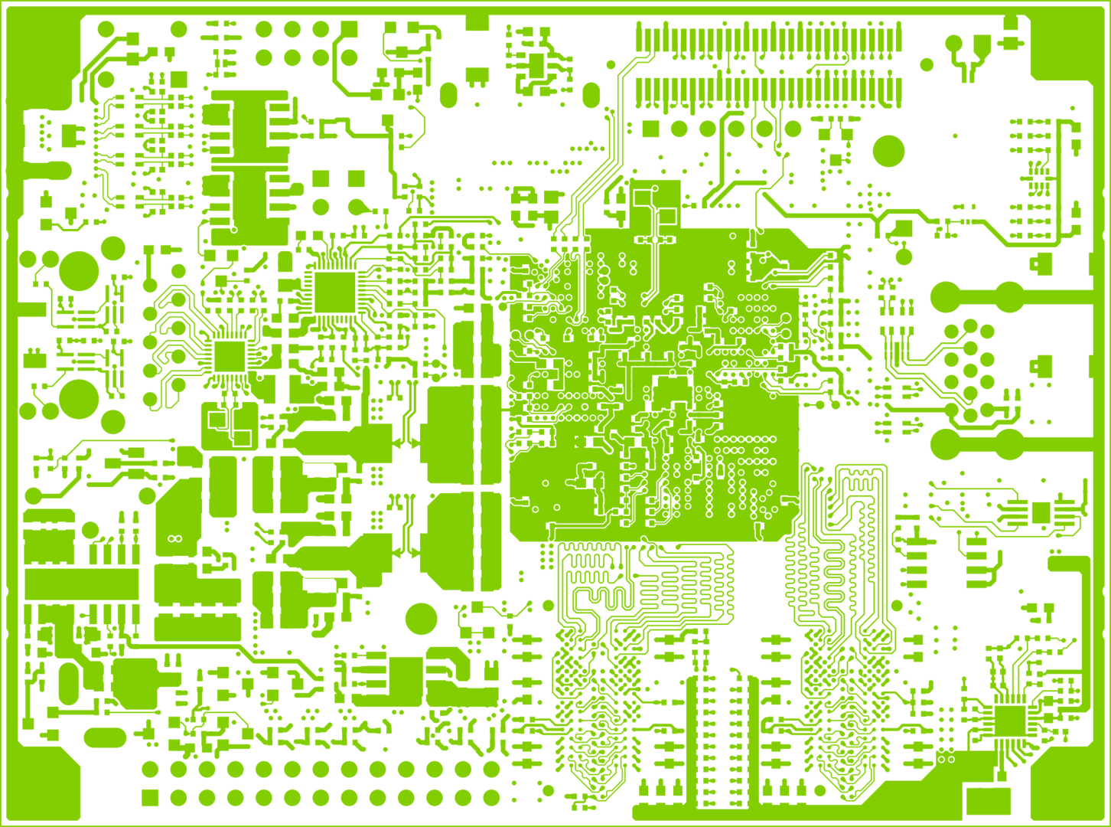

Slide 18
Put it together...

Slide 31

So lets concede
Chema^^ CC-BY-SA - https://www.flickr.com/photos/eldar_/2772189270

Slide 32


Slide 33


Slide 34


Slide 35


Slide 36
Questions,
Comments,
Concerns
?
@warty9
@warthog9
warthog9@eaglescrag.net
CC-BY-SA

