Slide 1



LibreOffice Online:
The future of document editing is in your hands
Robinson Tryon
SCALE 14x
January 23rd, 2016
Notes:
Hi, everyone!

Slide 2

I hope you're in the right room
I'll be talking about LibreOffice Online
  And probably waving my hands around a lot
Feel free to raise your hand or ask a question at any time
This is a lot more fun if y'all get involved!
  It also helps to fill the time in case I didn't prepare enough slides

Slide 3
Here, this one will help to fill some time

Slide 4
About:me
Robinson Tryon
Bug Wrangler/LibreOffice QA
  and other Document Foundation projects
  Worn hats for QA & Release Engineering
  Author & English proofing for Annual Report
  and lots of other things…
Outreach and marketing in the US
  Promote/Coordinate LibreOffice use
  Free/Open File Formats
  Document Freedom Day

Slide 5
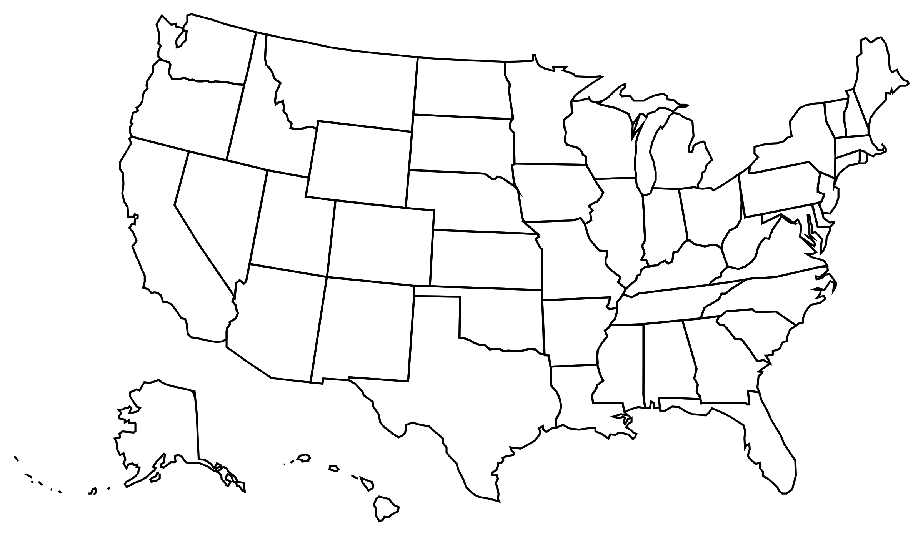
Deep in the heart of Texas
Used to live in the North (Vermont), but now live in Texas
  People are very friendly
  It’s far too warm
    75º degrees on Xmas!?
  I haven’t met any real
  cowboys yet

Slide 6
And yes, I often speak too quickly

Slide 7
If that happens, please wave your arms a lot,
and I'll slow down a bit

Slide 8


Slide 9
How many of you have used LibreOffice?

Slide 10
How many have used or heard of OpenOffice?
Notes:
– Follow-up: How many of you have used Microsoft Office?
OpenOffice is a predecessor of LibreOffice.
In 2010, a group of OpenOffice community members decided to fork the project and set up a community-focused non-profit, ensuring that no single company would have exclusive control over the software.

Slide 11


LibreWhat?
Many people have not heard of LibreOffice
  ...or of OpenOffice.org
  ...or of Sun (Microsystems)
This means that we need to work harder on brand awareness
Notes:
Quick poll:
How many of you have used LibreOffice?
How about OpenOffice.org?

Slide 12
Which means...

Slide 13

I'm hijacking the next half hour of your time
In a secret plan
To turn you into walking, talking LibreOffice promoters

Slide 14
Let's get started!

Slide 15
So what’s in this talk?
LibreOffice Online:
  Ancient History
  Current Features & Development
  Building the Code
  Testing & QA
  Getting your company to try it out!

Slide 16
Ancient History

Slide 17
LibreOffice in a Nutshell
Free/Open Source Software office suite
Available to download, use, and share at no cost
Shepherded by non-profit “The Document Foundation” (TDF)
Available for Windows, Mac OS X, Android, and GNU/Linux
Uses Open Document Format (ODF) natively
  Also supports the use of dozens of file formats

Slide 18
Ancient History (aka the Desktop)
LibreOffice predecessor (OpenOffice.org) was available first on the Desktop for Win, Mac, and Solaris
Mac builds available since 2003 (via x11)
  Native OS X support added in v3.0 (2008)
Full, cross-platform functionality

Slide 19
Mobile & Tablets
Android Viewer app arrived early in 2015
  Beta editing support added late in the year
Users can install apps from 3rd parties
  Result: Install from Google Play
  ...or F-Droid
  ...or daily build of an .apk
  ...or build it yourself

Slide 20
Locked & (not) Loaded
Building on iOS presented challenges
Multiple groups worked on iOS in 2014
  Squeezing core code into 60 MB
  Initial iOS Document Editor from CloudOn
...but such a restrictive platform
  Apple holds all the keys

Slide 21

LibreOffice: Platform-specific builds
Until now, each build has been platform-specific
Each new OS required dedicated LibreOffice dev time
Don’t have a motivated user base or $$$ backer?
  No LibreOffice for you!

Slide 22
Pain and suffering...
Want to run LibreOffice on your old, trusty Solaris Workstation?
  Who’s going to set up and maintain a buildbot?
How about Android?
  New UI and a whole new set of testing procedures
  Switching between OS revs? Ugghhh...
iOS? ChromeOS?
  *sigh*

Slide 23

Supporting the Long Tail
Most sane consumer devices now have a browser
  Hopefully one with good standards support
As long as documents can live in the cloud, interoperability is a reachable goal
But we still want to keep control over our data

Slide 24
So what’s the easy answer?

Slide 25
CODE: Collabora Online
Development Edition
CODE == Collabora’s LibreOffice Online work + ownCloud
The easiest way to try out LibreOffice Online
Targeted at devs, QA, and other technical folks
No support: if it breaks, you get to keep both pieces
Download 700MB VM here: https://www.collaboraoffice.com/code/

Slide 26
CODE: What’s the Plan?
Collabora and ownCloud partnership
Commercial solution available later in 2016
Collabora CloudSuite + ownCloud Server
Improvements to LibreOffice Online shared with upstream project

Slide 27
Open First: Collabora & Community
Collabora is the primary contributor to LibreOffice Online
Improvements to LibreOffice, LibreOffice for Android, and LibreOffice Online shared with community
Open First: Exceeding the legal requirements of copyleft license

Slide 28
Current Features & Development

Slide 29
LibreOffice Online
Currently under development by Collabora Productivity
LibreOffice desktop productivity tools to the cloud
  Word processing, Spreadsheets, Presentations
Provides consistency across devices
Neatly sidesteps file format issues

Slide 30
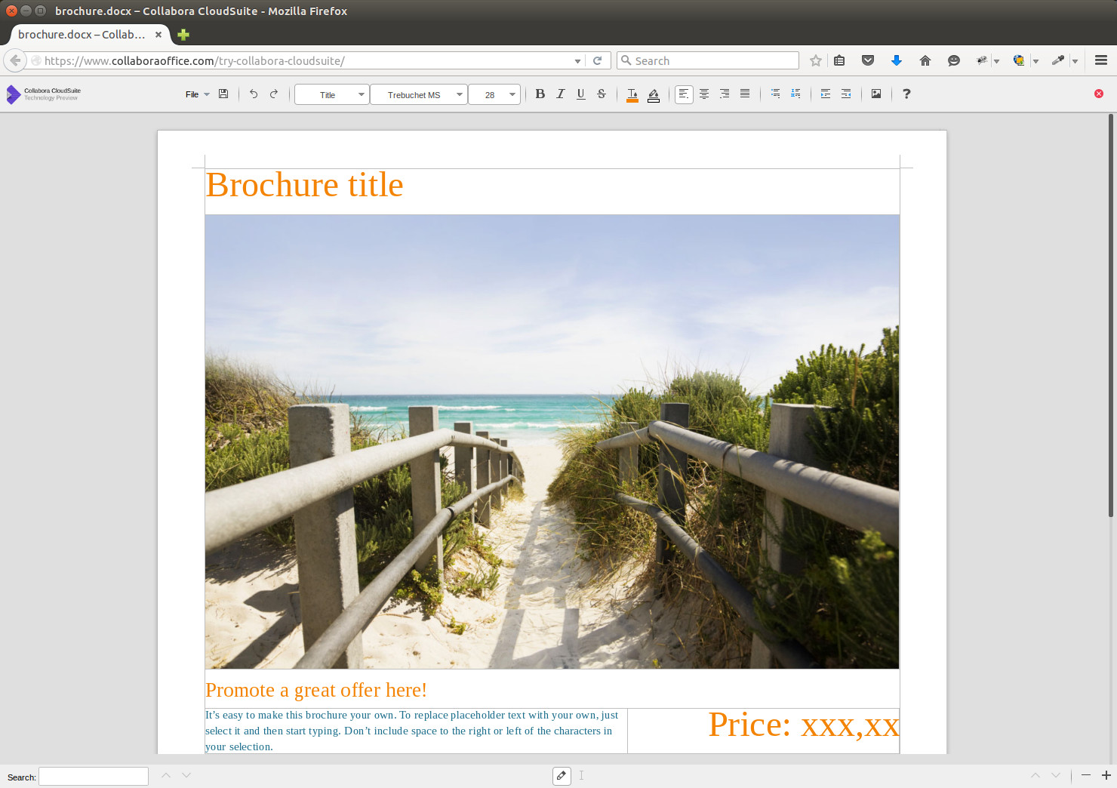

Slide 31
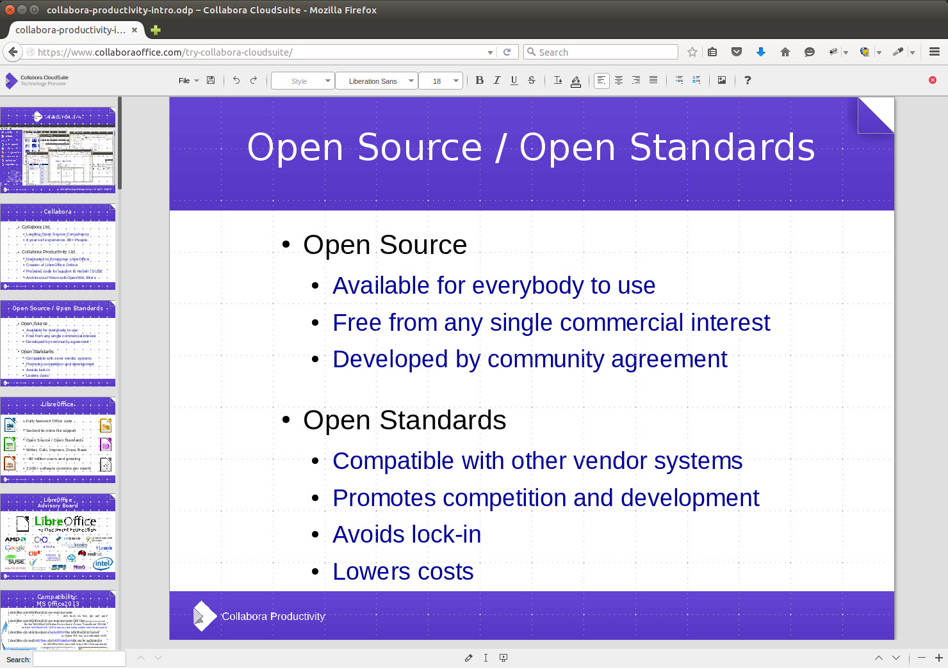
LibreOffice Online

Slide 32
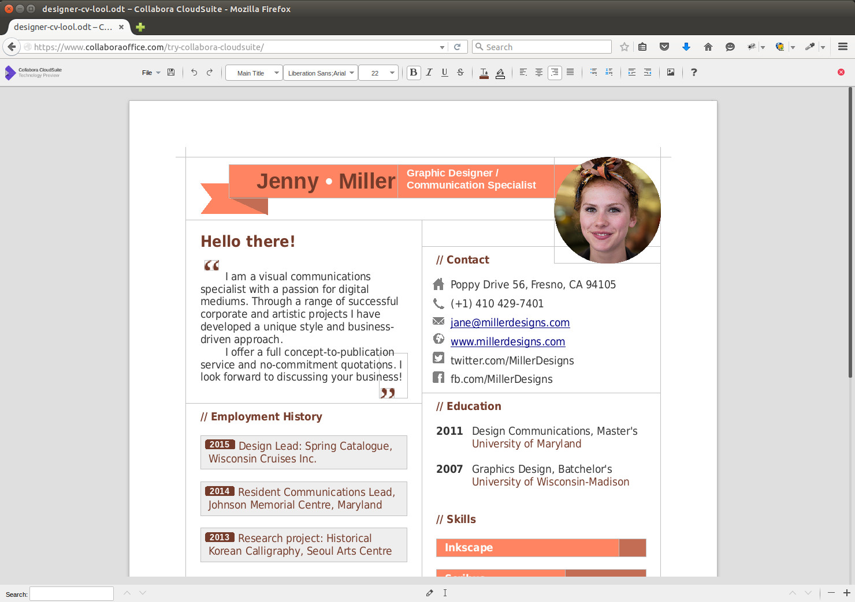

Slide 33
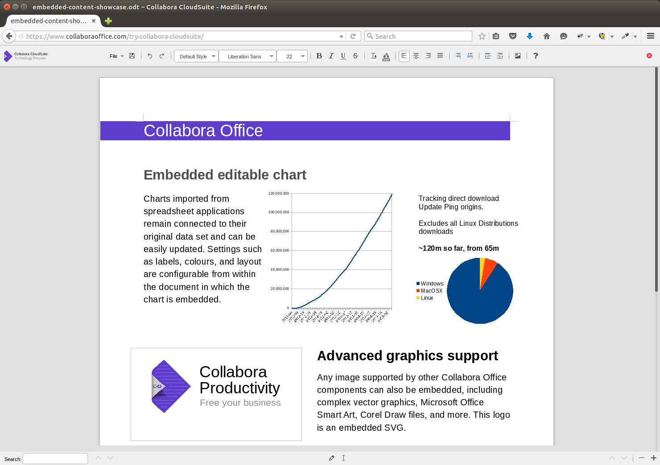

Slide 34
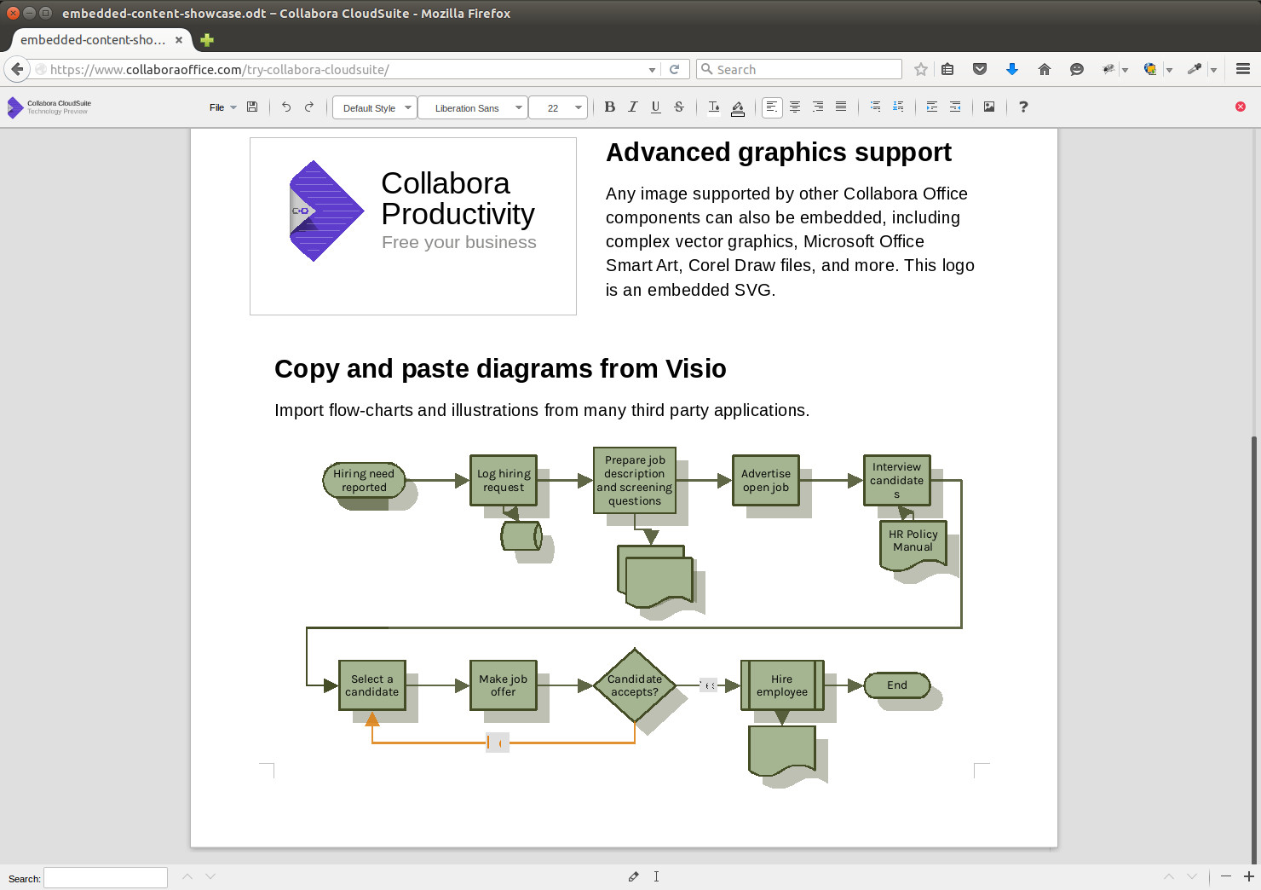

Slide 35
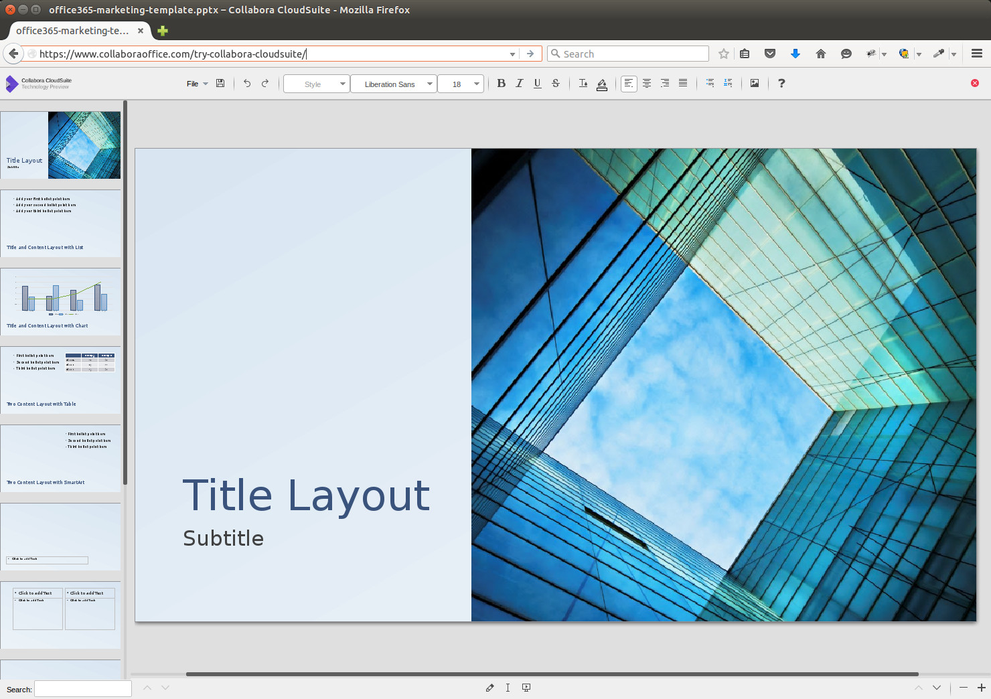

Slide 36
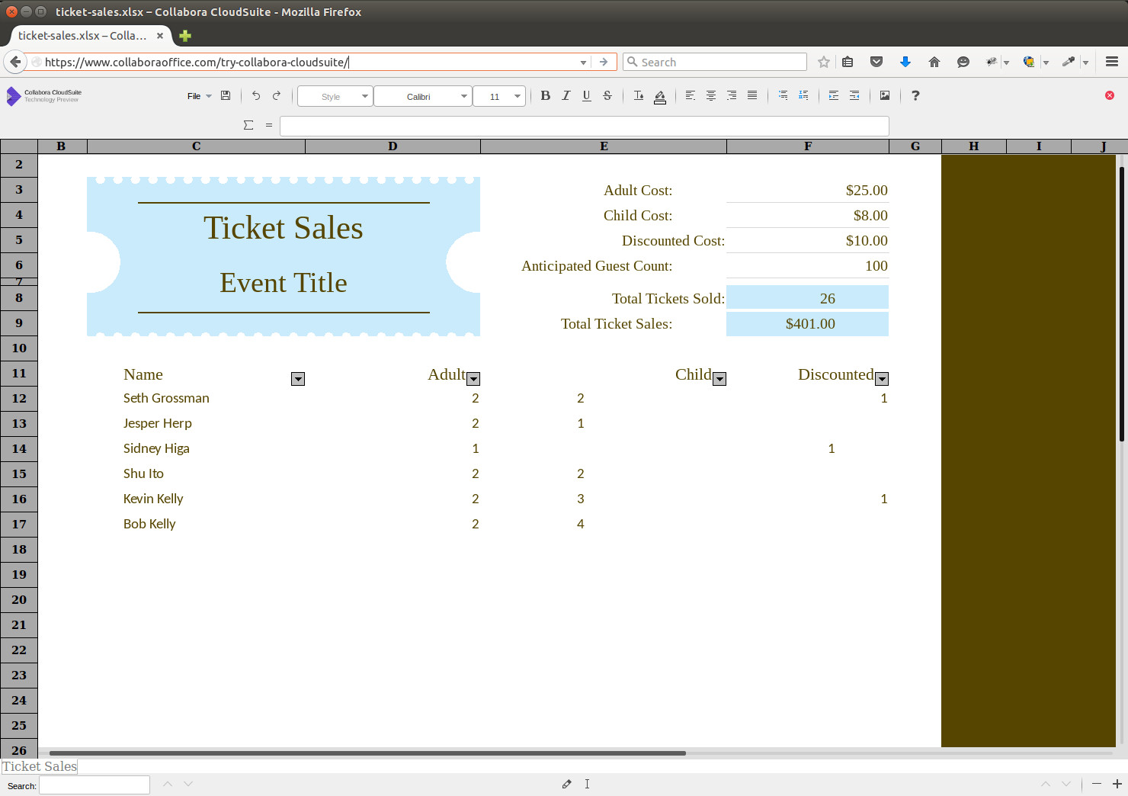

Slide 37
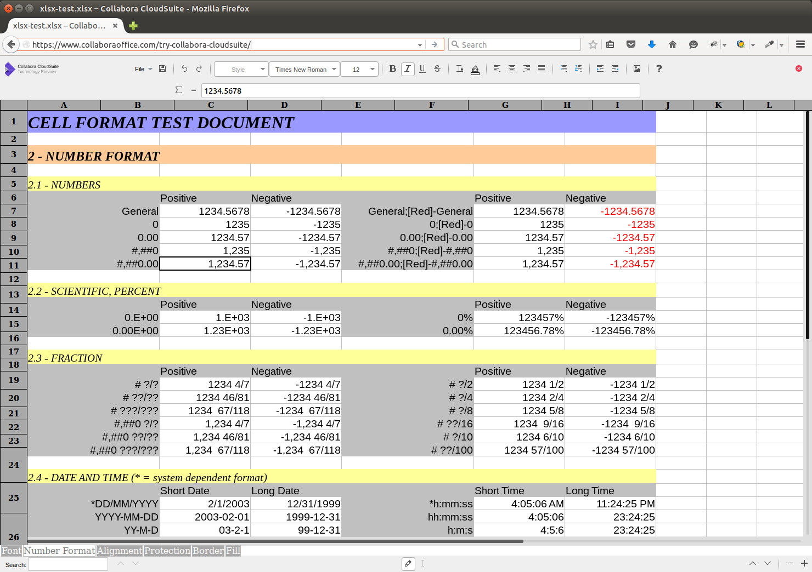

Slide 38
Building the Code

Slide 39
LibreOffice Online Develoment
Clone the LibreOffice Online code from our repo:
  http://cgit.freedesktop.org/libreoffice/online/
Want to poke at the ownCloud pieces? Clone the GitHub Repo:
  https://github.com/owncloud/richdocuments
Feeling super lazy? Just grab the CODE VM and tweak the code in place

Slide 40
Testing & QA

Slide 41
Testing, Testing, Testing
Want to test? We’re more than happy to have you join us!
High-quality feedback is greatly appreciated
You’re going to exercise the code in ways we can’t imagine
  But if you just want to whine, you’re just going to slow the devs down
(Sadly, this happens far too often)

Slide 42
QA Setup
Grab the CODE VM or build the code from git
Take a look at the open bugs already reported to Bugzilla:
  https://bugs.documentfoundation.org/buglist.cgi?product=LibreOffice Online&resolution=---
If you find any unreported issues, please file a new bug.

Slide 43
QA: What needs testing?
Company letterhead or templates?
  Let us know if your most common documents have rendering issues
Compare LibreOffice Online vs. Desktop
  Are there noticeable differences?
  Do you notice any performance issues?
For our Speakers: How does your talk look when rendered in the browser?

Slide 44
Getting your company to try it out!

Slide 45
LibreOffice Online: Security
As Free Software, LibreOffice Online may be deployed privately
No license audits or 3rd party agreements required
Simplify process of conformance to data security laws such as HIPAA or Legal Confidentiality

Slide 46
The End – Questions?

Slide 47
Sources and Licensing
Authors: Robinson Tryon, Michael Meeks, Daniel Rodriguez, Marc Paré
Sad Frog by dobladov – public domain
https://openclipart.org/detail/222252/sad-frog-feels-bad-man-meme
Turtle by scout – public domain
https://openclipart.org/detail/191076/turtle
mouse with a very long tail by johnny_automatic
https://openclipart.org/detail/10087/mouse-with-a-very-long-tail
Question Guy by scout – public domain
https://openclipart.org/detail/191766/question-guy
Lumberjack by tzunghaor – public domain
https://openclipart.org/detail/161725/lumberjack
LibreOffice Online images c/o Collabora Productivity
Digital signatures of PDFs: screenshots by Tor Lillqvist – public domain
Ubuntu Doc Viewer screenshots c/o Aaron Honeycutt
Collabora LibreOffice
http://www.collabora.com
PDF graphic by FSFE – public domain
http://www.pdfreaders.org/graphics.en.html
Debian logo by SPI – CC-BY SA 3.0
https://www.debian.org/logos/
Walrus with TDF eyes by Robinson Tryon,
based on Cartoon Walrus by Studio Fibonacci – public domain
https://openclipart.org/detail/169963/cartoon-walrus-by-studiofibonacci
Firefox Logo by Mozilla Foundation
https://wiki.mozilla.org/Firefox3.5/Logos
Firefox is a registered trademark of the Mozilla Foundation.
Android robot by Google – CC-BY 3.0
https://developer.android.com/distribute/tools/promote/brand.html
Reproduced or modified from work created and shared by Google
Toy unicorn by spacefem – public domain
https://openclipart.org/detail/184660/toy-unicorn-by-spacefem-184660
Blackboard with Letters by J_Alves – public domain
https://openclipart.org/detail/49369/blackboard-with-letters-by-j_alves
Snowflakes by Zecas – public domain
https://openclipart.org/detail/189282/snow-flake-8-by-zecas-189282
https://openclipart.org/detail/189278/snow-flake-5-by-zecas-189278
Pagemaker and libpagemaker screenshots by Dave Tardon – CC-BY-SA 3.0
https://wiki.documentfoundation.org/File:PageMaker-creenshot-PageMaker.pnghttps://wiki.documentfoundation.org/File:PageMaker-screenshot-LibreOffice.png
Writer shapes textbox by Vmiklos – CC-BY-SA 3.0
https://wiki.documentfoundation.org/File:Swtextbox.png
All text and image content in this document is licensed under the Creative Commons Attribution-Share Alike 4.0 License (unless otherwise specified). "LibreOffice" and "The Document Foundation" are registered trademarks. Their respective logos and icons are subject to international copyright laws. The use of these therefore is subject to the trademark policy.

