Slide 1
Getting over the barrier and start contributing to OpenStack
SCALEx14
(Jan 23, 2016)
Anthony Chow
Twitter: @vCloudernBeer
GitHub: vCloudernBeer
Blog: http://cloudn1n3.blogspot.com/

Slide 2

Why do I want to contribute to OpenStack?
Get involved with the “cloud” technology
Find a new job
Get to know the community full of “nice” people
$$$$

Slide 3
A Brief Overview of OpenStack
Joint project between Rackspace and NASA in 2010
Designed to run on commodity hardware
Open source cloud operating system
Manages a pool of compute, storage and networking resources via CLI or dashboard (web interface GUI)
Sometimes refer as IaaS (Infrastructure as a Service)
Not a product but a sets of tools to build a cloud
Python based
Running Platform – Linux (Ubuntu, RHEL, SUSE)
Bi-annual release cycle with release name not number

Slide 4
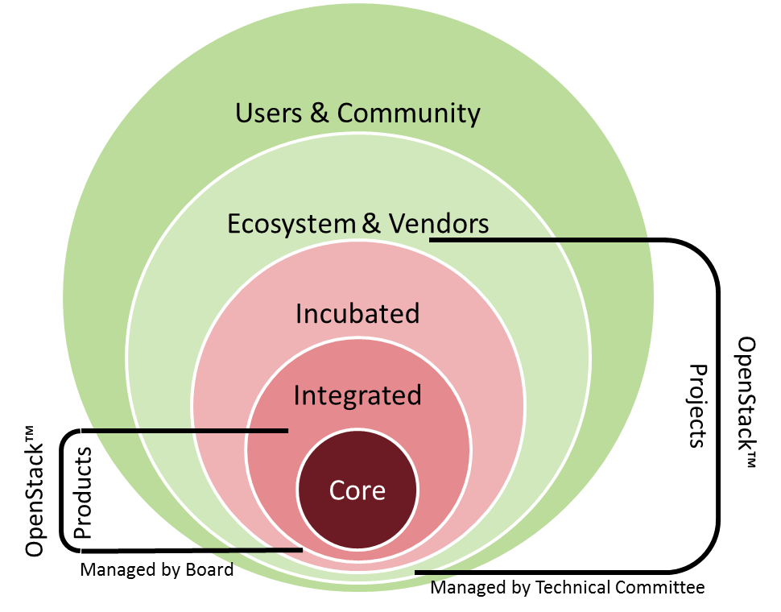
OpenStack Projects
Big Tent vs “incubation and integrated”
DefCore
Core Services
  Swift
  Keystone
  Nova
  Neutron
  Cinder
  Glance
Optional Services
  Horizon
  Ceilometer
  Trove
  Sahara
  Magnum
  Congress
https://governance.openstack.org/reference/projects/index.html

Slide 5
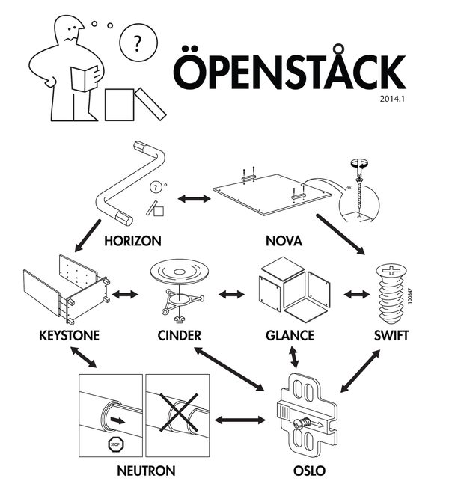
Do you feel this way with OpenStack?

Slide 6

What is holding you back from contributing to OpenStack?
Don't know Python that well
Do not know where to start
No time
OpenStack is too complicated

Slide 7
What can I work on?
For the context of this presentation
  Coding
  Documentation
Other things that we can “contribute”
  Testing
  Translation
  Help with “openstack.org” website
  Help shape the UX
  Community builder
https://wiki.openstack.org/wiki/How_To_Contribute

Slide 8
Before choosing what to work on
Create account
  Launchpad Account
  Join OpenStack Foundation
  Sign the OpenStack individuals contributor License Agreement
  Create and upload SSH key to Gerrit
Setup development environment
  Install git
  Install git-review
http://manishankert.blogspot.com/2014/05/how-to-contribute-to-openstack.html
http://www.symantec.com/connect/blogs/how-contribute-openstack

Slide 9
Finding something to work on
https://wiki.openstack.org/wiki/Bugs
  Status/Importance/Assigned to/Milestone
https://bugs.launchpad.net/openstack
  Low hanging fruit
IRC
  #openstack-dev on freenode
  http://eavesdrop.openstack.org/
OpenStack mailing list
  https://wiki.openstack.org/wiki/Mailing_Lists
Ask OpenStack
  https://ask.openstack.org/en/questions/

Slide 10
Where and how do I work on the bug fix?
Local Linux machine
Use KVM to spin up Linux virtual machine
Vagrant
VMware Workstation or Fusion
DevStack
RDO

Slide 11
Unit testing on local machine
Tox – automate and standardize Python testing
Pep8 – Check Python code against style convention
./run_test.sh
http://docs.openstack.org/developer/nova/unit_tests.html
http://superuser.openstack.org/articles/a-guide-to-testing-in-openstack

Slide 12
Commit the fix
Gerrit – a code review system that trigger to run CI testing
Voting system – need two “+2” for the code to be merged.
-1 does not mean your fix is “wrong”
http://docs.openstack.org/infra/manual/developers.html
https://wiki.openstack.org/wiki/GitCommitMessages

Slide 13
Learn the Gerrit Workflow in the Sandbox
Demo time.
http://docs.openstack.org/infra/manual/sandbox.html

Slide 14

This is it
OpenStack is particularly friendly to first time commiter
You got nothing to lose (well may be time).
You might gain …. (whatever your goal is).

