Slide 1
Girl Scouts & Computer Science
Beginning in Middle School

Slide 2
Acknowledgements
San Manuel Band of Mission Indians
Colton Joint Unified School District
Redlands Unified School District
Yucaipa Unified School District

Slide 3



Girls Scouts of San Gorgonio County serves more than
13,000 girls ages 5-17 in Riverside and San Bernardino Counties.

Slide 4
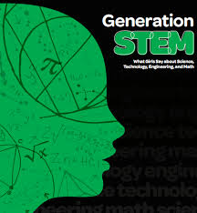
Generation STEM
Seventy-four percent of high school girls across the country are interested in the fields and subjects of STEM
Girls are interested in the process of learning, asking questions, and problem solving
Girls want to help people and make a difference in the world
Girls who are interested in STEM are high achievers who have supportive adult networks and are exposed to STEM fields
Perceived gender barriers are still high for girls and may help explain why STEM fields aren’t their top career choices

Slide 5
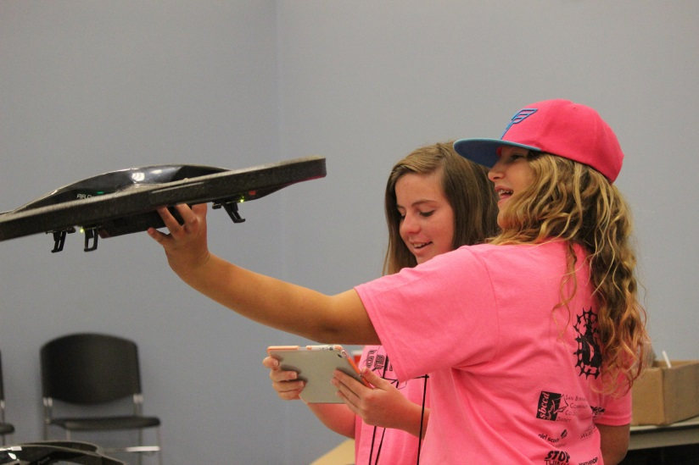
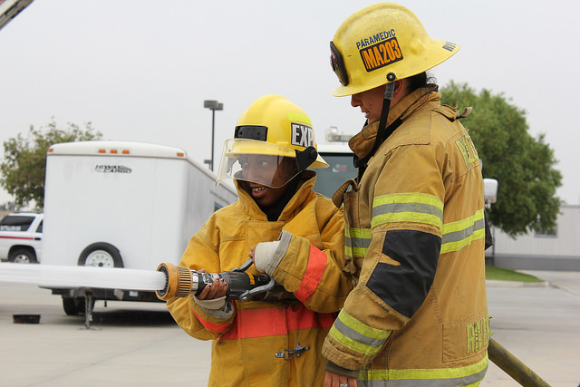
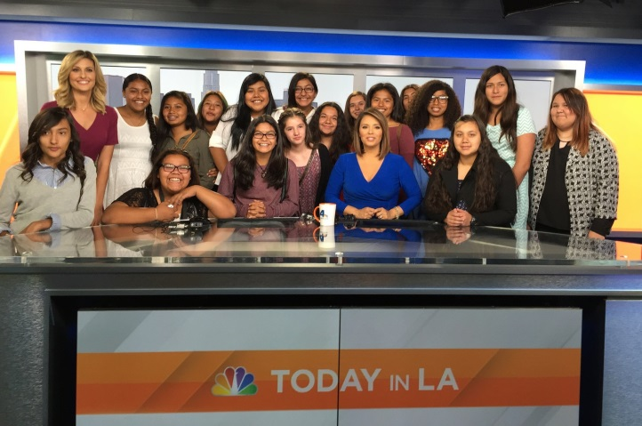
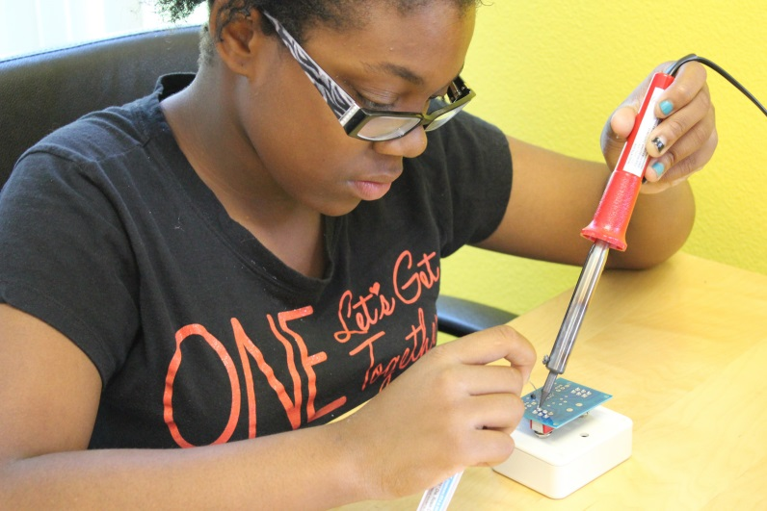
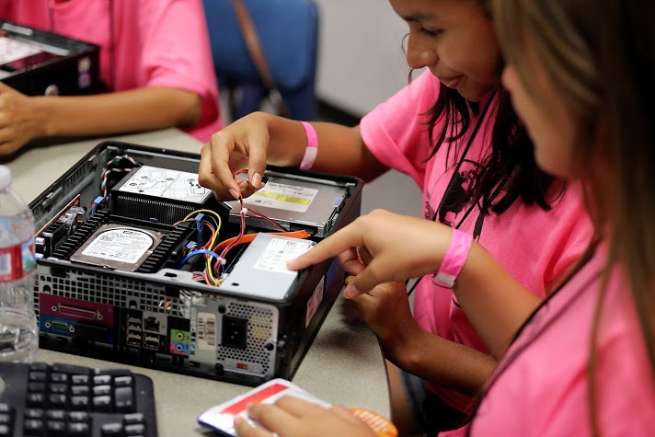
Classroom to Career: Developing Tomorrow’s Leaders Today
https://www.youtube.com/watch?v=gk69jeV_P2s

Slide 6
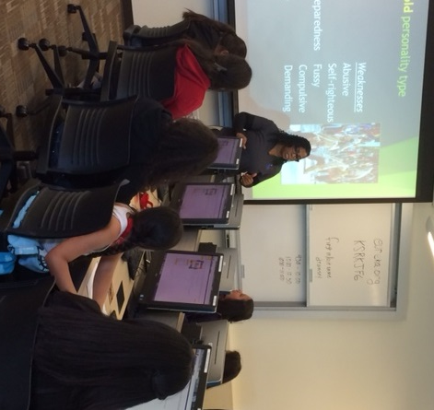
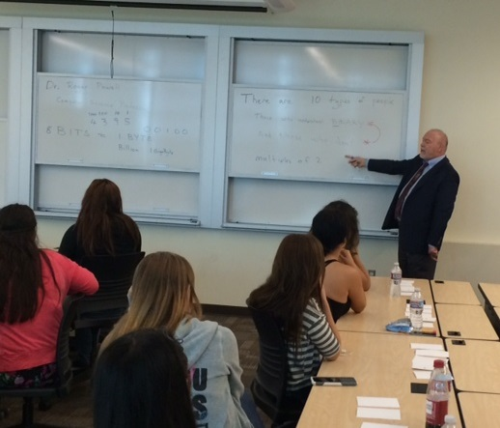
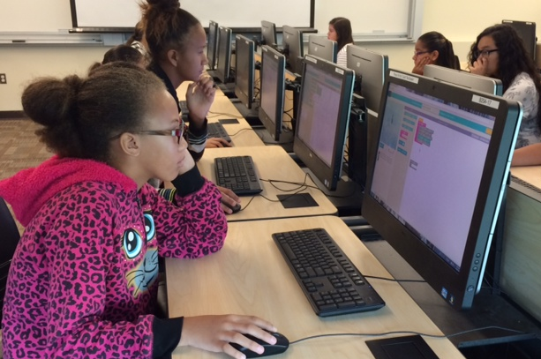
Girl Scouts & San Bernardino
Valley College

Slide 7
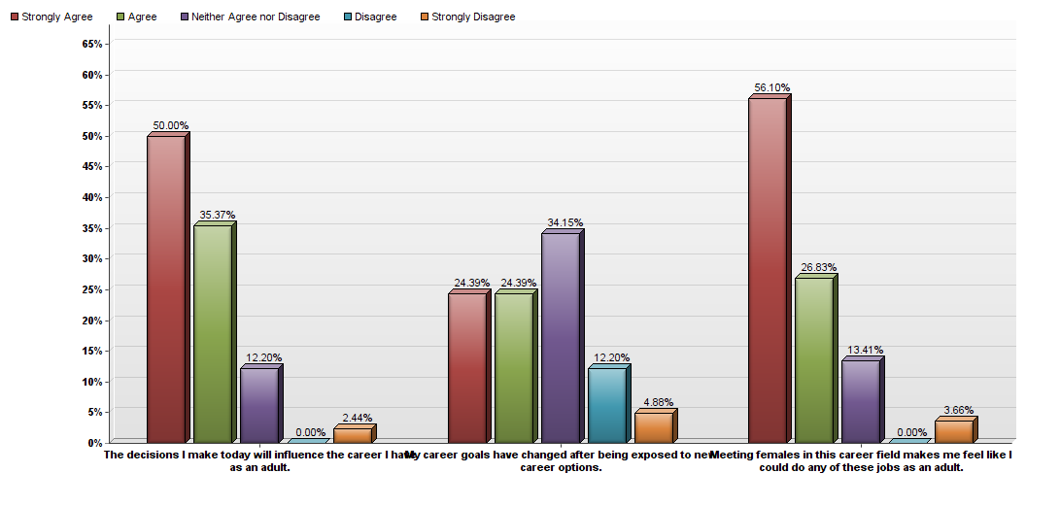
SBVC Evaluations
I learned that computers aren't just for nerds and boys -RR, Terrace Hills Middle School
I learned how to code and use binary code like 00001 is code for the letter A. -A.C, Colton Middle School
The most helpful career advice I got today was "always try, never give up even if you think its impossible". –DS, Ruth O. Harris Middle School

Slide 8

The HSI STEM PASS GO Grant was awarded to San Bernardino Valley College, to enhance success, completion, graduation and transfer rates of Hispanic students, low-income students and underrepresented students in the STEM disciplines

Slide 9

Why Not Computer Science or Computer Technology?
Barriers students face…
Obstacles they go through…
What can we do?
Overcoming challenges…
Up against the grind
Terrified

Slide 10
Connection – Matching Careers with Personalities
  Eureka
  People code
  StrengthQuest
Create a Cost Sheet
  Housing/Rent
  Car
  Utilities
View Pay and projected growth
  Job market

Slide 11
Computer Science & Information Technology
Computer Science
  Transfer
  Aligned with ACM 2009 recommendations
Computer Information Technology
  Career and Technical Education
  Broad and hands-on
  Aligned with Industry Certifications

Slide 12
There are 10 types of people in the world:
those who understand binary and those who don’t

Slide 13
csce.club
The Computer Science and Computer Engineering Club at San Bernardino Valley College (CSCE) was chartered by the Associated Students San Bernardino Valley College in 2010. We are a group of students with an interest in computer science and computer engineering.
We welcome all students regardless of skill level or major to join us at our events and weekly meetings.

Slide 14
code.org
Hour of Code
Learn principles of coding by writing code
Works well with middle school girls
Puzzles and games using “blockly”
  developers: developers.google.com/blockly
  others: blockly-games.appspot.com

Slide 15
Hosting an hour of code
Preparation
  set up and test everything
  clue in the guys
Girls are natural collaborators
Girls want to get to know the facilitators
Be positive and enthusiastic
Wrap-up with women in CS videos

Slide 16
Where from here?
Keep what is good
One and done is not enough
  involve girls in follow on activities
  help the Girl Scout leaders deal with STEMphobia
Activities for leaders, parents, and girls
  Grants
  Build community

Slide 17
Questions

