Slide 1


Why you can't find new grads with FOSS experience
Gina Likins
<glikins@redhat.com>
@lintqueen on twitter

Slide 2

Oh the places we've been.
Notes:
First, a little background:
I'm part of the University Outreach team at Red Hat, charged with helping colleges and universities produce more students who understand and are interested in FOSS. (We don't do recruiting, there's a team from HR that does that – our goal is to increase the whole open source pool.)
Tom Callaway and I have spent a lot of time talking with students all across this great nation of ours.
This path is not completely accurate, but we have spoken with students at more than 25 schools...we're not meaning to skip the middle; it just looks that way. And for the most part, when we ask students if they know what open source looks like, we get a look something like this:

Slide 3


Slide 4

This was a mystery.
Notes:
Image CC-BY-SA 2.0 by https://www.flickr.com/photos/rlodan01/4555108439/
How can this be the case? Open source is HUGE, right?
Your line: How huge is it?

Slide 5
Open Source (in 2015)
Nearly 80% of companies run part or all of their operations on FOSS
  Fewer than 3% use no FOSS
64% of companies participate in FOSS projects
  50% have more than half their employees working on FOSS
  88% expect to increase FOSS contributions over next 2-3 years
Notes:
These statistics come from the 2015 Black Duck Future of Open Source Survey results.
It's so huge that:
Nearly 80% of companies run part or all of their operations on FOSS
Fewer than 3% use no FOSS
64% of companies participate in FOSS projects
50% have more than half their employees working on FOSS
88% expect to increase FOSS contributions over next 2-3 years
So, clearly companies need employees with open source expertise, so why aren't universities teaching it?

Slide 6

The many variables
Notes:
Image CC-BY-SA by https://www.flickr.com/photos/blondinrikard/13927054414/
I think it's important that we – the open source community – understand the way university systems work so that we can create opportunities for embedding open source in computer science and software engineering programs.
Let's take a look at some of the variables involved...

Slide 7
A quick quiz
Question 1: Yes or No:
It's relatively simple for university instructors to create new classes.
Notes:
Ok – Raise your hand if you think that it is relatively simple for university instructors to teach a new class.

Slide 8

Survey Says
Notes:
Image CC-By-SA by https://www.flickr.com/photos/smemon/4949690926/
First, this is very school-specific, but in general, it's not easy to add a course for credit. Why not? Here are a couple reasons (this is very school specific):
The department (CS or SE) has to create a curriculum that fits together as a whole *and* that students can work through in 4 years. Given that, departments can't “afford” to add courses that don't fit clearly into a learning path.
Schools have a limited resource budget – both in terms of instructor hours and in terms of things like available classroom space. There's competition for that time/space.
When courses can be added – (and the process is documented) – it can take years.
Unfortunately, student interest does not usually map into curriculum change. Let's look at some examples of student interest...

Slide 9
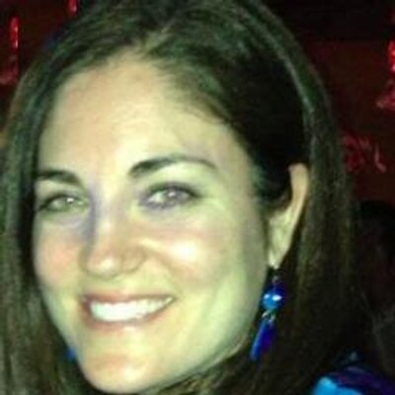
Kerrin Perniciaro
Director of Web/IT strategy at SUNY Stonybrook
On OSS:
“...many incoming students... expect it to be part of the curriculum...”
Notes:
Back in 2014, Kerrin Perniciaro, who is the Director of Web/IT strategy at SUNY Stonybrook said that:
“...many incoming students... expect [Open Source] to be part of the curriculum...”

Slide 10

OpenHatch
Notes:
OpenHatch is a non-profit dedicated to matching prospective free software contributors with communities, tools, and education. They do this with a team of 1 or 2 people.
They have a fantastic workshop called “Open Source Comes to Campus”, which has been run at 51 schools. (Red Hat has sponsored a number of these workshops) The goal of the workshop is to teach the tools and culture of open source development and to help students impact real projects.

Slide 11
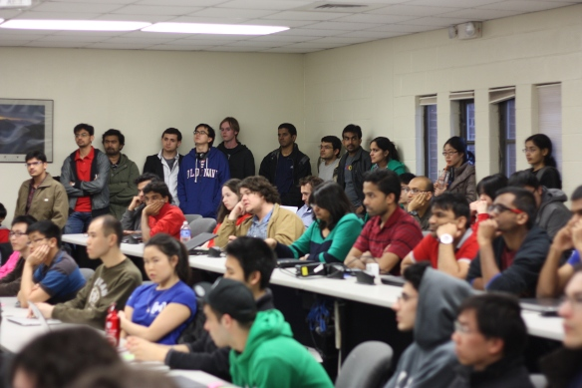
OpenHatch visits SUNY Stony Brook (May 2014)
Intro to open source presentation
90 students signed up
  75 attended
Followup workshop in Fall 2014
  “We had difficulty finding enough mentors for the event”
Notes:
So in May 2014, Open Hatch came to SUNY Stony Brook. This event, like the majority of OpenHatch's engagements on campus were driven by a small handful of passionate students.
As far as we can tell, SUNY Stony Brook does not offer Open Source as part of their curriculum.
OpenHatch has no upcoming events scheduled
Last event was in May 2015
OpenHatch board is investigating the future of the project

Slide 12
A quick quiz
Question 2: Yes or No:
Best practices recommend teaching open source.
Notes:
Ok – Raise your hand if you think it's a best practice to teach open source.

Slide 13

Survey Says
Notes:
Image CC-By-SA by https://www.flickr.com/photos/steveboneham/5764026117/
In 2013, the Association for Computing Machinery released a new curriculum guide for Computer Science (the previous one was released in 2001)

Slide 14
The ACM Guidelines
Notes:
This guide is a joint effort by the ACM and the IEEE to establish a set of recommendations for what students in a higher education computer science program should learn.

Slide 15
The ACM Guidelines
518 pages; 18 “Knowledge Areas”
Notes:
This guide is a joint effort by the ACM and the IEEE to establish a set of recommendations for what students in a higher education computer science program should learn.
This is a breakdown of the structure of the ACM Curriculum Guidelines

Slide 16
The ACM Guidelines
518 pages; 18 “Knowledge Areas”
1 Knowledge Area → Social Issues & Professional Practice (SIPP)

Slide 17
The ACM Guidelines
518 pages; 18 “Knowledge Areas”
1 Knowledge Area → Social Issues & Professional Practice (SIPP)
10 Topics in SIPP → 1 is Intellectual Property (IP)

Slide 18
The ACM Guidelines
518 pages; 18 “Knowledge Areas”
1 Knowledge Area → Social Issues & Professional Practice (SIPP)
10 Topics in SIPP → 1 is Intellectual Property (IP)
Within IP → 7 “Tier 1” Sub-Topics & 2 “Elective” Sub-Topics

Slide 19
The ACM Guidelines
518 pages; 18 “Knowledge Areas”
1 Knowledge Area → Social Issues & Professional Practice (SIPP)
10 Topics in SIPP → 1 is Intellectual Property (IP)
Within IP → 7 “Tier 1” Sub-Topics & 2 “Elective” Sub-Topics
→ 1 of those elective “Sub-Topics” → “Foundations of the Open Source Movement”
Notes:
So in all these 518 pages, open source is mentioned in the recommendations section … once. As an elective.
The guide also includes specific examples of how actual courses overlap with those recommendations. For example:
Miami University, in their CSE 262 Course “Technology, Ethics, and Global Society” mentions it … as the one elective they do not teach in the Intellectual Property Topic.
Anne Arundel Community College in Arnold, MD mentions it in their CSI 194 course “Ethics and the Information Age” as “Alternatives to the property model”
In total – including the reference classes – the words open source appear 10 times. In 518 pages.

Slide 20
A quick quiz
Question 3: Yes or No:
Getting your research published in a journal or presented at a conference matters if you're trying to get tenure.
Notes:
Ok – Raise your hand if you think that publishing matters for tenure-track professors.

Slide 21

Survey Says
Notes:
Image CC-By-SA by https://www.flickr.com/photos/jepoirrier/8319130269/
Ha-ha. You though this was going to be easy!
Tenure-track instructors are under pressure to:
publish
attract grant funding, and
present work at “noteworthy” conferences.

Slide 22
A quick quiz
Question 4: Yes or No:
There are many journals and conferences for computer science and software engineering instruction that have a focus on open source.
Notes:
Raise your hand if you think there are conferences and journals that these instructors can publish their open source-related work in...

Slide 23

Survey Says
Notes:
Image CC-By-SA by https://www.flickr.com/photos/foilman/6977796150/
Nope. Not so many. CS and SE instructors who are interested in teaching and open source are in a weird man-in-the-middle place.
Most CS and SE journals are not really interested in teaching or pedagogy, so if your passion is teaching open source, that doesn't leave you with many options.
OTOH, the large conferences for computer science educators, such as SIGCSE (Special Interest Group for Computer Science Education), still do not have an open source track -- which should be no surprise, given the ACM curriculum guidelines.

Slide 24
A quick quiz
Question 5: Yes or No:
Instructors have experience with open source.
Notes:
Raise your hands if you think that many or most computer science and software engineering instructors have experience with open source.

Slide 25

Survey Says
Notes:
Image CC-By-SA by https://www.flickr.com/photos/wheatfields/1794297759/
There are many reason why instructors do not have experience with open source. Let's look at a few of them.

Slide 26


the tenure process...
Leaves little time for trying new things in the classroom
  and
creates a risk-averse climate, as instructors do not want to jeopardize chances for tenure.
Notes:
Image CC-BY-SA by https://www.flickr.com/photos/fabiolarebello/206950948/ (clocks) and https://www.flickr.com/photos/renaissancechambara/2954786781/

Slide 27

Open source projects are simple...
Notes:
The reality is that open source projects are:
Large
Complex
Not always incredibly well documented
This can make them hard to understand.

Slide 28
A quick quiz
Question 6: Yes or No:
Timelines for open source and academia are well-suited for each other.
Notes:
So, open source and academia have similar timelines, yes? Hands up if you agree.

Slide 29

Survey says
Notes:
Academia is...slower paced.
I keep learning this over and over when I realize that the deadline for submitting to an academic conference is 10+ months before the conference (and I don't think of it until it's 5 months out…).
Let's look at some typical timelines.

Slide 30
Timelines
Fedora Project
  Release Cycle: 6 month
  Planning Cycle: ~1yr
  Execution Time:
  6-12 months
Academia
  Release Cycle: 1-4 yr
  Planning Cycle: 2-5 yr
  Execution Time:
  4 years

Slide 31
A quick quiz: last question
Question 7: Yes or No:
It's AOK for an instructor to admit that they don't know the answer.
Notes:
Ok – last one. Raise your hand if you think it's AOK for an instructor to admit that they have no idea what's going on.

Slide 32

Survey Says
Notes:
Image CC-By-SA https://www.flickr.com/photos/hmk/9132402574/
Yeah, that was totally a cheap trick. Of course it should be perfectly fine for an instructor to admit that they don't understand something.
But the reality is that it's often not. In most situations, the expectation – from the university and students – is that the instructor does have all the answers, and it takes a very secure teacher to go against that expectation.
One of the things we stress when we work with teachers, though, is that when they model uncertainty for their students they are doing them a great service. It will be rare that a student leaves school and has all the answers. More common will be the circumstance that the code isn't fully documented, or the person who could answer the question is on vacation, or the thing they learned in school is no longer correct. And in those cases, the best “training” a student can have is in how to find answers and ask good questions.

Slide 33
Sorry for the downer.
Notes:
Sorry for the downer.

Slide 34

Maybe this will help.
Notes:
(Okay, I might have been looking for an excuse to put a picture of my baby pomeranian in...but he's super-cute, right?)

Slide 35
What can we do?
Support programs that teach instructors how to teach open source
  POSSE & teachingopensource.org & foss2serve.org
Notes:
Given the problems that instructors face when trying to create new classes, we've working with a model where open source projects are used in place of “textbook code” that's sitting on a server in the classroom.
This is still hard...but doable, especially if we support programs that teach teachers how to teach open source.
And that's where POSSE comes in.

Slide 36

http://redhat.com/posse
Notes:
Stands for Professor’s Open Source Software Experience (POSSE)
Supported by Red Hat and grants from the National Science Foundation.
Designed for university instructors who want to incorporate open source community participation into their computer science courses.
...so it provides a way to introduce open source within the framework of existing curricula (addresses difficulty of introducing net new courses)
Participants complete course prework online, attend an in-person immersive workshop, then form support groups to help each other through the coming year.
It is led by professors (which helps, as academics don't always trust industry folks)
gives professors -- who have limited time to learn about open source and are often unsure how to get started -- a foothold in open source (addressing lack of knowledge/experience issue)

Slide 37
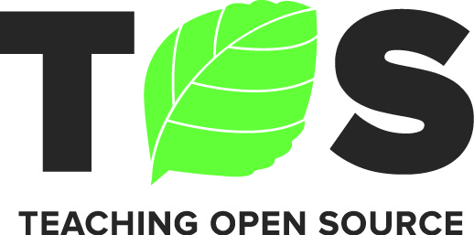
Notes:
Teachingopensource.org is an online community for professors, institutions, communities, and companies to come together and make the teaching of Open Source a global success.
Launched in 2009, the site serves to provide shared resources such as course content, presentations, and reference models for instructional programs. The mailing list and IRC channel provide additional ways for instructors to connect and find support. The site is undergoing a renewal now.

Slide 38
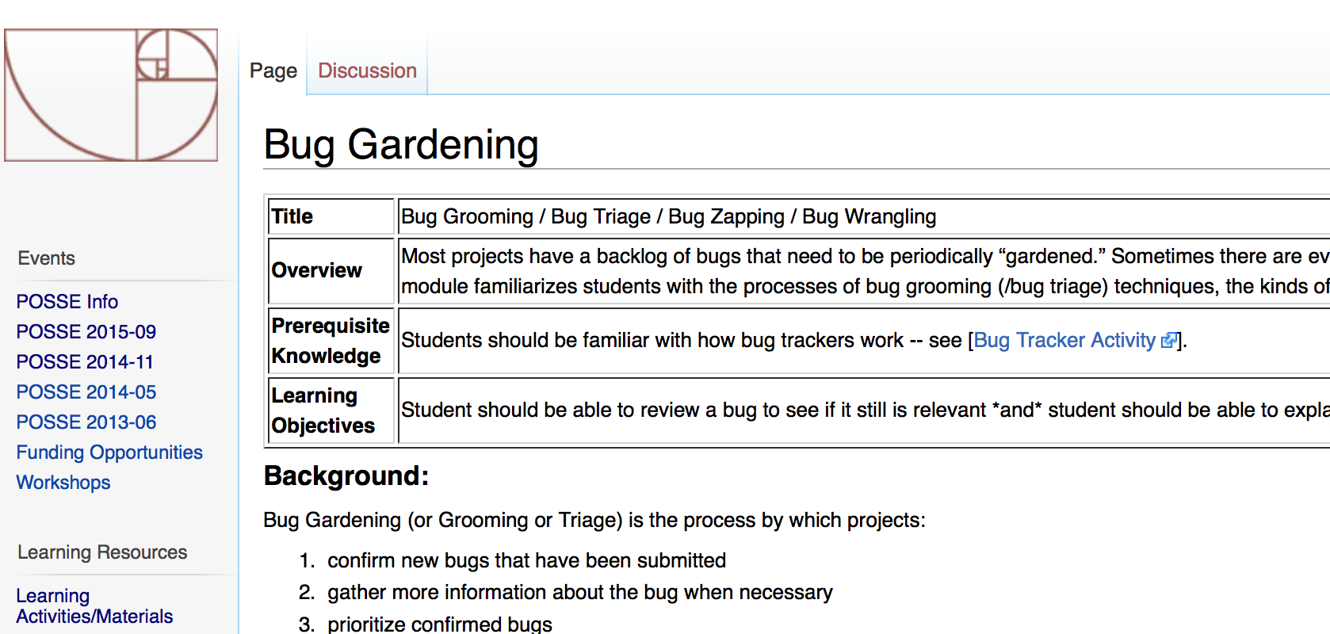
Foss2serve.org
Notes:
Foss2serve is the home for all the learning activities (think “labs”) that are being created to help teachers teach FOSS. (Ugh I had to say it again)
Activities are designed for students to complete in FOSS community
Examples activities might be:
Bug gardening (see http://foss2serve.org/index.php/Bug_Gardening for example), where students learn how to find older bugs that may have been fixed but not cleared and recommend them for action
Learning about community roles by documenting who holds main roles in community (maintainer, commit access, leads on subprojects)
Testing existing documentation for project (suggestion: use “Getting started” document if there is one)
Some activities can be completed standalone; others have prerequisites (for example, students have to understand project’s workflow before submitting a bug)
Each activity:
sets a learning objective (or objectives) for students
sets expectations, actions and outcomes for both project and professor
Framework provides pedagological underpinning as well as practical information such as rubrics and possible grading methods

Slide 39
What can you do?
Very few schools teach source control at all in undergraduate curriculum, so we should:
  Encourage use of source control – and as early as possible in curriculum
  Have recruiters look for github urls on student resumes
Notes:
Very few schools teach source control at all in the undergraduate curriculum.
Encourage use of source control – and as early as possible in curriculum
When I say source control, I mean git/github.
Students exposed to github early see a logical progression to open source ideas later on. At RIT they started used github to distribute and collect assignments, when the time came to talk about open source principles such as collaboration and meritocracy, the students said “yeah, we kinda figured that out already” because they'd been working together, transparently and openly.
To help add incentive, have your recruiters look for github urls on student resumes.
This is happening already, but we can be more unified in asking for this

Slide 40
What else can you do?
Let us know if you are interested in open source and higher education
Reach out to local schools
Share successes – evangelize
Encourage open and transparent efforts within academia
Notes:
Let us know if you are interested in open source and higher education
If your project is willing to work with an instructor, let us know.
For extra credit – help with the curricular materials. We can use help proofing – and in some cases creating – new materials. Even if you generate materials outside of FOSS2SERVE, we can get them linked in, etc.
Reach out to local schools
Speak to interested classes & clubs about open source
Sponsor and mentor hackathons and student projects – and not just by giving them cash – volunteer your time and techinical resources.
Mentor individual students
A note on finding and working with schools: Leverage the existing strengths and interests of the school. Gaming? Security? Networking? The open source skills will transfer
Promote successes:
Sharing of successful models across institutions
Use our wider community audience to promote academic FOSS successes
Encourage open and transparent efforts within academia

Slide 41
Work in mutual partnerships with academia, industry, and community
Notes:
Work in mutual partnerships with academia, industry, and community:
Promote Open Source ideas more broadly than any specific technology.
– We rarely talk about Red Hat-specific anything when we speak at schools…
And this should go without saying, but, you cannot simply treat higher-ed as a sales lead. Sure, they have an IT infrastructure, but the engagement with students and faculty has so much greater potential.

Slide 42
Thanks!
Questions? education@redhat.com

Slide 43
Bonus

Slide 44
Why Focus on Higher Education
Some challenges with US school system at primary level:
  Most schools are public & usually underfunded. Often an entire school district will have 1 staff member with IT knowledge.
  US focus on standardized testing leaves little room for “new”
  Stranger danger: Many schools do not permit outsiders who are not staff or a parent
  Programming is often not taught at all at this level and is not included in Common Core.
  The ocean. It is large and cannot be boiled.
Notes:
Not just teaching, but using open source as a learning platform
Reference on underfunding: http://www.cbpp.org/research/most-states-funding-schools-less-than-before-the-recession
Reference on common core:https://en.wikipedia.org/wiki/Common_Core_State_Standards_Initiative Media and technology
Since media and technology are intertwined with every student's life and in school in the 21st century, skills related to media use, which includes the analysis and production of various forms of media, are also included in these standards.^{[21]}
The standards include instruction in keyboarding,^{[23]} but do not mandate the teaching of cursive handwriting. As of late 2013, seven states had elected to maintain teaching of cursive: California, Idaho, Indiana, Kansas, Massachusetts, North Carolina and Utah.^{[24]}

Slide 45
Focus on Higher Education
US higher education (university level) schools are a mix of public and private schools
  Already have focus areas of interest to us (Computer Science, Engineering, IT)
  Budget concerns are usually not the primary roadblock
  Actively interested in industry partnerships
Notes:
Not just teaching, but using open source as a learning platform

Slide 46
What Instructors Tell Us
Don't know how to where to find appropriate FOSS projects for students to work on
  Often, it is easier for students to work on “sandbox” projects that do not change at all.
Even if they did find one, they don't know what questions to ask to see if they're a good match.
Notes:
Most instructors realize that these sandbox projects do not provide a very valuable experience for the students. Often these projects are done individually, or in very small groups. The sandbox project cannot be cited externally as experience.

Slide 47
FOSS Internet Dating
Need to make it easier for instructors to find FOSS projects that are a good fit for their class
Allows people to show interest
Asks the right questions to collect relevant information.
Allows potential matches to be easily found
Provides structure and known framework for initial conversations

Slide 48
Proposed Solution
Enable instructors to find FOSS projects that fit classes’ skill, available time, and student interests
Creates central location for projects to “advertise” willingness to work with universities and what they are looking for
Generates a “badge” communities can display to indicate participation
Provides structure and guidance for project-based activities
Provides framework for interaction over course of term so open source communities and professors who are new to process do not reinvent the wheel

Slide 49
Schools we've visited
Christopher Newport University
Cornell
Duke
GA Tech
Harvey Mudd
Lenoir Rhyne
Meredith College
MIT
NCSU
NYU
Purdue
RIT
RPI
Seneca College
The College of New Jersey
U Washington
UC Berkeley
UC Santa Cruz
UNC-Chapel Hill
UNC-Charlotte
UT Austin
VA Tech
Virginia Commonwealth
Virginia Tech
W Mich

