Slide 1
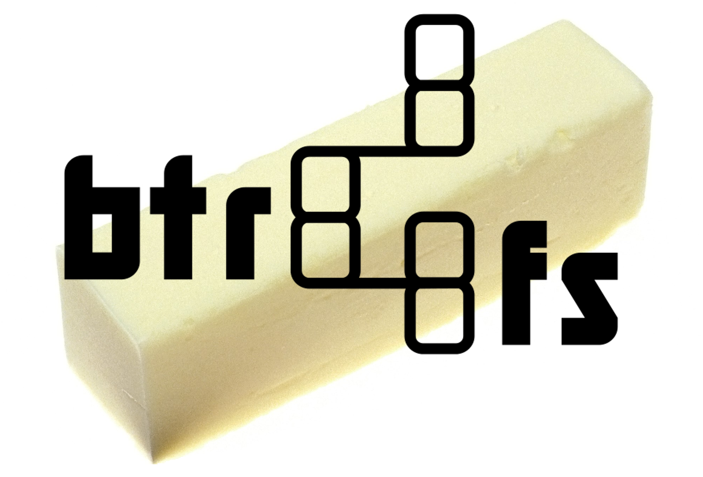

Hot BTRed ZFS
An overview of next-gen filesystems
What... Why... Which
These slides are © 2016 Jim Salter, with license Creative Commons Attribution-ShareAlike 3.0 unported. http://creativecommons.org/licenses/by-sa/3.0/deed.en_US

Slide 2
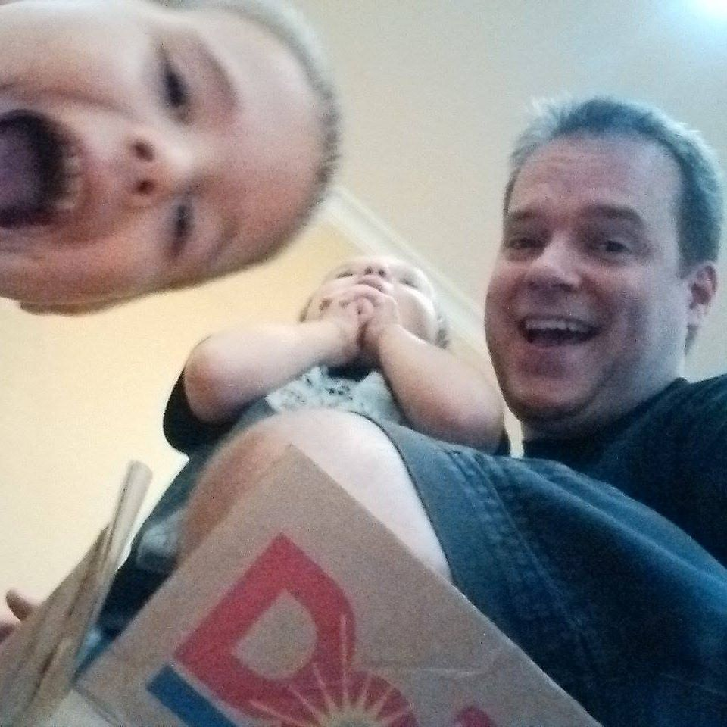
First of all: Who?
Jim Salter
Dad,
Technomancer,
Mercenary Sysadmin,
8 years of ZFS in production
~3 years of btrfs in test
Today's slides can be found at:
http://openoid.net/presentations/2016-hot_btred_zfs/

Slide 3
Features oh, so many features
Vdev types - RAIDZ1, RAIDZ2, RAIDZ3, n-way mirrors Pluggable inline compression - LZ4, GZIP, more Enterprise scalability features – ZFS Intent Log device, L2ARC device, multiple vdevs per pool, etc Data deduplication (but this sucks)
Development underway on parity RAID, >2 dev mirrors Per-file and per-folder feature granularity (compression, noCOW, etc) On-the-fly reconfiguration of RAID levels, size, rebalancing. HUGELY popular for SOHO types

Slide 4
What
… is a “next generation” filesystem?
What's a last generation filesystem?
What's a filesystem “generation” anyway?

Slide 5

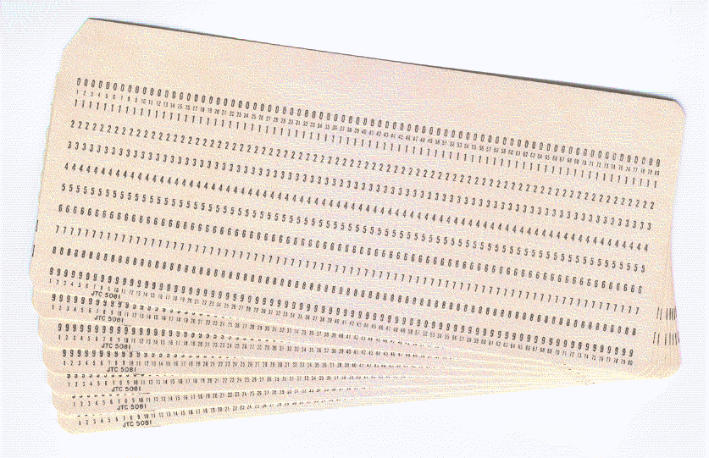
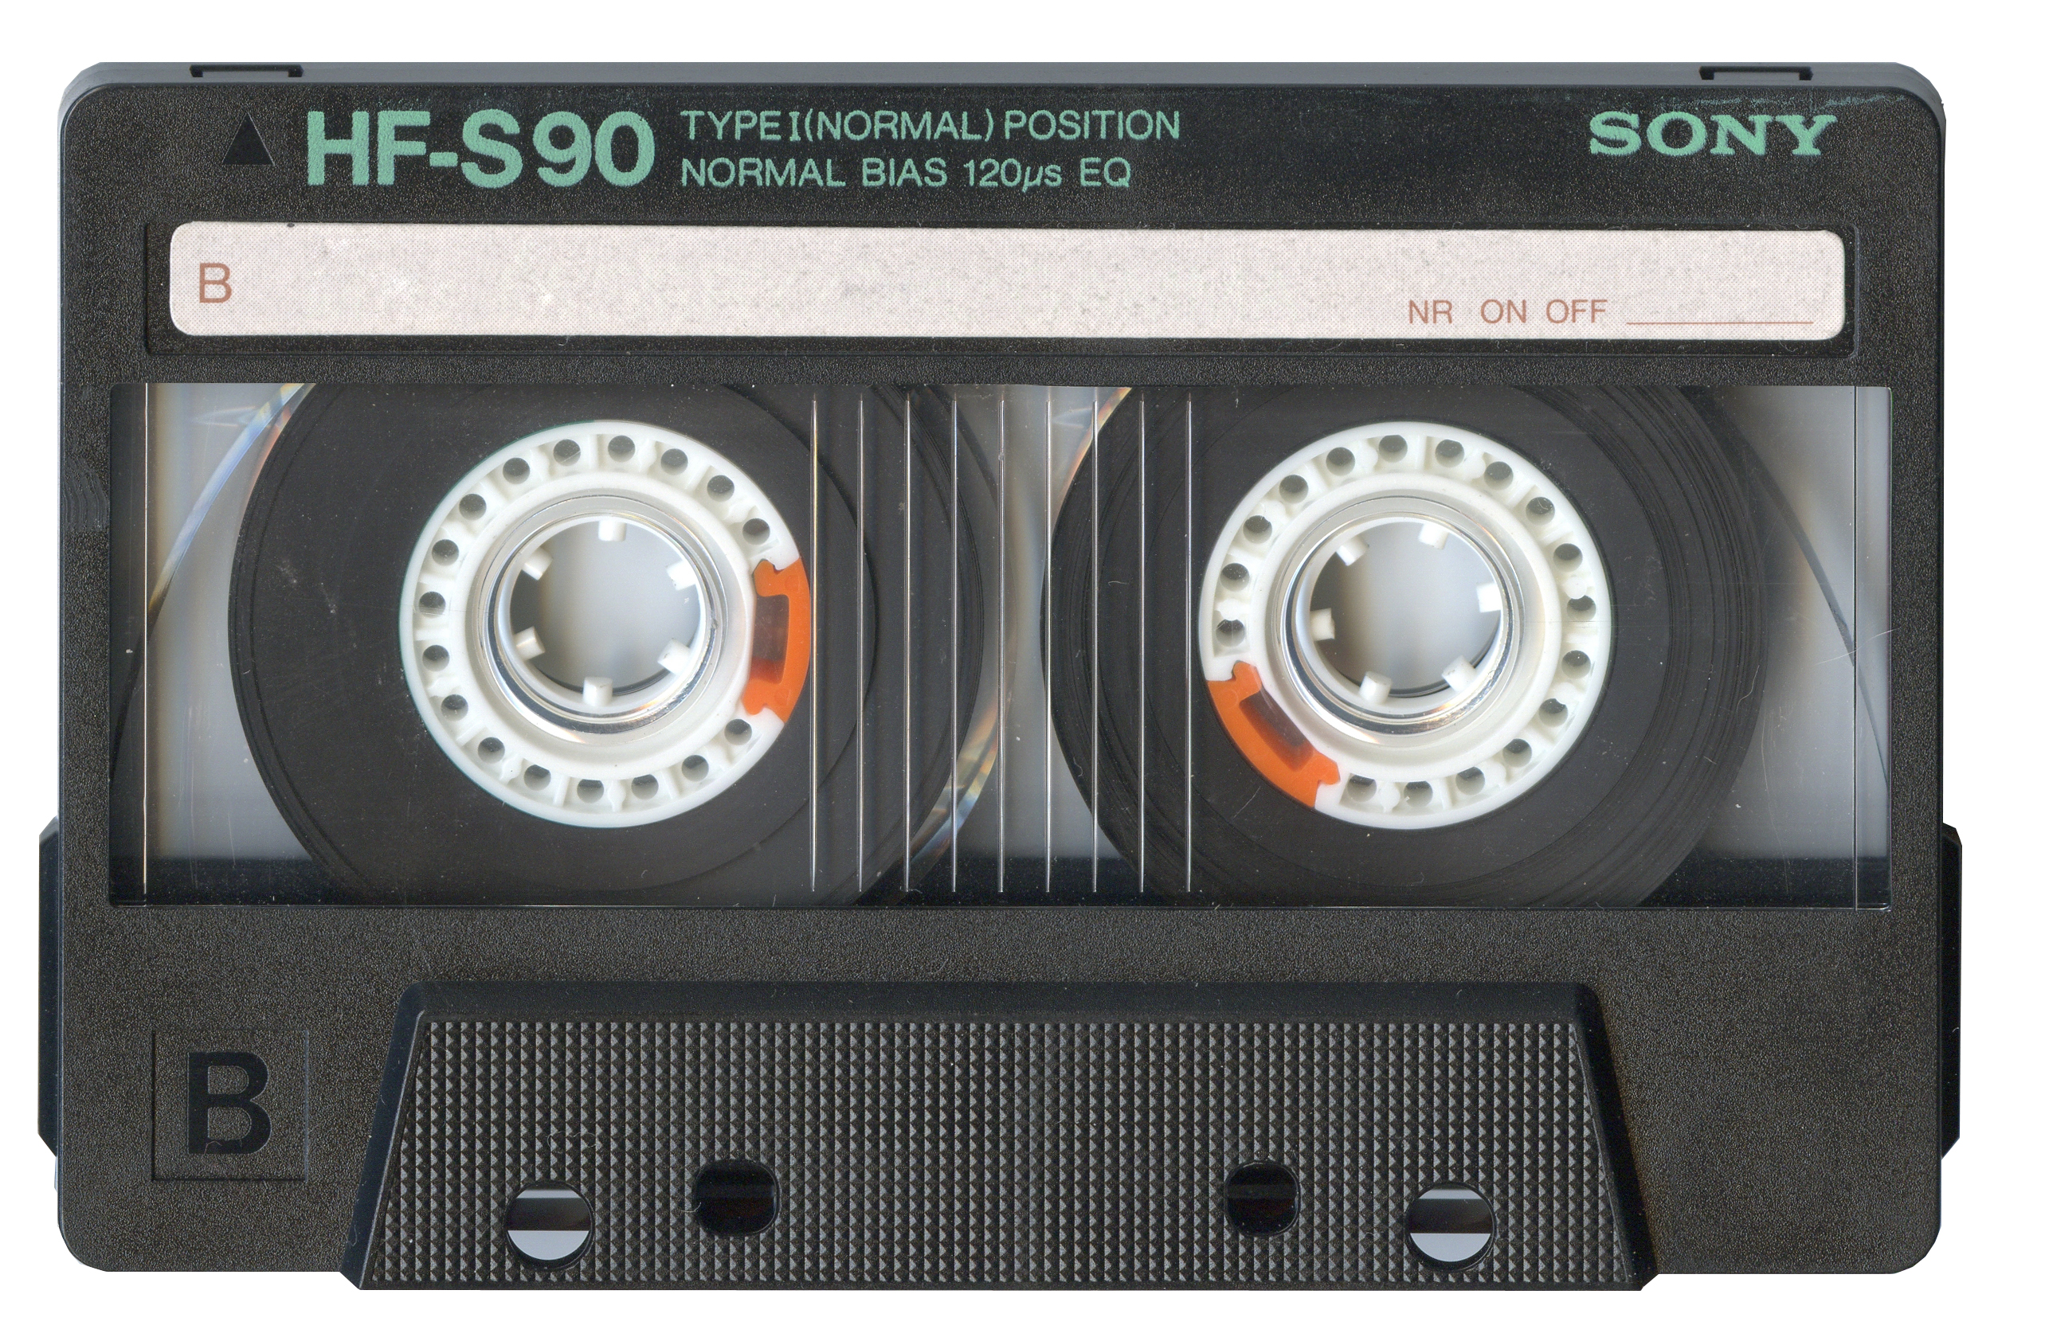
Generation 0 punching paper holes and recording modem squeal on a tape deck
No Files No Folders No System

Slide 6
Generation 0 punching paper holes and recording modem squeal on a tape deck
Let's take a moment to explore how this worked.

Slide 7
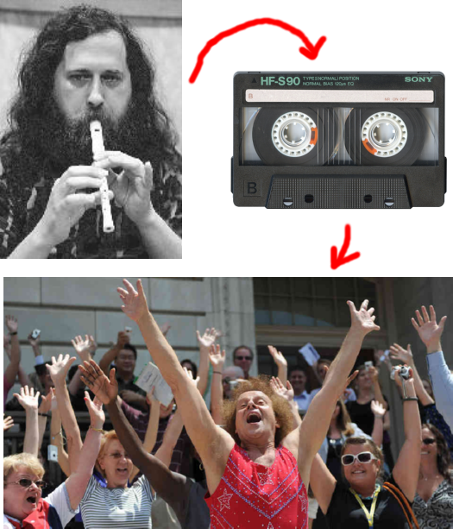
Generation 0 punching paper holes and recording modem squeal on a tape deck

Slide 8
Generation 0 punching paper holes and recording modem squeal on a tape deck

Slide 9
Generation 0 punching paper holes and recording modem squeal on a tape deck

Slide 10

Generation 0 punching paper holes and recording modem squeal on a tape deck

Slide 11
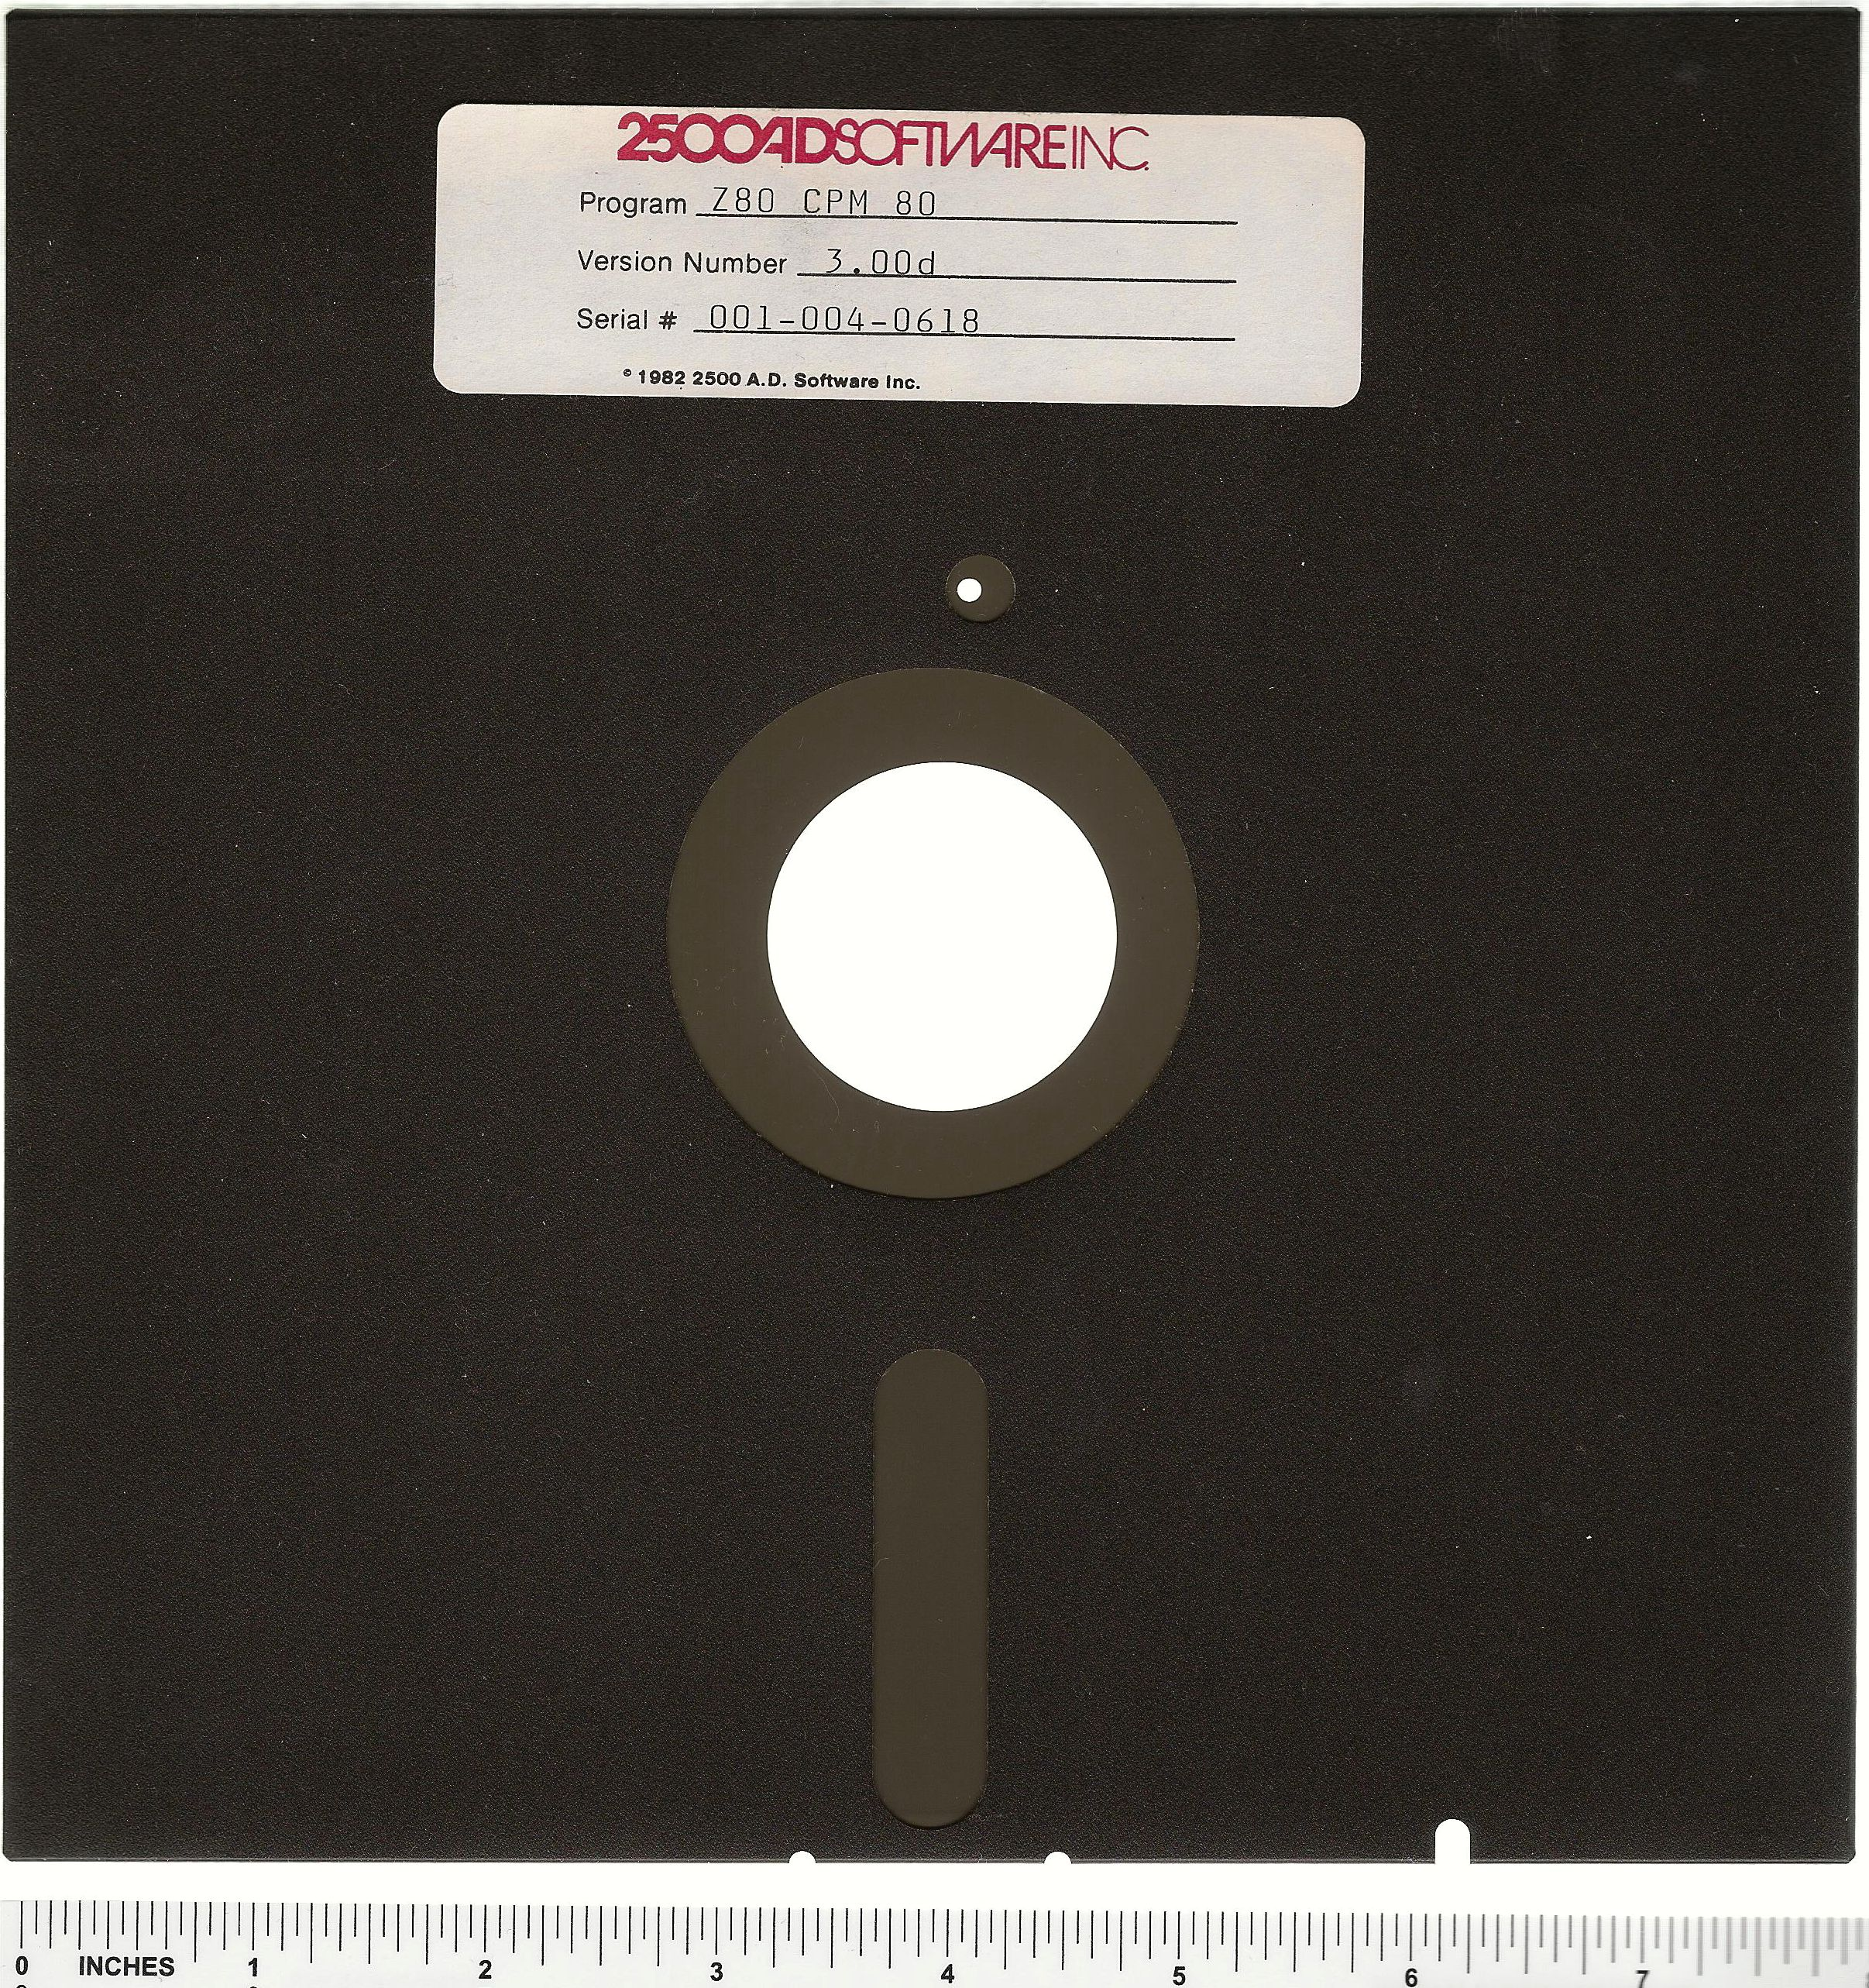
Generation 1 the beginnings of random access
Files! … that's all we got

Slide 12
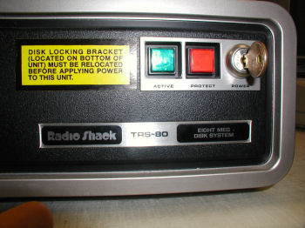
Generation 2 the beginnings of organization
Files! Folders! … that's all we got

Slide 13
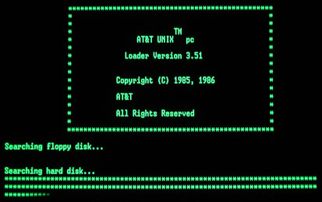
Generation 3 in which we no longer trust everyone
Files! Folders! Ownership! Permission!

Slide 14
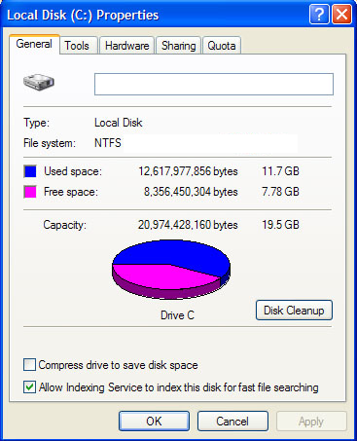

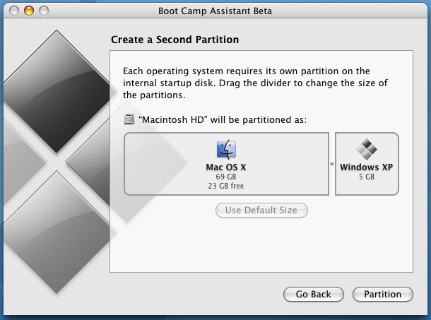
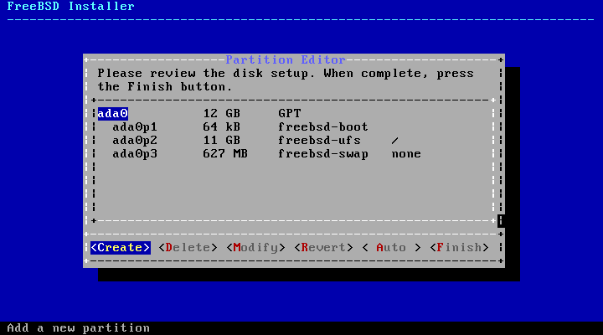
Generation 4 in which we're tired of power failure
Journalling!

Slide 15
Generation 5 in which we really get serious
Volume Management Per-block checksumming Self-healing RAID arrays Atomic COW snapshots Asynchronous replication Far-future scalability

Slide 16
Why do I really care about this stuff?
Data Retention Data Management Data Longevity Protection from human error Protection from environmental failure

Slide 17

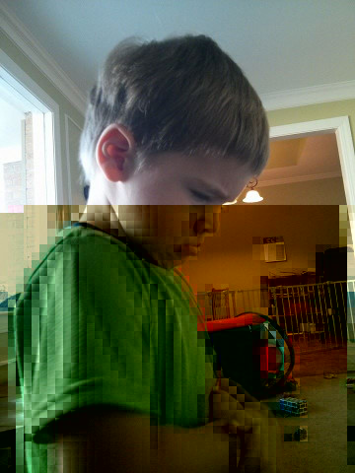
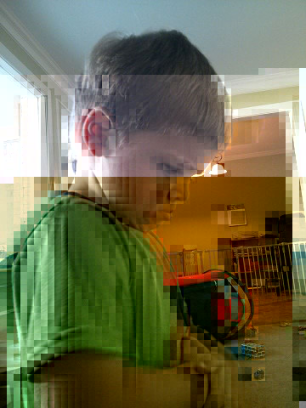

bit rot in moR!l daeaces, ar% gften eboQch tk bafkrupQ
http://arstechnica.com/information-technology/2014/01/bitrot-and-atomic-cows-inside-next-gen-filesystems/

Slide 18
Checksumming! per-block checksumming + redundant storage = GTFO bitrot
[87.030967] BTRFS info (device vdf): csum failed ino 258 off 0 csum 3377436548 private 796777854
[87.031188] BTRFS info (device vdf): csum failed ino 258 off 0 csum 3377436548 private 796777854
[87.031678] btrfs read error corrected: ino 258 off 0 (dev /dev/vde sector 267344)

Slide 19
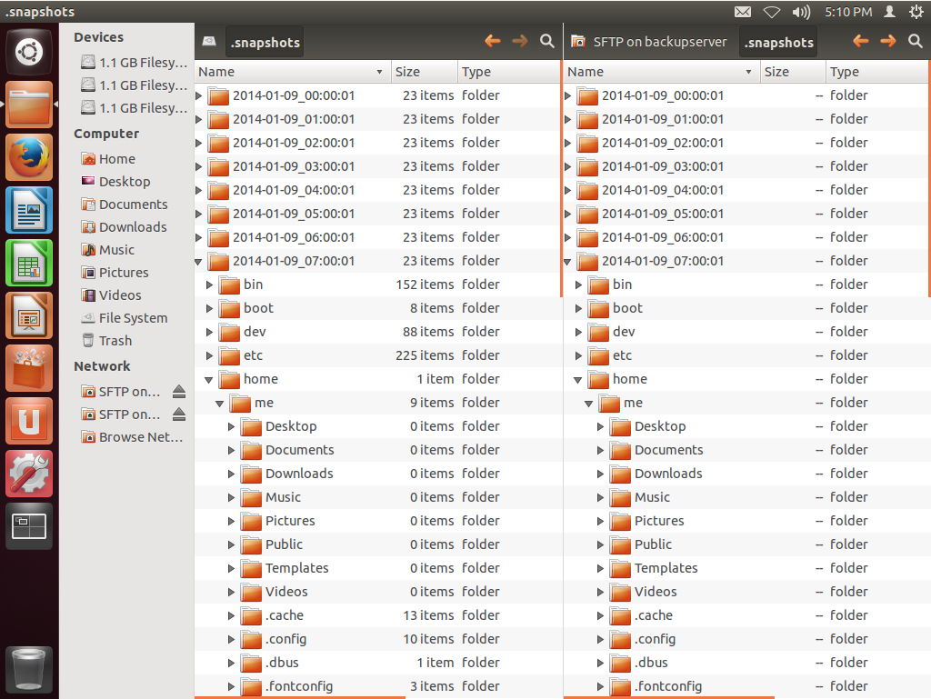
Replication your backups suck. so much. lern 2 replicate ok

Slide 20
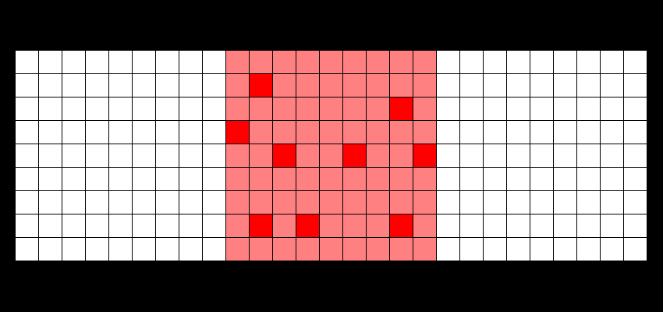
Traditional FS in-place modification of data is just what it sounds like
Dark red: newly (re)written data blocks
Pale red: existing data blocks
White: unlinked data blocks

Slide 21
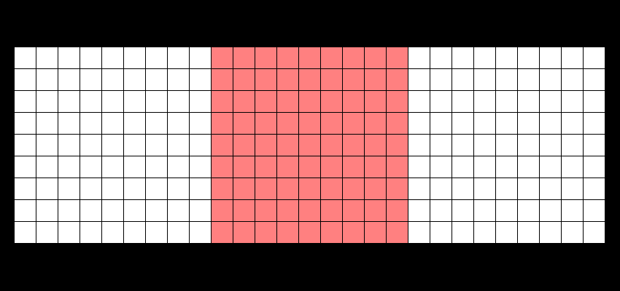
Copy on Write FS
”the data comet” : write a new block, unlink the old block
Dark red: newly (re)written data blocks
Pale red: existing data blocks
White: unlinked data blocks

Slide 22
Abstracting CoW where the blocks are isn't important: “the data worm”
Dark red: newly (re)written data blocks
Pale red: existing data blocks
White: unlinked data blocks

Slide 23
Understanding CoW visualizing “atomic COW snapshots”
Dark red: newly (re)written data blocks
Pale red: existing data blocks
White: unlinked data blocks
Blue tint: snapshot @1
Yellow tint: snapshot @2

Slide 24


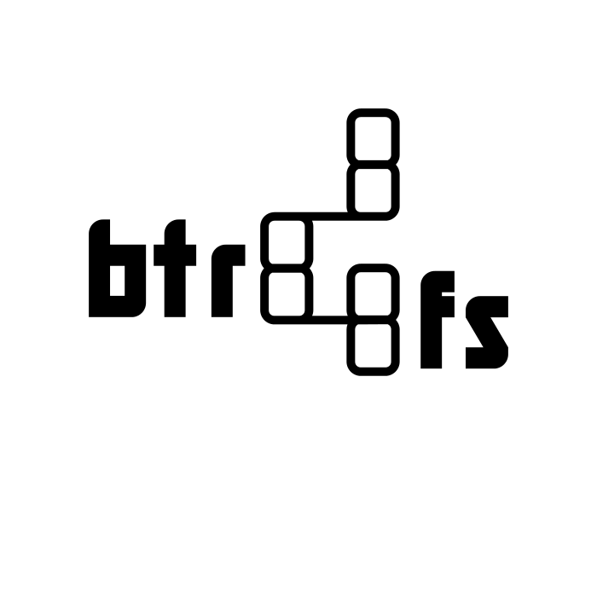
Maturity
(n / 2) + 7
2001: Development begun 2004: First official announcement 2005: Implemented in baseline Solaris
Jun 2007: Chris Mason announces btrfs to the kernel mailing list Jan 2009: Implemented in baseline Linux kernel Jan 2016: Still best considered “experimental” - strongly warned to VERIFY your backups, REGULARLY.

Slide 25
(im)Maturity long-term “production testing” was... painful =(
I deployed btrfs as the VM data storage for one customer in November 2013. That one customer became more work to maintain than the entire rest of my client base. I spent the entirety of Mother's Day in 2014 ripping btrfs back out and replacing it with ZFS due to chronic, never ending reliability, performance, and replication issues.

Slide 26
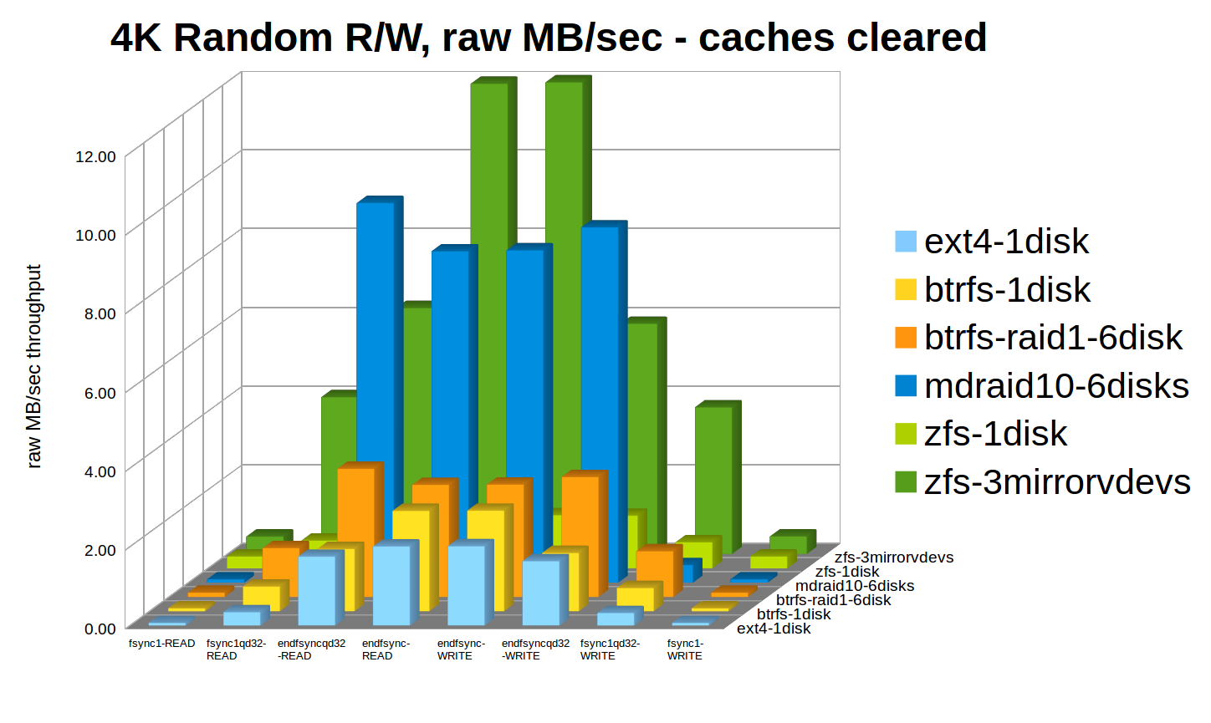
Performance

Slide 27
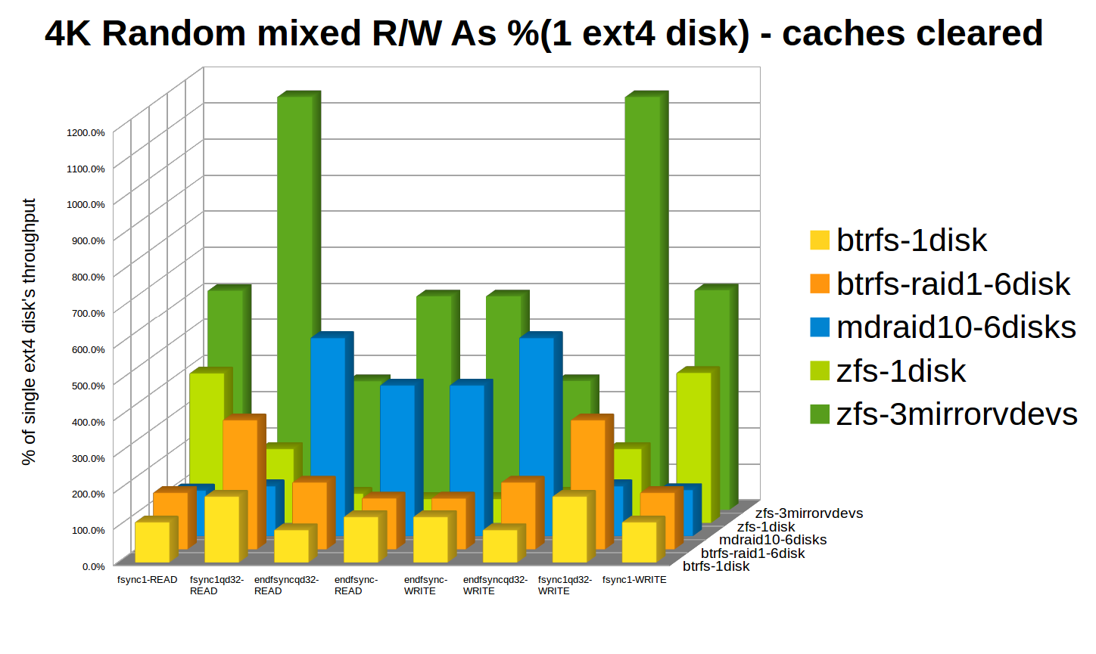
Performance

Slide 28
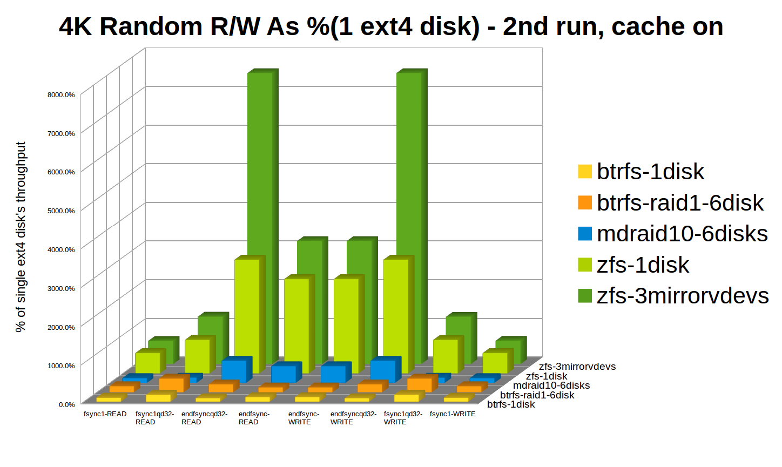
Performance

Slide 29
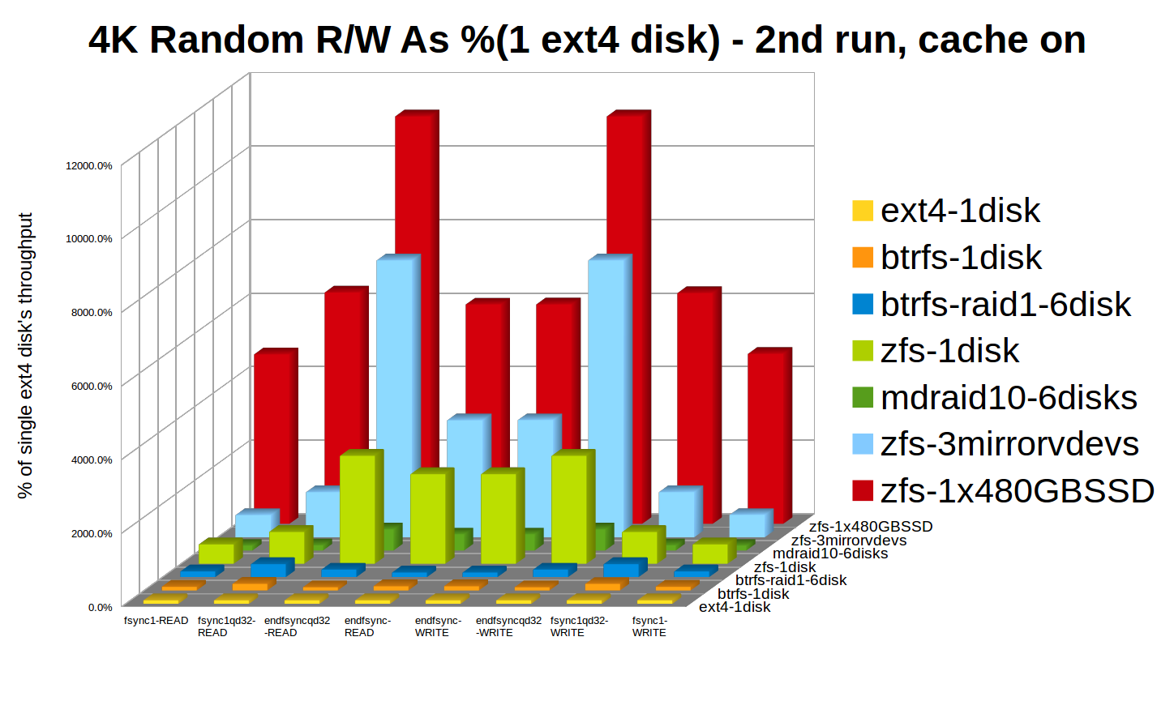
SSDs, lol =)

Slide 30
Portability licensing vs hardware requirements
CDDL is less absolutely restrictive than GPL Compatible with BSD kernels (as loadable module) Probably compatible as a Linux kernel module. Maybe compatible directly inside the kernel. But opinions vary =\ Already implemented on three OS families – Solaris, BSD, Linux. And, sorta kinda Mac.
GPL licensed... you won't see this in Windows or Mac kernels. Scales DOWN well – some devs even run btrfs on phones!

Slide 31
Future Proofing betting against the GPL is usually a bad idea
Has a 5+ year jumpstart on btrfs Work being done on relicensing GPL Various orgs have decided CDDL not incompatible with GPL after all Ubuntu to ship OpenZFS in standard repos with Xenial!
GPL licensed Built in to the mainline Linux kernel May eventually be a default Linux filesystem

Slide 32
The Bottom Line we live in interesting times
Questions?

