Slide 1
Intro to Making Music with GNU/Linux (2015)
Aaron Wolf
wolftune.com
Snowdrift.coop

Slide 2
Distros/Repos
KXStudio
AV Linux
Fedora Jam

Slide 3
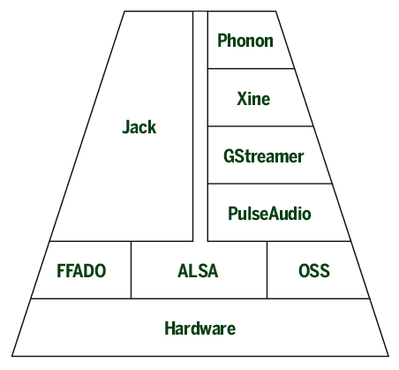

Slide 4
Resources
wiki.linuxaudio.org
linuxmusicians.com
IRC: #opensourcemusicians
libremusicproduction.com

