Slide 1
openQA
Life is Too Short for Manual Testing
Douglas DeMaio
Senior Consultant - openSUSE
Notes:
Thank you for attending
I know you're all hungry. Perhaps some of you are thirsty, so we will move through this so quickly
I'm Douglas DeMaio
Not a Technician
Not an expert, so if you have any technical questions, I can refer you to the people that know the ansers

Slide 2
Contents
Why automate testing?
The problem with every other testing tool
openQA to the rescue
openQA & openSUSE
openQA & SUSE Linux Enterprise
openQA & You
Notes:
Summary of this presentation
OpenSUSE is a community project sponsored by SUSE.
Two Distributions
Several Tools and openQA is one of those tools we use in the project to bring people
well tested repeases

Slide 3
Why automate testing?
Notes:
The answer should be obvious
Change
Progress
Innovation

Slide 4

Always changing..
CC-BY Jason McHuff @ flickr

Slide 5
Always changing
Kernel 3.12 (Oct 2013) – SLE 12
  10,480 change sets
  +601000, -279000 Lines of Code
Kernel 3.16 (Aug 2014) – openSUSE 13.2
  12,804 change sets
  +578000, -329000 Lines of Code
Kernel 4.1 (June 2015) – openSUSE Leap 42.1
  11,664 change sets
  +486000, -286000 Lines of Code
Notes:
Over the year we have used openQA
You can see how much change takes place in a distribution
SUSE Linux Enterprise 12
13.2
And Now 42.1

Slide 6
Change is good
Security, Bug, Performance Fixes
Hardware Support
New Features
Notes:
It allows you to move with the speed of other developments that are moving quickly
Upstream is fast paced and we need to move with that pace to remain relevant

Slide 7
Change is bad
Security, Performance Regressions
Bugs!
Functionality Changes
Notes:
New bugs, security issue
People don't understand change
Some people adapt
Others live in the past

Slide 8
Everyone needs automated testing
In order to benefit from new software developments as fast as possible
While avoiding regressions, bugs, and unexpected functionality changes
Notes:
Automated testing helps openSUSE Develop fast and your will see that when I get to Tumbleweed

Slide 9
The problem(s) with every other test tool
Notes:
Discussion point
Ask the room if they're using Selenium, Cucumber, LDTP, etc
Selenium – Web Only
LDTP – Linux Only
.

Slide 10
Lacking
Jenkins
Focuses strictly on package
Selenium
Don't Render well
Entirely web interface
Lacks a GUI
* No open source testing tool compares to openQA
Notes:
Most tools require deep knowledge of the products API/ABI, test the code, not the software.

Slide 11
openQA to the rescue

Slide 12
OpenQA – Background
Open Source distribution testing framework
Started in 2009
Tests Operating Systems and their applications
A tool used to enhances DevOps
GUI & Console Testing
Used by the openSUSE® distribution, Tumbleweed, and now SUSE®
Notes:
Berhard Wiederman
Hackweek project
We made this tool part of a system of tools to create releases

Slide 13
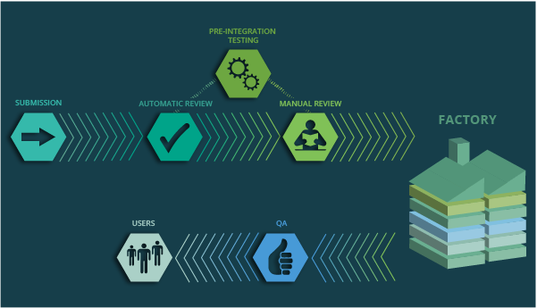
OpenQA – Part of a Process
Testing
Testing
Notes:
General overview of packages entering openSUSE and being released

Slide 14
openQA – Overview
Doesn't touch the software directly
Uses the software the same way users will
Virtual Machines, IPMI, VNC to provide a keyboard and mouse to control the system-under-test
openCV (Computer Vision) to 'read' the actual screen output and compare to predefined 'needles'
Serial for basic text comparisons
Records screenshots, logs, video for analysis

Slide 15
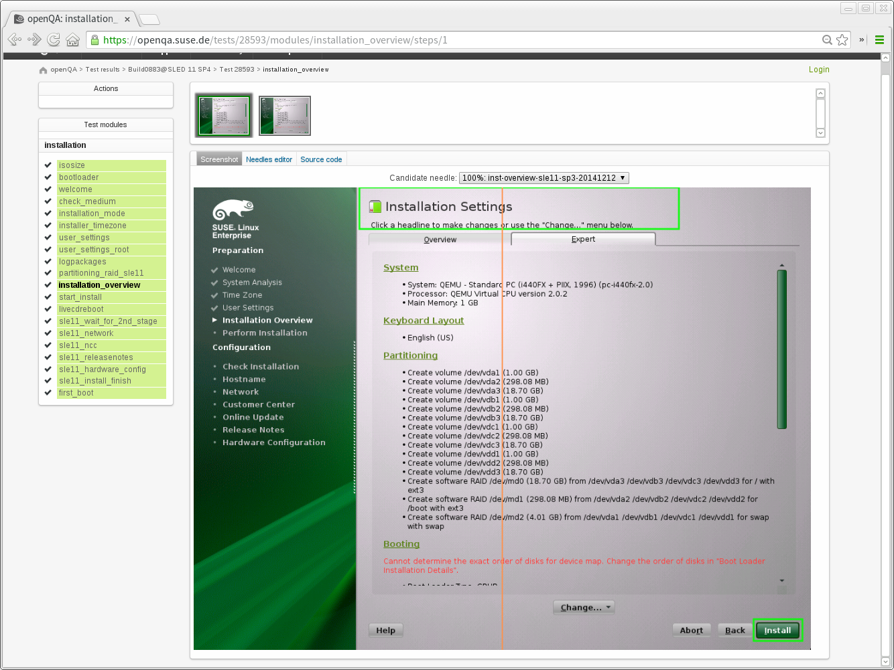
Installation Testing – Beginning to End
Notes:
If there is a falure. It stops

Slide 16
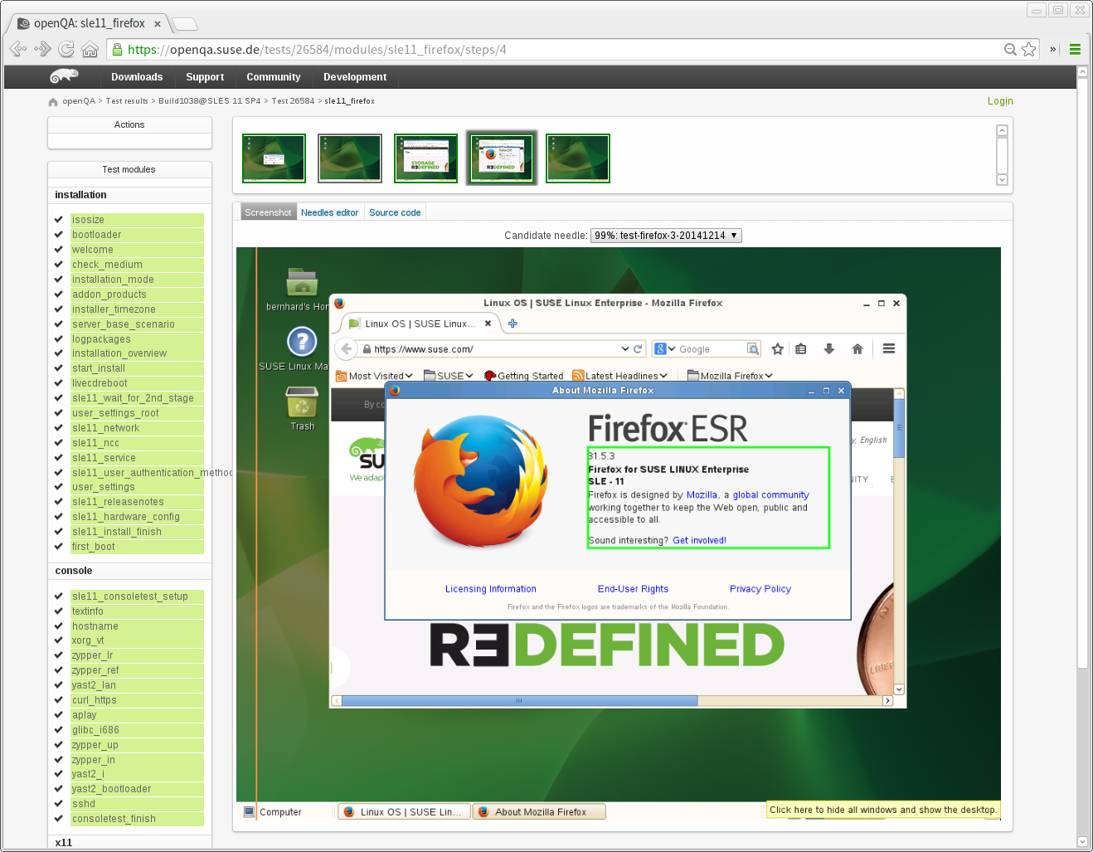
Graphical Application Testing
Notes:
You can see what's being tested
You have a
GUI
Video
Json file
Text logs

Slide 17
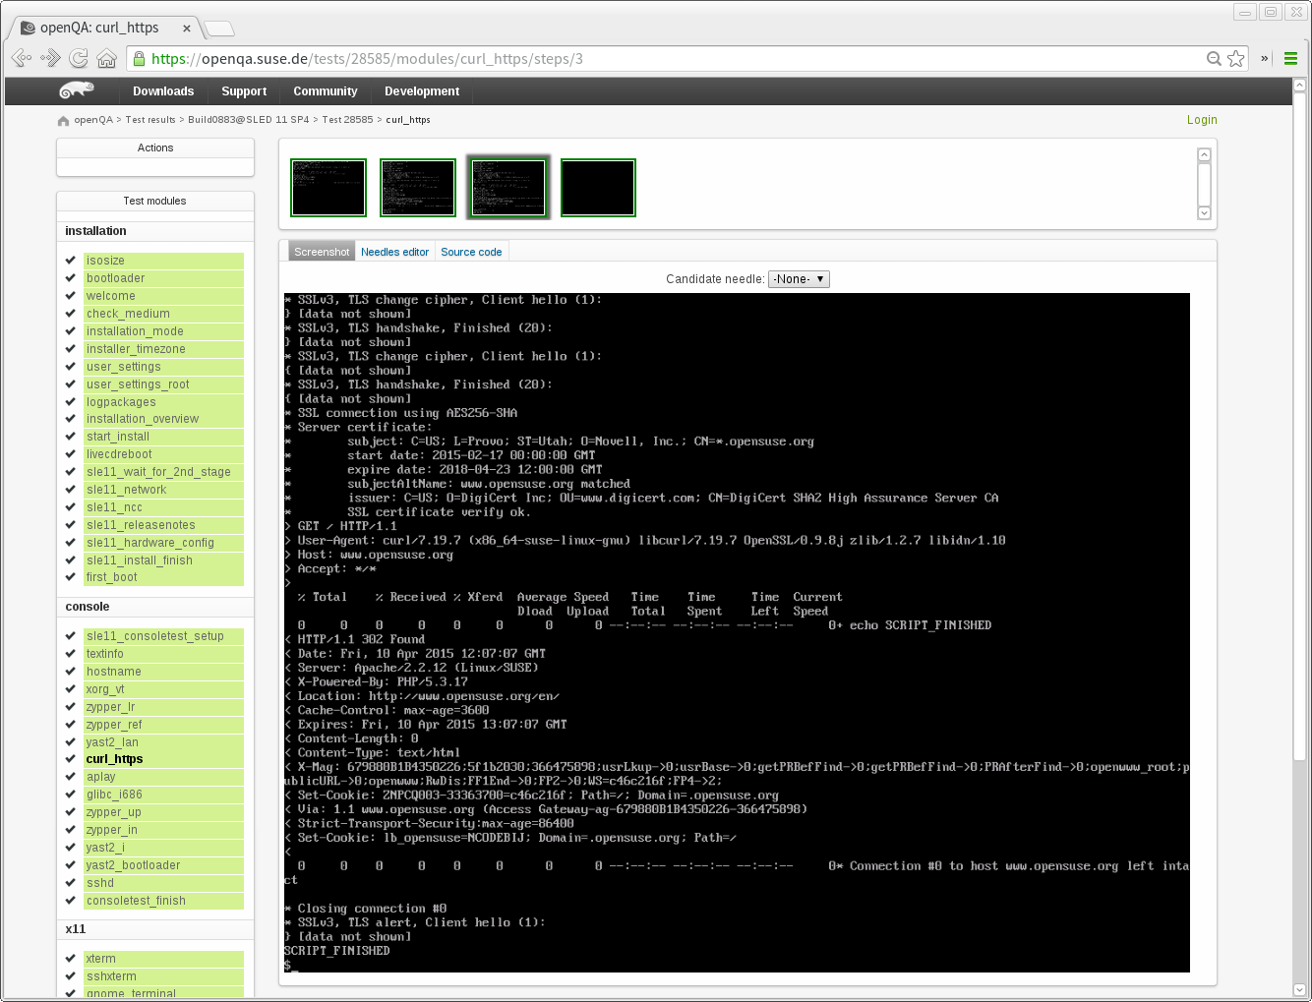
Console Testing
Notes:
It tests the console
See the script running

Slide 18
PROPER Console Testing
<< type_string(string='\'curl -f -v http://10.0.2.2:20063/current_script > /tmp/scriptrPOv.sh && echo "curl-0" > /dev/ttyS0
\''
, max_interval='\'250\''
)
[Fri Apr 10 14:07:01 2015] [debug] GET "/current_script".
[Fri Apr 10 14:07:01 2015] [debug] Routing to a callback.
[Fri Apr 10 14:07:01 2015] [debug] Request from 127.0.0.1.
[Fri Apr 10 14:07:01 2015] [debug] Routing to a callback.
[Fri Apr 10 14:07:01 2015] [debug] 200 OK (0.001168s, 856.164/s).
Debug: /var/lib/openqa/share/tests/sle-11-SP4-Alpha/tests/console/curl_https.pm:8 called testapi::validate_script_output
<<< wait_serial(regex='curl-0'
, timeout=2
)
>>> wait_serial: curl-0: ok
Notes:
Output from the previous screen

Slide 19
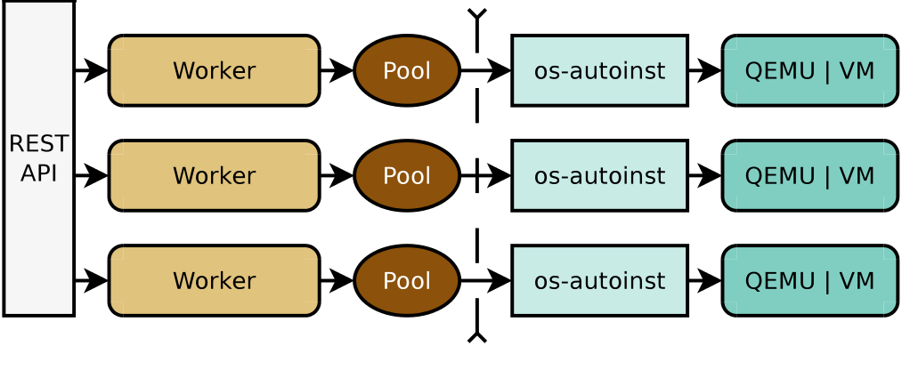
openQA Architecture
Web
UI
openQA
openqa-worker
os-autoinst
Notes:
It gives you a quick emulator

Slide 20
New Feature Highlights
Multi Arch Support (Intel, ppc64le, s390x, aarch64)
Multi Machine Testing (incl. openvswitch)
Add On Testing (Multi-DVD Installations)
Remote Workers
Real Hardware Testing
Disk Image Creation
Testing without OS Installation
Dashboard & Comments
Notes:
Multiple architectures
Bare Metal Testing
It tests in a vm

Slide 21
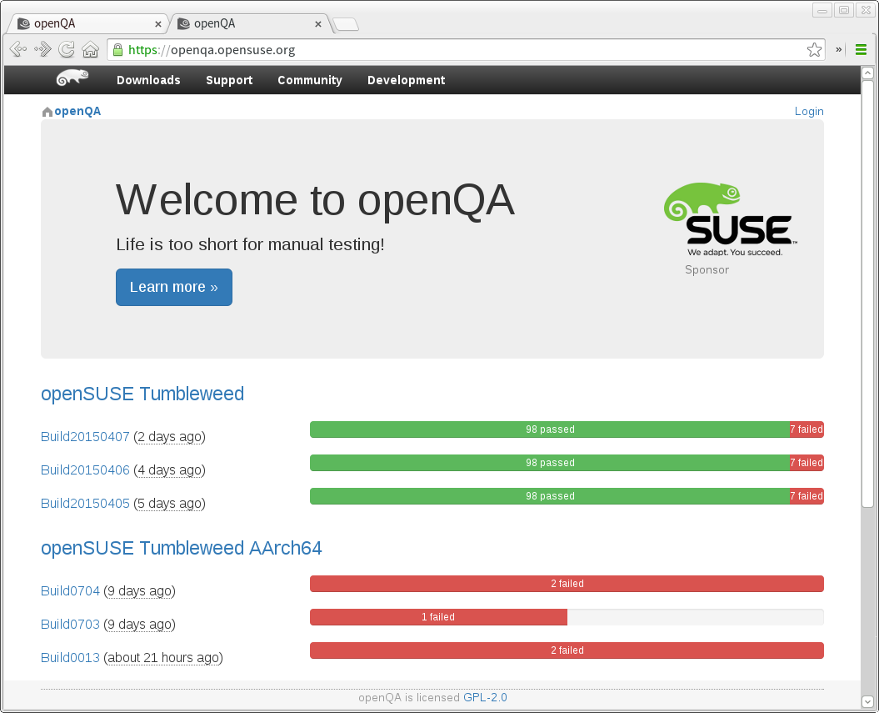
openQA – Results Dashboard
Notes:
You can see all the tests

Slide 22
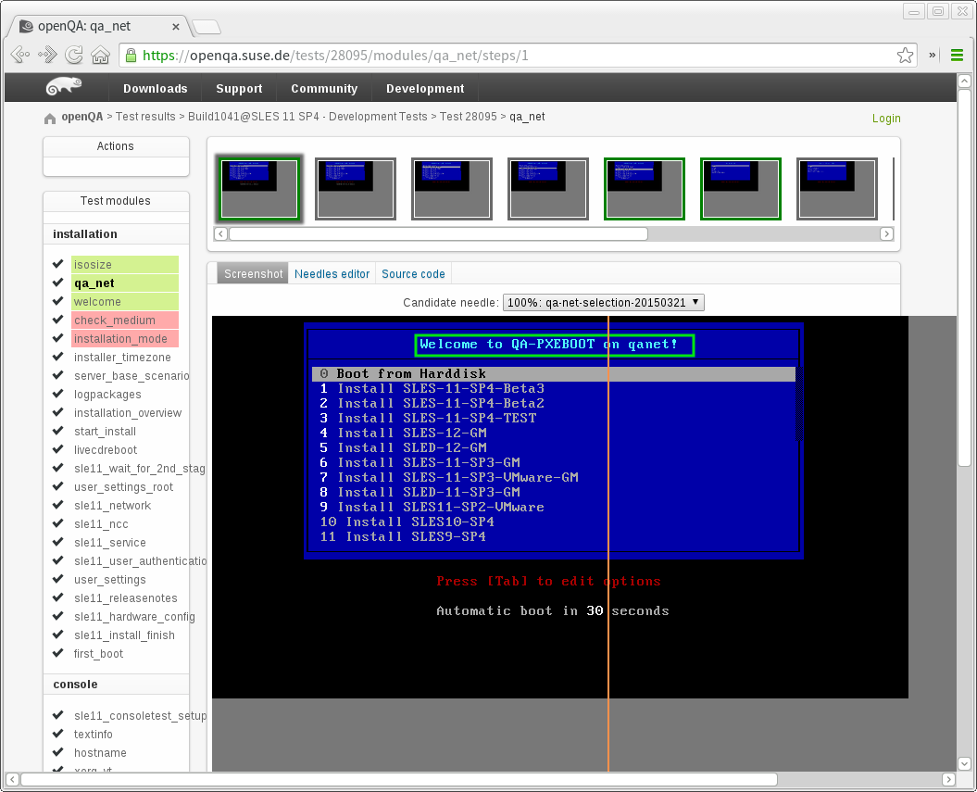
openQA – Bare Metal Testing

Slide 23
Who's using openQA?
openSUSE
  Tumbleweed – Rolling Release Testing
  Leap – Validation and System Testing
SUSE
  SLES – Multi-Arch (x86_64, s390x, ppc64) Validation, System, Stress, Regression Testing
  SLED – Validation, System, Stress, Regression Testing
  HA – Multi-Arch (x86_64, s390x) Validation and Multi-Machine Testing
Notes:
2013
Not exactly new
Just not well known

Slide 24
Who's using openQA?
openSUSE
  Tumbleweed – Rolling Release Testing
  Leap – Validation and System Testing
SUSE
  SLES – Multi-Arch (x86_64, s390x, ppc64) Validation, System, Stress, Regression Testing
  SLED – Validation, System, Stress, Regression Testing
  HA – Multi-Arch (x86_64, s390x) Validation and Multi-Machine Testing
Red Hat...

Slide 25
Red Hat??
Using openQA to test Fedora 22 and Rawhide
Dockerised openQA
Contributing Patches, Ideas, and New Tooling
Public Instance
  https://openqa.happyassassin.net/

Slide 26
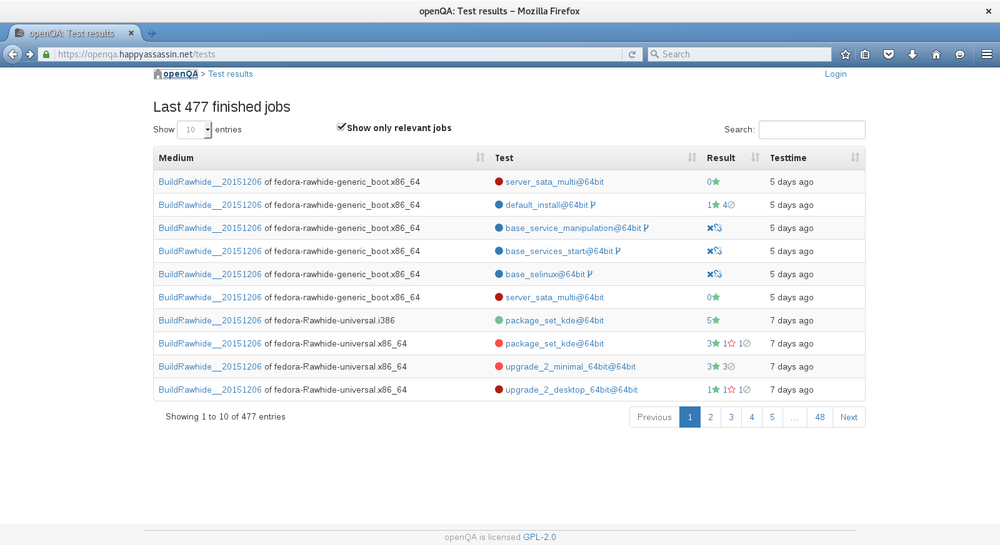
Rawhide

Slide 27
openQA & openSUSE

Slide 28
openQA & openSUSE Leap
openSUSE Leap is a new distribution combining packages from both SUSE Linux Enterprise and openSUSE
Extensive integration challenge, combining two separate code bases and ensuring key functionality is preserved
Over 25 different installation/upgrade scenarios tested for each development build

Slide 29
openQA – Magic behind Tumbleweed
openQA is an integral part of openSUSE development
Incoming changes are 'Staged' and tested in isolation atop of the last 'known good' build
In depth testing is then carried out on the whole distribution before release
openSUSE Tumbleweed snapshots released after successful testing
New Tumbleweed release every 2-3 days, sometimes faster.
TESTING, TESTING, TESTING

Slide 30

A 'quiet' Tumbleweek
3 Snapshots
146 Package Updates
15 New Packages on the DVD
38 Packages Removed from the DVD
1 new Kernel
All tested with over 118 different installations/upgrades
QUIET?!

Slide 31
Another Tumbleweek
5 Snapshots
298 Package Updates
47 New Packages on the DVD
42 Packages Removed from the DVD
2 new Kernels
All tested with over 118 different installations/upgrades

Slide 32
openQA & SUSE Linux Enterprise

Slide 33
openQA & SUSE Linux Enterprise
openQA integrated into the SUSE Enterprise development process since SLE 11 SP4
Used by Development Teams, QA, and Release Management
Pre-Validation, Validation, and Post-Validation Testing

Slide 34
Pre-Validation/Staging
Incoming changes are 'Staged' and tested in isolation on top of the last 'known good' build
Monitored very regularly (hourly) by Release Managers
Submissions not checked in until openQA tests pass

Slide 35
Validation
In depth validation testing is carried out in parallel across the whole distribution for every Build
Over 100 different Validation scenarios tested
Milestones (Alpha, Beta, etc) announced only after successful testing
Improved coverage and performance compared to only manual testing

Slide 36
Post-Validation
openQA can schedule additional tests automatically after validation passes
openQA produces automatically verified disk images for further testing of valid builds
Suitable for Regression, Kernel, Stress, Performance and other in-depth, long running, tests.

Slide 37
openQA & You

Slide 38
Contributing to openQA
Main Website
  http://os-autoinst.github.io/openQA
Documentation
  http://os-autoinst.github.io/openQA/documentation/
Bug Reports & Feature Requests
  https://progress.opensuse.org/projects/openqav3

Slide 39
Base off existing tests
openSUSE is transparent
All SLE & openSUSE tests are publicly available
https://github.com/os-autoinst/os-autoinst-distri-opensuse

Slide 40
Best way to start
Think about how you would describe the steps for someone else to do
Assume that person is stupid
Write down those steps
Use those steps as comments in your test code
Write test code for each step
What can you do w/openQA to enhance or develop processes to aid with a DevOps transformation

Slide 41
Making Test Files
Test modules go in a /tests folder
Subfolders help with organisation (installation, console, qa_automation, $application, etc)
One application/service test = one $filename.pm in the tests folder

Slide 42
From notes, to code
Screenshots assert_screen (FATAL)
check_screen (NON-FATAL)
Keypress send_key
Type String type_string
Run Command assert_script_run (FATAL)
script_run (NON-FATAL)
Serial Console wait_serial

Slide 43
Example Test - Console
# Become Root
become_root;
# Add Repo
assert_script_run "zypper --no-gpg-check -n ar -f " . / get_var('QA_HEAD_REPO') . " qa_ibs";
# Install - zypper in qa_testset_automation
assert_script_run "zypper -n in qa_testset_automation";
# Stress Validation
assert_script_run "/usr/share/qa/qaset/run/regression-run";
# Monitor screen
type_string "screen -r";

Slide 44
Example Test - Graphical
# Check welcome screen has appeared
assert_screen "inst-welcome", 120;
# Press keys to get to the language selection
send_key 'right';
send_key 'ret';
# Check language selection is valid
assert_screen "inst-langselection", 60;
# Press alt-c and make sure you're on the summary
send_key 'alt-c';
assert_screen "inst-summary", 5;

Slide 45
One more thing…

Slide 46
mkcloud
“openQA for Open Stack”
Deployment Tool for Testing & Demonstrations
Covers all current versions of SUSE Cloud
CLI – No GUI
Limited configuration possibilities
https://github.com/SUSE-Cloud/automation

Slide 47

ALWAYS CHANGING.. ALWAYS FUN

Slide 48
Find out more
and start contributing
os-autoinst.github.io/openQA

Slide 49
Questions?

Slide 50
Contacts rbrown@suse.com
IRC: #openSUSE-factory

Slide 51
License
This slide deck is licensed under the Creative Commons Attribution-ShareAlike 4.0 International license. It can be shared and adapted for any purpose (even commercially) as long as Attribution is given and any derivative work is distributed under the same license.
Details can be found at https://creativecommons.org/licenses/by-sa/4.0/
Credits
Template
Richard Brown
rbrown@opensuse.org
Design & Inspiration
openSUSE Design Team
http://opensuse.github.io/branding-guidelines/

