Slide 1


Privacy Badger
Take Control of Your Web Browsing
Noah Swartz
noah@eff.org
@swartzcr

Slide 2
Electronic Frontier Foundation
Non-Profit defending civil liberties in the digital world
Impact litigation, activism, technology
Projects like HTTPS Everywhere, Let's Encrypt, Panopticlick and Privacy Badger
I am a staff technologist at EFF
  I'm a programmer; I can't answer your legal questions

Slide 3
What We Are Going to Talk About
Browser Tracking — It's a Bigger Problem Than You May Think
Why Online Privacy Matters
Who Is Tracking Us
How Are They Doing It
What Can We Do To Stop It

Slide 4
Third Parties Are Everywhere
Images & CSS can be cached on CDNs
Fonts, maps, videos, widgets
Analytics engines
Social media share buttons
And obviously - Ads

Slide 5
Your Browsing Is Being Tracked
How third parties track you
  Unique ID cookies
  Canvas Fingerprinting
  Tracking Pixels
  'Super Cookies'
  and more!

Slide 6
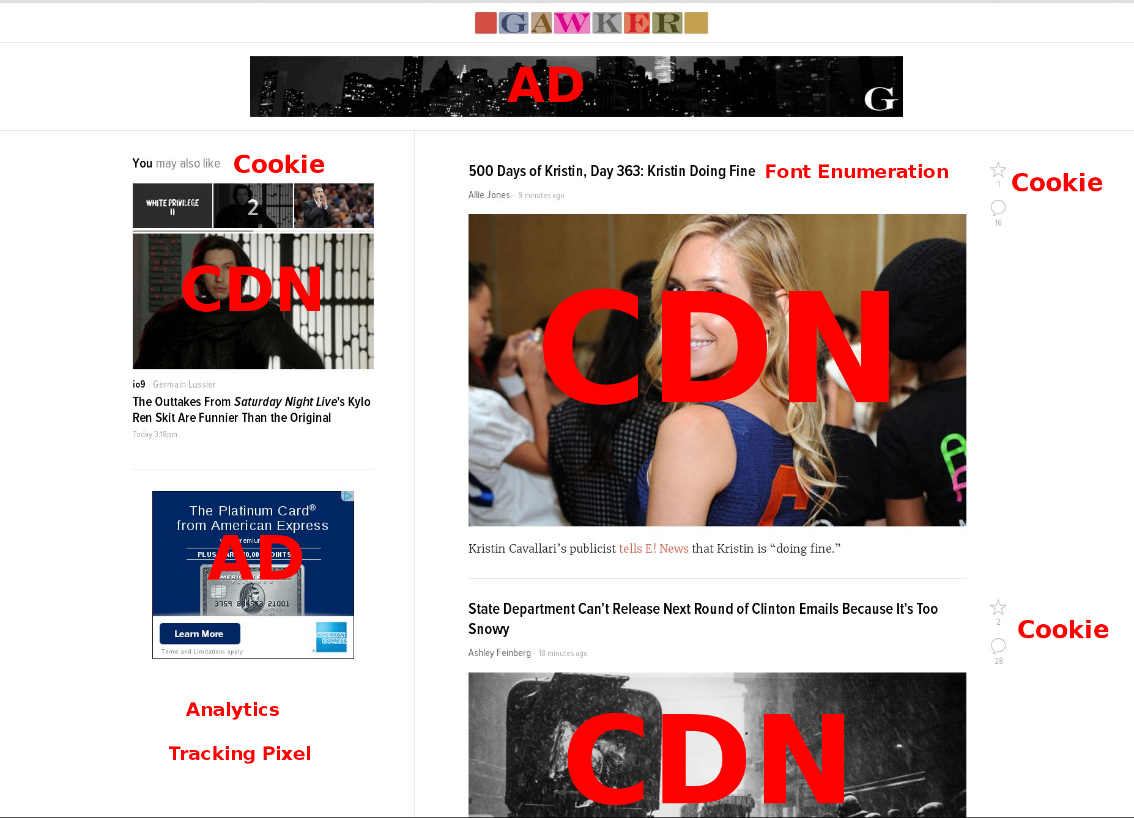

Slide 7
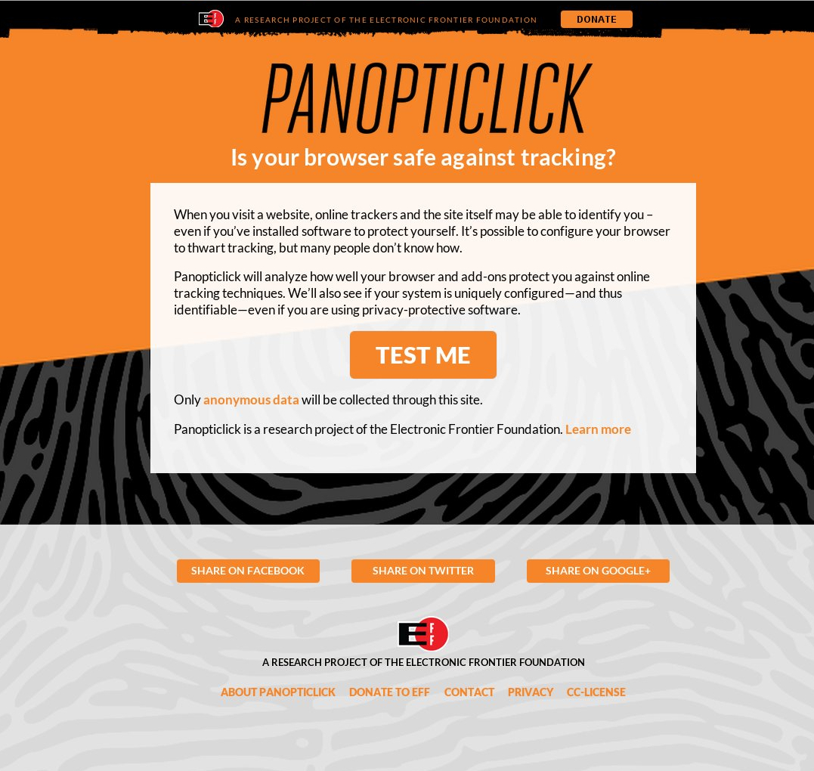

Slide 8
Who is tracking you online?

Slide 9





Some Key Players in the Industry

Slide 10
Third Party Trackers
Non-consensual
  You don't opt in to an agreement with them
Ubiquitous
Hard to avoid
Strong financial incentive

Slide 11
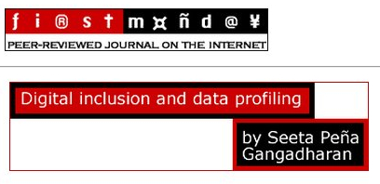
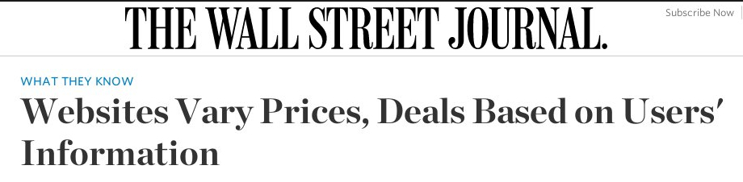
But I Like Targeted Ads!
You have no control over how your information is stored/used
Third parties have no obligation to anonymize or store temporarily
Data can be stolen or sold
Misuse of ad targeting

Slide 12
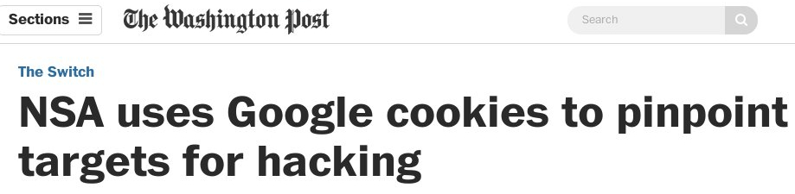
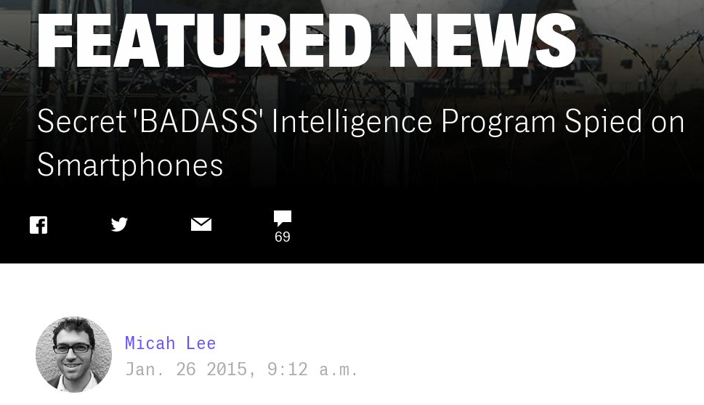
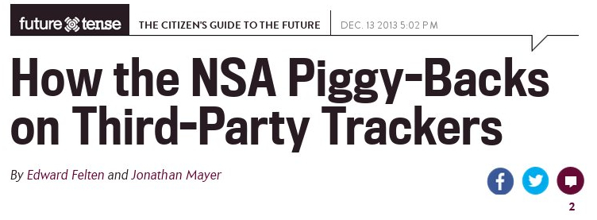
Third Party Tracking is Also Useful For Spies

Slide 13


Slide 14
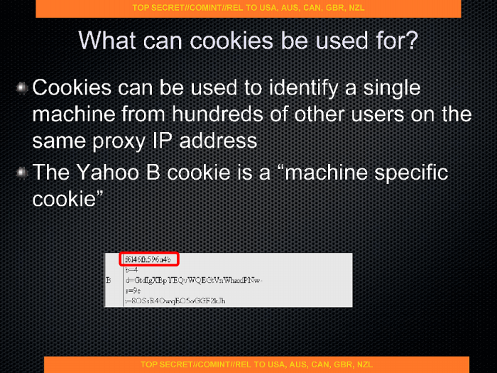

Slide 15
Why Should You Care About Privacy?
You May Want to Read Things That Are Controversial or Embarassing For Research or Just General Interest
Data Which May Be Embarassing When Put Together
  A search for health insurance quotes and then looking up a disease on Web MD for example
Chilling Effects

Slide 16
How Can Online Tracking be Stopped?

Slide 17
How About Incognito Browsing?
Only untrackable between sessions
Hard to retain first party info
Vulnerable to fingerprinting
  And some super cookies
Tor Browser
  Not a general purpose solution
  Hard for the layperson
  Tor network can't handle the load of all web users (yet!)

Slide 18
What About Ad Blockers?
By default only block ads, not necessarily trackers
Blacklist means they're always behind
Arms race problem
Not always trustworthy
  Ghostery sells information to advertisers
  Other ad blockers will get paid off to unblock ads

Slide 19

Policy Work — Do Not Track
standard
Opt in to DNT – advertisers will not track you
  Really they only don't tell you they are tracking you
Not as strong as it could be
Low level of adoption
Not a real privacy preserving option

Slide 20

Digital Advertiser Alliance
Advertisers have proposed to self regulate
DAA members offer an 'opt out'
  Only required to not show target ads
  No requirements on what data they can and can not collect/store
Not legally binding
Still only limited adoption

Slide 21

A Combination of Tech and Policy

Slide 22
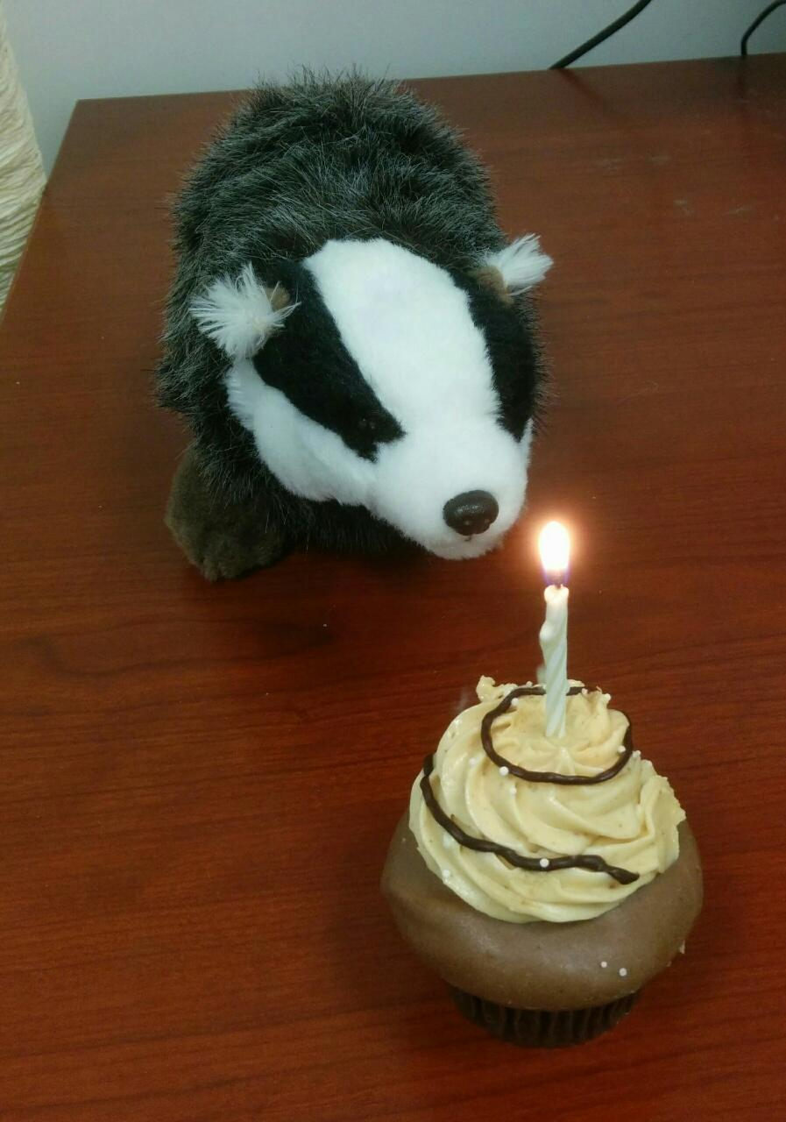
Privacy Badger in it's natural habitat

Slide 23
Privacy Badger
Browser Plugin – Chrome/Firefox
Open Source - GPLv3
Focuses on completely blocking trackers
Tries to solve the arms race problem
  Uses an algorithm instead of a blacklist
  Can cause false positives and false negatives
  Allows advertisers a way out

Slide 24
How Does Privacy Badger Work?
Send a DNT=1 header
Watch for requests to third party domains
If a third party domain sets a high entropy cookie*, add it to a list of potential trackers
If the tracker is seen on multiple sites – block it
  Or anonymize your browser but still load the content

Slide 25
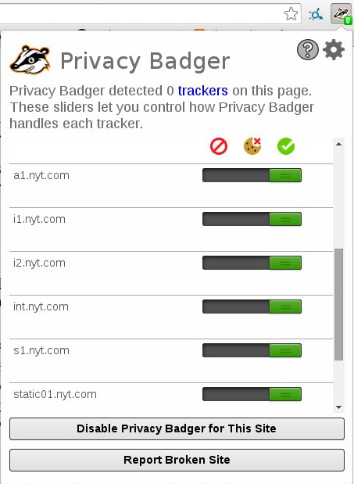
Privacy Badger on NYT.com

Slide 26
How Does Privacy Badger Work?
Occasionally a tracker can't be blocked without creating significant problems for the user
  Youtube, Google Maps, AWS, Paypal, etc.
For these we block cookies
  HTTP and Javascript
  HTML5 Supercookies
  Canvas fingerprinting

Slide 27
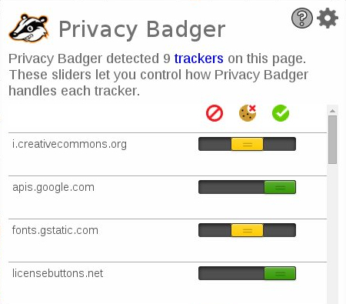
Privacy Badger on BoingBoing.net

Slide 28
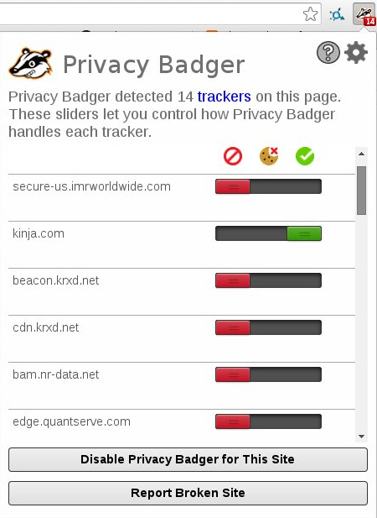
Privacy badger on Gawker.com

Slide 29
How Does Privacy Badger Work?
Users can see and adjust what is blocked, greylisted and allowed
Can disable privacy badger entirely for certain sites if they wish.
Can opt back in to third parties for certain uses (e.g. Disqus, Youtube comments)

Slide 30
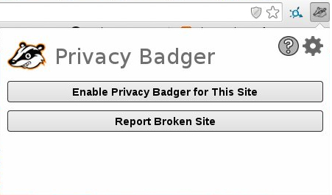
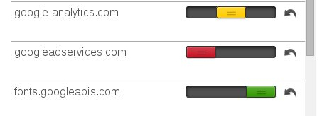
User Choice!

Slide 31
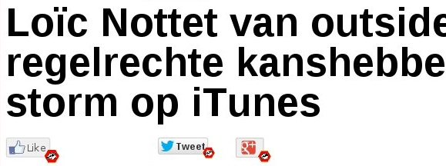
How Does Privacy Badger Work?
Social Widgets
  Privacy Badger replaces them with locally sourced versions
  Gives the option to turn them back on

Slide 32
But what about third party sites that legitimately do not wish to track users?

Slide 33
The Policy Side — A New DNT
We just released DNT 1.0!
  https://www.eff.org/dnt-policy
Sites host it on a .well-known domain
States that users sending DNT will not be tracked
Blocking sites that don't respect DNT creates an incentive to respect DNT

Slide 34
The Policy Side — A New DNT
User identifiers will be discarded
Logs will not be kept longer than necessary
Data can be kept for debugging or security
Data won't be sold to sites that don't respect this DNT policy
Sites adopting it get whitelisted by Privacy Badger
  But won't override user settings

Slide 35
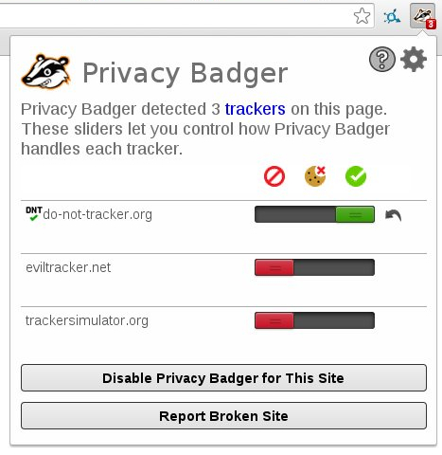

Slide 36
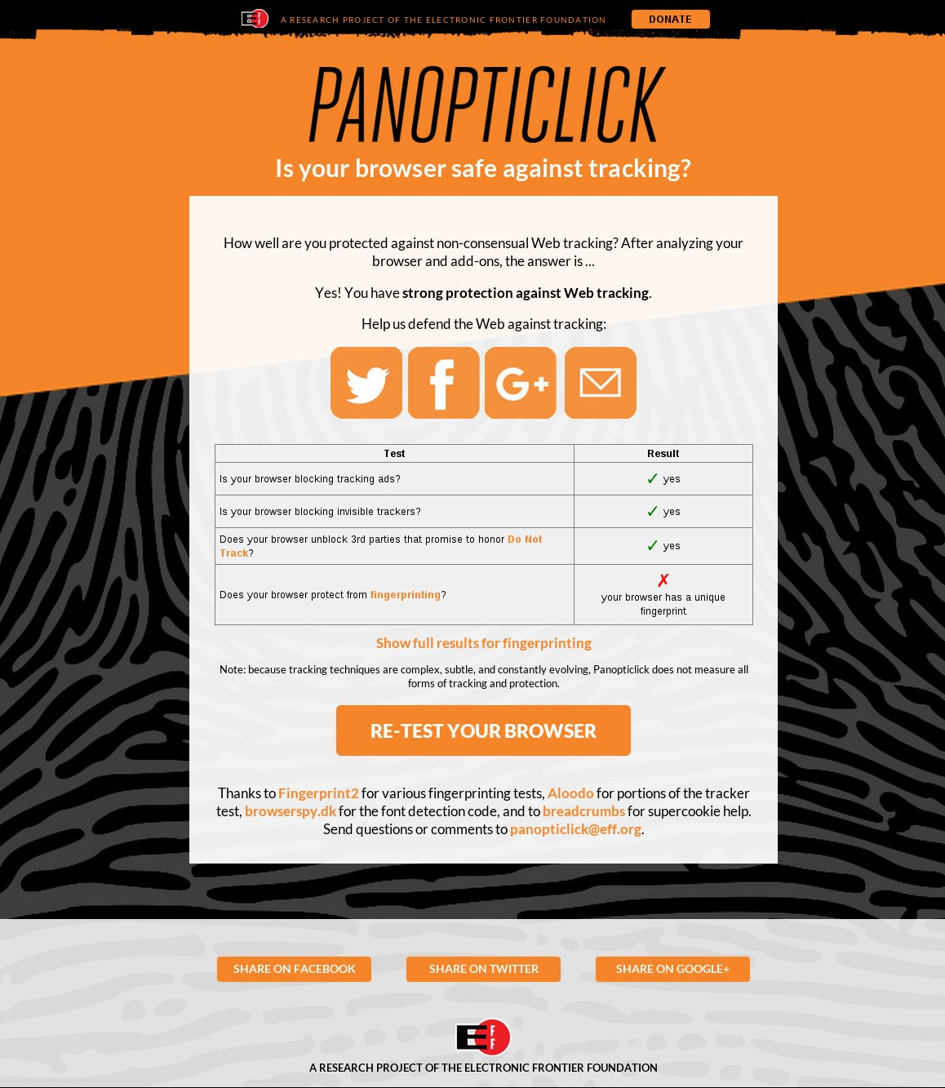

Slide 37
The Policy Side — A New DNT
Drafted with Disconnect, adopted by:
  Mixpanel
  Medium
  AdBlock
  Adzerk
  Healthcare.gov
And more to come!

Slide 38
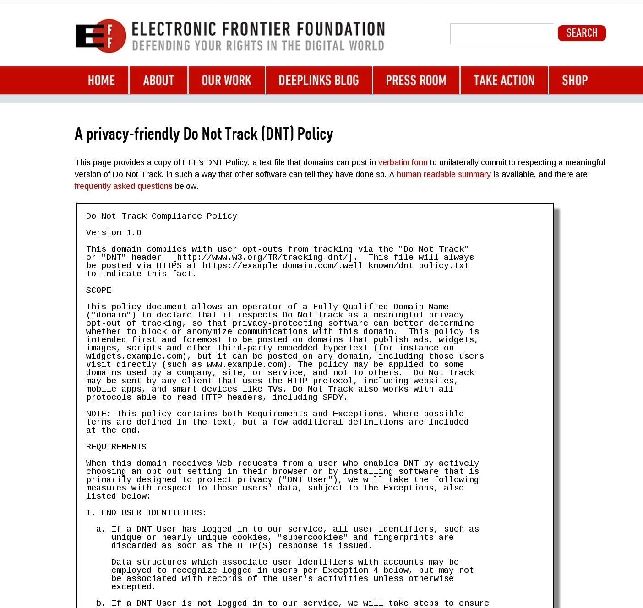

Slide 39

What Are You Waiting For?
Get Privacy Badger!
EFF.org/pb

Slide 40
How You Can Help
Use Privacy Badger
  Report broken sites from inside Privacy Badger
Submit a bug report / pull request
  https://github.com/EFForg
Respect users who send DNT header
Donate to EFF!

Slide 41
Still To Come...
Better tracker detection algorithms
Localization / UI
Extension enumeration
Third party integration
Mobile/Safari versions
More DNT adoption from third parties

Slide 42
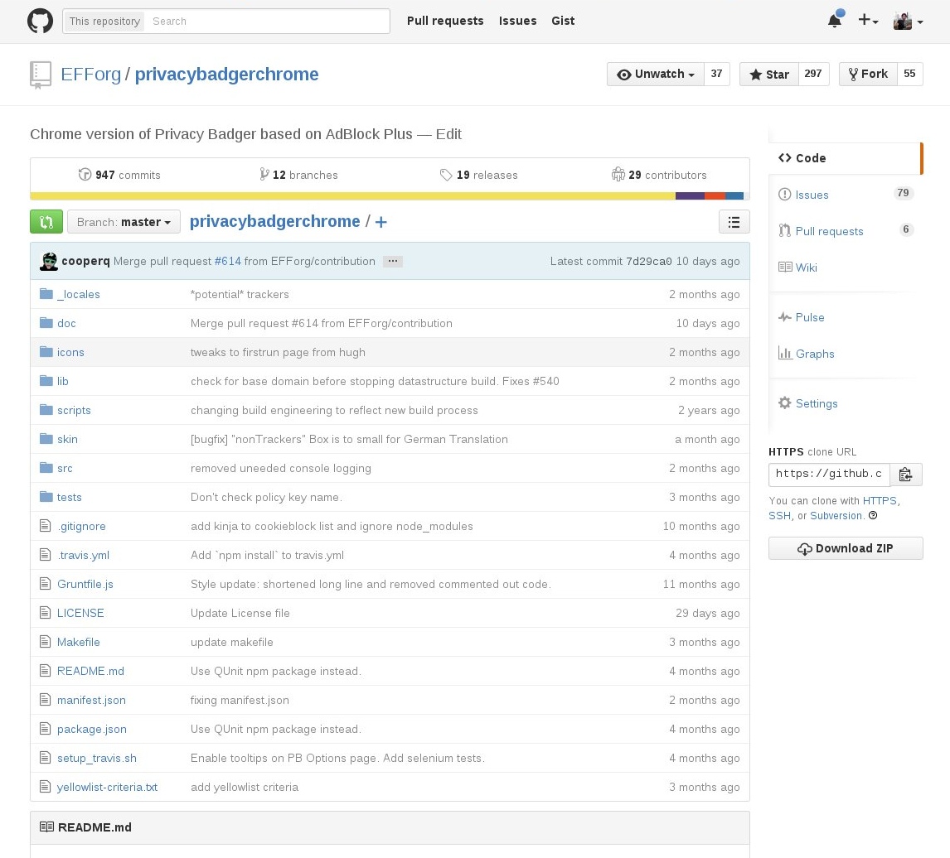
How Can I Contribute?
Github.com/EFForg/privacybadgerchrome

Slide 43
How Can I Contribute?
Repos for both Chrome & Firefox
Issues are well tagged
  'Good Volunteer Task', 'High Priority', 'UI'
GPLv3!!!
Non-technical tasks as well
Half million users!

Slide 44
How Can I Contribute?
Javascript Code
Planned mobile ports
  IOS & Android, and Firefox for mobile
Uses chrome webrequest API
More fingerprinting techniques
Lots more tests to add :)

Slide 45
Get involved!
Email me at: Noah@EFF.org
https://github.com/EFForg/privacybadgerchrome
https://github.com/EFForg/privacybadgerfirefox

Slide 46
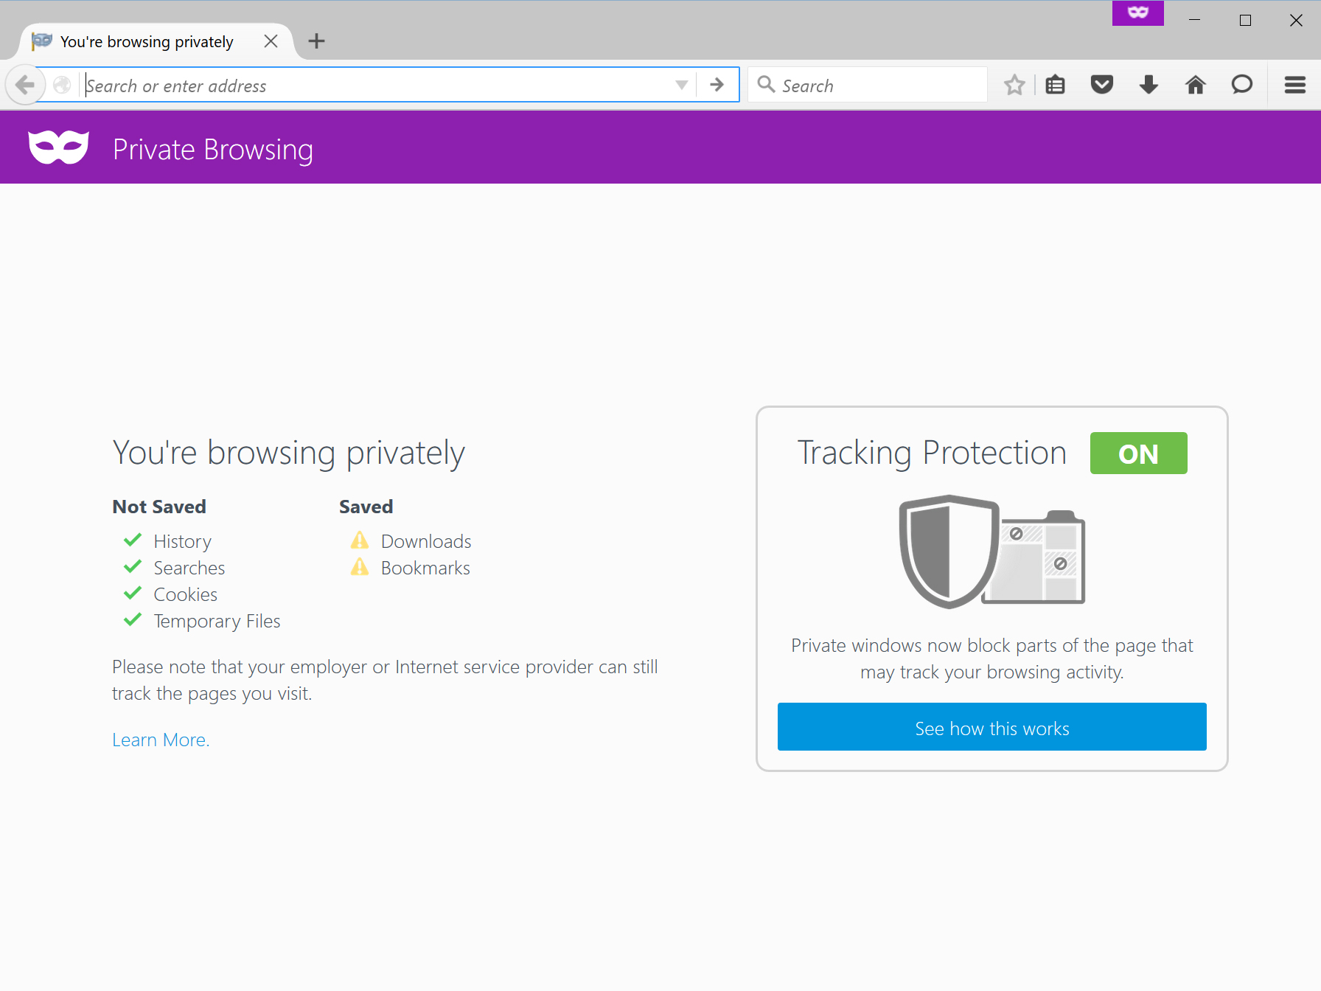
But that's not all!
https://support.mozilla.org/en-US/kb/tracking-protection-pbm

Slide 47
Thanks!
Questions?
noah@eff.org
Twitter: @swartzcr
https://eff.org/privacybadger
p.s. I have stickers
PGP: 9206 A6E0 F07C F141 663F 8B93 9C7A DED2 2966 0F56

