Slide 1
Speeding up
ps and top
Kirill Kolyshkin, Andrey Vagin
SCALE 14x, 23 Jan 2016
Pasadena, CA

Slide 2
Agenda
Intro {Virtuozzo, OpenVZ, CRIU}
Limitations of current /proc/PID interface
Similar problems solved before
Proposed solutions (yabad and good ones)
Performance results

Slide 3







Leading provider of secure, production-ready
containers, hypervisors, and virtualized storage
An industry pioneer, first containers in 2001
Powering some of world’s largest cloud networks
  over 5 million mission critical cloud workloads
700+ worldwide partners

Slide 4




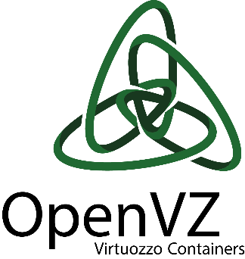







Founded in 1997,
“spun off” in Dec 2015
HQ in Seattle, offices in
London, Moscow, Munich
Over 170 employees, including
100+ engineers, 15 kernel hackers
Contributor/sponsor of key open source initiatives
“A rose by any other name…”
1997
2008
2015
2016
Notes:
“a rose by any other name” – you know your Shakespear, right?

Slide 5
$ whoami
Linux user since 1995
  Slackware on floppy disks, kernels 1.0.9 and 1.1.50
Developing VEs containers since 2002
  vzctl and vzpkg
Leading OpenVZ from 2005 till 2015
SCALE user speaker since SCALE4x (2004)
Twitter: @kolyshkin
Notes:
Kernel 1.0.9 did not have support for IDE CDROM, and it took me a week to compile the 1.1.50 kernel that had it (as each kernel compilation was an overnight job).
SCALE speaker in 2004. How many of you were at SCALE4x? What makes it more interesting is that time I came all the way from Moscow, Russia, and it was my first time in U.S.

Slide 6

OpenVZ
Full (system) containers for Linux
Developed since 1999,
open source since 2005
Live migration since 2007
~2000 Linux kernel patches
  enabling LXC, Docker, CoreOS…
  biggest contributor to containers
Now reborn as Virtuozzo 7, more open than ever
Notes:
OpenVZ, my beloved child

Slide 7

CRIU: Checkpoint / Restore In Userspace
About 3 y.o, ver 1.8 Dec 2015
Replaces OpenVZ in-kernel c/r
Saves and restores
sets of running processes
Integrated into Docker, LXC
Not just for live migration!
  save HPC job or game, update kernel or hardware,
  balance load, speed-up boot, reverse debug, inject faults

Slide 8
Ideas behind CRIU
We can't merge kernel c/r upstream, so...
hack it! Redo the whole thing in userspace
Use existing interfaces where available
  /proc, ptrace, netlink, parasite code injection
Amend the kernel where necessary
  only ~170 kernel patches
  kernel v3.11+ is sufficient
  (if CONFIG_CHECKPOINT_RESTORE is set)
Notes:
We failed to merge in-kernel c/r because that kernel code is very invasive, touching every kernel subsystem, no kernel maintainer wanted that in their code

Slide 9
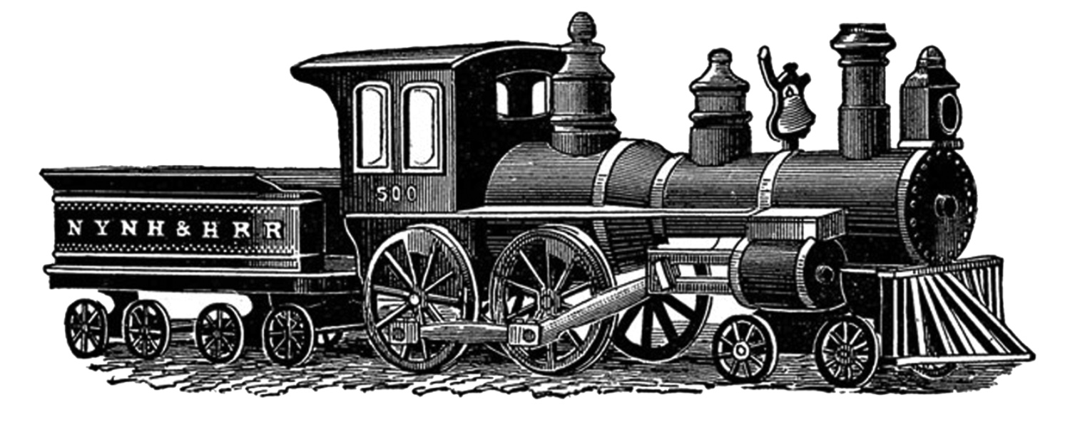
Current interface: /proc/PID/*
$ ls /proc/self/
attr cwd loginuid numa_maps schedstat task
autogroup environ map_files oom_adj sessionid timers
auxv exe maps oom_score setgroups uid_map
cgroup fd mem oom_score_adj smaps wchan
clear_refs fdinfo mountinfo pagemap stack
cmdline gid_map mounts personality stat
comm io mountstats projid_map statm
coredump_filter latency net root status
cpuset limits ns sched syscall
Notes:
More than 40 files and 10 directories for each process.

Slide 10
Limitations of /proc/PID interface
Requires at least three syscalls per each process
  open(), read(), close()
Variety of formats, mostly text based
Not enough information (/proc/PID/fd/*)
Some formats are non-extendable
  /proc/PID/maps where the last column is optional
Sometimes slow due to extra attributes
  /proc/PID/smaps vs /proc/PID/maps
Notes:
Variety of formats – no one wants to spend their life writing parsers for all these formats
An example of non-extendable format is /proc/*/maps – last field is file name, and it is ... optional!

Slide 11
/proc/PID/smaps
$ time cat /proc/*/maps > /dev/null real 0m0.061s user 0m0.002s sys 0m0.059s
$ time cat /proc/*/smaps > /dev/null real 0m0.253s user 0m0.004s sys 0m0.247s
7f1cb0afc000-7f1cb0afd000 rw-p 00021000 08:03 656516 /usr/lib64/ld-2.21.so
Size: 4 kB
Rss: 4 kB
Pss: 4 kB
Shared_Clean: 0 kB
Shared_Dirty: 0 kB
Private_Clean: 0 kB
Private_Dirty: 4 kB
Referenced: 4 kB
Anonymous: 4 kB
AnonHugePages: 0 kB
Swap: 0 kB
KernelPageSize: 4 kB
MMUPageSize: 4 kB
Locked: 0 kB
VmFlags: rd wr mr mw me dw ac sd

Slide 12
Similar problem: info about sockets
/proc
  /proc/net/netlink
  /proc/net/unix
  /proc/net/tcp
  /proc/net/packet
Problems: not enough info, complex format, all-or-nothing
Solution: use netlink, generalize tcp_diag as sock_diag
  the extendable binary format
  allows to specify a group of attributes and sockets

Slide 13
[Bad] solution 1: introduce task_diag
Not obvious where to get pid and user namespaces
Impossible to restrict netlink sockets
  Credentials are saved when a socket is created
  Process can drop privileges, but netlink doesn't care
  The same socket can be used to get process attributes and to set ip addresses
Notes:
Another bad example of using netlink: taskstats

Slide 14

A new interface for processes
/proc/task_diag is a transaction file
  write request → read response
Netlink message format:
binary and extendable
Get information about a specified set of processes
Optimal grouping of attributes
  Any attribute in a group can't affect a response time
Information about one process can be split
into a few messages (16KB message size)
Work in progress, anything may change!

Slide 15
Netlink message and attributes
nlmsg_len
nlmsg_type | nlmsg_flags
nlmsg_seq
nlmsg_id
Simple and flexible
message-based protocol
Easy to add a new group
Easy to add new attribute
nlattr_len | nlattr_type
payload
nlattr_len | nlattr_type
payload
Notes:
The structure is pretty generic, this is what makes this format extendable.

Slide 16
Ways to specify sets of processes
TASK_DIAG_DUMP_ALL
  Dump all processes
TASK_DIAG_DUMP_ALL_THREAD
  Dump all threads
TASK_DIAG_DUMP_CHILDREN
  Dump children of a specified task
TASK_DIAG_DUMP_THREAD
  Dump threads of a specified task
TASK_DIAG_DUMP_ONE
  Dump one task

Slide 17
Groups of attributes
TASK_DIAG_BASE
  PID, PGID, SID, TID, comm
TASK_DIAG_CRED
  UID, GID, groups, capabilities
TASK_DIAG_STAT
  per-task and per-process statistics (same as taskstats, not avail in /proc)
TASK_DIAG_VMA
  mapped memory regions and their access permissions (same as maps)
TASK_DIAG_VMA_STAT
  memory consumption for each mapping (same as smaps)

Slide 18
Performance: ps
Get pid, tid, pgid and comm for 50000 processes
$ time ./task_proc_all a
real 0m0.279s
user 0m0.013s
sys 0m0.255s
$ time ./task_diag_all a
real 0m0.051s
user 0m0.001s
sys 0m0.049s
A few times faster ;)

Slide 19
Performance: using perf tool
> Using the fork test command:
> 10,000 processes; 10k proc with 5 threads = 50,000 tasks
> reading /proc: 11.3 sec
> task_diag: 2.2 sec
>
> @7,440 tasks, reading /proc is at 0.77 sec and task_diag at 0.096
>
> 128 instances of sepcjbb, 80,000+ tasks:
> reading /proc: 32.1 sec
> task_diag: 3.9 sec
>
> So overall much snappier startup times.
// David Ahern

Slide 20
Thank you!
http://virtuozzo.com/
http://openvz.org/
http://criu.org/
@kolyshkin
@vagin_andrey
https://github.com/avagin/linux-task-diag/

