Slide 1
What You Should Know About Container Security
SCALEx15
March 2, 2017
Anthony Chow
Twitter: @vCloudernBeer
Blog: http://cloudn1n3.blogspot.com/

Slide 2
Advantages of Containers
Small footprint
Self contained
Fast provisioning time
Docker: Build – Ship - Run
Useful tool for DevOps
Effective solution for Microservices

Slide 3
Disadvantages of Container
Not so easy with persistent storage
Less isolated than a Virtual Machine
Share the same OS Kernel
Networking solutions to provide isolation

Slide 4
Types of Threads to Containers
Escape
Cross-container attacks
Application vulnerabilities
Denial of Service attack on the host.

Slide 5
Different ways of looking into Container Security
Host based
Container based
3rd Party Security Offerings
Miscellaneous

Slide 6
Host based container security
Namespace
Control group (cgroup)
Root capabilities
Linux Security Modules

Slide 7
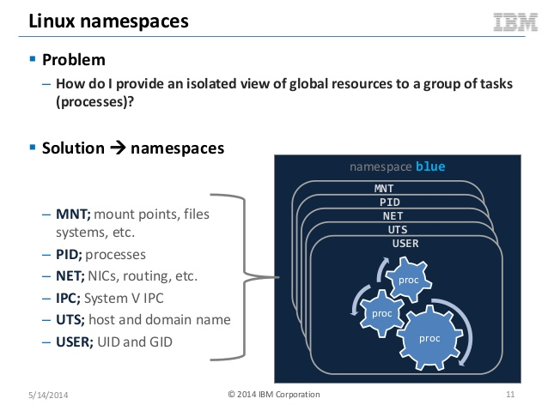
Image source: https://image.slidesharecdn.com/linuxcontainersnextgenvirtualizationforcloudatlsummitar4-3-copy-140514133120-phpapp02/95/linux-containers-next-gen-virtualization-for-cloud-atl-summit-ar4-3-copy-11-638.jpg?cb=1400074471

Slide 8
User Namespace
Not turned on by default in Docker
Docker daemon needs to be started with “–userns-remap=default”

Slide 9
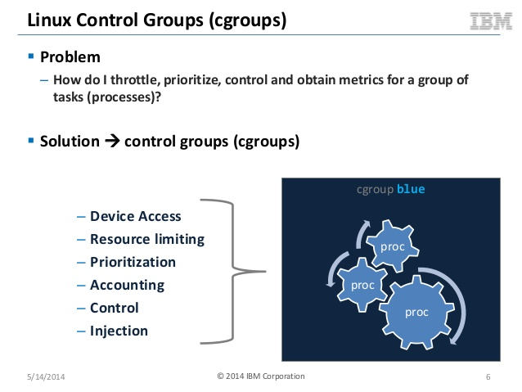
Image source: https://image.slidesharecdn.com/linuxcontainersnextgenvirtualizationforcloudatlsummitar4-3-copy-140514133120-phpapp02/95/linux-containers-next-gen-virtualization-for-cloud-atl-summit-ar4-3-copy-6-638.jpg?cb=1400074471

Slide 10
Root Capabilities
Fine grain control over ‘root’ privileges
/usr/include/linux/capability.h
sudo /sbin/capsh –print
https://linux.die.net/man/7/capabilities
docker run -ti --name ubuntu1 --cap-drop=net_raw ubuntu bash
Redhat uses SystemTap to find capabilities of a container (https://developers.redhat.com/blog/2017/02/16/find-what-capabilities-an-application-requires-to-successful-run-in-a-container/)
https://docs.docker.com/engine/security/seccomp/

Slide 11
Access Control Types
Discretionary Access Control
the owner of the object specifies which subjects can access the object
Mandatory Access Control
the system (and not the users) specifies which subjects can access specific data objects
Role Based Access Control
Access is based on permission associated with a role and user is assigned with different roles.
Rule Based Access Control
Access is allowed or denied to resource objects based on a set of rules defined by a system administrator

Slide 12
Linux Security Module (LSM)
https://www.cyberciti.biz/tips/selinux-vs-apparmor-vs-grsecurity.html
SELinux
3 modes: Enforcing, Permissive and disabled
http://www.projectatomic.io/docs/docker-and-selinux/
https://opensource.com/business/14/9/security-for-docker
Works with labels
AppArmor
  2 modes: Enforcement and Complain
  https://docs.docker.com/engine/security/apparmor/
  Works with file path.

Slide 13
Container based security
Digital Digest for container image integrity
  Docker Content Trust
  CoreOS – dm_verify
Container Scanning
  IBM – Vulnerability Advisor
  RedHat – Atomic host
  CoreOS – Clair and Quary
  Docker – Docker cloud and Docker Hub

Slide 14
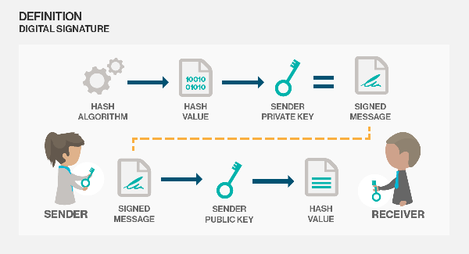
Image source: http://cdn.ttgtmedia.com/rms/onlineImages/ss_digitalsignature_2014_v01_desktop.png

Slide 15
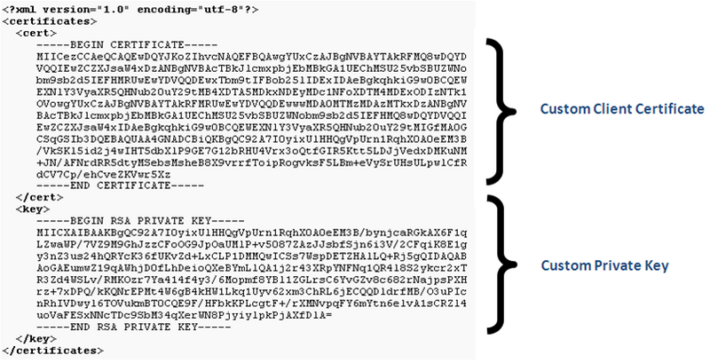
Image source: http://wiki.snom.com/wiki/images/thumb/0/05/M9_custom_cert.PNG/800px-M9_custom_cert.PNG

Slide 16
3rd Party Security Offerings
Aqua - https://www.aquasec.com/
Anchore - https://github.com/anchore/anchore
TwistLock - https://www.twistlock.com/
Tenable - http://www.tenable.com/
Blackduck -https://www.blackducksoftware.com/

Slide 17
Miscellaneous
Open Container Initiative (OCI)
Hardware Assisted
Docker 1.13 Secret Management
Linux Container with ansible-container

Slide 18
Useful blog post on container security
https://opensource.com/business/14/7/docker-security-selinux
https://opensource.com/business/14/9/security-for-docker
https://coreos.com/blog/verifying-os-at-runtime.html
https://docs.docker.com/engine/security/security/

Slide 19
Thanks for coming and enjoy the rest of SCALEx15

