Slide 1

Mentoring 101
How to be a great community mentor
Brian Proffitt
Principal Community Analyst
@TheTechScribe
March 4, 2017

Slide 2
Who Am I?

Slide 3

Brian, Explained
Dad
Husband
Linux and open source participant since 1999
Native of Indiana
Hoosier

Slide 4
Why Mentor?

Slide 5

Notes:
Onboarding is the first and most common reason.
Onboarding is made up of three key aspects:
Explaining what the project is
Giving access to the project’s results
Showing how to use and work with it
Mentoring is part of the third aspect. Many projects have their own special tricks and quirks. Mentoring incoming developers, even informally, is a good way to improve onboarding efficiency.

Slide 6




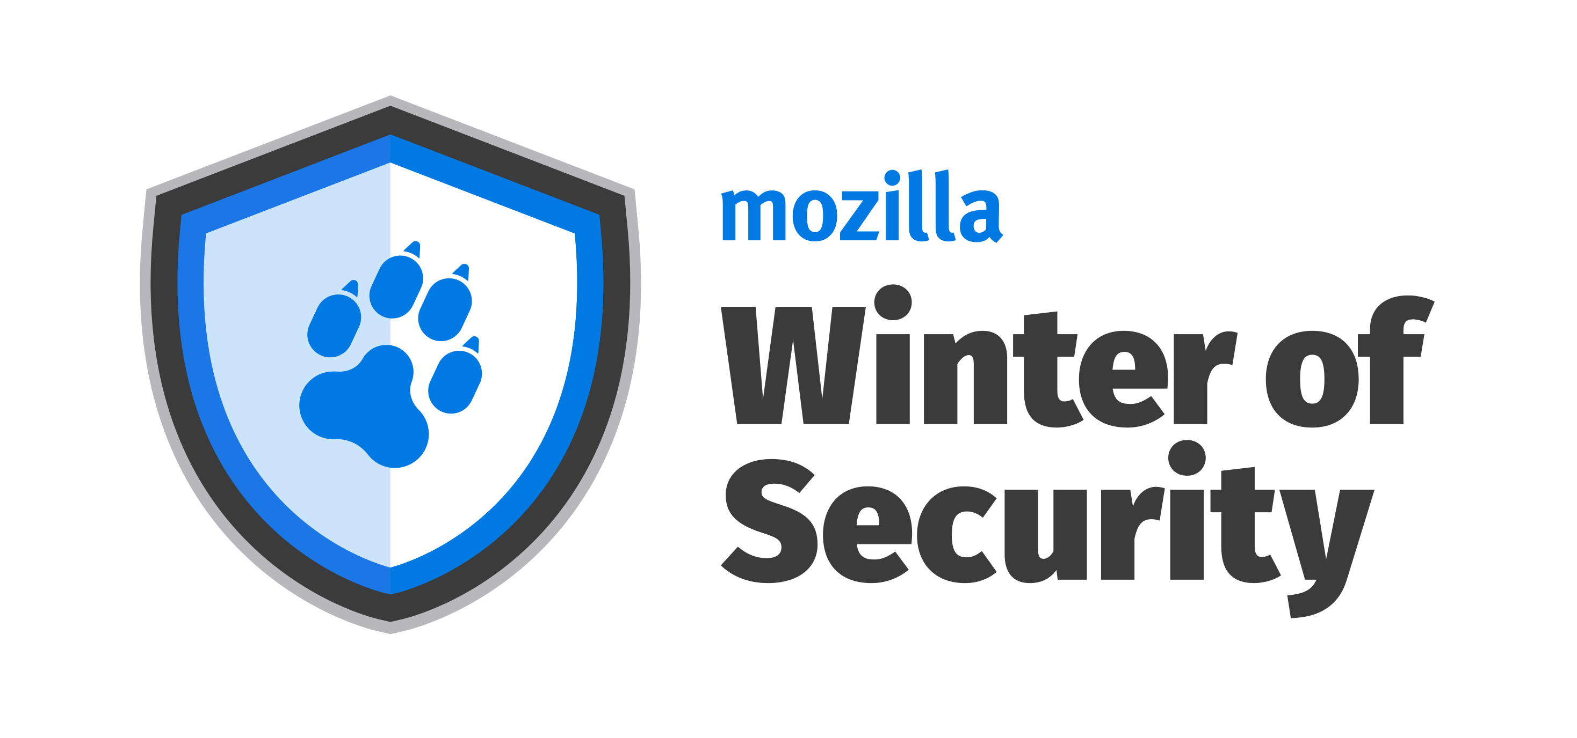



Notes:
Season of KDE
Mozilla Winter of Security
Outreachy
Rails Girls SOC
TOR Summer of Privacy
Google SOC
OpenDaylight summer internship program
The X.Org Endless Vacation of Code (EVoC)
Free Software Foundation Internship
Radare Summer of Code

Slide 7
Mentorship Is Definitely a Thing

Slide 8
You Just Need a Plan

Slide 9
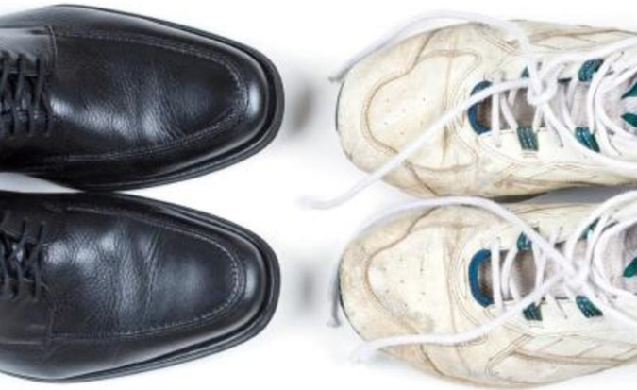
Formal vs. Informal
Programs will have their own rules and structure.
These will help guide you.

Slide 10

Sample Guidelines
Participation
Commitment
Flexibility
Notes:
Quality mentoring requires a substantial time commitment and the willingness and ability to take a leadership role.
There are specific skills that you can work on in order to be more effective; even experienced mentors can improve. Some self-assessment questions that can help you to evaluate your strengths and weaknesses in this role are:
Are you already part of the developer community?
Do you have a real interest in potential X projects?
Are you willing to dedicate significant time?
Mentoring a student requires a combination of passion, responsibility and patience. A good mentor is willing to engage with students throughout their learning process.
Be Prepared to Seek Help

Slide 11
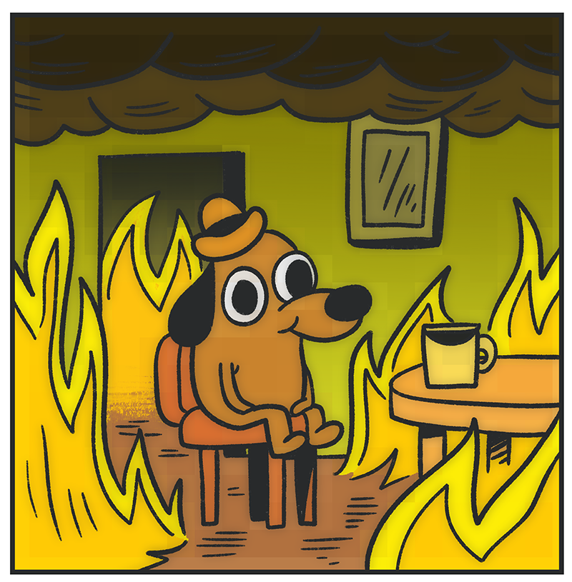
Undermentoring
Students will have problems.
And so will you.
Notes:
Problems from Under-Mentoring
The student's project is never properly defined. The project goals and deliverables are unclear, and the work schedule is not set. The consequences of this are serious and impact the project if left unchecked.
The mentor has little idea what the student is doing. The state of the project is unclear, and its progress is uncertain. Evaluation is impossible to do well.
The student produces code that isn't useful. The student starts off on 'the wrong path', failing to use existing functions or established project idioms. Rather than fixing problems as they arise they keep on adding more. The code is never integrated into the main codebase because it doesn't work well enough and would require more work to fix than it is worth.
The student gets stuck. The student seems to be engaged, and to be working hard, but no apparent progress is being made. Alternatively, the student's communications are infrequent and terse, and seem to always be on the same issue or milestone.
The student disappears, perhaps for days or weeks at a time. If the student is under-mentored, it may be difficult to determine when this period began, and thus to know when to panic. Insufficient information is available for evaluation; thus it becomes impossible to fairly evaluate the student.

Slide 12
So How Do We Avoid This?

Slide 13
With Proactive Mentoring

Slide 14

Determine Your Management Style
Authoritative
Democratic
Coaching

Slide 15
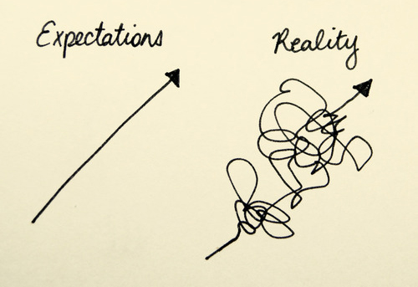
Set Expectations
Align goals
Define process
Avoid confusion
Notes:
After defining your management style, both you and your mentee will find it helpful to sit down and go over expectations -- especially if you're just getting to know each other.
For example, let's say an old classmate from your alma mater sends you a cold email asking what it's like to work at your company. You might be wondering if they asked you that because they want to work for your company, or whether they're just curious about what a company in your industry is like. Understanding exactly where they're coming from is going to help drive your discussion in the direction that's helpful for both of you. If your company isn't hiring or you aren't comfortable helping them get a job, for instance, then you'll want to set those expectations early.

Slide 16

Take An Interest in the Mentee
Active Listening
Relationship Building
Learn Their Style
Notes:
A mentor/mentee relationship is a very personal one. You can give mediocre advice without really knowing a person, but to stand out as an amazing mentor, you're really going to have to get to know your mentee on a personal level.
You probably have some of the more career-oriented questions down: what their working style is, their dream job, goals for their current job, and so on and so forth. But what about the stuff that makes them ... them? Getting to know your mentee on a deeper level will help you build a strong relationship, and it'll also help you understand who they are as a person, their likes and dislikes, how they interact with others, and so on.
So if your mentee tells you they had a great weekend, don't just move on with the program. Ask them what they did, whom they did it with, or what their relationship is like with those people.
One great way to get to know someone? Become an active listener. This is easier said than done: It means making a conscious effort to really, truly pay attention to what your mentee is saying, instead of thinking about what you're going to say next. You might worry that you need to come up with something helpful right away, when in fact, the best thing you can do for your mentee is to listen closely to what they're saying, ask open questions to dig deeper, and act as a sounding board.

Slide 17

Wait Before Giving Advice
Listen First
Don’t Go All “When I was...”
Ask Questions
Notes:
When you're mentoring someone, you might feel pressured to give them advice straight away. But not all feedback is helpful feedback, and giving unhelpful -- or unwelcome -- feedback can be detrimental to your relationship. An amazing mentor knows how to determine whether or not a situation lends itself to off-the-cuff feedback or really thoughtful feedback.
Corliss calls this "hitting the pause button."
"A good mentor knows when to hit 'pause' during a conversation," she told me. "Once in a while, a conversation might catch us off guard. For example, maybe someone raises an HR issue or a serious problem with an employee. Maybe someone says something that makes you mad or upset. If you don't have the right information, experience or emotional state to react to a scenario properly, hit 'pause.' That will give you a chance to get more information, talk to your resources, and come back with a clear and valuable response."

Slide 18

Don’t Assume Anything
Avoid Stereotypes
Learn Details of Situation
Emphasize Communication
Notes:
It's easy to fall into stereotypes or not see a situation from another person's perspective. But great mentors recognize that it's their responsibility to break through common assumptions by asking questions and digging deeper. This is especially true if you're mentoring someone who's in the early stages of their career, or if the two of you are just getting to know each other and they aren't sure how transparent to be.
For example, let's say you're mentoring someone who's having trouble getting through to their manager. Instead of launching into a story about a time you had communication issues with a manager of yours, spend time asking questions that draw out the important details of their problem. Ask your mentee detailed questions about their relationship with their manager. Don't assume you understand their working style simply based off of the conversations you've had with them, as they probably work and communicate differently with their manager than they do with you.
Only once you've gotten an honest background on a problem can you share helpful, relevant feedback -- without making decisions for your mentee. That's up to them.

Slide 19
Because the One Thing to Remember...

Slide 20
They Aren’t You

Slide 21

Motivation Comes in Different Forms
Think Laterally
Understand the Mentee
Kung Fu Panda (TM) Dreamworks Animation LLC

Slide 22





THANK YOU
twiitter.com/RedHatOpen
facebook.com/redhatopen
community.redhat.com

