Slide 1
What the Heck is FreeCAD and why do I care?
Notes:
Welcome to this presentation on What the Heck is FreeCAD and Why do I care?

Slide 2
Who the Heck am I?
Notes:
First up, who the heck am I? As we’ll see shortly that does turn out to be pertinent

Slide 3
Your Guide
Jon A. Cruz
  Learned AutoCAD *mumble* *mumble* years ago
  Multimedia dev/creator
    Cubicomp
    MacroMind 3D
    Stratavision3D
    3D Studio (pre Max)
    Lightwave 3D
    …
  If you recognize those…
    ...
Notes:
I originally started with CAD and 3D software many years ago, with a bit of the serious ‘old guy’ on the block: AutoCAD. Some software I learned while in college, and some while helping to found a multimedia startup back in the day.
More importantly I started with a very wide sample of different approaches to solving problems in the 3D realm.

Slide 4
Your Guide
Jon A. Cruz
  Learned AutoCAD *mumble* *mumble* years ago
  Multimedia dev/creator
    Cubicomp
    MacroMind 3D
    Stratavision3D
    3D Studio (pre Max)
    Lightwave 3D
    …
  If you recognize those…
    You’re old too
Notes:
And if you recognize some of this software, you might be old too

Slide 5
What the Heck is this?
Notes:
So, onto this presentation itself. What the heck is it?

Slide 6
What this Is Not
A tutorial
A scholarly analysis
Boring
  (hopefully)
Notes:
Well, let’s start briefly with what it is not.
First and foremost this is not a tutorial. So don’t worry if you don’t catch every step, or all the mentions. It’s not the details themselves that should matter
Also hopefully it won’t be boring.

Slide 7
What this Is
Fast
Subjective
Pointing out the direction to go
A challenge
  ...
Notes:
Now onto what this presentation is
It’s going to be a fast paced, fairly subjective (see? I mentioned my background would be pertinent) overview and introduction to FreeCAD
Instead of tutorial-level details this should give you an idea of the places and steps to go to in order to successfully start using FreeCAD yourself.
And also…

Slide 8
What this Is
Fast
Subjective
Pointing out the direction to go
A challenge
  For you to rise to meet
An inspiration
Notes:
A challenge. Not to say that FreeCAD is a challenging bit of software, even if it seems a little daunting at first.
Instead I hope that you will take this as a personal challenge in the fun sense of the word in order to see what you might be able to do once you get a little bit of hands-on with a new tool.
So hopefully you’ll come away from this being inspired to get going and get in there.

Slide 9
What About the Answer?
Notes:
Now the title of this presentation does ask a question, “What is the answer?” you might say.

Slide 10
What About the Answer?
We’ll get to it
Notes:
We’ll get to that... later

Slide 11
Overview
Notes:
Now that we’ve had a little chance to get an idea of what’s going to be happening, it seems good to start into an overview of the software itself.

Slide 12
Comparisons
Fusion360
OpenSCAD
Blender
Others
Notes:
One way we’ll do that is to run a few quick looks at other software that might come to mind when one starts to look at FreeCAD

Slide 13
FreeCAD vs. Fusion360
Fusion360 full featured
Good product, good company
Annual subscription
Cloud storage
...
  ...
  ...
...
Notes:
How about Fusion360? This actually used to be a huge player in the market, and one I almost started to pick up. It’s a good product from a fairly good company.
However it does take an annual subscription to use (much like some other commercial products in the creative realm).
It also uses cloud storage to keep its files, which leads into the next point

Slide 14
FreeCAD vs. Fusion360
Fusion360 full featured
Good product, good company
Annual subscription
Cloud storage
Free/Hobbyist version
  Major changes Fall 2020
  No longer a safe bet for non commercial users
Mac & Windows only
Notes:
There is (or was) a free/hobbyist version but that underwent major changes a few years back with locking down features, limiting the number of cloud storage files allowed, etc. So that makes it much less of an attractive choice for those not using it at work.
A less philosophical factor is that it is Mac and Windows only. If you’re a Linux user, that’s not so good.

Slide 15
FreeCAD vs. OpenSCAD
Main Approach
  OpenSCAD for coding 3D objects
  FreeCAD for drafting 3D objects
Both parametric
Different tools for different jobs
FreeCAD has OpenSCAD integration
FreeCAD has more dedicated “workbenches”
Notes:
Now how does FreeCAD compare to OpenSCAD?
The main thing is that OpenSCAD is for coding 3D objects and FreeCAD is for drafting them. They are both parametric and share some conceptual overlap, but these are different tools for different purposes.
On the other hand FreeCAD does have OpenSCAD integration.
Additionally FreeCAD has a lot of dedicated “workbenches” (more on that in a moment) that try to simplify and empower its use.

Slide 16
FreeCAD vs. Blender
Blender commercial level 3D animation
  Fair chance of getting jobs using Blender (finally)
FreeCAD for
  drafting/designing 3D objects
  CNC production
Blender for
  drawing, crafting and animating 3D objects and scenes
Notes:
How about FreeCAD compared to Blender? Well, nowadays at least people can actually get industry 3D animation jobs using Blender (finally).
FreeCAD, however, is more for drafting/designing 3D objects for CNC production or other such.
Blender is generally more of an “artists” tool better for crafting and animating 3D objects and scenes.

Slide 17
FreeCAD vs. these others
Several other common tools
  Tinkercad
  MeshMixer (outdated)
  Others
Ok For starting, but you’ll hit limitations sooner
Notes:
There are other solutions, but some are web-based, other Windows only, etc. and then with many of them you’ll hit the limitations they have sooner rather than later, so you might as well take a little time getting started with some good tools
(noticed I used the plural on “tools”)

Slide 18
Strengths & Weaknesses
Notes:
With the comparisons out of the way, lets now move on to look and some of the strengths and weaknesses of FreeCAD

Slide 19
Strengths
Features/Usages
  CAD
  Parametric
  Python
  FEM / Finite Element Analysis
  BIM
  Architectural
  Etc.
...
  ...
  ...
  ...
Notes:
As you can see, FreeCAD checks a lot of the buzzword boxes. It is a general CAD package that is Parametric.
Basically being parametric means that it will store the steps of operations done to create something along with explicit values that you can then go back and change, creating more options and freedom in modeling.
It also has heavy use of Python, so if you’re a fan of that language you are in luck.
Finally it covers many bases including finite element analysis, BIM, Architectural use, etc.

Slide 20
Strengths
Features/Usages
  CAD
  Parametric
  Python
  FEM / Finite Element Analysis
  BIM
  Architectural
  Etc.
Applications
  CNC milling
  Laser cutting
  3D Printing
Notes:
Some of the more practical and common uses are to create things for CNC milling, laser cutting or 3D printing.
It’s that last point that finally pushed me to get off the benches and actually start learning FreeCAD in earnest.

Slide 21
Strengths
OpenSource
  No cost. No subscription.
  Good development & community
Extensible
CNC paths workbench
Finite Element Analysis
Good Community
Good Support
Interacts with SVG
  Personal bias
Notes:
After checking those buzzwords off, some of the other good aspects of FreeCAD are that it is OpenSource, so it is affordable and has good development and user communities.
It is extensible, so your hands are not tied if something is missing.
The finite element analysis aspect is for a more advanced use case, but is often cited as one of its more attractive feature.
And it does a good job using SVG input files, so I have a personal bias in favor of that. (Inkscape and all, you know)

Slide 22
Weaknesses
Learning curve
Maybe not as powerful as Autocad
  Performance on more complex models
Too many choices
  Add extensions
    Code your own
  OpenSCAD workbench
Doesn’t do what you want
  ...
Notes:
Like many other capable software packages out there FreeCAD does have a bit of a learning curve, but it’s not too unreasonable.
Some cite that it is not a powerful as AutoCAD in the size and complexity of models it can handle, but that’s usually not a concern for casual users.
On the other hand there are so many things you can do with FreeCAD that number of choices can be overwhelming at first. Oh, and the choices include that OpenSCAD workbench if you want to go that route
Then finally just might not do what you want...

Slide 23
Weaknesses
Learning curve
Maybe not as powerful as Autocad
  Performance on more complex models
Too many choices
  Add extensions
    Code your own
  OpenSCAD workbench
Doesn’t do what you want
  Yet
Notes:
Yet. Wait for another release and you’re going to get new things to use and new toys to play with. Get involved with the community and you can even get help with having your specific needs met. Remember, you don’t get that with most commercial software.
(threads just being added in 0.20.2 is just one recent example)

Slide 24
Getting FreeCAD
Notes:
So, once you’ve decided that you might want to check out FreeCAD, how do you do that?

Slide 25
Getting FreeCAD
Windows
  Download
Mac
  Download
Linux
  In your distro
    TOO OLD
  Download
Notes:
For most major platforms you can just download the latest.
Windows, Mac, and Linux are all well supported.

Slide 26
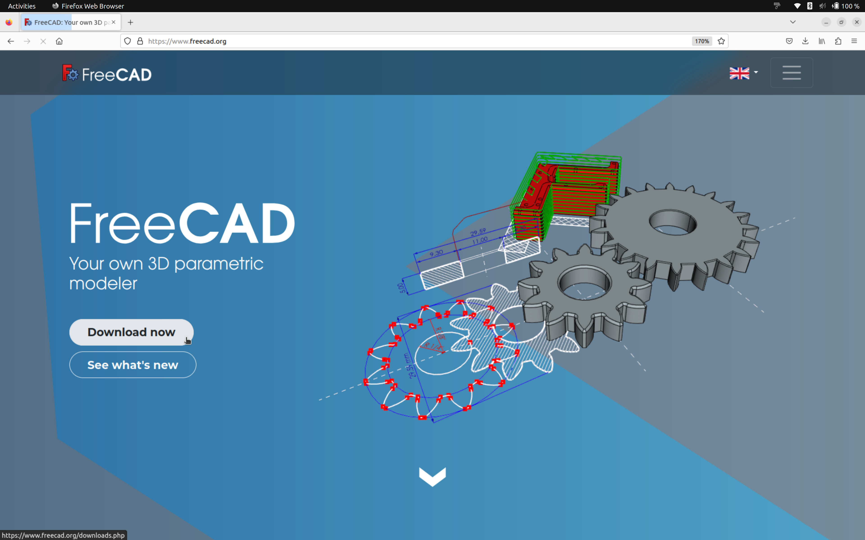
Getting FreeCAD
Notes:
So just head on over to the FreeCAD website and you should see a download button on the front page.

Slide 27
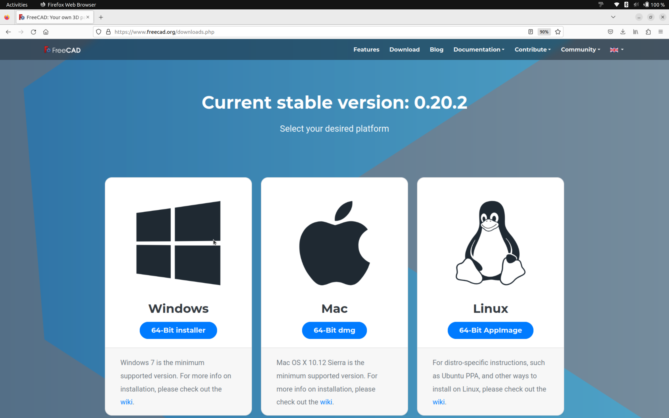
Getting FreeCAD
Notes:
That then leads you to a simple page to pick and choose which version or versions you need.

Slide 28
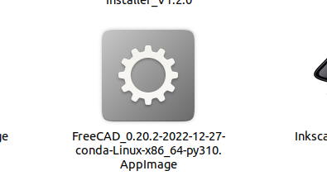
Linux Download
Download the AppImage
  You probably want this
Build the source
  Trunk is fairly stable
  Just like Inkscape
    (shameless plug)
Notes:
For Linux users, you might have some version of FreeCAD already in your distro’s repository. But that is probably not the latest version so go ahead and download the AppImage.
You could also download the source and build it yourself. Just like with Inkscape, the development team works hard to keep the latest tip of the dev branch to be stable and working so don’t be afraid to go that route if you prefer.

Slide 29
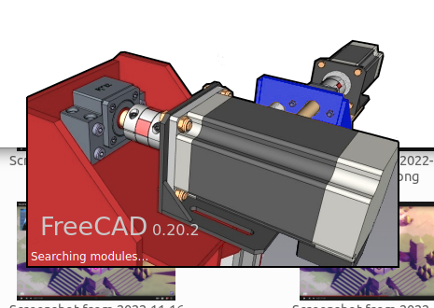
Interface
Notes:
And finally, onto FreeCAD itself

Slide 30
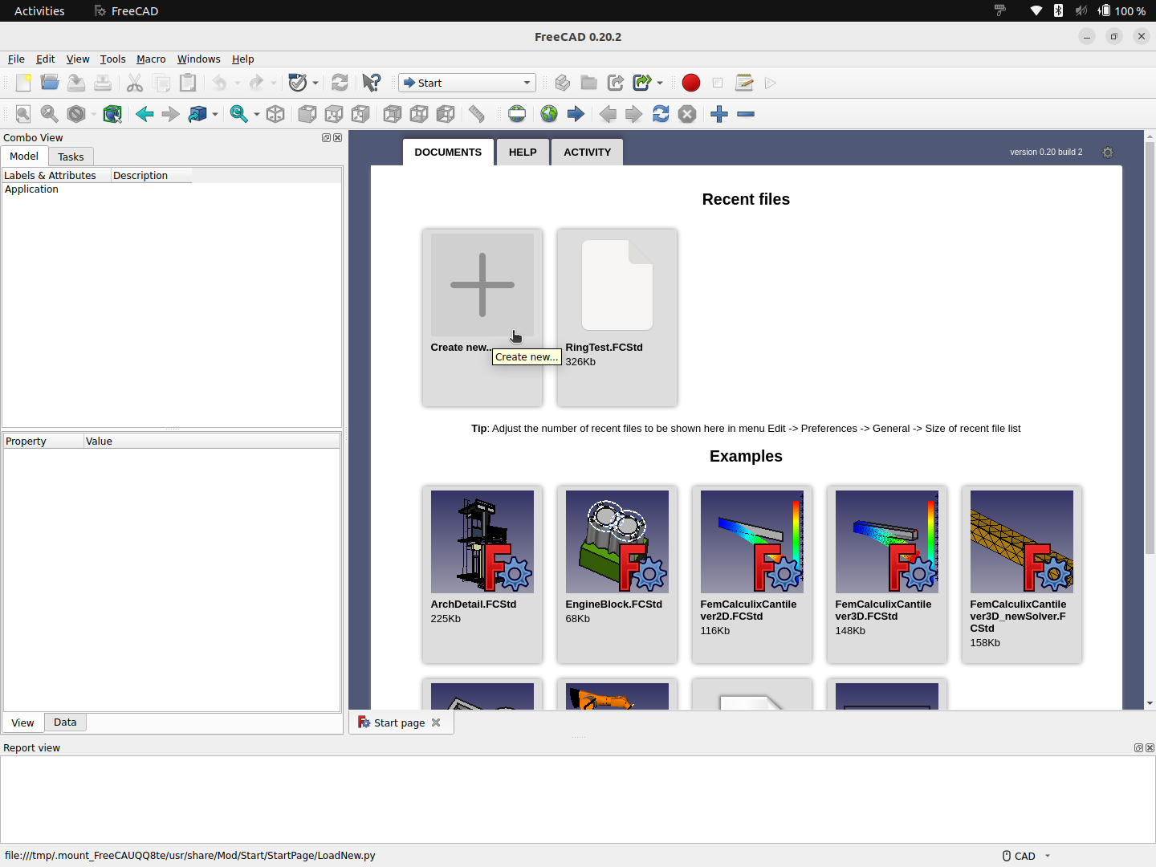
Parts of the Interface
Notes:
Just a few quick tips on what to look at in the interface. It is one that follows most general conventions so no big surprises there

Slide 31
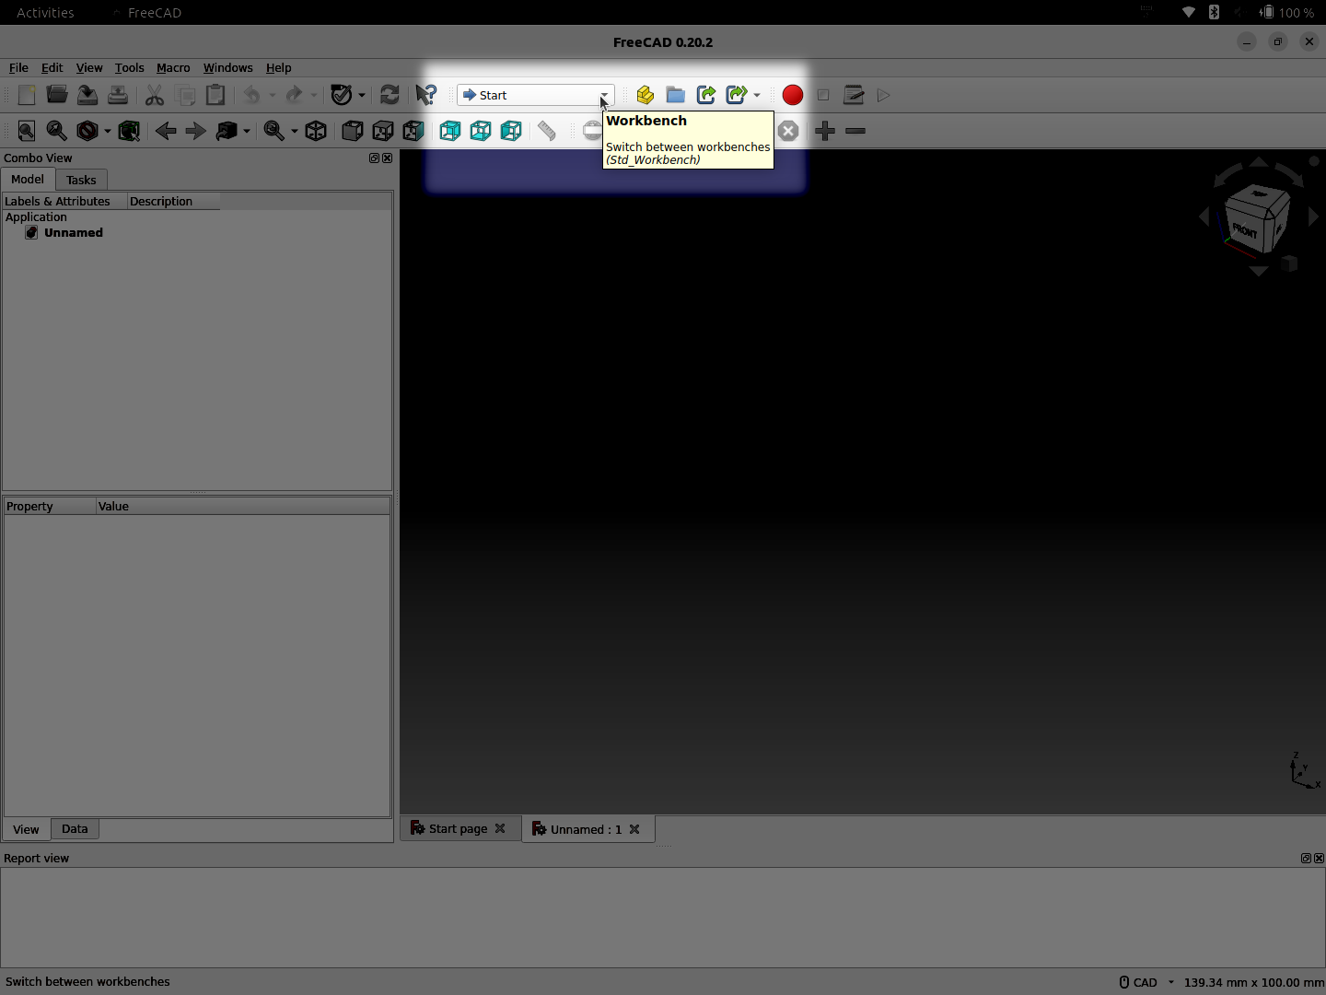
Workbench Toolbar
Notes:
The key first step is to look at this toolbar with just a single widget. The Workbench selector will let you change the interface to match your task at hand via…
Surprise, surprise: Workbenches.

Slide 32
“Workbench”
Collection of tools to focus on a given task
  Toolbars
  Menu items
  Etc.
Can contain some overlap
If you’re not seeing the UI you expect, you might need to switch to another workbench
Notes:
FreeCAD uses the “workbench” concept to organize its tools. Much like a physical workshop might have a bench with all the tools for working with a lathe, a different one for working with a drill press, etc.
There can be some overlap of menu items and toolbars between workbenches, but getting used to switching is a key to a good start.
Also, if you’re looking at some tutorials or screenshots and things don’t seem to match up as far as the UI goes, check which workbench is currently selected.

Slide 33
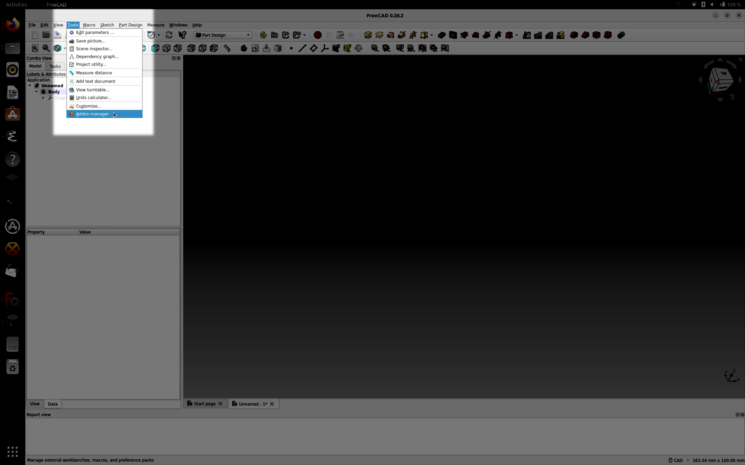
Addons
Notes:
And part of the extensibility is the use of Addons.

Slide 34
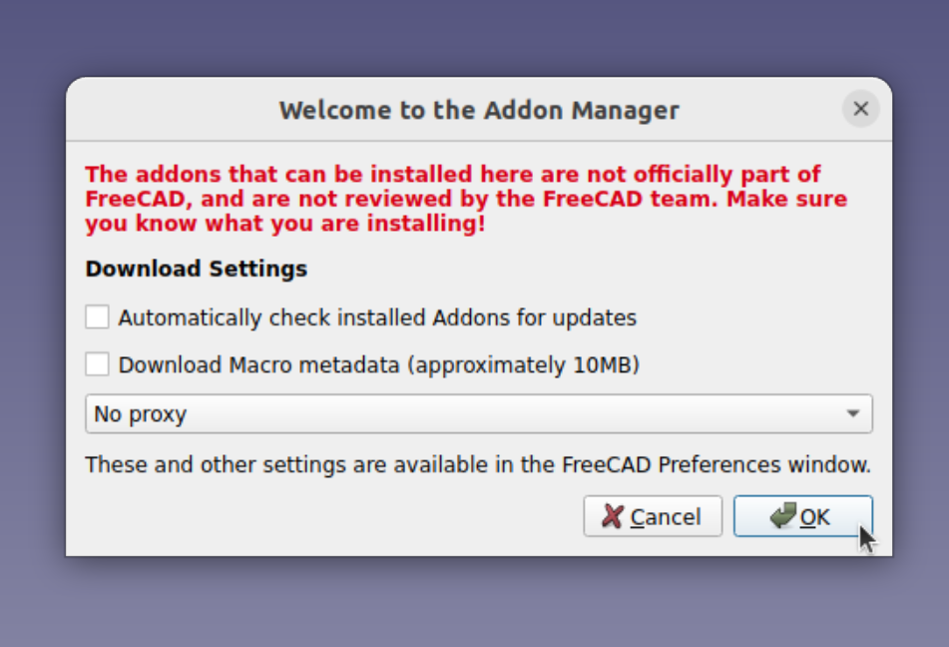
Addons
External modules
  Macros
  Preferences
  Workbenches
Add your own
Notes:
These are external modules that might give you macros, preference settings or even new workbenches. You can also add your own.
Just be aware that you might need to check which ones you use, how common they are and how refined. Buyer beware.

Slide 35
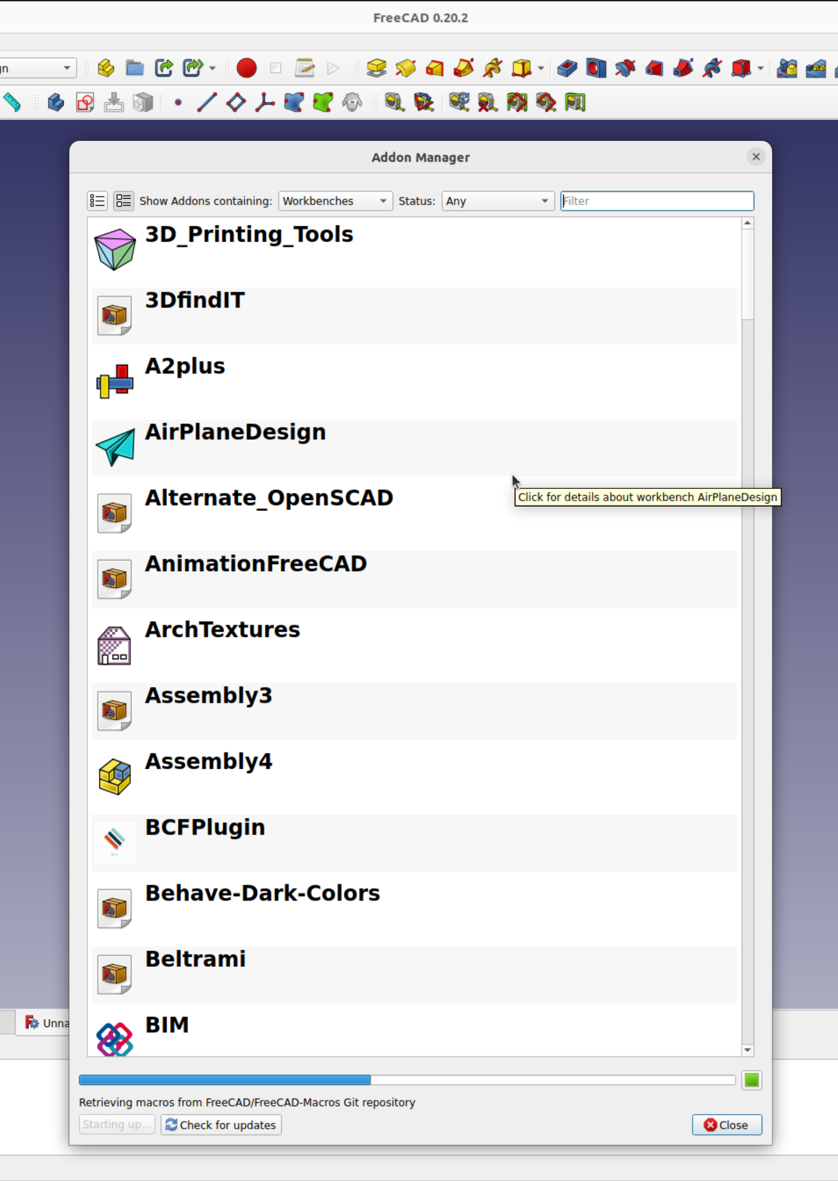
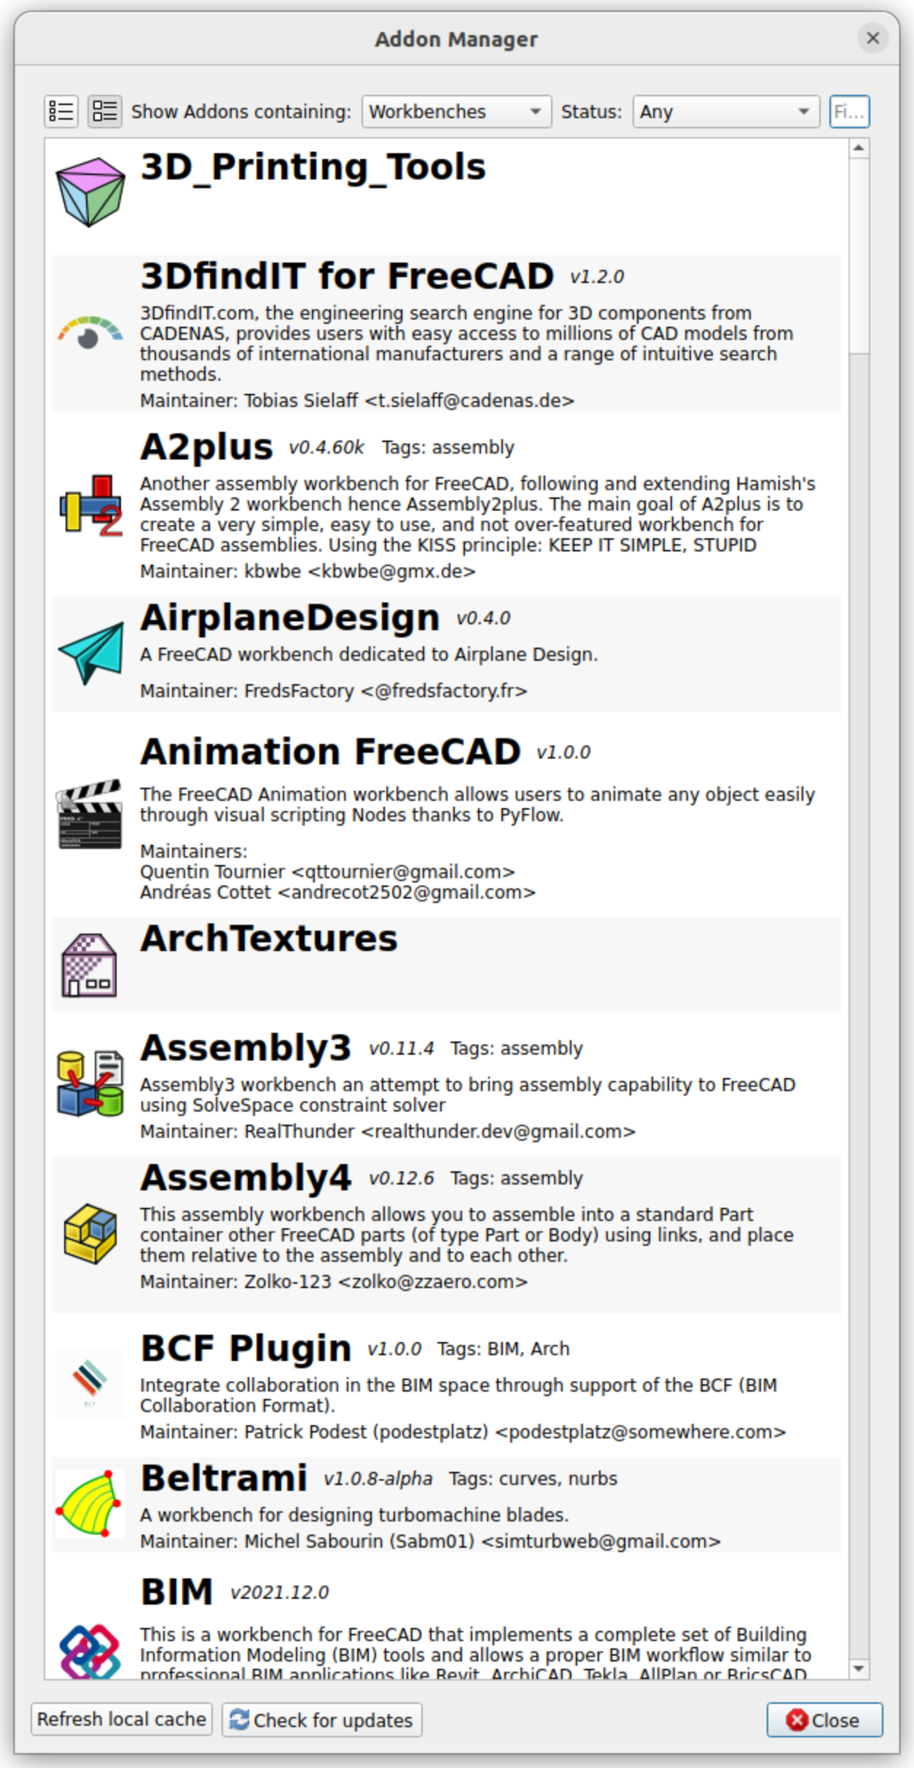
Addons
Notes:
When you first pull up the Addon manager it might take a moment to populate, but then you’ll see new addons with their descriptions.
A2Plus might be a good one to look at if you want to animate some parts. Also you might look at ExplodedAssembly and the Fasteners addons.

Slide 36
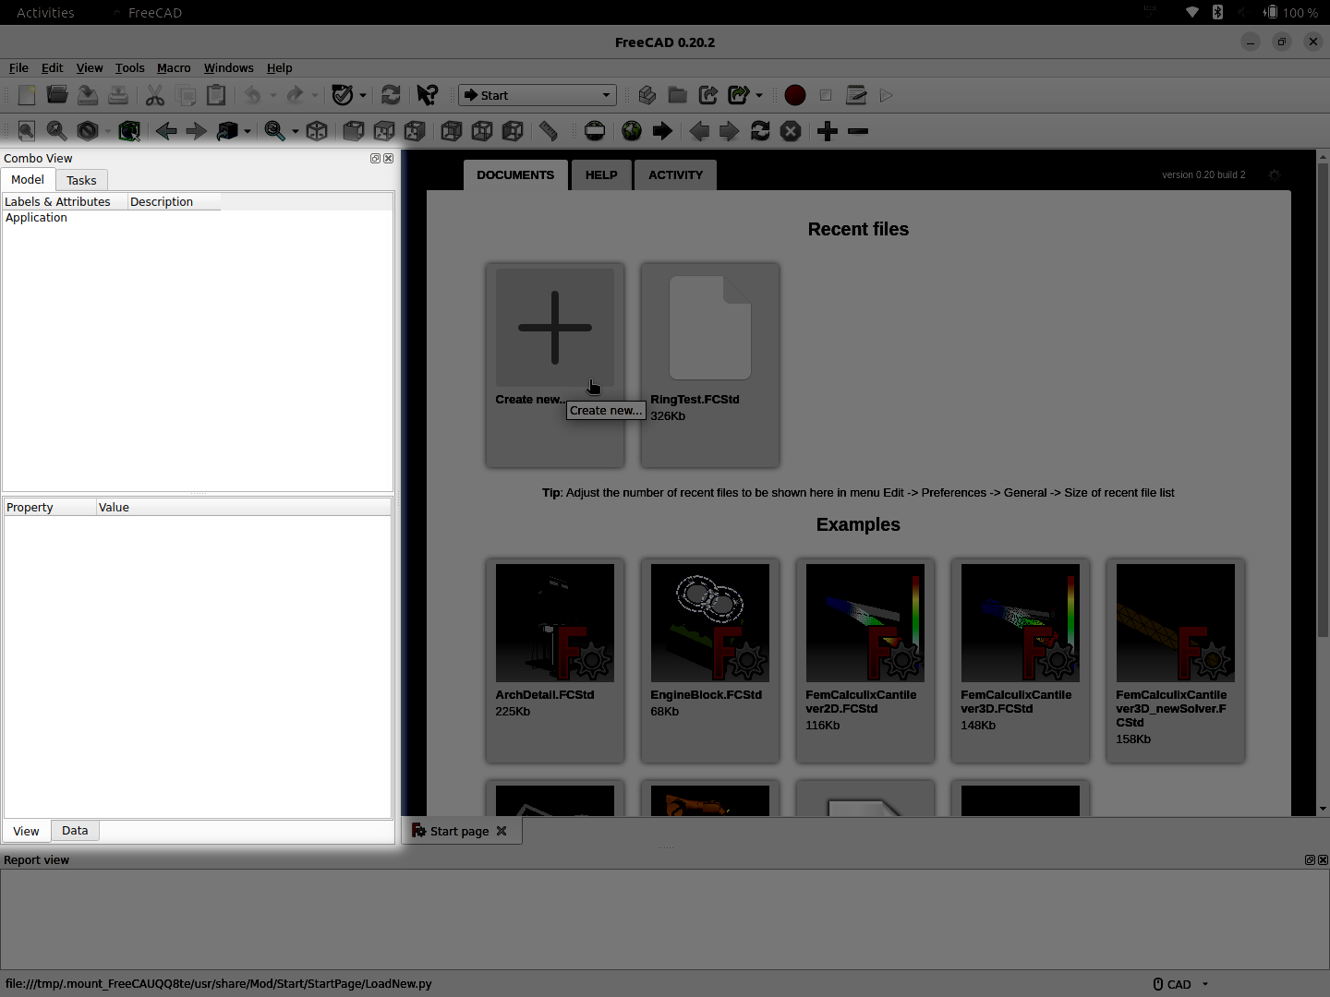
Combo View
Notes:
Through your time working you’ll want to be referring to the area on the left known as the combo view. You can switch between the object tree and the details for the task at hand. The bottom half includes the “Data” area that can hold properties used to tune things once base creation is done.
If you don’t see some expected details when initially creating something check to see if it has properties that will tune what you want.

Slide 37
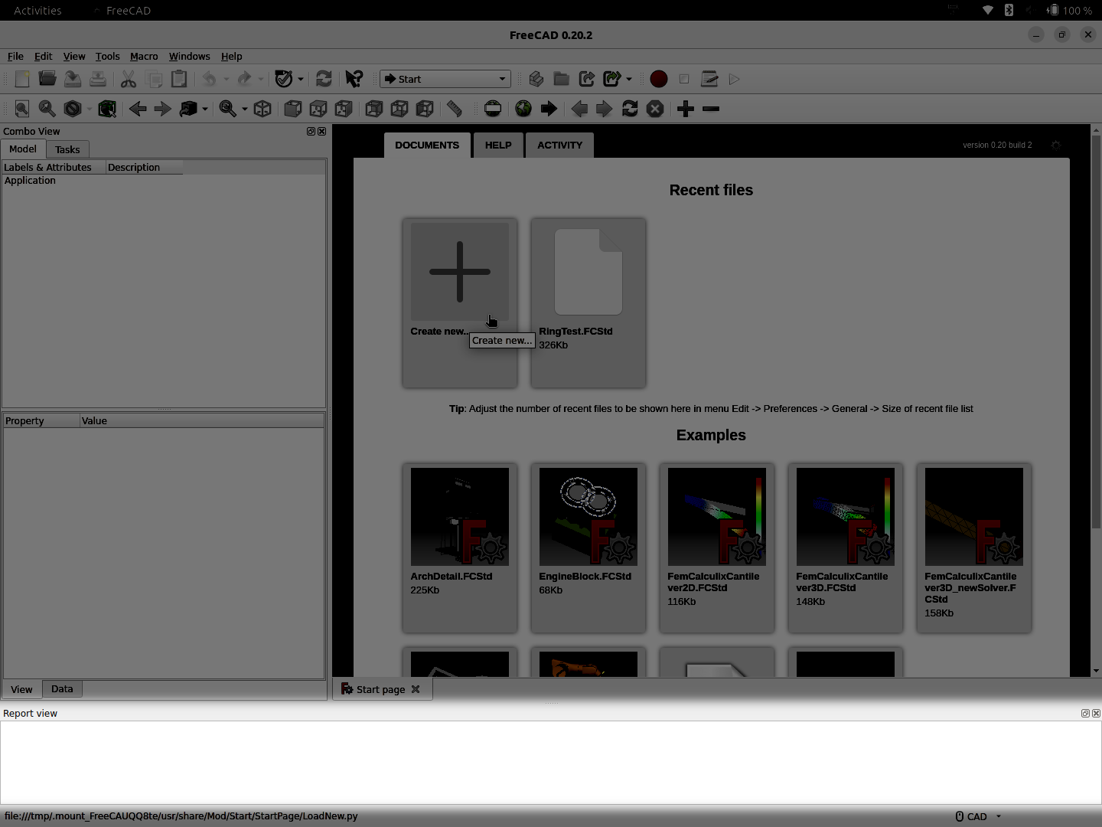
Report View
Notes:
And at the bottom we see the report view. As you go you might have warnings and errors flagged and showing up here. One handy tip is to clear it at reasonable times so that if you notice an issue it would be from something you just did rather than some edit you did minutes or hours before.

Slide 38
Navigation
Multiple choices
  Other packages/products navigation style setting
  Might make transition easier
Stick with the native
  Named “CAD”
  Will match tutorials
  Different tool – different interface
Notes:
FreeCAD allows you to change how the navigation works in the 3D view. This is meant to help with people used to other packages. Right-clicking on the 3D area will have “Navigation styles” as submenu
However, especially at fist, I would recommend sticking with the native default that is named “CAD”. It will help you match tutorials and also avoid trying to get the hang of which operations are now flipped/hidden.
In general, it’s a different tool so just treat it as such.

Slide 39
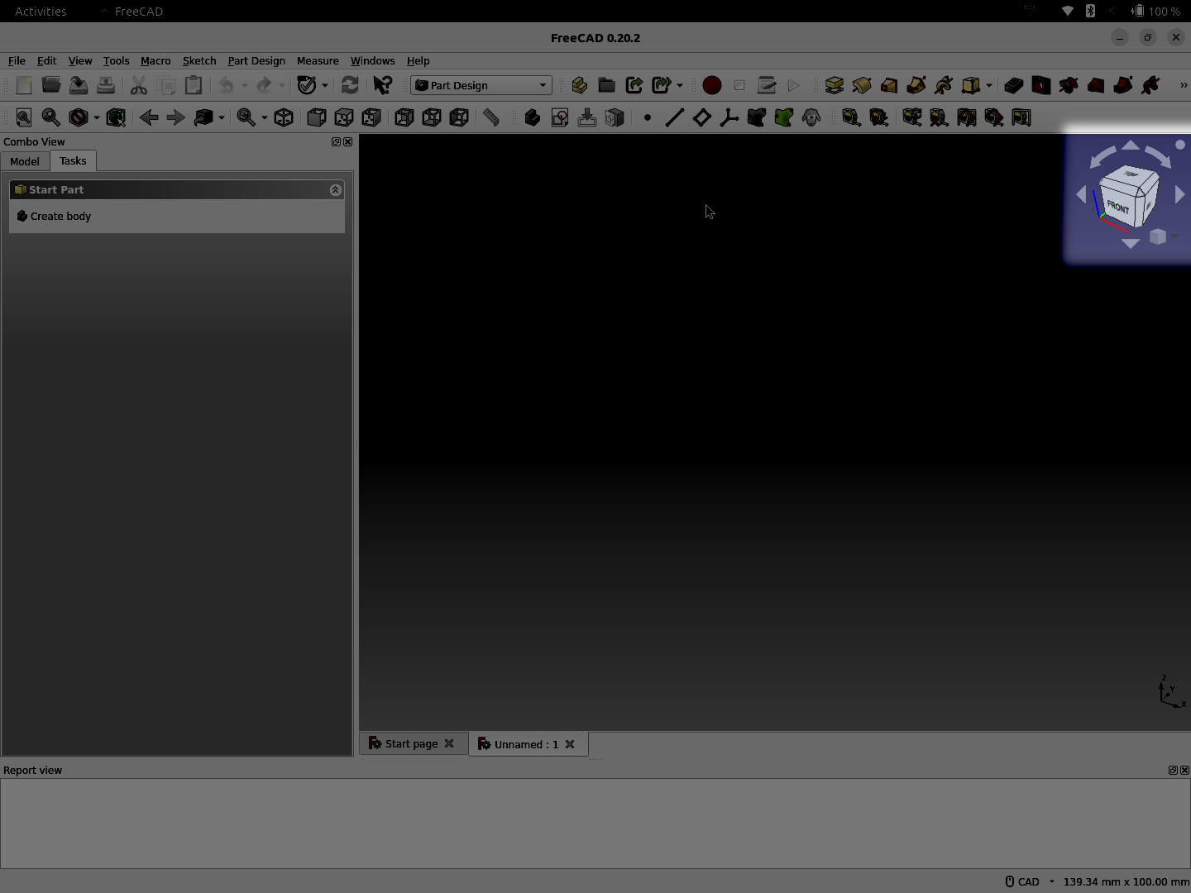
Navigation Cube
Notes:
In the top-right corner of the 3D view is the navigation cube. This is your friend, and makes tracking and switching the view very easy. Also the smaller cube to the bottom-right is a drop-down menu with a few common options.

Slide 40
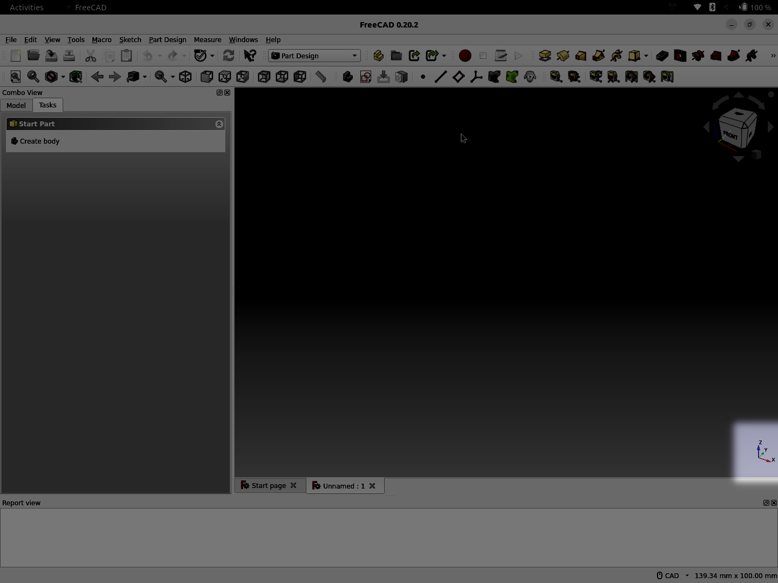
Coordinate Axes
Notes:
And hiding waaaay down on the bottom right corner are the Coordinate Axes. X-axis in red, Y-axis in green and Z-axis in blue (and yes, for the color-blind these are also labeled by letter)

Slide 41
Coordinate Axes
Down in the corner
Easy to forget
  If you’re lost/confused check which way is up :-)
Extremely useful for setting “View|Clipping plane”
Notes:
Remember that little tiny axes display is quite helpful. It’s easy to forget, but can help you check which way is up.
It’s also extremely useful when setting the clipping plane as you can see which letter is hidden due to pointing towards or away from you and then use that axis to clip along.
(hopefully we’ll see the clipping plane in action during the demo phase)

Slide 42
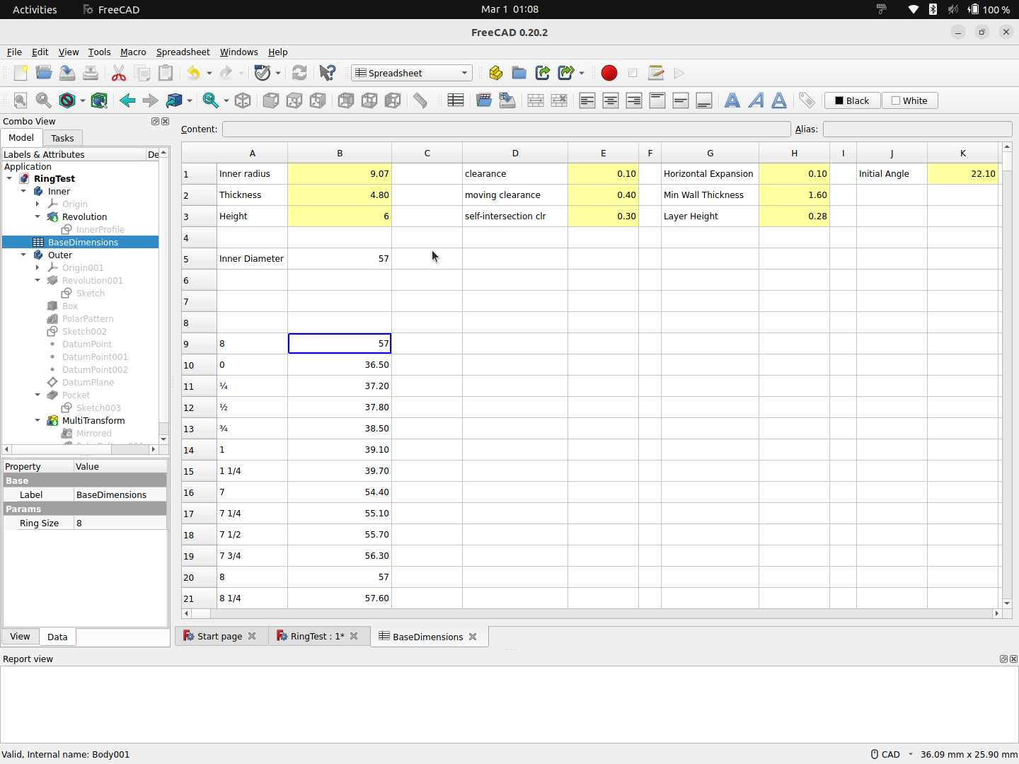
Spreadsheet
Notes:
And finally, FreeCAD has it’s own integrated spreadsheet support!
This lets you control values, calculate them, and set things for your models to be dynamic. An advanced aspect even allows you to add a pop-up property picker to change multiple values at once.
Here I have everything on one sheet, but you can easily separate things more naturally to different spreadsheets. It’s also important to separate input and output values (read from the geometry) so having separate sheets for those is good.

Slide 43
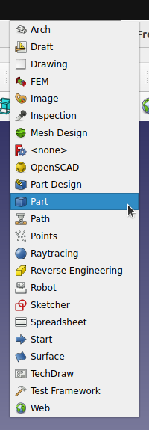
“Part” Workbench
One of the old standbys was the “Part” workbench
  Allows you to build up by adding or subtracting primitives
  Similar in concept to how OpenSCAD builds models up
  Not the one I recommend to learn first
Notes:
To kick things off we’ll try to demo one of the main workbenches. No, it won’t be the “Part” workbench.
The Part workbench is the old workhorse, and is fairly capable in that it allows you to model by creating and combing primitives.
It’s a bit similar to OpenSCAD in how it approaches 3D modeling, just with a GUI instead of coding.
Not the one I’m going to cover in more detail. Instead...

Slide 44
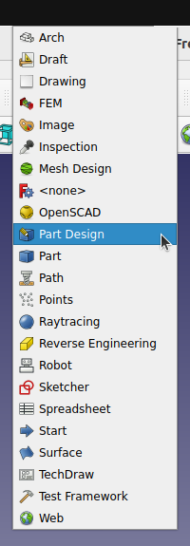
“Part Design” Workbench
New and more interesting
Creates instances of a “Body”
  Target result is one single solid per “Body”
What I’ll be demoing
  Learn one, then learn the other
  Note that there are many
Notes:
We’ll dive into the newer “Part Design” workbench.
You create a model by building up one or more instances of “Body” objects. The result is one single solid per “Body”
This is the one I’ll be (hopefully) demoing.
The general advice out there is to pick one of these two workbenches, lean it well, then learn the other.
Also note that there are many other workbenches even in my fairly fresh install here. You might learn a few, or you might learn many. It’s all up to you and your personal needs.

Slide 45
Magic time!!!
Notes:
And now, IT’S MAGIC TIME!!!

Slide 46
Demo
Notes:
Let’s hopefully have a dynamic and helpful demo of some key basics.

Slide 47
Demo
A FreeCAD speed run, if you will
Notes:
Switching now to a live demo

Slide 48
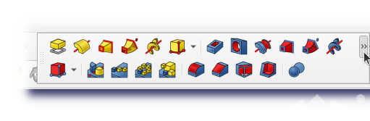
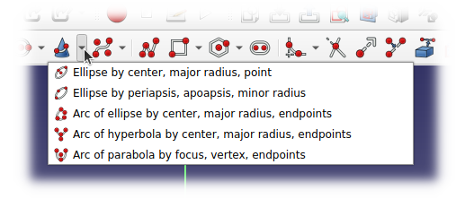
Demo Info
Remember, both toolbars and buttons sometimes have widgets to popup more choices
  Toolbars more flow/automatic
  Buttons grouped by function
Notes:
Using standard toolkit features both the toolbars and individual buttons might have expansion widgets to get at more content.
Keep an eye out for both of these.
In the case of individual buttons with expansion widgets they are usually grouped to place alternative versions of an operation under one spot in a toolbar

Slide 49
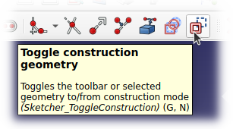
Demo Info
When sketching you can draw two types of each
  Normal lines/shapes
  Construction lines/shapes
Construction items are happy little helpers that hide away when not needed
Notes:
There are two main types of lines/arcs/circles that you can sketch. Normal lines or construction geometry.
Normal items show up as white and turn green when fully constrained.
Construction items show up as blue and then turn light blue when fully constrained.
When a sketch is closed, construction geometry is hidden and gets out of your way. However they can still be used for things such as an axis for PartDesign’s Revolution feature.

Slide 50
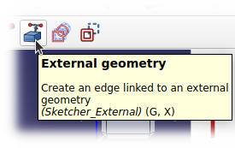
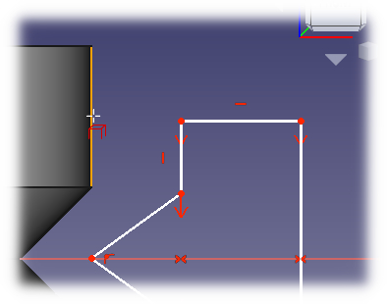
Demo Info
In sketching, you can take edges and such from other places for reference
Select the tool then select one or more parts of other sketches/geometry
Notes:
Normally sketches are limited to being self-contained and only referencing other geometry in that sketch. However you can use the “External Geometry” tool to bring in edges and such from other parts of your model and use them as if they were defined in the current sketch

Slide 51
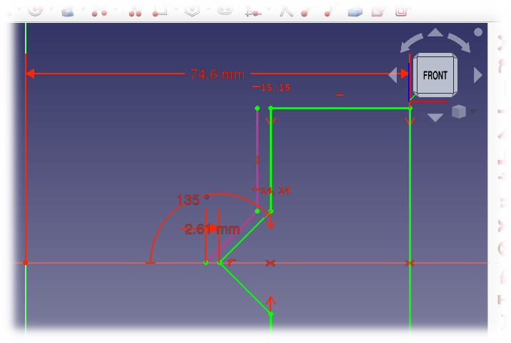
Demo Info
The result are imported to the sketch
The magenta type of line
Helps to create proper offsets, etc.
Notes:
Imported geometry are shown as magenta lines in your sketch and can be used to constrain construction or normal geometry you create in that sketch.
Helps when you have different aspects of construction that you want to reference correctly.
Note that this is different from copying or creating a carbon copy of a different sketch and building from there.

Slide 52
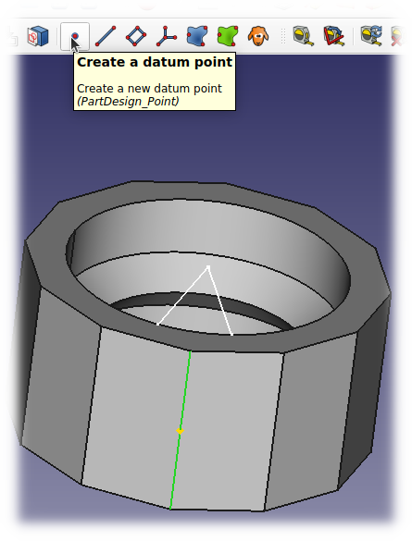
Demo Info
“Datum” items VERY helpful
  Point
  Line
  Plane
  Coordinate System
Attach to other sketches, etc.
Usable for many things
  Creating planes for other sketches
Notes:
“Datum” objects are your friends!
You can create datum points, datum lines, datum planes and datum coordinate systems.
“Datum” objects are auxiliary geometry that are not used as part of the final 3D output, but can be used as reference in sketches and other operations.
One helpful application is to use datum items when creating planes for new sketches that are in a specific orientation. Attaching directly to a shapes faces, edges, and vertices might cause things to shift later if those are changed, but datum points are explicit references.

Slide 53
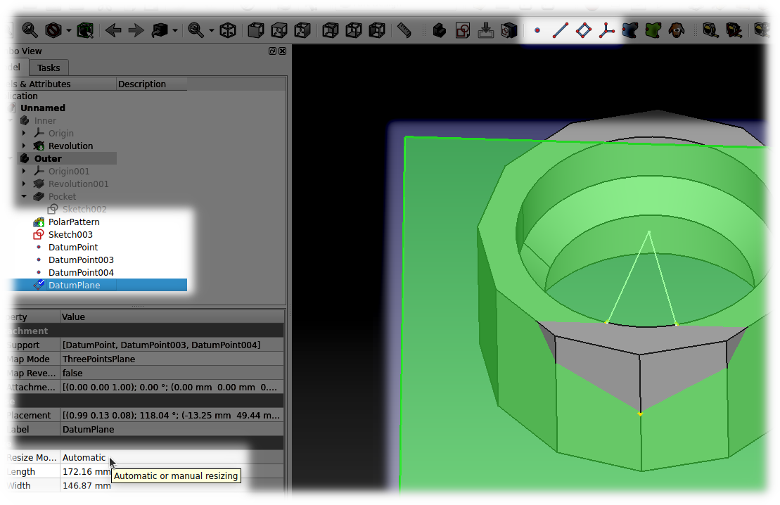
Demo Info
Notes:
In this case here datum points were created attached to three vertices in two different sketches. Then those three datum points were selected and a new datum plane created that passes through those three points.
If the sketches are changed, the points will shift to keep up and the plane will always hit where it is expected to.
Also note that when creating a plane you can change the Resize Mode property from automatic to manual and then resize the plane to display smaller or larger so as to not be a bother and hide too much or not show enough.

Slide 54
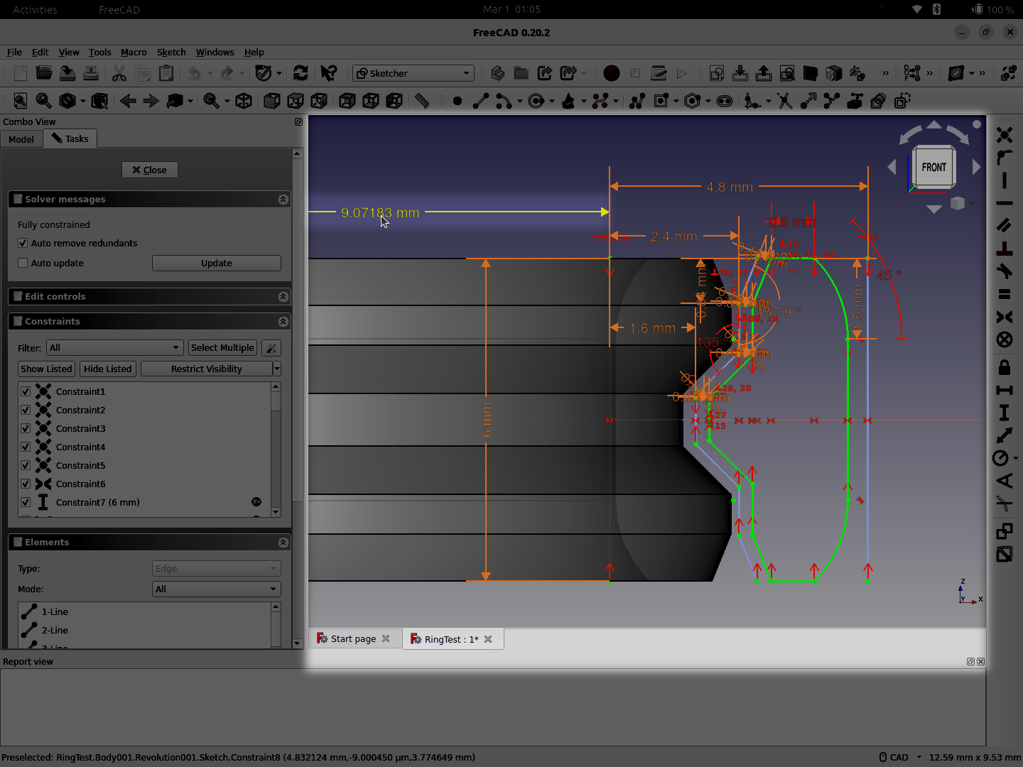
Demo Info
Notes:
When setting constraints, you can edit a value by selecting the number and double clicking it to bring up the value editor.
(By the way, if constraints are getting in the way you can click and drag on the number to move it to somewhere that looks better)

Slide 55
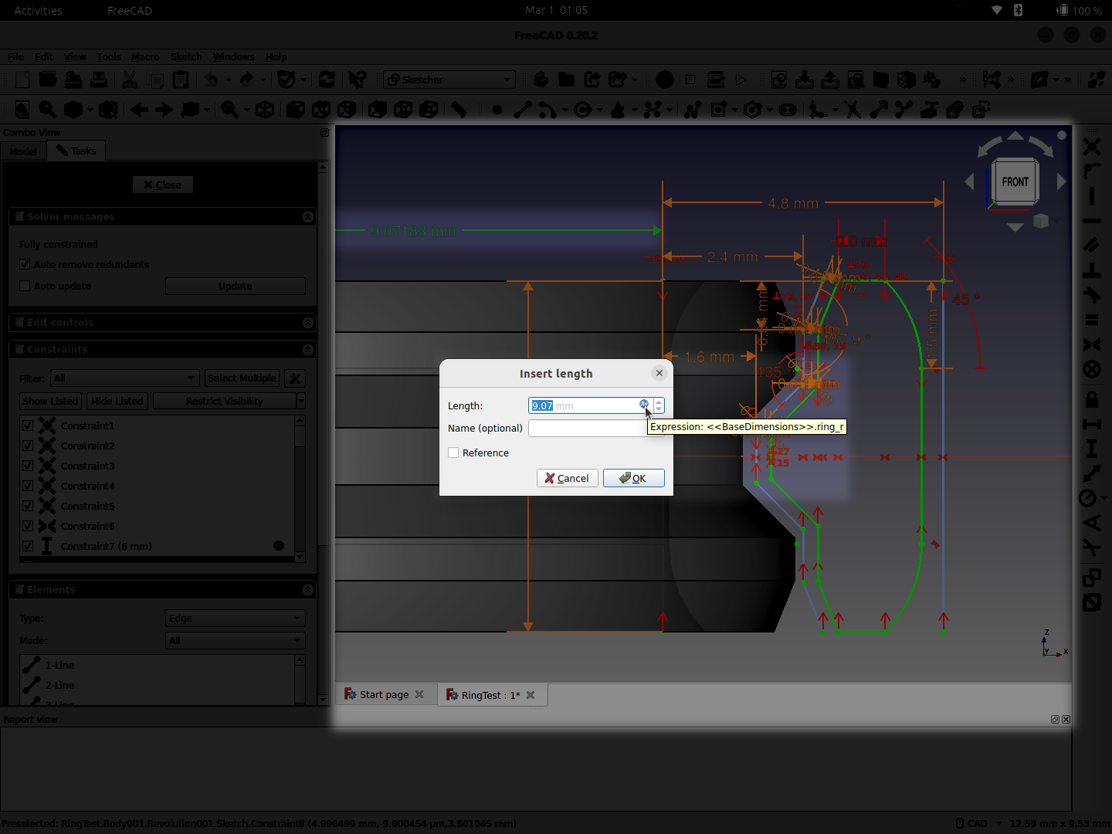
Demo Info
Notes:
Once you select and open a value for editing note that there is a round blue “f(x)” button in the edge of the input area.
Hovering over the button will show any expression that has been added instead of a simple value. Then clicking on it will bring up an expression editor for that property

Slide 56
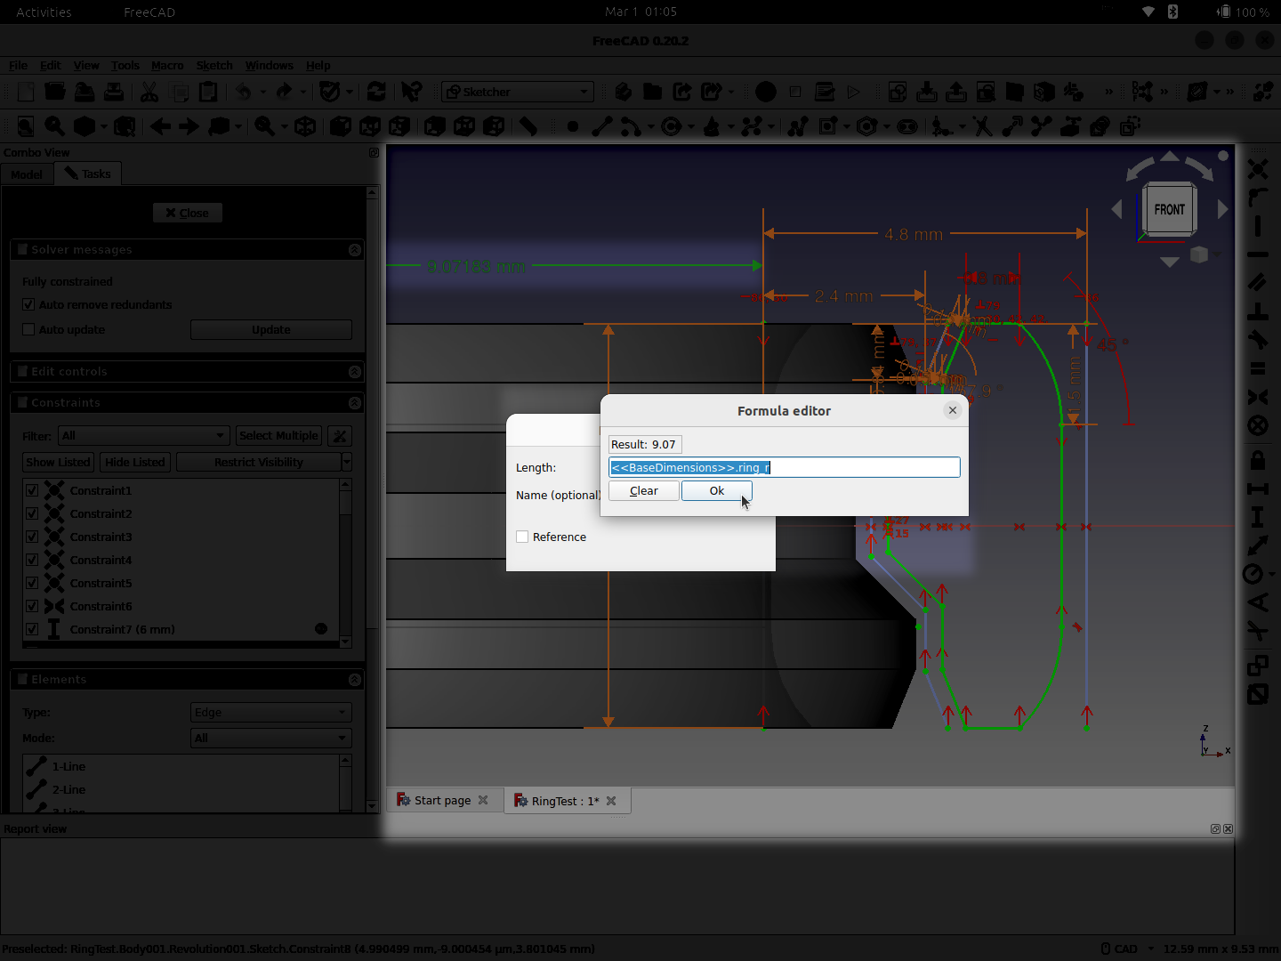
Demo Info
Notes:
As you start to type in the formula editor window it will offer completion suggestions and follow names in spreadsheets, etc.
Also in the top left it will show you the current result of the expression you have entered so it is easy to confirm a proper expression without having to click “Ok” to see a result.

Slide 57
Demo End
Back to your regularly scheduled presentation.

Slide 58
TNP
One term that might come up is “TNP”
  Topological naming problem
    https://wiki.freecad.org/Topological_naming_problem
If previous steps in the model are changed, dependent features may ‘break’
Not unique to FreeCAD
Focus of the next release
  == “v1.0”*
    *YMMV, IANAL, These forward-looking statements...
Notes:
One final note I need to toss out there is a term you might come across, or might come up and come across you: TNP
The topological naming problem is where features are built up on top of geometry, then the geometry is changed and “vertex 2 of edge 3” no longer is at the place one expected it to be.
So changing a parametric model that was not constructed to be proof against that may cause issues.
This is not unique to FreeCAD; many commercial packages have this issue, and some have heuristics to try to counter.
The Next Version, though, is focused on addressing this.

Slide 59
The Answer
Notes:
Ah, the answer

Slide 60
The Answer
Q: What the Heck is FreeCAD?
  A: ...
Q: Why do you care?
  A: ...
Notes:
Time to answer the questions I proposed by this talk: the answer to what the heck is FreeCAD and why should you care.

Slide 61
The Answer
Q: What the Heck is FreeCAD?
  A: It’s fun!
Q: Why do you care?
  A: ...
Notes:
The big one is easy! FreeCAD is fun. You can afford to try it out and it has enough power to get most users going very quickly. The power it has is very impressive so it will be usable in the long run. Watch a few different tutorials on the different applications for FreeCAD and see what clicks for you.
And then to address the part about why you should care...

Slide 62
The Answer
Q: What the Heck is FreeCAD?
  A: It’s fun!
Q: Why do you care?
  A: Chances are it can solve one or more problems for you
Notes:
Chances you can solve one or more problems you’re facing today. It might be as simple as fixing something you have broken around the house. Or it could be something along the lines of “how can I be creative if I don’t have practice in artistic methods”.
Go forth, try FreeCAD, and have fun!

Slide 63
Questions?

Slide 64
References
Introductory
  FreeCAD
    https://www.freecad.org/
  FreeCAD Managing Expectations
    https://wiki.freecad.org/FreeCAD_Managing_Expectations
Fusion360
  Autodesk Announces Major Changes To Fusion 360 Personal Use License Terms
    https://hackaday.com/2020/09/16/autodesk-announces-major-changes-to-fusion-360-personal-use-license-terms/
Community
  Forums https://forum.freecad.org/
  Reddit https://www.reddit.com/r/FreeCAD/
  Tutorials
  Joko Engineeringhelp https://www.youtube.com/@JokoEngineeringhelp
  MangoJelly Solutions https://www.youtube.com/@MangoJellySolutions

