Slide 1
Saving kittens
SCALE 2023
Los Angeles, USA
Jos Poortvliet
Marketing Director, dog owner & privacy advocate
jos@nextcloud.com

Slide 2
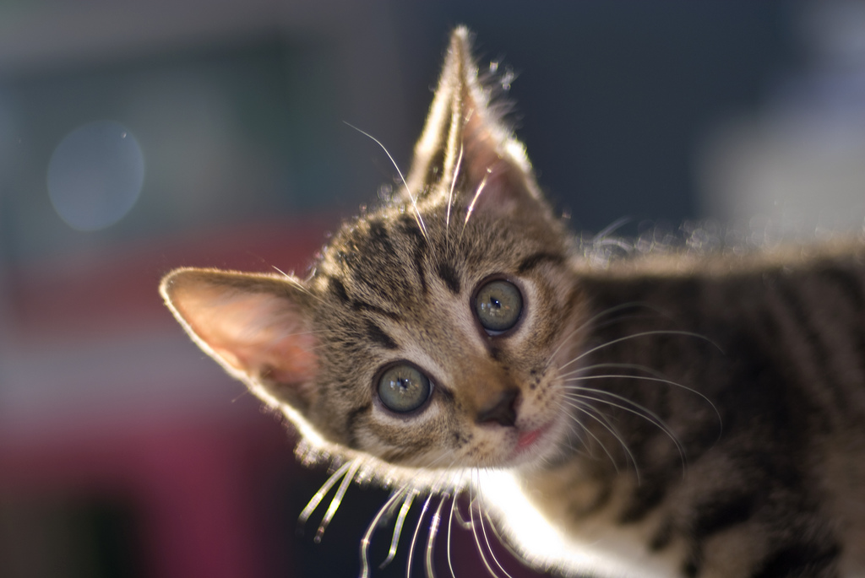
Me
Notes:
about me!
- long time open source contributor – Mandrake Linux, KDE, ownCloud
- co-founder Nextcloud
- let me mention… my dog.

Slide 3
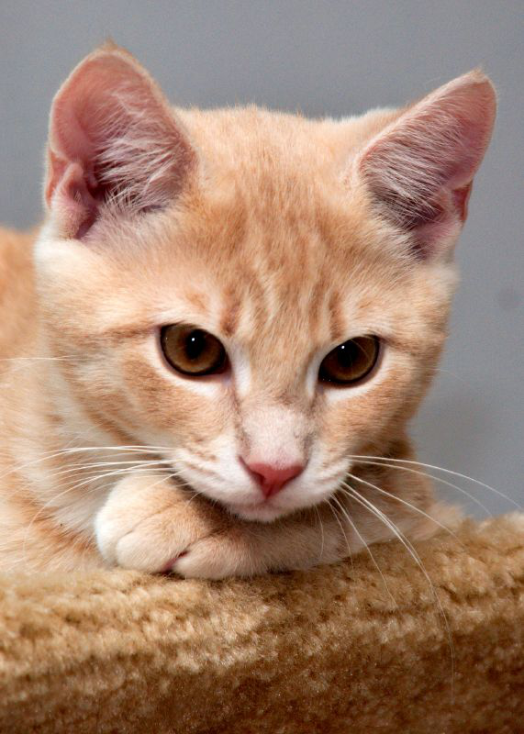
You
Notes:
why listen
Freedom, to do what?
Big Tech & freedom
Free Software & Open source
Agenda:
- freedom and privacy Post Snowden
- Big Tech and freedom
- open source and freedom
- Licenses & Law
- This Is The Way

Slide 4
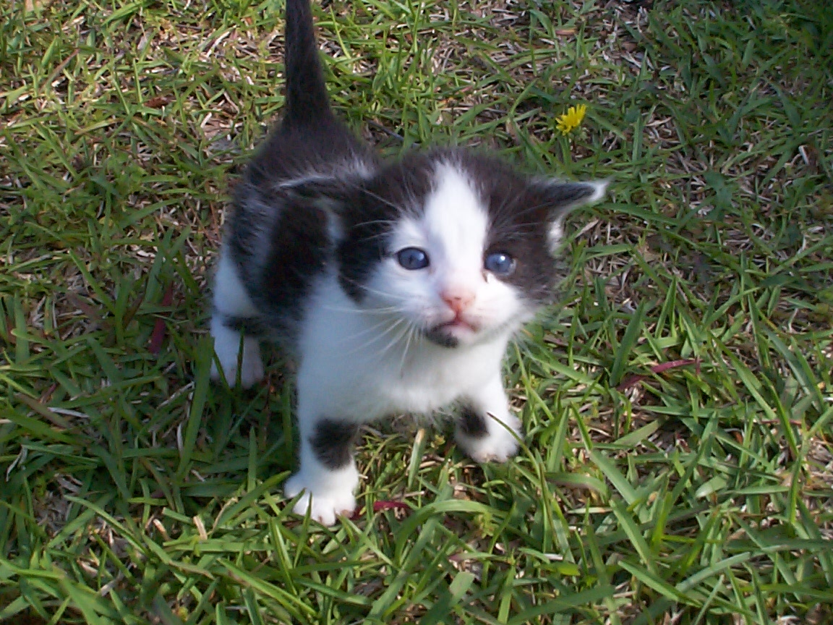
In the beginning
Notes:
When we were young and beautiful…
We were free.
Well, not really, but we were safe.
Well, not really, but… we were naive?

Slide 5
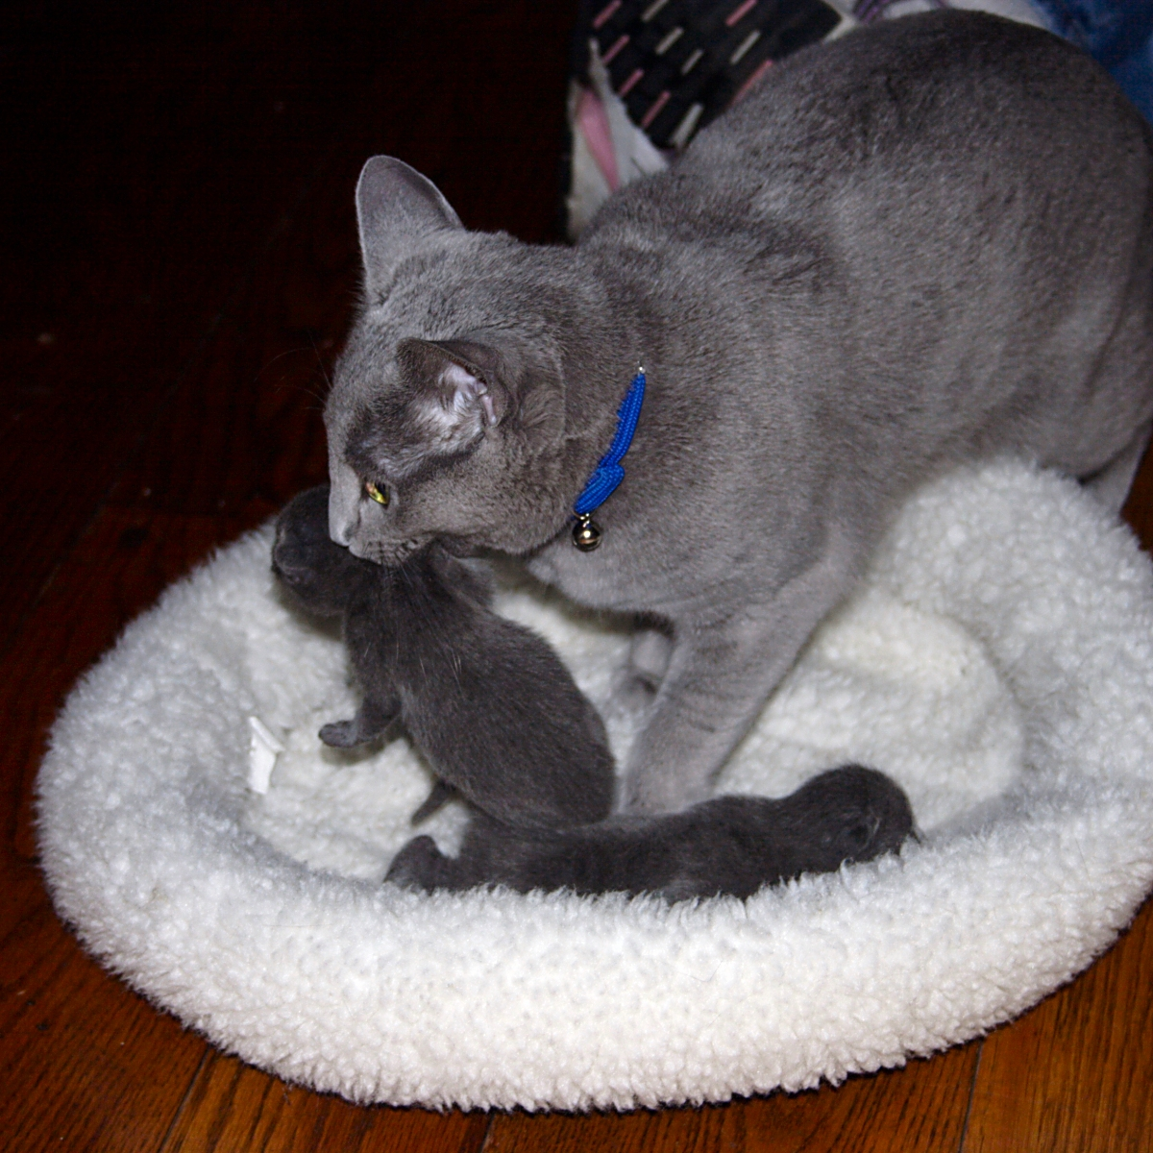
Snowden
Notes:
Then Snowden came, and we learned.
What is privacy? And what does it have to do with being ‘free’?
Time to talk about the cloud, surveillance and more.

Slide 6
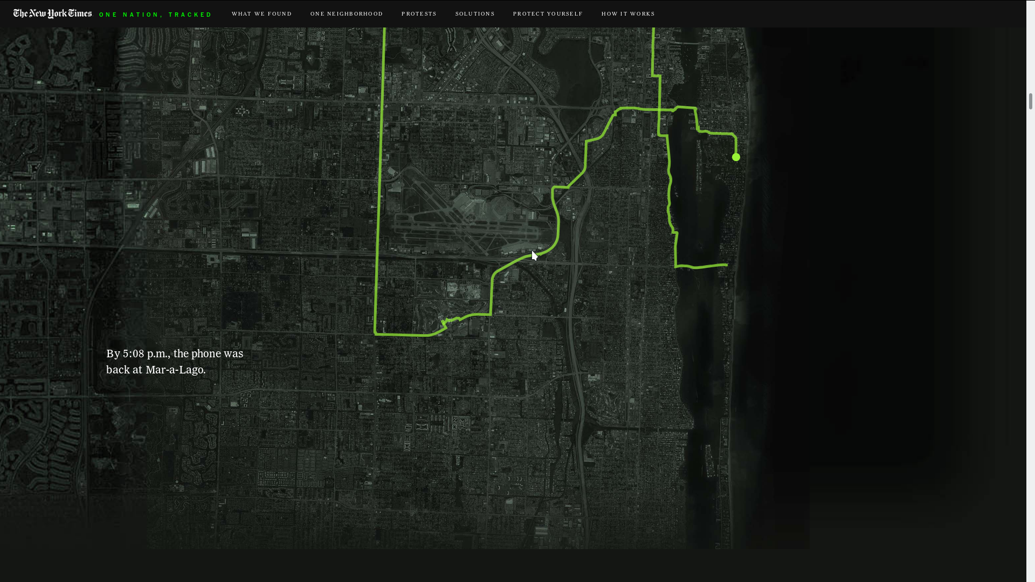

Slide 7
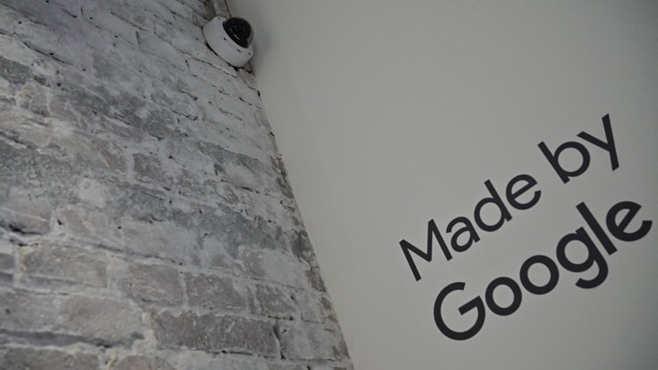

Slide 8
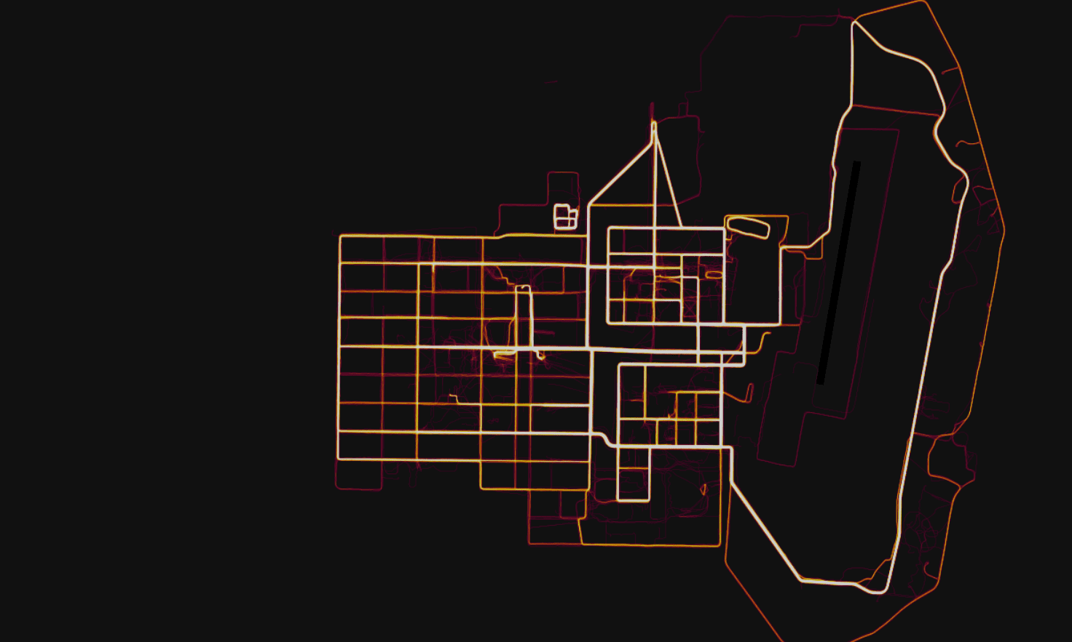

Slide 9
Targetting
“worthless” “insecure” “stressed” “defeated” “anxious” “failure”
micro-target ads down to
“moments when young people
need a confidence boost”
Notes:
https://www.wired.com/2017/05/welcome-next-phase-facebook-backlash/

Slide 10



Slide 11




Slide 12
Facebook using 2FA phone numbers for ads
Myanmar
Echelon
…

Slide 13


Slide 14
What can you do?
Know what people hear, see and talk about
Know what they want and need
And influence all that
POWER over people

Slide 15
2 models to control thinking
🇺🇸
  Advertisement
  Make you want things
🇨🇳
  Make you not care
  Or agree

Slide 16
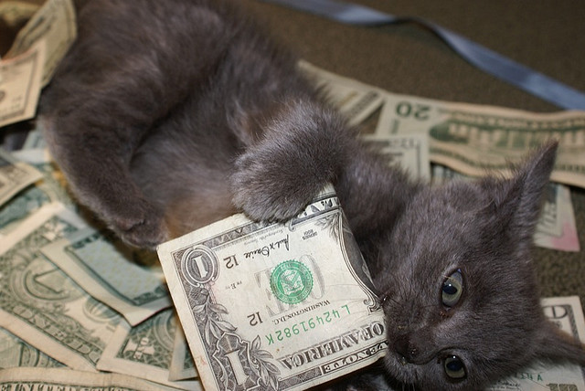
Business
Notes:
It started with big, big money.

Slide 17
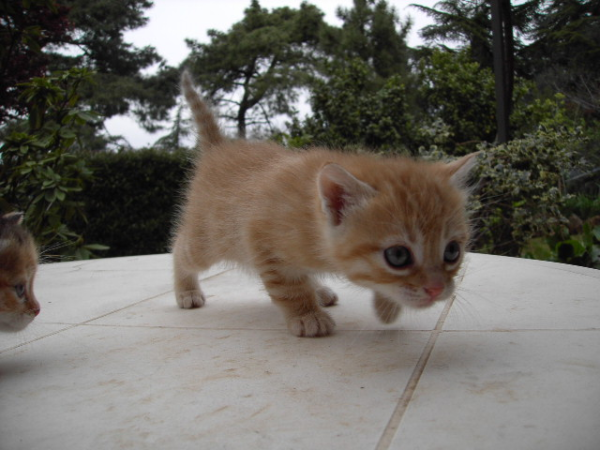
Strategy

Slide 18
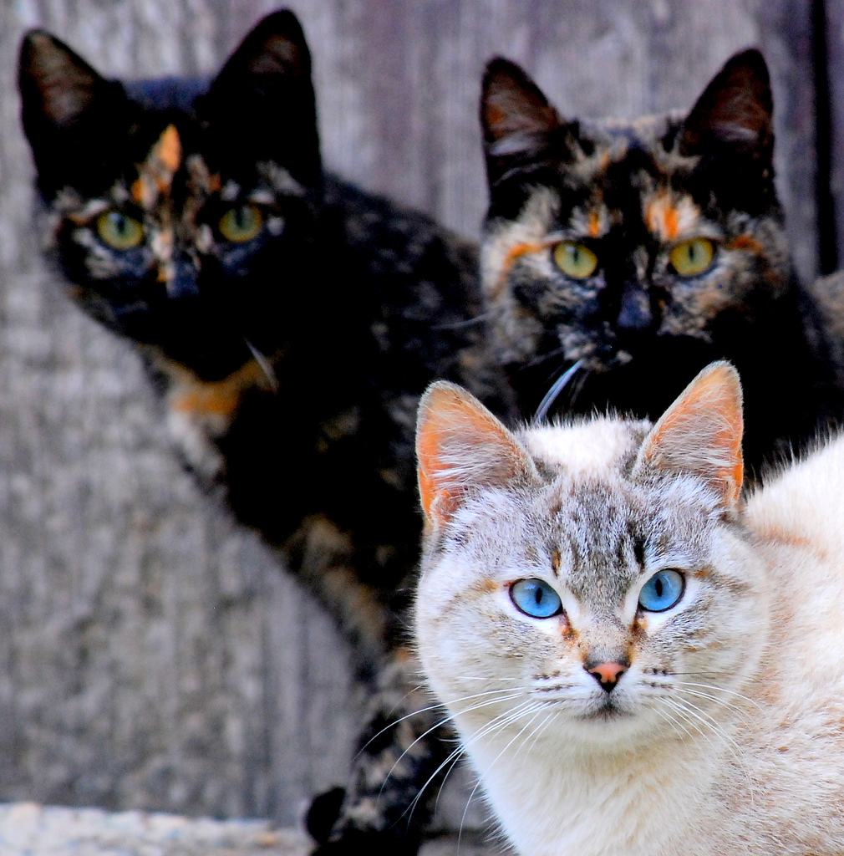
Others

Slide 19
Kitty Image credits
Slide 1: Merlijn Hoek
Slide 2: artolog
Slide 3: Atli Harðarson
Slide 4: aloha orangeneko
Slide 5: ClintJCL2
Slide 6: Catpiper
Slide 7: eran finkle
Slide 8: Dan Coulter
Slide 9: cwalker71
Slide 10: clevergrrl
Slide 11: sensual shadows
Slide 12: marissa cap
Slide 13: dabogirl
Slide 14: pasotrapaso
Slide 22: cseeman
Slide 23: ian
Slide 26: anzaq78
Slide 27: metacheetr
Slide 28: anjaka
Slide 29: Clarea_vsAngel
Slide 30: ClintJCL
Slide 31: nathonline-beta
Slide 33: Project Bretzn
Slide 34: begemot
Slide 36: malingering
Slide 37: andreas solberg
Slide 38: abcrumly
Slide 39: freakgirl
Slide 40: tashalutec
Slide 41: malingering
Slide 42: angi_nelson
To be found on Flickr under the above names with a Creative Commons license. Thanks all!

