Slide 1
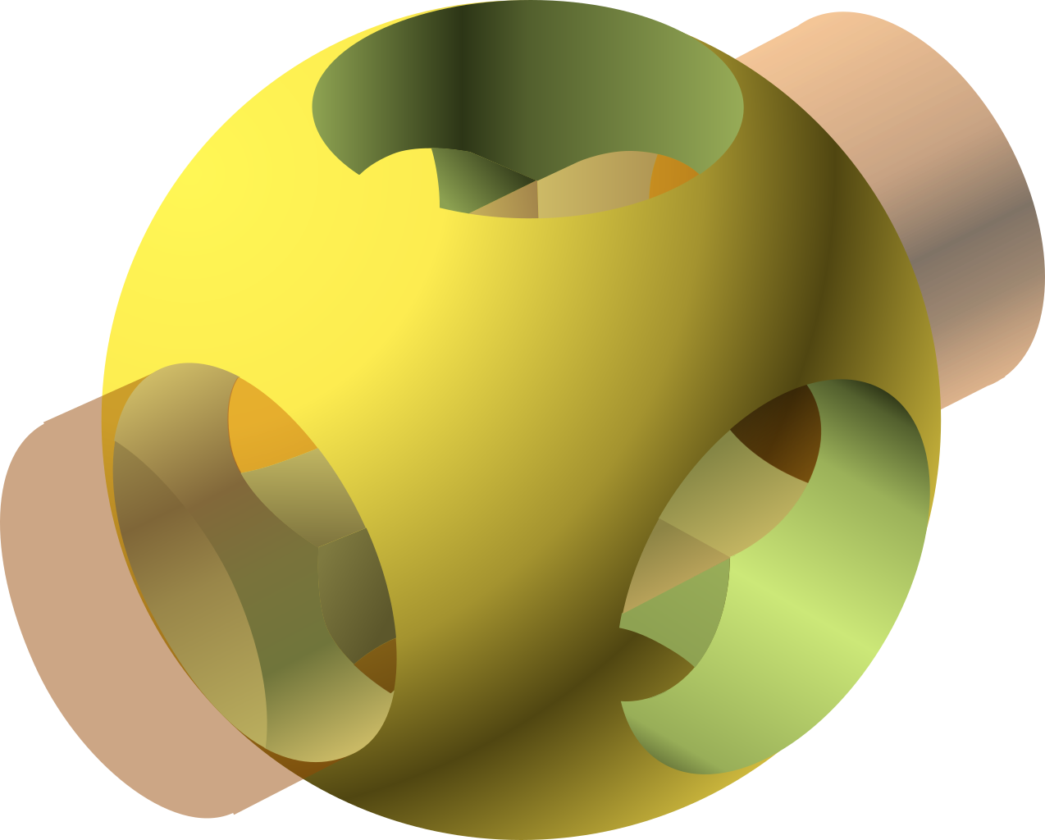
Introduction to OpenSCAD
Jon A. Cruz

Slide 2
Introduction

Slide 3
Introduction
This Presentation

Slide 4
Introduction
This Presentation
  Scope
  Goals
  The Answer

Slide 5
Introduction
This Presentation
  Scope
  Goals
  The Answer
OpenSCAD

Slide 6
Scope
To explain...

Slide 7

Scope

Slide 8
Scope
Sum Up

Slide 9

Ready?

Slide 10
Goals

Slide 11
Goals
Initial push

Slide 12
Goals
Initial push
Inspiration

Slide 13
Goals
Initial push
Inspiration
Sources to continue with

Slide 14
The Answer

Slide 15
The Answer
… And profit?

Slide 16
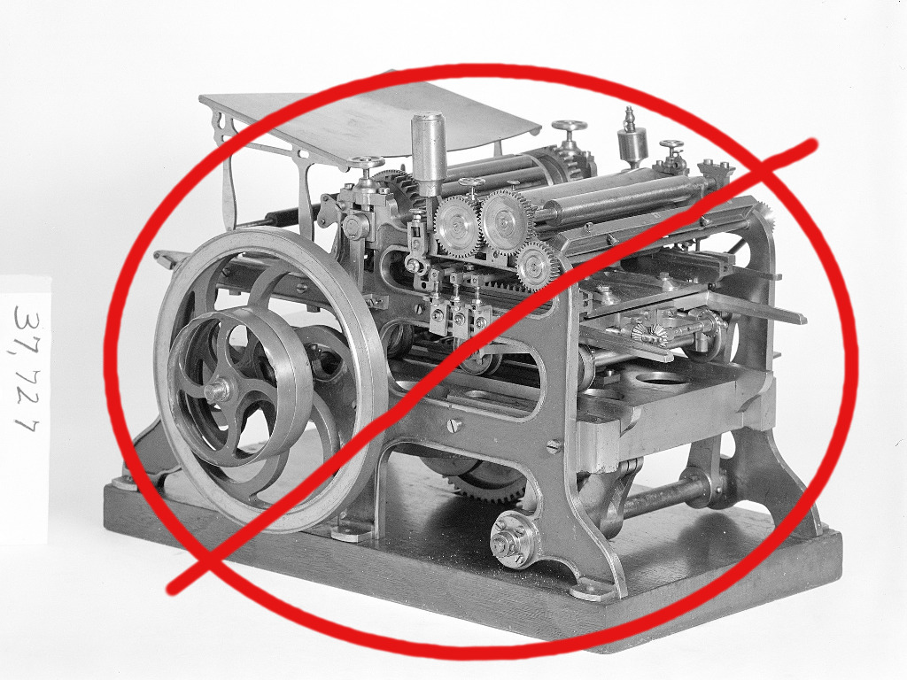
The Answer
… And profit?
Not a money-printing machine

Slide 17
OpenSCAD

Slide 18
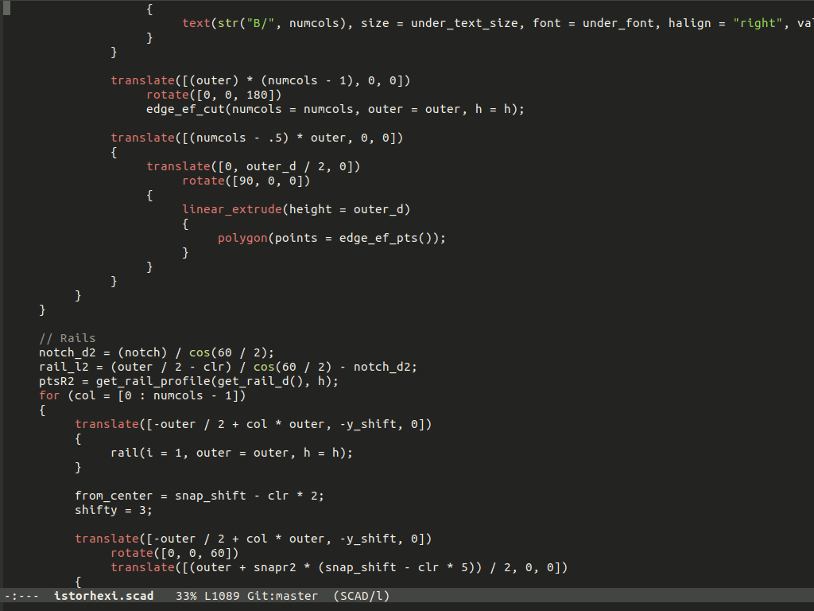
OpenSCAD
Converts This...

Slide 19
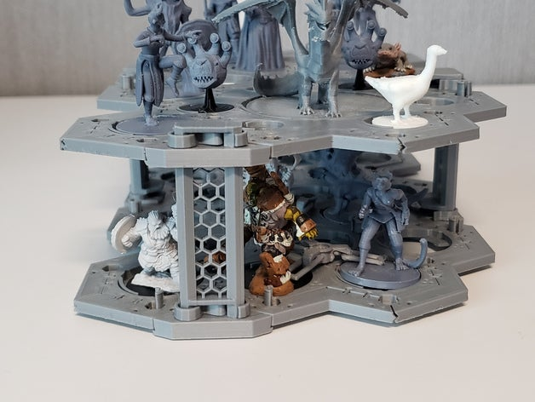
OpenSCAD
Converts This...
… To This

Slide 20
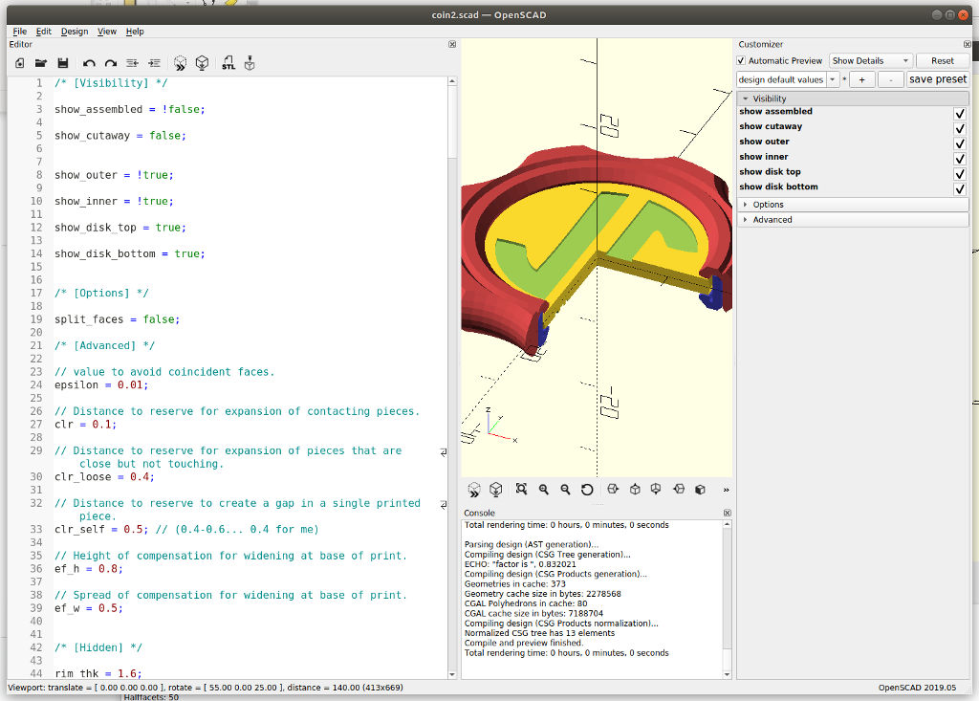
OpenSCAD

Slide 21
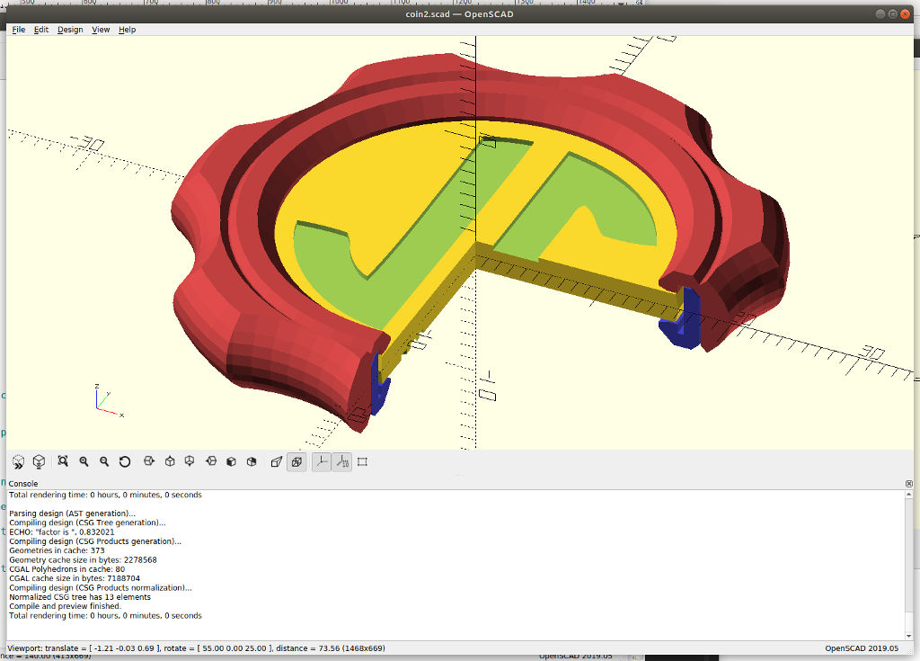
OpenSCAD

Slide 22

OpenSCAD

Slide 23
OpenSCAD

Slide 24
Comparison to other tools
FreeCad
Blender
Tinkercad
SketchUp
Fusion 360
Search for more...

Slide 25
Comparison to other tools
FreeCad
  Visual, CAD, parametric
Blender
  *The* name in OpenSource 3D
Tinkercad
  Easy to start, web-based.
SketchUp
  More archetectural,
  web-based
Fusion 360
  Nice CAD,
  Free for non-commercial
Search for more...

Slide 26
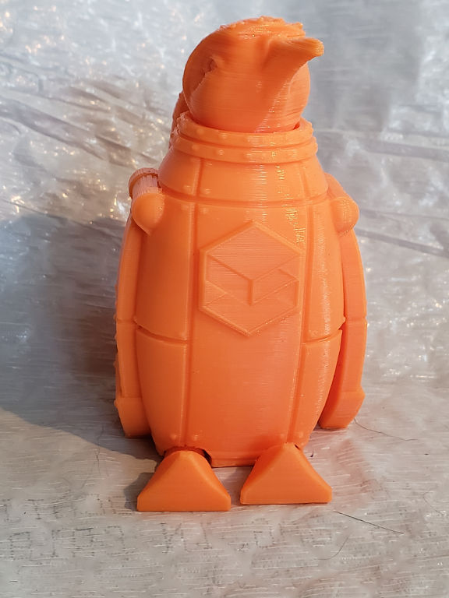
When is OpenSCAD a good choice?
Parts/Components
Non-organic
Parametric
SnoLabs Penguin by Louise Driggers

Slide 27
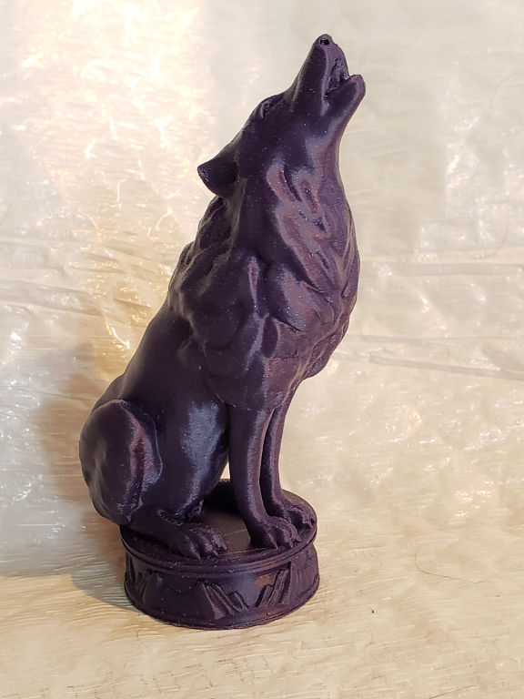
When is OpenSCAD not as strong?
Organic
Freehand art
Sculpting
Simulation and Analysis
Wolfsong by Louise Driggers

Slide 28
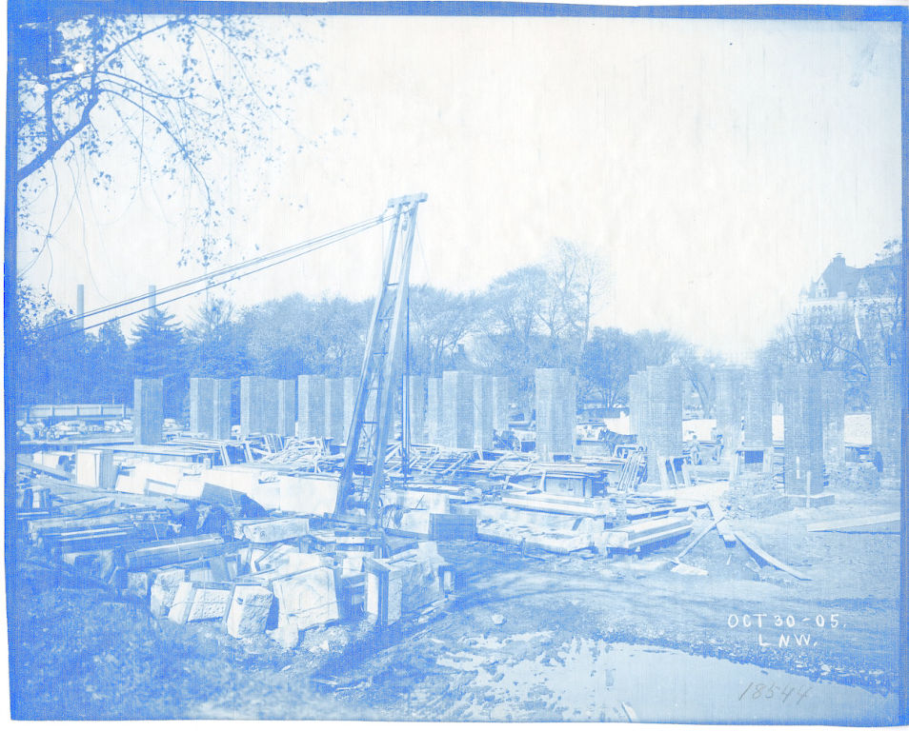
Structure of the Language

Slide 29
Key Concepts

Slide 30
Use The Force

Slide 31
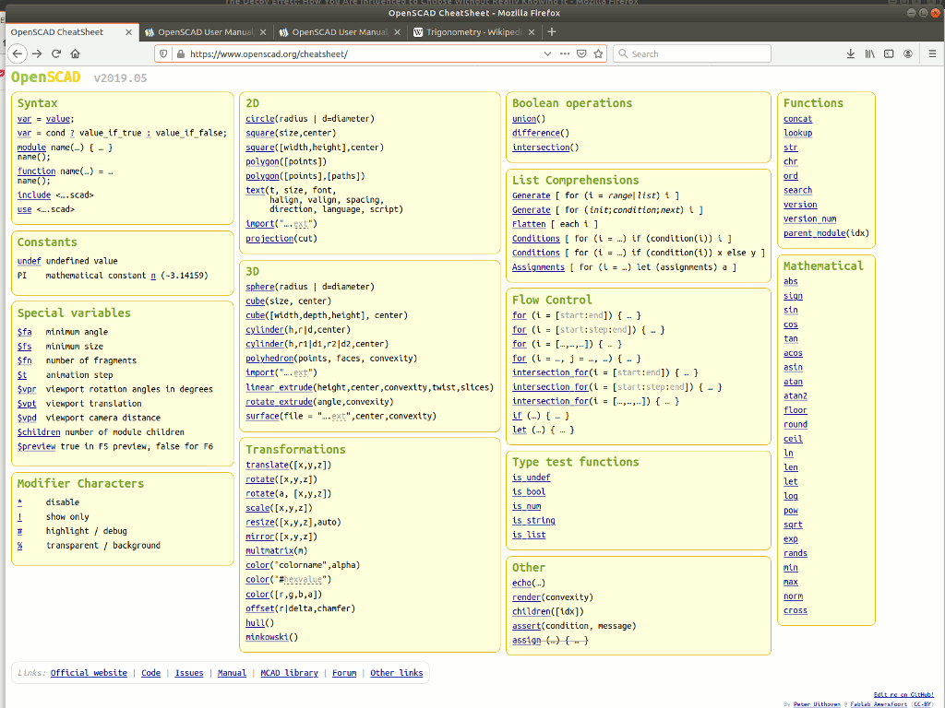
Use The Force the CheatSheet
No! Don’t rely on just feelings and guesses
Quick reference
  Nicely grouped
  https://www.openscad.org/cheatsheet/

Slide 32
Constructive Solid Geometry
Core of OpenSCAD
Build up combining simple to become complex
Both 2D and 3D
Many ways to get similar results

Slide 33
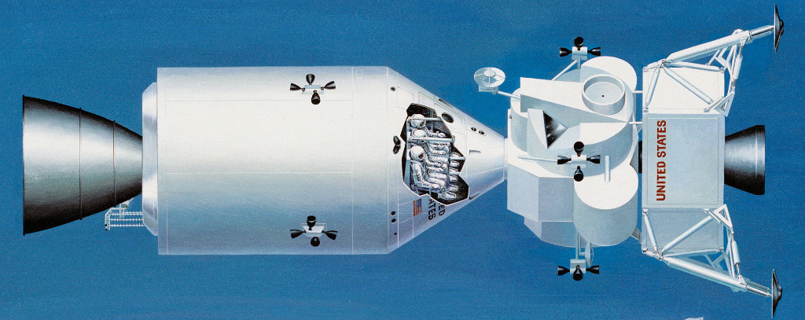
Modules
‘Emit a thing’
Equivalent of ‘subroutine’ or ‘function’ elsewhere

Slide 34
Functions
Emit a value
Simple or complex
let() is magic
  Locals for the function

Slide 35
Geometry Basics
2D Primitives
3D Primitives
Boolean operations
Transformations

Slide 36
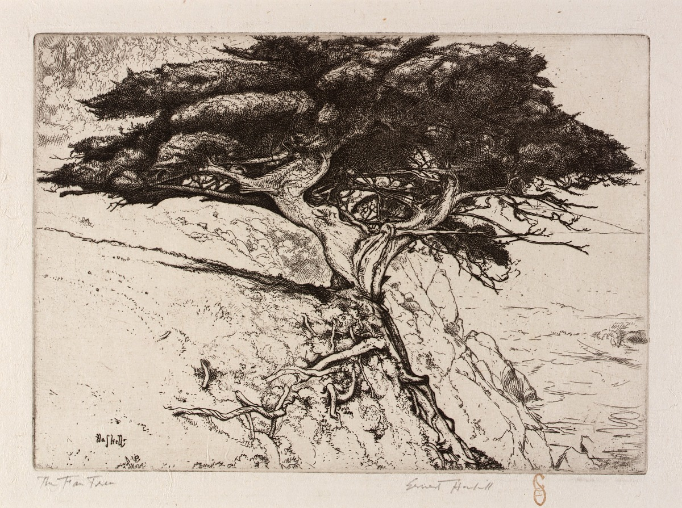
Land of the Declarative Tree

Slide 37
Think Declarative
Building a tree, not sequencing functions

Slide 38
Think Declarative
Building a tree, not sequencing functions
‘Emit’ is a good thought
  Similar to XSL
  Similar to Proper make/build systems…
  Declarative rather than imperative

Slide 39
Variables in OpenSCAD
Variables are not variable
  Generally non-modifiable
Can override
Per scope
Last value wins

Slide 40
Magic Variables
$<whatever> are magic (reserved)
Some that you care about

Slide 41
Magic Variables
$<whatever> are magic (reserved)
Some that you care about
  $fa, $fs, $fn
    More later

Slide 42
Magic Variables
$<whatever> are magic (reserved)
Some that you care about
  $fa, $fs, $fn
    More later
  $t
    Also more later

Slide 43
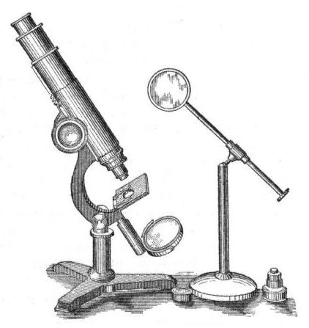
Details of the Language

Slide 44
Control and Lists

Slide 45
‘for’ Loops
Set one or more variables
for (i = …)

Slide 46
‘for’ Loops
Set one or more variables
for (i = …)
  [start:end]
  [start:step:end]
  [val, val2, val_n]

Slide 47
‘for’ Loops
Set one or more variables
for (i = …)
  [start:end]
  [start:step:end]
  [val, val2, val_n]
Rounding might affect your end

Slide 48
List Comprehensions

Slide 49
List Comprehensions
They’re magic!

Slide 50
List Comprehensions
They’re magic!
Advanced topic
  Check the cheatsheet and manual

Slide 51
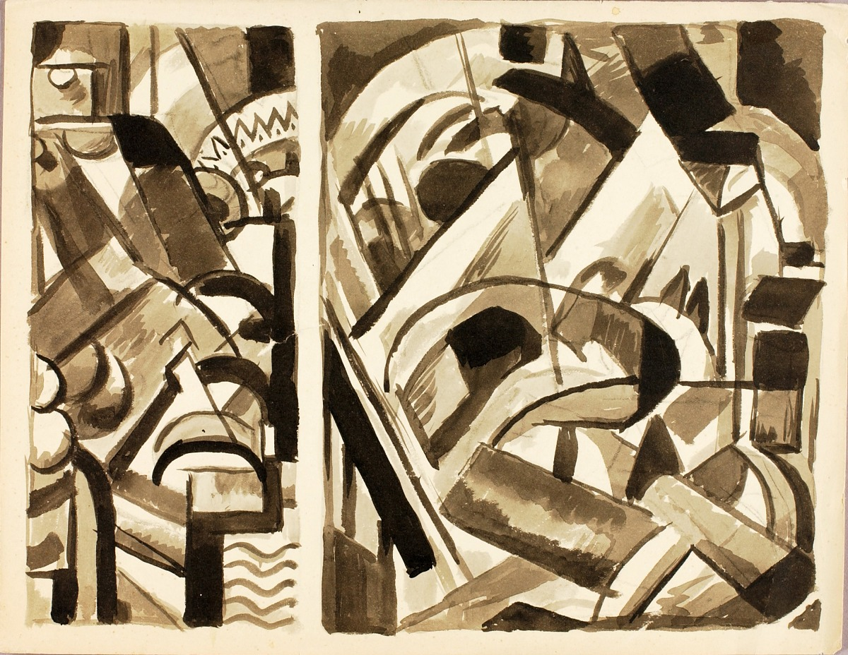
Primitives

Slide 52
2D Primitives
circle
square
polygon
text
import
  DXF
  SVG. Another talk in and of itself.
Projection

Slide 53
3D Primitives
sphere
cube
cylinder
polyhedron
linear_extrude
rotate_extrude
import
surface

Slide 54
Might Seem Incomplete
Missing types
Some secrets from the problem domain
Shapes have secrets

Slide 55
Secret Life of Shapes

Slide 56
Secret Life of Shapes
There are no circles/cylinders

Slide 57
Secret Life of Shapes
There are no circles/cylinders
N-gons! (regular polygon)
  Approximated

Slide 58
Secret Life of Shapes
There are no circles/cylinders
N-gons! (regular polygon)
  Approximated
The magic variables play here
Polygon is *inscribed*
Magic formula

Slide 59
Magic Variables
Calculated reasonably from each other
$fs
  Minimum size of facet
$fa
  Minimum angle for facets
$fn
  Minimum number of facets
  Overrides $fa and $fs

Slide 60
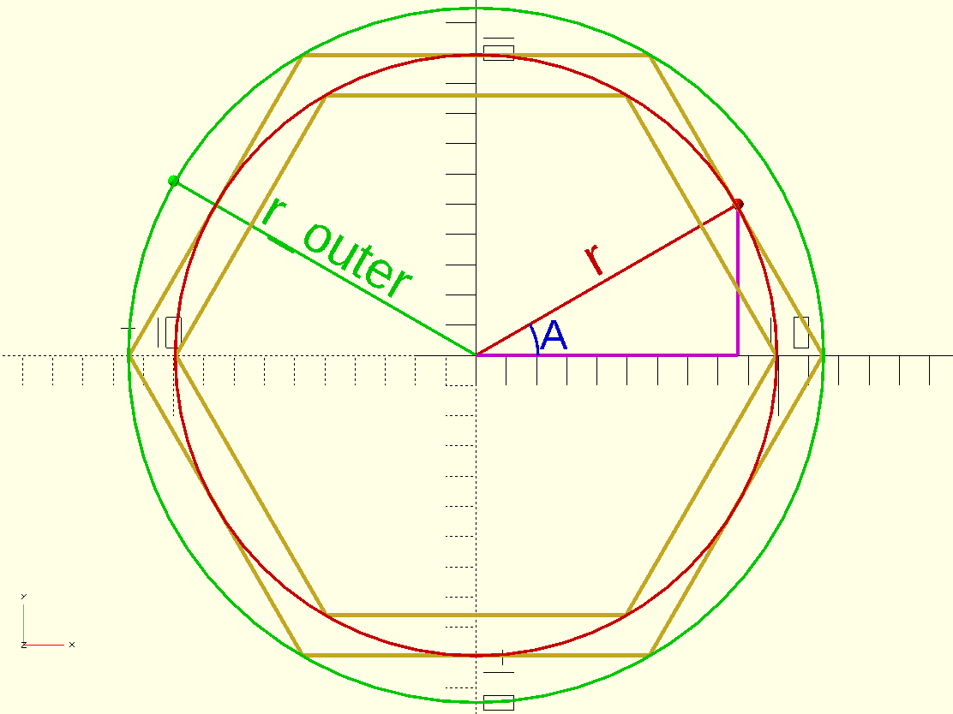
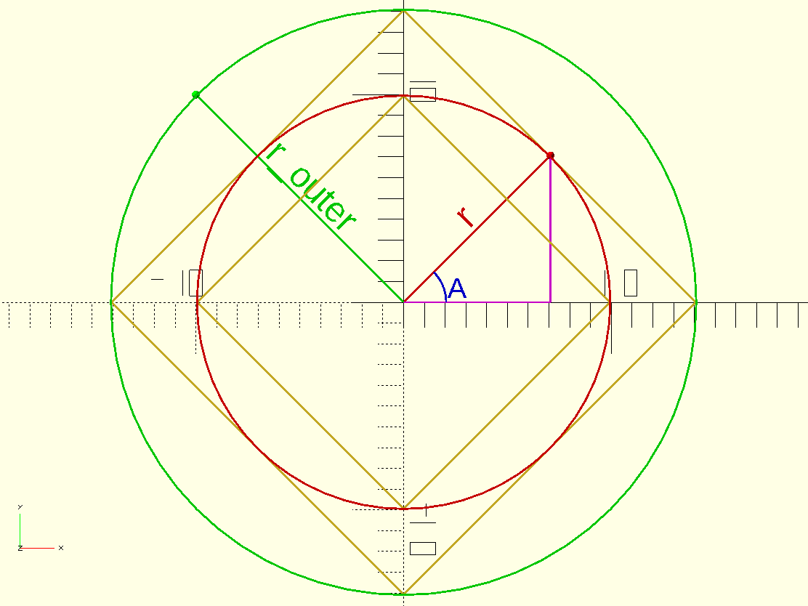
Magic Formula
r_outer = r / cos(angle)
  [ angle = 360 / (faces * 2) ]
  Edge-to-edge instead of point to point
  Polygon outside of circle
Use basic trig to get other relationships
  Don’t worry, math is your friend…

Slide 61
Secret Life of Cylinders
Not only are they extruded N-gons

Slide 62
Secret Life of Cylinders
Not only are they extruded N-gons
They are also cones
Pick your method
  r/d
  r1/d1 & r2/d2

Slide 63
Boolean Operations
union()
  Merges things together
difference()
  Cuts things out
intersection()
  Only the overlap

Slide 64
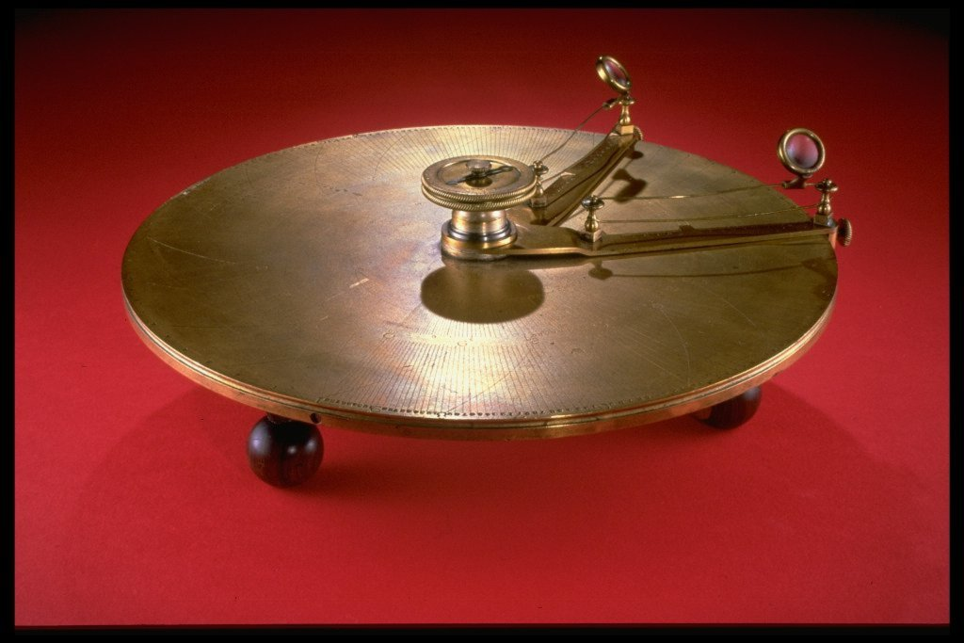
Math is Your Friend
(and easier when you can see it)

Slide 65
Math Reference Points…
Trig functions operate in degrees, not radians.
  PI is a predefined constant if you need it.
Rotation starts on the right and goes counter-clockwise
  Starts at “East” or “3 O’clock”
  Right-hand rule

Slide 66
Math You Can See
Creating 2D & 3D representations makes it easy to see
Chain individual transforms to see steps
Move to center, rotate, move back

Slide 67
Rotate, Move, Rotate, Move…
Move in a single direction/axis
Rotate
Repeat
Viola! you’re working with polar coordinates

Slide 68
What is the Matrix?

Slide 69
What is the Matrix?
Use matrix math if you like
Dot operations, etc.
Can build up to apply via multimatrix
I normally avoid so as to keep things visible
  Not how my brain works. YMMV

Slide 70
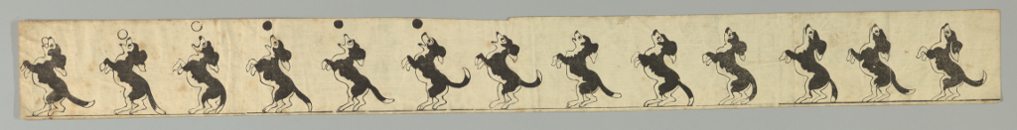
Animation is for Debugging?!?!

Slide 71
Animation in OpenSCAD
*very* simple
$t goes 0 to almost 1, or 1
Fraction based on the frames per second (fps) you feed the GUI

Slide 72
Animate to Debug???
To test motion
  Can leverage intersection() to see collisions
To test via sliding slicers
  e.g. use intersection() with a cube() that has translate() with something multiplied by $t in the translate.
To test parameters
  Edit by hand or use the customizer

Slide 73
Linear Animation is Jerky
Use simple ease-in/ease-out
<possible max> * cos(360 * $t)
  Vary with sin()
  Vary with 180, 90, etc. instead of 360
  Vary by adding some constant

Slide 74
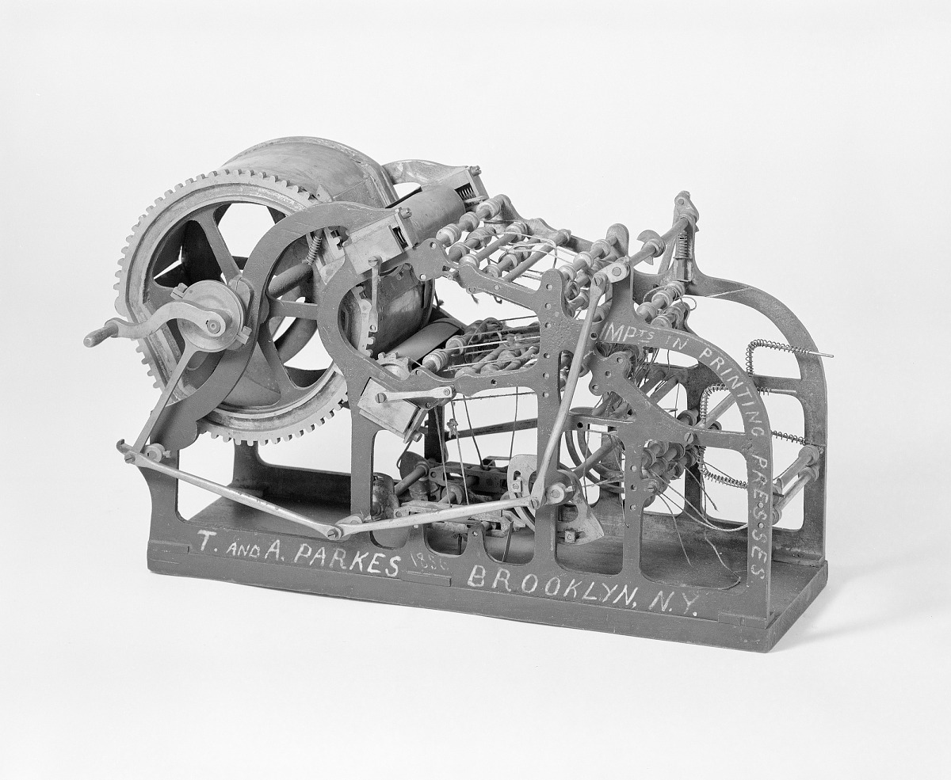
Going to Print

Slide 75
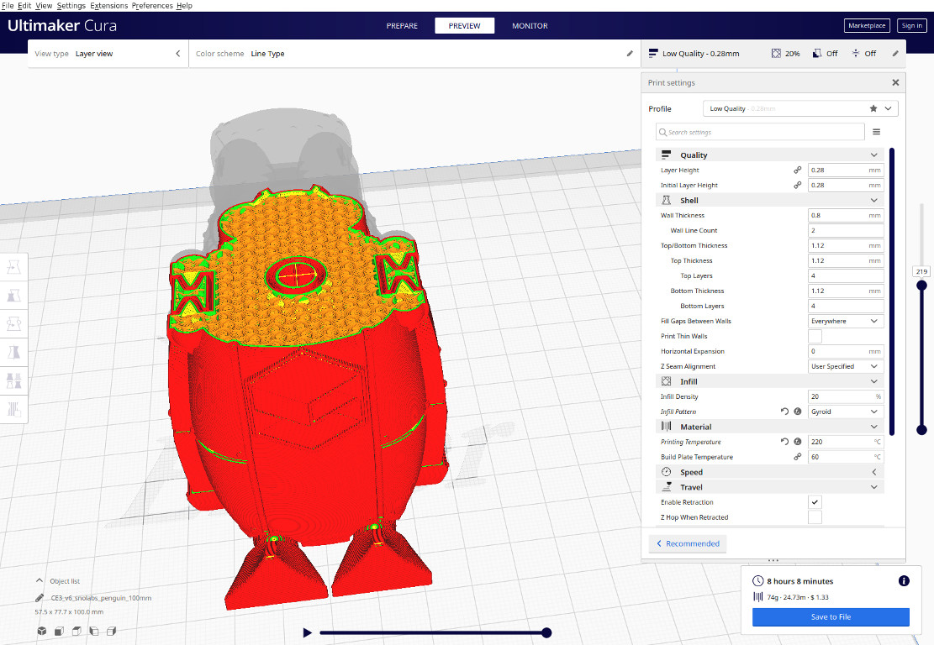
Slicers – what and why

Slide 76
What
Prepare your 3D shapes to be printed layer-by-layer
First step to real-world
Try to always preview

Slide 77
Which
Ultimaker Cura
PrusaSlicer
Simplyfy3D
Slic3r
OctoPrint (maybe)
  You give up all control

Slide 78
Printing Tricks

Slide 79
Printing for FDM
Normally max 45 degree overhang
Align for strength
Allow for printed sizes being slightly larger
  Specify a variable for the extra
Allow for slight extra expansion at the bottom
  Chamfer/angle the bottom

Slide 80
Advanced
A few hints
  Clips/bars (beams) twice the thickness at base
    Or four times the width
  Round sharp joints == fillet
    Radius ½ the width on clips
  Support ribs & gussets 60% normal wall width
Look for published info (papers on injection molding)
Collect your reference “Book of Magic”

Slide 81
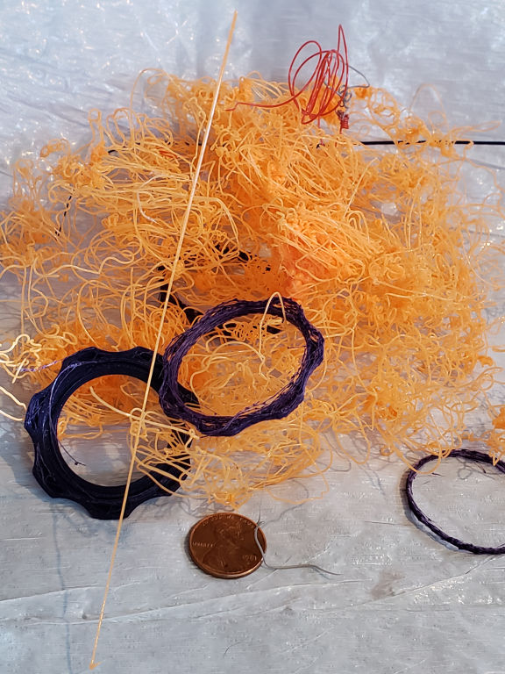
When (not if) Printing Fails
Try, try again
Look for what failed
  Hardware failure?
  Design of print?
  Orientation of print?
  Lack of supports?
  Lack of adhesion?

Slide 82
Winding Up

Slide 83
Common Places to Search/Share
yeggi
  Search for things
Thingiverse
  Hosting
  Has customizer for older OpenSCAD files
Other more specific place
  Many, many out there
  Tell me what to include

Slide 84
Opportunities for Revenue
Art sales
  Physical pieces
  Model sales
Designing custom parts
Printing for others
  Competing against many companies

Slide 85
Having Fun
Most important aspect
Hobby (for now)
You have control
Collaborate

Slide 86
Questions?

Slide 87
Thanks!

Slide 88
Bonus Features: First Links
OpenSCAD CheatSheet
  https://www.openscad.org/cheatsheet/
OpenSCAD User Manual
  https://en.wikibooks.org/wiki/OpenSCAD_User_Manual
Trigonometric ratios
  https://en.wikipedia.org/wiki/Trigonometry#Trigonometric_ratios

Slide 89
Bonus Features: Other Tools
FreeCad
  https://www.freecadweb.org/
Blender
  https://www.blender.org/
Tinkercad
  https://www.tinkercad.com/
SketchUp
  https://www.sketchup.com/
Fusion 360
  https://www.autodesk.com/products/fusion-360/overview

Slide 90
Bonus Features: Slicers
Ultimaker Cura
  https://ultimaker.com/software/ultimaker-cura
PrusaSlicer
  https://www.prusa3d.com/prusaslicer/
Simplyfy3D
  https://www.simplify3d.com/
Slic3r
  https://slic3r.org/
OctoPrint
  https://octoprint.org/

Slide 91
Bonus Features: Things
Collection of some Things referenced and used
  https://www.thingiverse.com/joncruz/collections/scale-18x
Basic Mechanical Features Glossary for Machining or Machinists
  https://www.thingiverse.com/thing:4148211
Cali Cat - The Calibration Cat
  https://www.thingiverse.com/thing:1545913
Collapsing Jian (Print in Place)
  https://www.thingiverse.com/thing:3837891
i-Stor Hexi - modular parametric miniature storage and transport
  https://www.thingiverse.com/thing:4094084
i-Stor Hexi Risers
  https://www.thingiverse.com/thing:4131964

Slide 92
Bonus Features: Artwork
Artwork by Louise Driggers
  https://twitter.com/loubie_3d
  Wolfsong
    https://snolabs.com/wolfsong/
  SnoLabs Penguin
    https://snolabs.com/snolabs-penguin/

Slide 93
Bonus Features: Possible collaboration/community resources
Note that you can look for areas for general 3d print design issues and also for OpenSCAD specific.
OpenSCAD Community
  https://www.openscad.org/community.html
Thingiverse Groups
  https://www.thingiverse.com/groups
  https://www.thingiverse.com/groups/openscad
r/openscad
  https://www.reddit.com/r/openscad/
r/3Dprinting
  https://www.reddit.com/r/3Dprinting

Slide 94
Bonus Features: Federated...
Print A Thing
  https://printathing.com/

Slide 95
Bonus Features: Sources to look for content
yeggi
https://www.yeggi.com/
Thingiverse
https://www.thingiverse.com/
https://www.thingiverse.com/newest
Cults 3D
https://cults3d.com/
Shapeways
https://www.shapeways.com/

Slide 96
Bonus Features: Image Sources
Smithsonian Open Access
  https://www.si.edu/openaccess
Wikimedia Commons
  https://commons.wikimedia.org/wiki/Main_Page

Slide 97
Magic Formula
# Sides | Per slice | formula
4 | 90 | r/cos(45)
5 | 72 | r/cos(36)
6 | 60 | r/cos(30)
7 | 51.43 | r/cos(25.71)
8 | 45 | r/cos(22.5)

