Slide 1

Advanced Regression Models with R Applications
Dr. Olga Korosteleva CSULB, Department of Mathematics & Statistics
Orange County R Users Group Fall Workshop, 2019

Slide 2
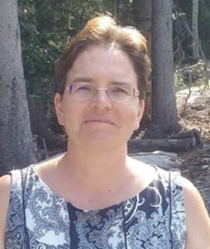
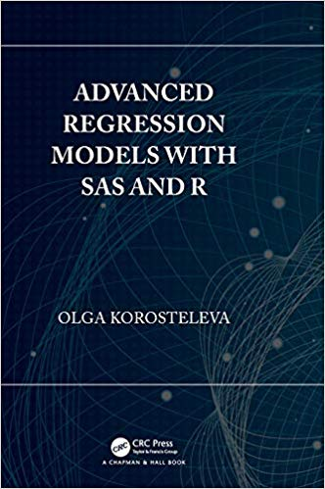
Dr. Olga Korosteleva
http://web.csulb.edu/~okoroste/

Slide 3
Workshop Topics
Linear regression
Gamma regression
Ordinary logistic regression
Poisson regression
Zero-inflated Poisson regression
Beta regression
Longitudinal random slope & intercept regression
Longitudinal logistic regression
Hierarchical models

Slide 4
Schedule
Time | What | Where
8:30 – 9:00 AM | Registration | SB1 Lobby
9:00 – 9:30 AM | Intro & Computer Set-up | SB2200
9:30 – 11:00 AM | Session 1 | SB2200
11:00 – 11:15 AM | Break
11:15 – 12:30 PM | Session 2 | SB2200
12:30 – 1:30 PM | Lunch | Patio, 3rd Floor
1:30 – 2:30 PM | Session 3 | SB2200
2:30 – 2:45 PM | Break
2:45 – 4:15 PM | Session 4 | SB2200
4:15 PM – 4:30 PM | Wrap-up | SB2200

Slide 5
Important Links
GitHub Repo https://github.com/socalrug/advanced_regression_2022-10-01
Slack Channel for the workshop: #regression-2022 https://tinyurl.com/socalrug-slack
Dr. Olga Korosteleva http://web.csulb.edu/~okoroste/
Advanced Regression Models with SAS and R https://www.amazon.com/dp/1138049018/
Orange County R Users Group https://www.meetup.com/SOCAL-RUG/

Slide 6
Special Thanks To
Dr. Olga Korosteleva
Paul Merage School of Business
Helpers & Volunteers
SoCal RUG Members

