Slide 1
California
Housing
Price Increase
Team Lasagna:
Jiwon Ko
Chloe Ko
Taeho Lee
Michelle Ng
Rohit Cherian

Slide 2
TOPIC
What are the important factors
for rent price increase in California?
SAN FRANCISCO
IRVINE
SAN DIEGO
FRESNO
SAN JOSE
LOS ANGELES

Slide 3
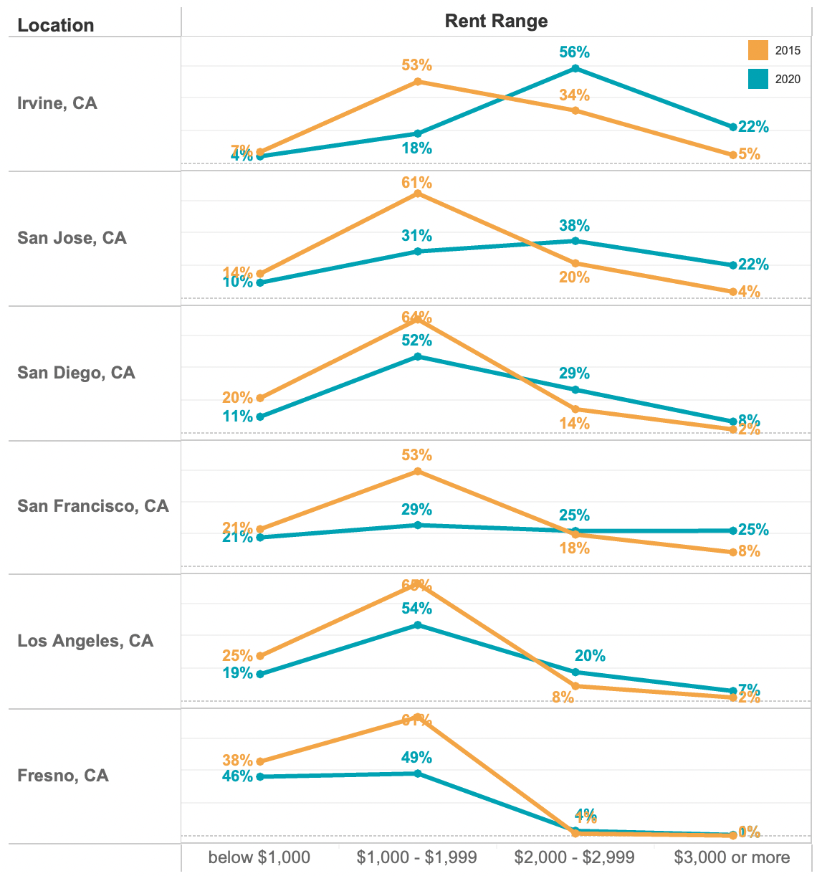
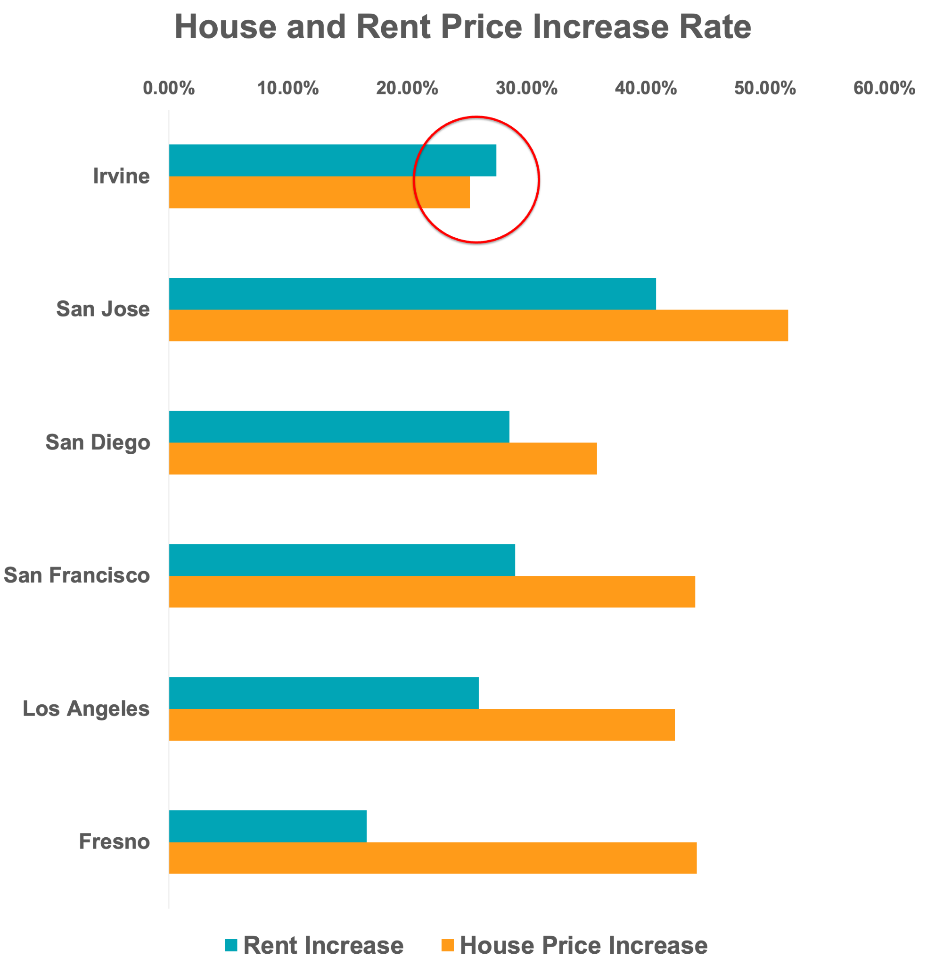
RENT VS HOUSE PRICE IN 2015 AND 2020
Rent Price Change from 2015 to 2020
House and Rent Price Increase Rate
Rent price range in $2,000 or more has been increased in Irvine, San Jose, San Diego.

Slide 4
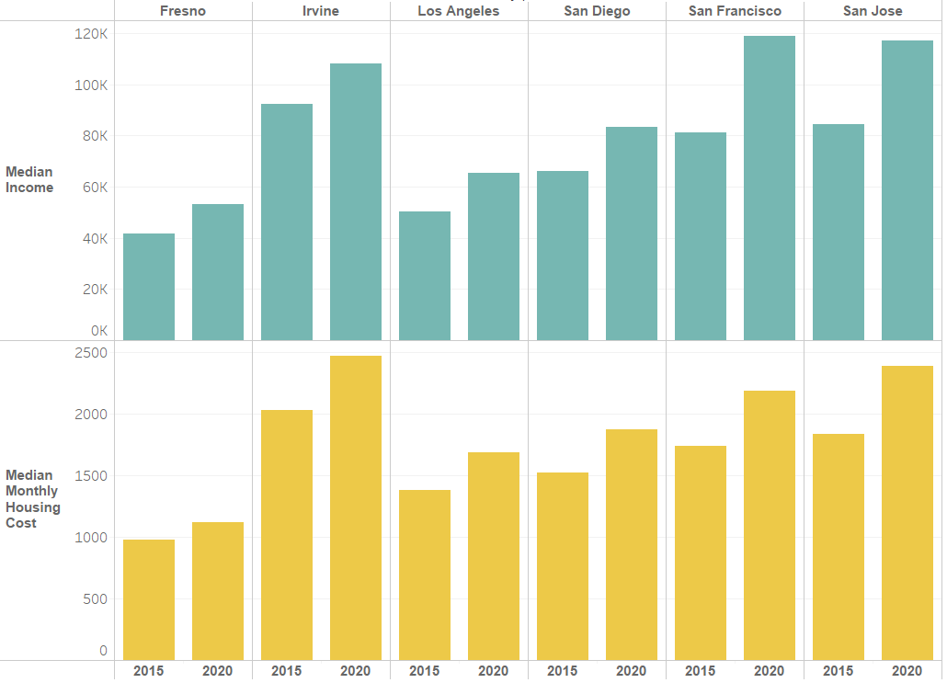
Income and Housing Cost in 2015 vs 2020
Positive relationship between income and housing cost
Fresno has the least increase in housing cost
Out of the 6 cities, Irvine is the most costly city to live in
Notes:
As shown from the graphs above we can see that the incomes increased from 2015 to 2020, and so did the housing costs. There is a positive relationship between income and housing costs, and we can

Slide 5
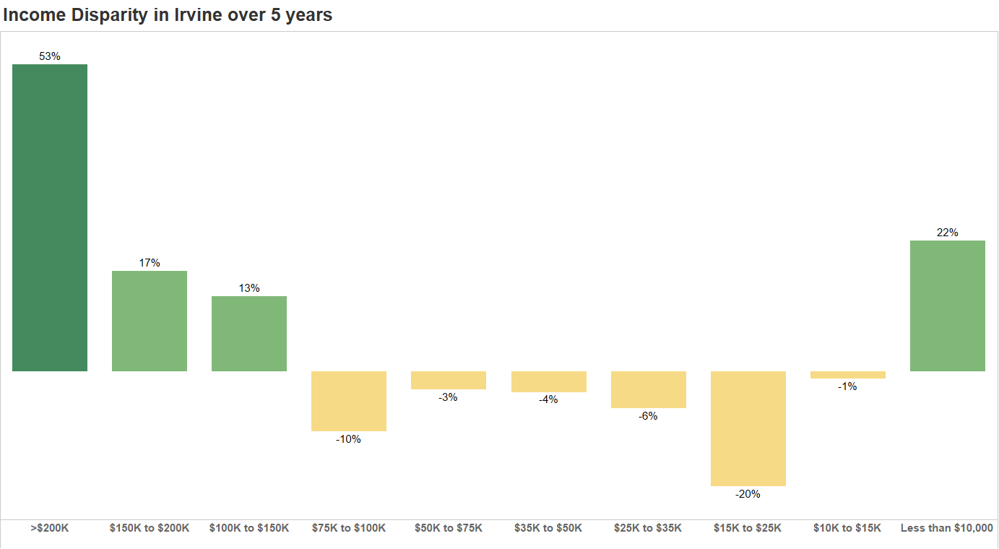
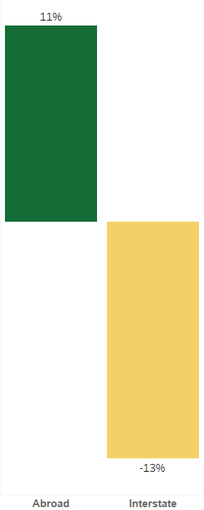
INCOME / MOBILITY
Income Disparity in Irvine over 5 years
Mobility of Working Age Group 25-45
Higher Income buckets in Irvine have the highest population growth over the last 5 years, whereas low income buckets experienced negative growth
Irvine has a substantial increase in the number of people coming from Abroad, as compared to population moving from another state over the last 5 years

Slide 6

RENT PRICE INCREASE PREDICTION
Target variable
Gross rent
Selected Features
% changes between 2015 & 2020 :
Median age, Moving(from another state), Moving(from abroad), Median income, Total population, Race(White),House value
Prediction Result
 | Anaheim | Long Beach | Tustin
Actual | 26.86% | 23.98% | 22.16%
Predict | 31.81% | 40.12% | 23.31%

Slide 7
THANK YOU
Question?

