Slide 1

Introduction to Stochastic Processes
Dr. Olga Korosteleva CSULB, Department of Mathematics & Statistics
Southern California R Users Group Winter Workshop, 2023

Slide 2
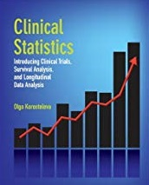
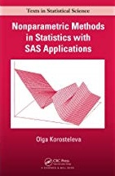
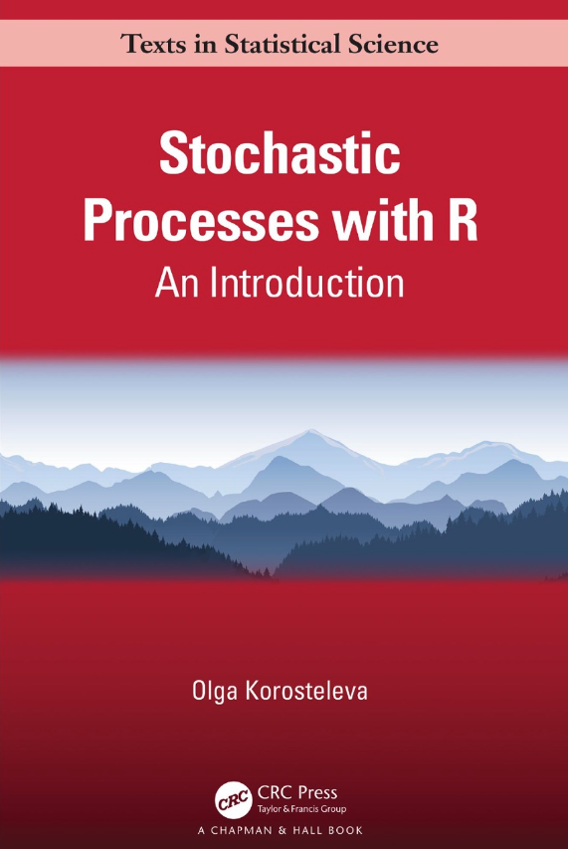
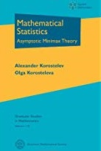
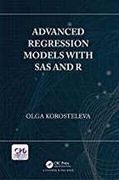
Dr. Olga Korosteleva

Slide 3
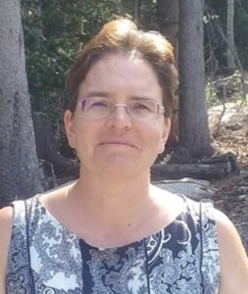
Dr. Olga Korosteleva
Friend to SoCal RUG
6 course in 4 years
Advanced Regression
Modeling Normally Distributed Data with Repeated Measures
Nonparametric Analysis
Bachelor in Mathematics, Wayne State University (1996)
Ph.D. in Statistics, Purdue University (2002)
Professor of Statistics
Department of Mathematics and Statistics at CSU Long Beach
Faculty supervisor for the Statistics Student Association
Southern California Chapter of the American Statistical Association (SCASA)
Past-president
Editor-in-chief of monthly eNewsletter
http://web.csulb.edu/~okoroste/

Slide 4
Workshop Topics
Markov Chain
Random Walk
Poisson
Birth-and-death
Branching process
Brownian motion

Slide 5
Schedule
Time | What | Where
8:30 – 9:00 AM | Computer Setup | SB1 2100
9:00 – 9:10 AM | Introduction | SB1 2100
9:10 – 10:50 AM | Session 1 | SB1 2100
10:50 – 11:10 AM | Break
11:10 – 12:00 PM | Session 2 | SB1 2100
12:00 – 1:00 PM | Lunch | Patio, 3rd Floor
1:00 – 2:40 PM | Session 3 | SB1 2100
2:40 – 3:00 PM | Break
3:00 – 3:50 PM | Session 4 | SB1 2100
3:50 – 4:30 PM | Wrap-up and buffer | SB1 2100

Slide 6
Important Links
GitHub Repo https://github.com/socalrug/stochastic_processes_2023-02-11
Slack Channel for the workshop: #stochastic-2023 https://tinyurl.com/socalrug-slack
Dr. Olga Korosteleva http://web.csulb.edu/~okoroste/
Stochastic Processes with https://www.amazon.com/dp/1032153733/
Southern California R Users Group https://www.meetup.com/SOCAL-RUG/

Slide 7
Special Thanks To
Dr. Olga Korosteleva
Paul Merage School of Business
Helpers & Volunteers
SoCal RUG Members

