Slide 1

Instruction Mix
Analyzer
A Presentation by: Nathan Galay

Slide 2
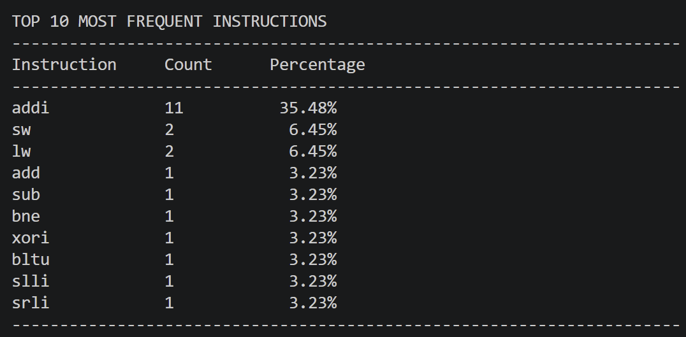
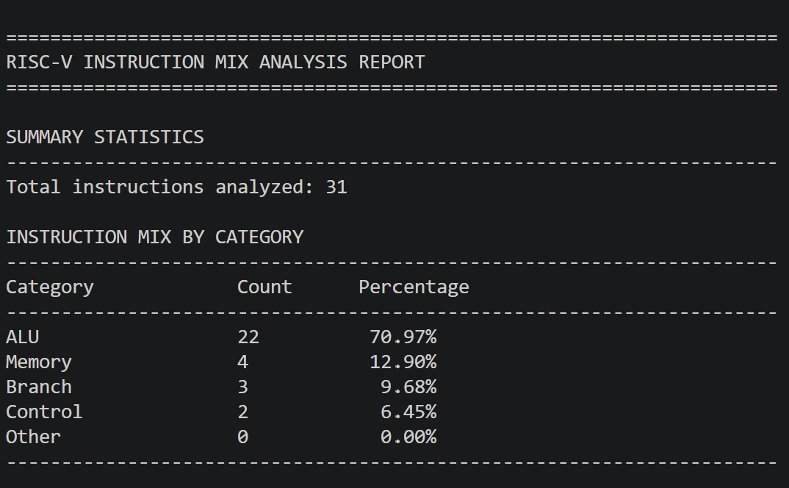
Introduction
I wanted to know the instruction set given in the assignments
straight-forward
Take in a .txt file that is filled with hex code; the code looks through the instructions and returns the instruction types and the specific instruction:
ALU
Memory
Branch
Control
Other

Slide 3

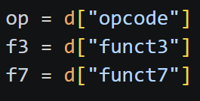
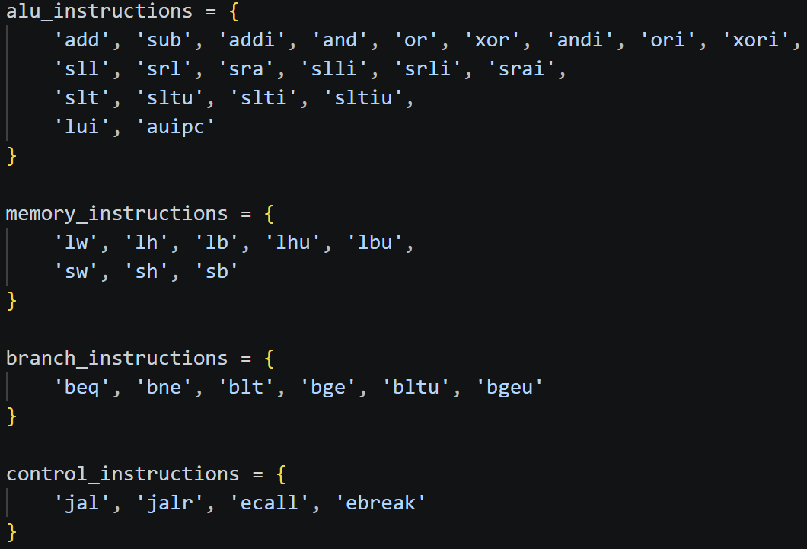
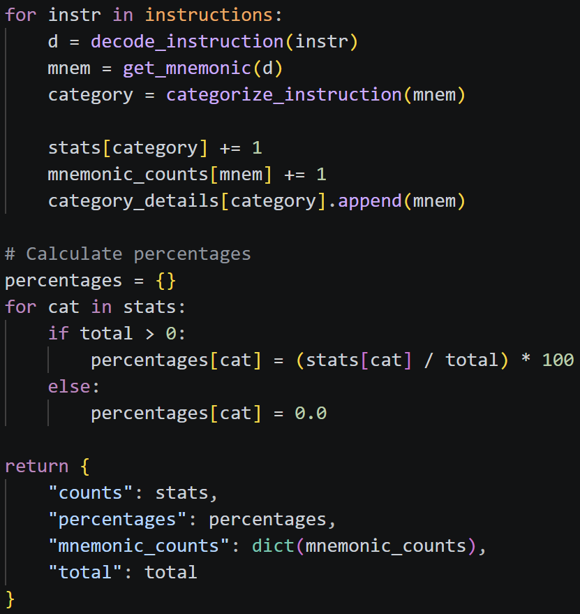
Looped Through:
Find the specific instruction:
Get Stats:
Key Code Structures

Slide 4
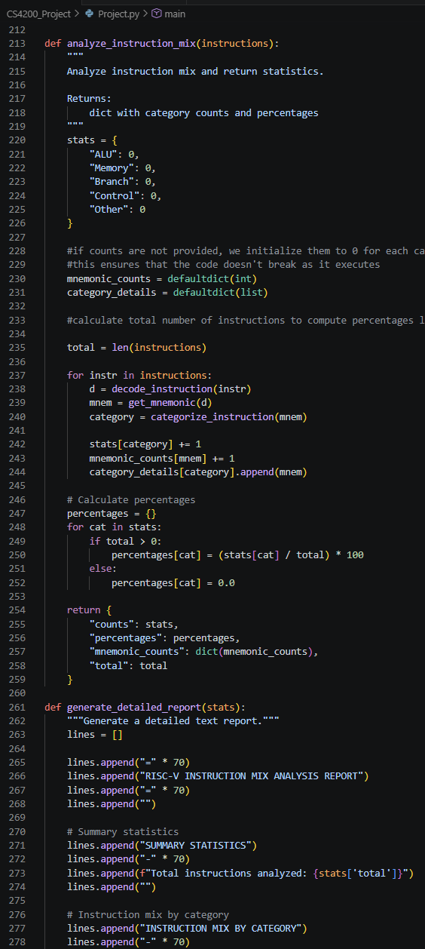
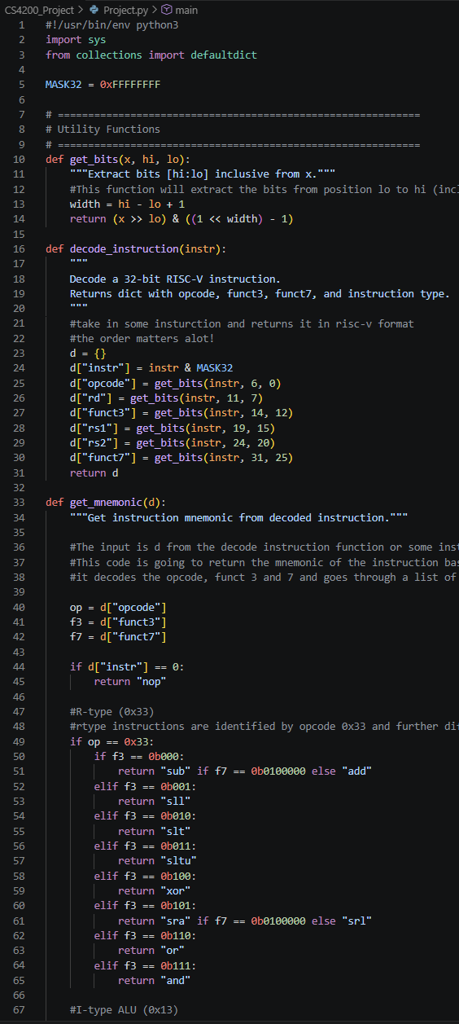
Demo
Hex was taken from a random previous assignment.

Slide 5
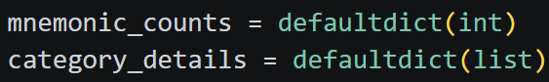
Findings and Observations
Instruction Type Coverage:
4 categories
39 specific instructions
Performance Analysis
you can see the CPU performance
Examine and find NOP instructions
I had to find ways to fill in sets that are empty when decoded (caused error):
You can witness the amount of compute, memory, and branch instructions there are in an instruction set.

