Slide 1
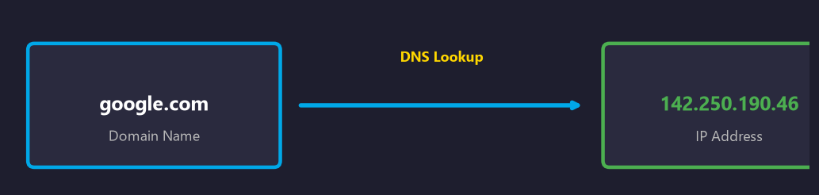
DNS RESOLUTION
How the Internet Finds Its Way
The Domain Name System — From Browser to Bytes

Slide 2
What is DNS?
The Domain Name System (DNS) is the phonebook of the Internet.
Translates domain names (google.com) into IP addresses (142.250.190.46)
Eliminates the need to memorize numeric IP addresses
Distributed, hierarchical database — no single point of failure
One of the oldest and most critical components of modern networking
Primarily operates on UDP port 53 with TCP fallback

Slide 3
Why DNS Matters
User Experience — Names are easier to remember than numbers
Performance — Caching at every level reduces lookup latency
Security — DNSSEC, DNS-over-HTTPS, DNS-over-TLS
Load Balancing — Round-robin DNS distributes traffic
Filtering — Block malicious domains at the resolver level
Service Discovery — SRV records locate services automatically
Resilience — Anycast routing with redundant nameservers

Slide 4
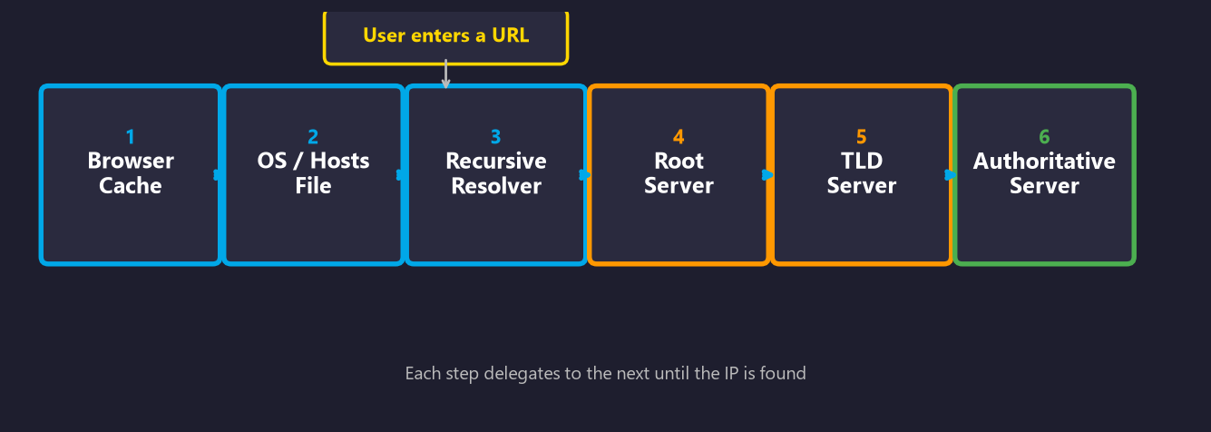
DNS Resolution — Full Pipeline

Slide 5
Step 1: Browser DNS Cache
Before any request, the browser checks its in-memory cache
Cache lifetime controlled by the record's TTL (Time-To-Live)
Typical TTLs range from 60 seconds to 24 hours
Chrome: chrome://net-internals/#dns
Firefox: about:networking#dns
Example Cache Entries:
google.com → 142.250.190.46
github.com → 140.82.121.3
stackoverflow.com → 151.101.1.69
Found in cache? → Immediate sub-millisecond resolution
Not found? → Query moves to the OS resolver

Slide 6
Step 2: Operating System & Hosts File
If browser cache misses, the OS resolver is queried
The OS maintains its own DNS cache via the system resolver
Before the cache, the system checks the static hosts file
OS Resolver — System-level DNS cache
View cache: ipconfig /displaydns (Windows)
Flush cache: ipconfig /flushdns (Windows)
Linux/macOS: sudo killall -USR1 mDNSResponder
Hosts File — Static IP-to-hostname mappings
Windows: C:\Windows\System32\drivers\etc\hosts
Linux: /etc/hosts
macOS: /etc/hosts
Used for: dev overrides, ad blocking, security
No match at OS level? → Query forwarded to the configured DNS resolver

Slide 7
Step 3: Recursive Resolver
Also called the recursive DNS server or full resolver
Does the heavy lifting — queries root, TLD, then authoritative
Caches results to speed up future requests for all users
Typically provided by your ISP or a public DNS service
How It Works:
1. Your device sends the query to the resolver
2. Resolver checks its own cache first
3. On cache miss, queries the root server
4. Root returns the TLD server address
5. TLD returns the authoritative server address
6. Authoritative server returns the IP address
7. Resolver caches the result and returns it
Google Public DNS 8.8.8.8 | 8.8.4.4
Cloudflare 1.1.1.1 | 1.0.0.1
Quad9 9.9.9.9
OpenDNS 208.67.222.222 | 208.67.220.220

Slide 8
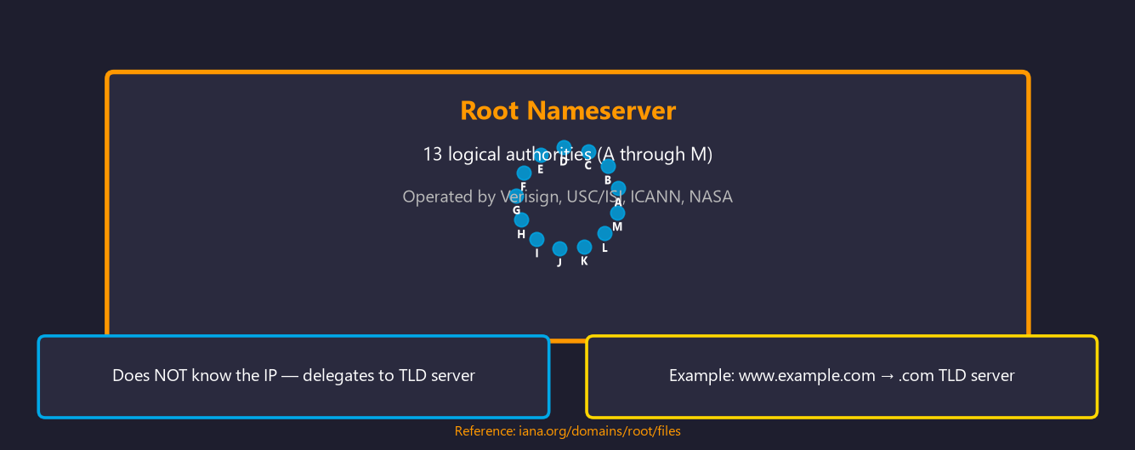
Step 4: Root Nameserver

Slide 9
Step 5: TLD Nameserver
The TLD server manages a specific TLD (.com, .org, .uk, etc.)
Operated by domain registries (Verisign runs .com and .net)
Does NOT have the IP — returns the authoritative nameserver
Resolution Flow:
Browser → OS → Resolver → Root → TLD → Authoritative
After the root, the query goes to the TLD
server which then points to the authoritative
server that holds the actual DNS records.
gTLDs (Generic) .com .org .net .info
ccTLDs (Country) .uk .de .jp .in .br
New gTLDs .dev .app .blog .io

Slide 10
Step 6: Authoritative Nameserver
The final stop — holds the actual DNS resource records
Configured by the domain owner via a DNS hosting provider
Returns the actual IP address (or the requested record type)
Can be primary (master) or secondary (slave) for redundancy
Common DNS Providers:
Cloudflare DNS
AWS Route 53
Google Cloud DNS
Azure DNS
Namecheap
GoDaddy
After the Authoritative Server Responds:
1. The recursive resolver caches the response (respecting the TTL)
2. The resolver returns the IP address to your browser
3. Your browser opens a TCP connection to that IP address
4. The page loads — all within milliseconds

Slide 11
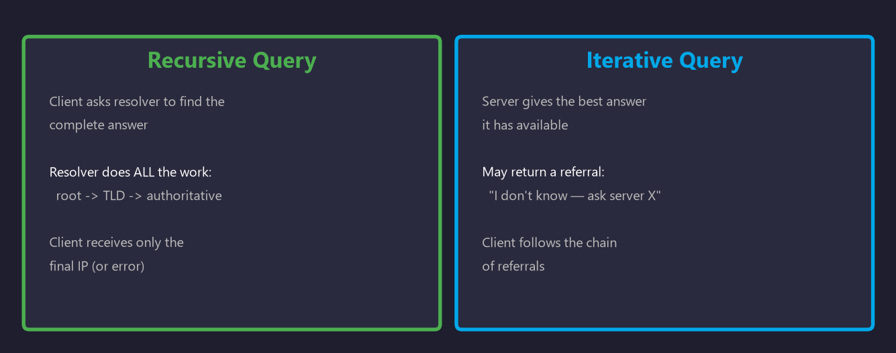
Recursive vs Iterative Query

Slide 12
Common DNS Record Types
A — IPv4 address
Example: 192.0.2.1
AAAA — IPv6 address
Example: 2001:db8::1
CNAME — Canonical name (alias)
Example: www → example.com
MX — Mail exchange
Example: mail.example.com
TXT — Text / SPF / DKIM
Example: v=spf1 include:_spf.google.com
NS — Nameserver
Example: ns1.example.com
SRV — Service location
Example: _sip._tcp.example.com
SOA — Start of Authority
Example: Primary NS, refresh, retry

Slide 13

DNS Caching Hierarchy

Slide 14
DNS Troubleshooting Tools
nslookup
Query DNS interactively or inline
$ nslookup example.com
dig
Detailed query with full output
$ dig example.com A +trace
ping
Test reachability (resolves DNS)
$ ping google.com
tracert
Trace network path to destination
$ tracert google.com
ipconfig
Flush OS DNS cache (Windows)
$ ipconfig /flushdns
systemd
Query Linux systemd-resolved
$ systemd-resolve --status

Slide 15
Key Takeaways
DNS translates human-friendly domain names into machine-readable IP addresses
Resolution follows a strict 6-step hierarchy: cache → OS → resolver → root → TLD → authoritative
Caching occurs at every level, dramatically reducing lookup latency
TTL (Time-To-Live) values control how long records are cached at each level
Recursive resolvers do the work for you; iterative queries chain referrals
DNSSEC, DNS-over-HTTPS (DoH), and DNS-over-TLS (DoT) improve security and privacy
Tools like dig, nslookup, and ping help diagnose DNS resolution issues
DNS Resolution — How the Internet Finds Its Way

