Slide 1
Segmentation Comparison
2025-08-20

Slide 2
Cell Level Segmentation
Halo
MP + Halo Software
Cortana
Deepcell/Mesmer ML Pipeline
Version 1:
No parameter opts

Slide 3
Direct comparison:
Halo
Cell Bounding Box
Cortana
Points @ Cell Coordinates

Slide 4
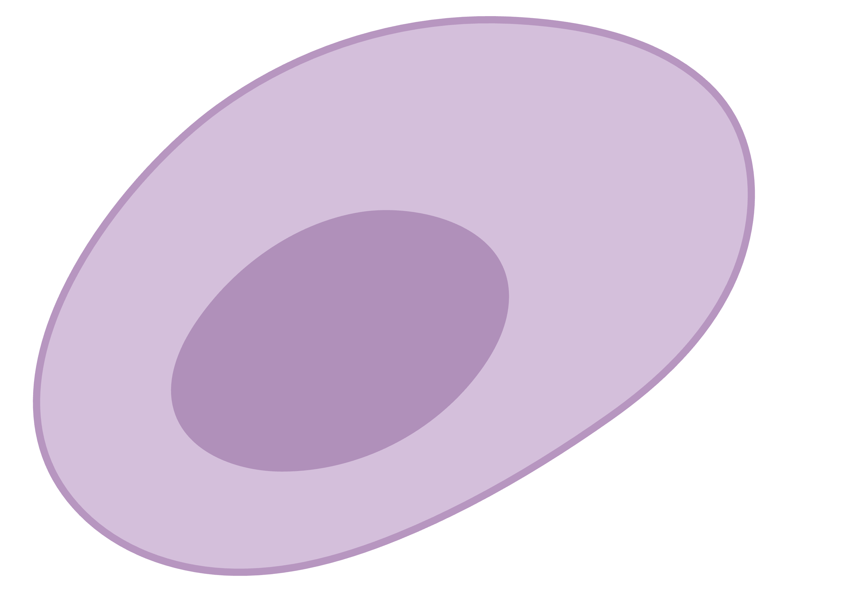
Geometry conventions
Halo gives a bounding box that frames the cell
This is the only location information it has
Mesmer gives the coordinates of the cell centroid
Also gives centroid of nucleus (not showing here)
We have the full pixel level information for cells so have much more info to use if needed

Slide 5
Direct comparison:
Halo
Cell Bounding Box
Cortana
Points @ Cell Coordinates

Slide 6
SampleID | Overlap Count | Description | Cortana (%) | Halo (%)
GBM_043 | 0 | No overlap | 13.02 | 4.8
GBM_043 | 1 | Single match | 82.77 | 88.86
GBM_043 | 2 | Multiple matches | 4.05 | 5.57
GBM_043 | 3 | Multiple matches | 0.15 | 0.69
GBM_043 | 4 | Multiple matches | 0 | 0.07
GBM_043 | 5 | Multiple matches | 0 | 0.01

