Slide 1

Artifacts That Explain Themselves: Build Metadata in Practice
Socheat Sou
Prajakta Kashalkar

Slide 2
Background
Over 40+ separate repos each with their own build
Fully airgapped – All images references use digests and not tag
Makes it difficult for team to really know what’s been built or installed
Developers want to know ”Is our code in this image?”
Testers want to know ”Which build is installed on the system?”

Slide 3
Metadata in Container Labels
Tracked metadata in a Git repo but cumbersome for non-DevOps
Adding metadata to container labels is more accessible
Used a prefix to quickly filter for our labels
Anyone could inspect images with digest to get the metadata – doesn’t require a running system
{
...
"isf.git_commit": "3a97fb6",
"isf.version": "2.11.1",
"isf.build_run": "64t-6vw",
"isf.is_hotfix": "true",
"isf.hotfix_reference": "78219",
"isf.internal": "true",
"isf.backup_service": "v11.0.0",
"isf.storage_service": "v5.5.1"
...
}

Slide 4
Immediate Benefits
Catalogs diff – enabled us to do Git bisect type operations when debugging regressions
Implemented simple build cache – Lookup Git commit of latest CICD build and skip the build if commit hasn’t changed, which is faster than Docker cache mechanisms
Operator | Working Build Log 20260407 | Broken Build Log 20260409 | Git Diff
ui | https://.../r4t-6vw | https://.../b3c-5de | 3a97fb6...6a1d8e3
storage | https://.../9x1-c2y | https://.../f7g-0hi | e7a3c91...4b6f2d5
network | https://.../d8f-3gh | https://.../k4l-8mn | 2b9d6f4...8e1a3c7

Slide 5
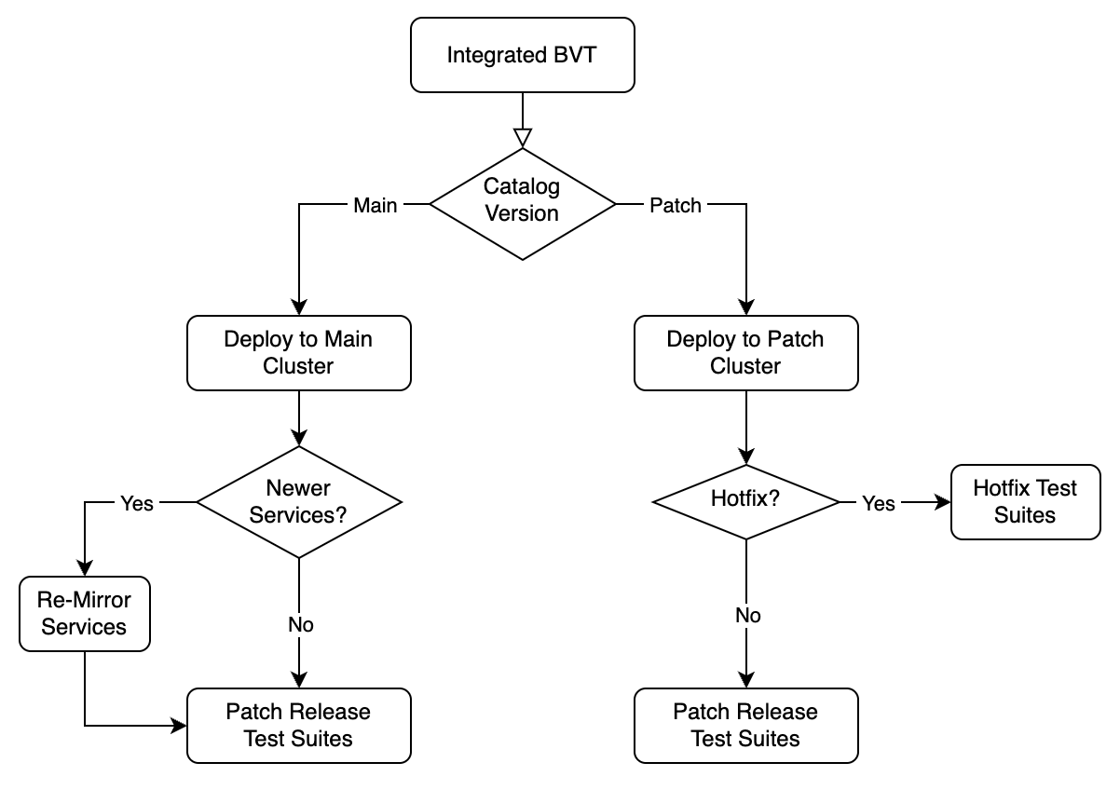
Portable Feature Flags
Enhanced our GitOps orchestration.
Some examples:
Cluster deployment is chosen based on version in image
Mirror the appropriate versions of services
Trigger different test suites if this is a hotfix image

Slide 6
Enabling Innovation
Labels implemented for DevOps, but unexpectedly was useful to other teams
Our security scanning pipelines automatically create CVE Git issues with a lot of audit data, including our container labels
Security team built a dashboard to help developers manage CVE issues and visualize trends, incorporating these labels in their design
Dashboard has ”hotfix” filter to get list of all hotfix images published
Especially useful in this AI era where data is passed to AI tools for processing and analysis

Slide 7
Recommendations
Take advantage of your artifacts that support adding and querying metadata
Other artifact types can be augmented to support embedding metadata
Consider what data is intrinsic to your artifacts
Brainstorm with your other teams to determine additional effective labels
Make it easy to add and query metadata to your artifacts to speed adoption
Expose enough data for your needs, but not so much that it's a security concern

Slide 8
Thank You!

