Slide 1


DECISION TREES IN ACADEMIC SUCCES IN SABER PRO

Slide 2
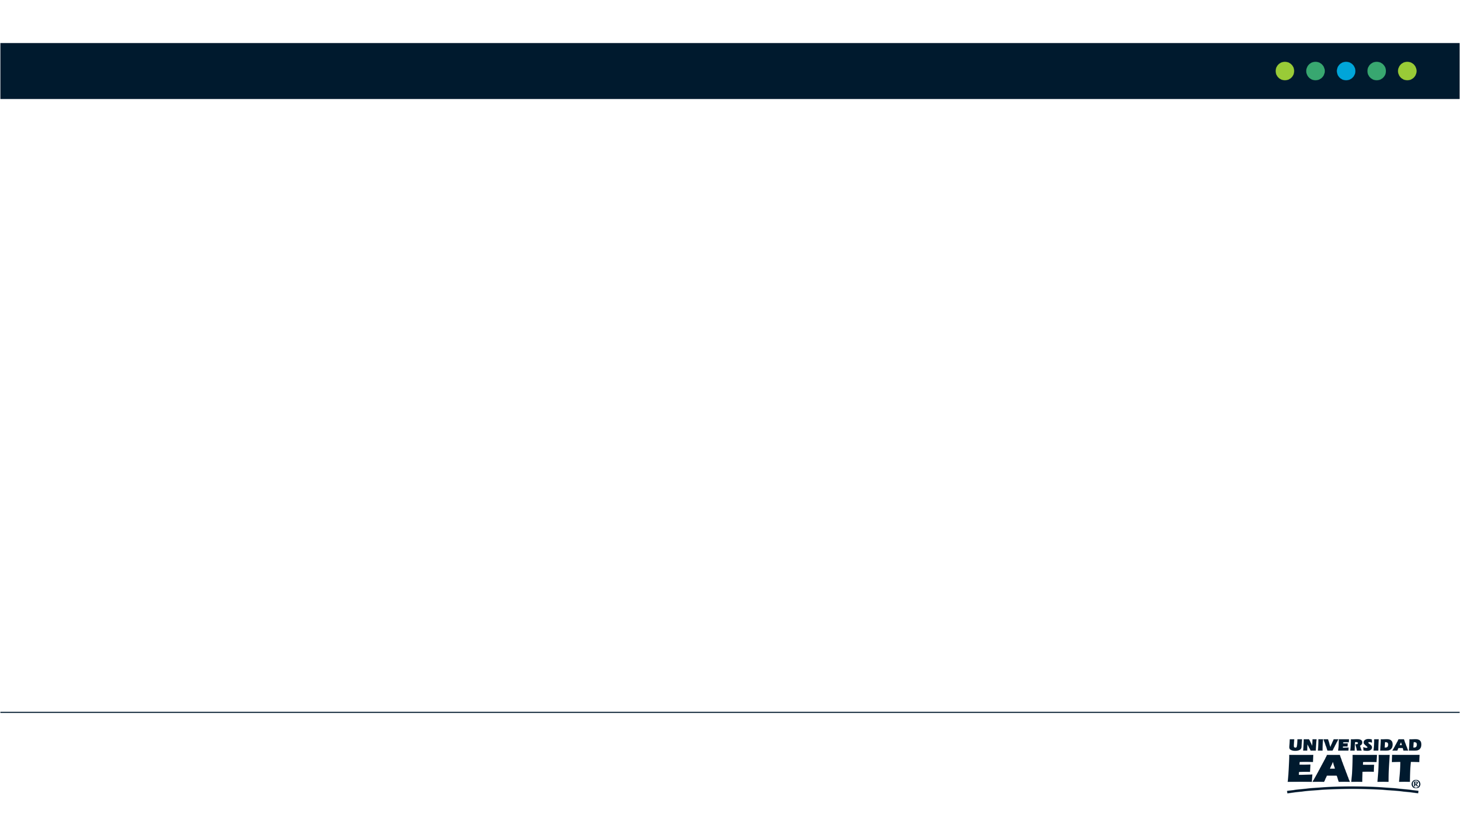





Team Presentation
Santiago
Ochoa
Miguel Angel
Zapata
Miguel Correa
Mauricio
Toro
http://github.com/ /proyecto/
sochoac1

Slide 3
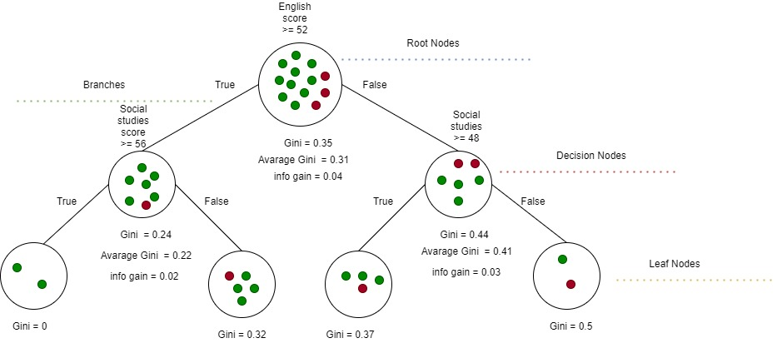

Algorithm Design
To build a binary tree the algorithm implemented was CART. In this example, we show a model to predict the academic success as the probability that a student must get a score above the average in the Saber pro.

Slide 4
Node Splitting
English score
>=52
Social studies
score >=56
Gini impurity = 0.23
Info gain = 0.02
Gini impurity = 0.48
Info gain = 0.1
Gini Average = 0.21
Gini Average = 0.38
Gini impurity = 0
Gini impurity = 0.32
Gini impurity = 0.37
Gini impurity = 0.41

Slide 5

Algorithm Complexity
 | Time Complexity | Memory Complexity
Training the model | O(N²*M*2^{M}) | O(N*M*2^{M})
Testing the Model | O(N*M) | O(1)
The variable N represents the number of rows and M represents the number of columns of a matrix which contains the training dataset to build the tree.

Slide 6
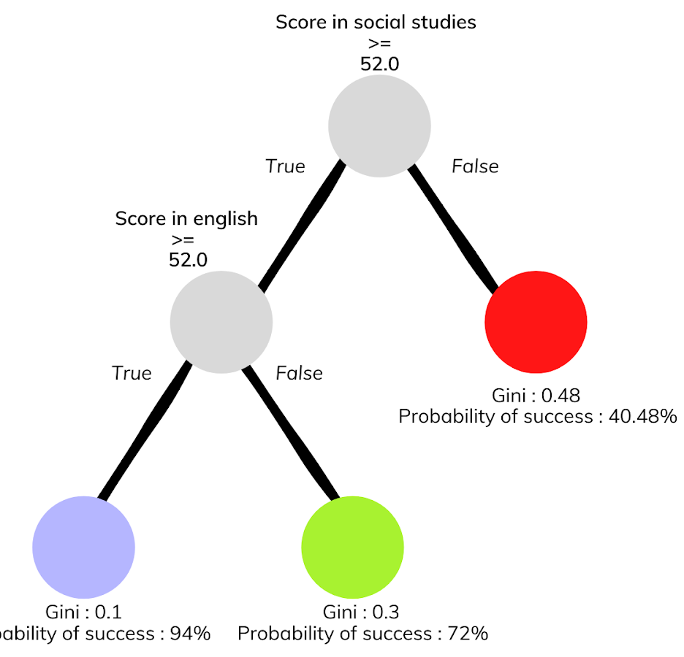
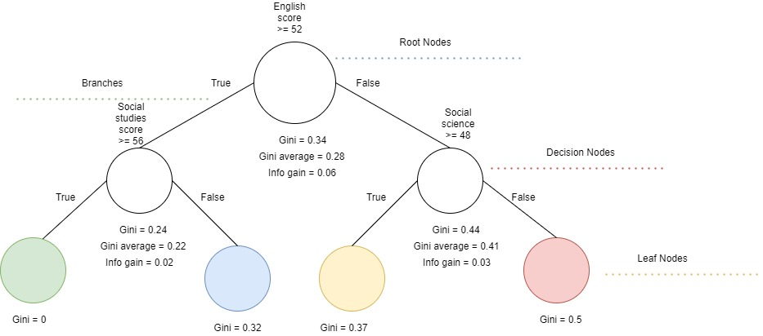



Decision-Tree Model
Most Relevant Features
Social Studies
English
Science
A binary decision tree to predict Saber Pro scores based on the results of Saber 11. Green nodes represent those with a high probability of success, blue ones a medium probability, violet a probability between medium and low and the red ones a low probability of success.

Slide 7
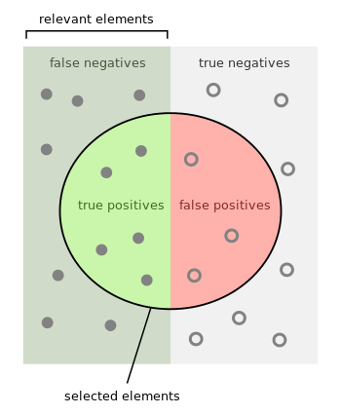
Evaluation Metrics
Exactitud
Precisión
Sensibilidad

Slide 8

Evaluation Metrics
 | Training data set | Testing data set
Accuracy | 0.78 | 0.77
Precision | 0.75 | 0.76
Recall | 0.8 | 0.79
Evaluation metrics using a training dataset of 135,000 students and test dataset of 45,000 students.

Slide 9


Time and Memory Consumption
Time Consumption
Memory Consumption

Slide 10
THANK YOU!

