Slide 1


DECISION TREES IN ACADEMIC SUCCES IN SABER PRO

Slide 2






Team Presentation
Santiago
Ochoa
Miguel Angel
Zapata
Miguel Correa
Mauricio
Toro
http://github.com/ /proyecto/
sochoac1

Slide 3
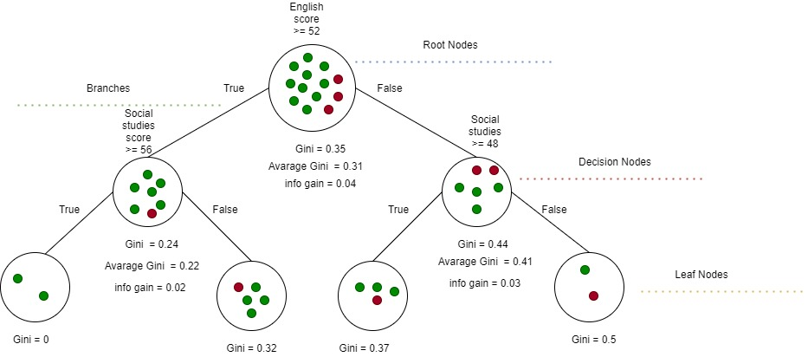

Algorithm Design
To build a binary tree the algorithm implemented was CART. In this example, we show a model to predict the academic success as the probability that a student must get a score above the average in the Saber pro.

Slide 4
Node Splitting
The green circles represent the student above the average and the blue circle represent the students below the average
This split is an example of how the algorithm works identifying the Gini impurity of each node. The condition stablished is “English score >= 52". At the time of find the Gini impurities for this case, left Gini is 0 , right Gini is 0.32 and weighted Gini is 0.23.
This is another example of splitting. In this case the condition that determinate how the data will be distributed is “Social studies score >= 56". The left node have produced a Gini impurity of 0.37, the right node impurity is 0.5 and the weighted Gini is 0.41

Slide 5

Algorithm Complexity
 | Time Complexity | Memory Complexity
Training the model | O(N²*M*2^{M}) | O(N*M*2^{M})
Testing the Model | O(N*M) | O(1)
Time and memory complexity of the (In this semester, one could be CART, ID3, C4.5… please choose) algorithm. (Please explain what do N and M mean in this problem. PLEASE DO IT!

Slide 6
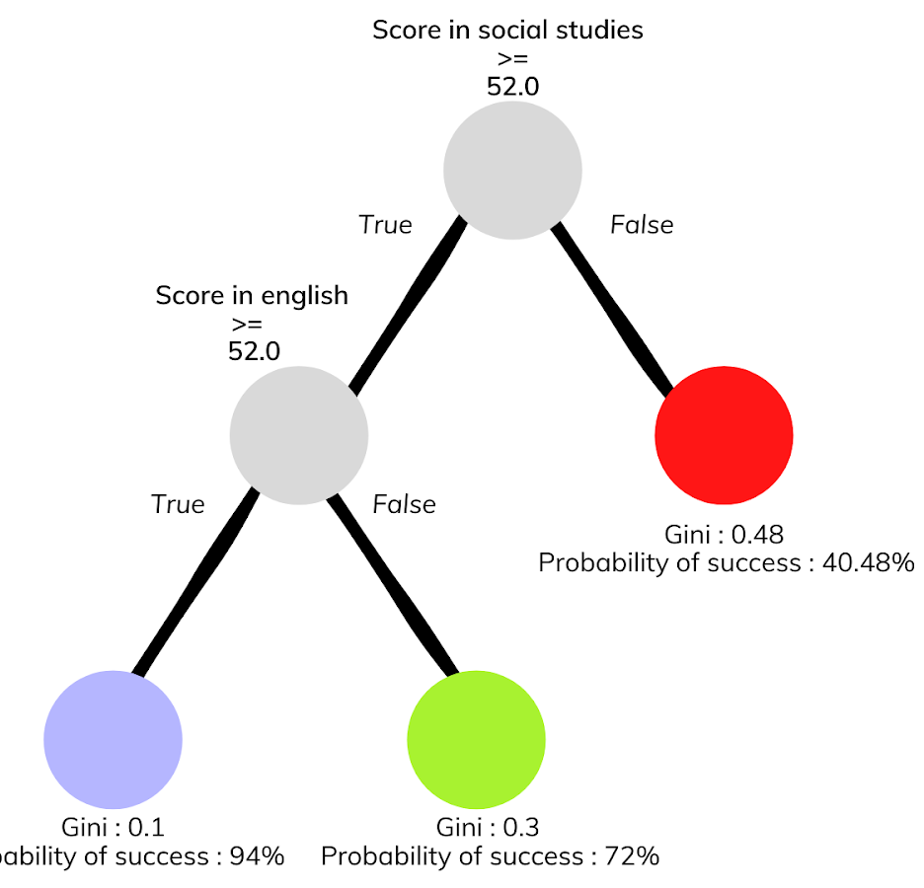
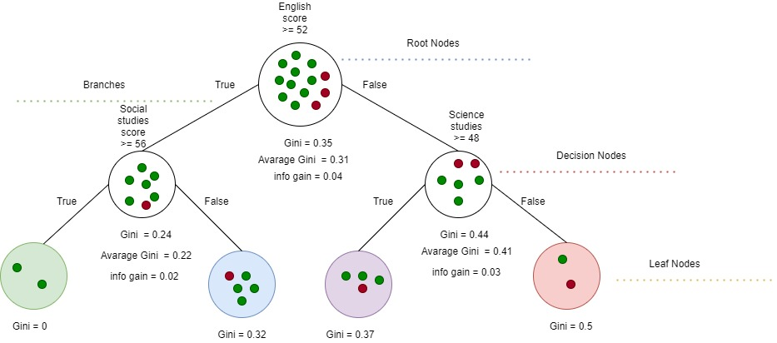



Decision-Tree Model
Most Relevant Features
Social Studies
English
Science
A binary decision tree to predict Saber Pro scores based on the results of Saber 11. Violet nodes represent those with a high probability of success, green medium probability and red a low probability of success.

Slide 7
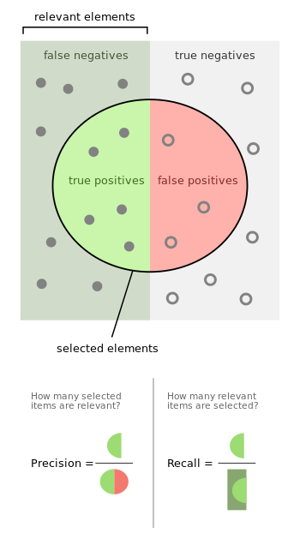
Complete this slide
For the third deliverable
Evaluation Metrics
Keep this title
Use vectorized figures to
explain the algorithm the evaluation metrics, so they are not pixeled like mines
Use these
Colors for
Your figures
Explain Accuracy too…
In the same manner
If possible, avoid equations for simple concepts that can be
explained through diagrams

Slide 8

Evaluation Metrics
 | Training data set | Testing data set
Accuracy | 0.78 | 0.77
Precision | 0.75 | 0.76
Recall | 0.8 | 0.79
Evaluation metrics using a training dataset of 135,000 students and test dataset of 45,000 students.

Slide 9


Complete this slide
For the third deliverable
Time and Memory Consumption
Keep this title
Create the plots in Excel. Do not copy pixelated screenshots from the technical report please!
Time Consumption
Memory Consumption

Slide 10
THANK YOU!

