Slide 1

meet our listeners

Slide 2
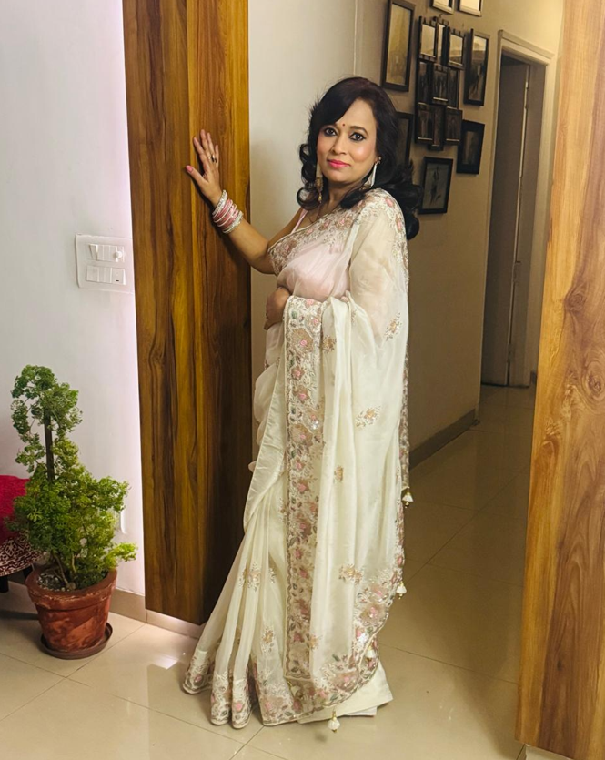
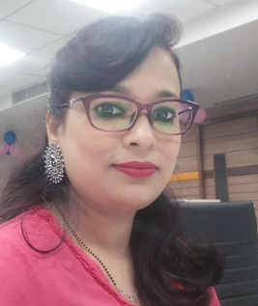
Listener’s Name: preeti gupta
Credentials: industrial engineer / business coach / Samaritan by heart
Languages known: English / Hindi
Geographical coverage for counselling: Pan India. ESP in the northern and central parts of India
Mantra of Life: cultivating compassion through empathy
>> Preeti's extensive global corporate experience across some of the renowned multinational corporations has shaped her into a deeply empathetic communicator who recognizes and respects individuals possessing diverse feelings, backgrounds, perspectives,
Emotional Awareness and Empathy.
>> Intuitive & observant, Preeti picks up subtle emotional cues by reading vocal tones, facial expressions, and body language & accordingly ensures momentum of conversation.
>> she maintains neutral perspectives and a non-judgmental stand. She avoids rushing to conclusions, and consciously looks at situations through the other person's lens.
>> As an empathetic listener, she ensures that everyone she talks to feels genuinely heard, deeply understood, respected, and feels confident in a safe environment. preeti responds with authentic kindness and concern, utilizing gentle, open-ended questions to deepen her understanding and supporting a compassionate conversation with sensitivity.

