Slide 1


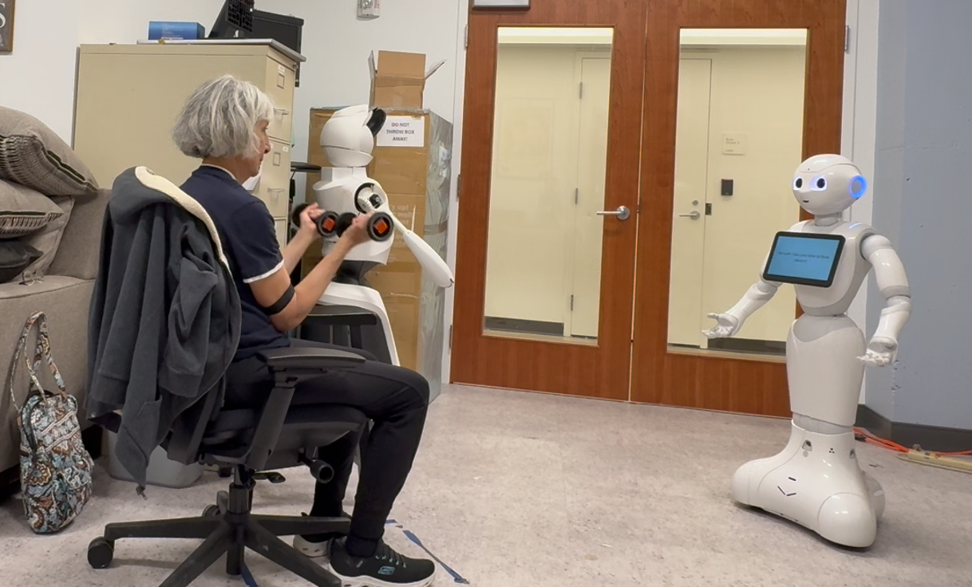
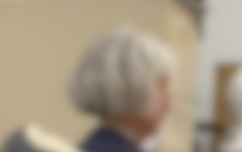
Designing a Conversational Exercise Coach for Aging Adults: Engagement, Motivation, and Interaction
Rayna Hata, Max Hu, Reid Simmons, Aaron Steinfeld
Robotics Institute, Carnegie Mellon University, Pittsburgh, PA, USA
Motivation
Staying physically active is critical for healthy aging, yet many older adults struggle to maintain exercise motivation without social support or clear guidance. Socially interactive robots offer a new way to encourage participation by combining companionship, structure, and accountability. In this work, we examine how two robot personalities, a friendly social buddy and a structured exercise coach, shape engagement and preference across repeated exercise sessions with older adults. Our goal is to understand how interaction style affects comfort, motivation, and ongoing willingness to exercise.
Research Questions
RQ1: Do older adults prefer to exercise with a social buddy type system or an exercise coach type system?
RQ2: Do their preferences change over time as they become more familiar with the system?
RQ3: Does exercising with either type of system personality motivate older adults to continue returning for future exercise sessions?
Methods
Participants: Three older adults (61 to 80, 3F), up to four weekly sessions each
Robot: Pepper with wireless mic and transcription, GPT for social condition dialogue
Design: Within-subjects. Intro + two exercise rounds (bicep curls, lateral raises), counterbalanced order
Conditions:
Social Buddy: conversation, casual tone, robot exercises with participant
Coach: structured guidance, corrective feedback, no free conversation
Measures: RoSAS, LCES, open-ended feedback
Analysis: Survey comparison and thematic review of comments
Preliminary Results
Older adults responded best when the system combined structured coaching with the flexibility to adjust social tone as they exercised and grew more familiar with the robot
Participants increasingly leaned toward the coach style as sessions progressed, but still expressed a desire to shift between social and directive support depending on energy and mood
Initial awkwardness and timing challenges gave way to smoother interaction, suggesting familiarity and repeated exposure help build comfort and trust with the system
Warmth and comfort perceptions trended upward while competence remained steady, pointing toward the promise of systems that can adapt tone and behavior over time to maintain motivation and engagement
Future Work
Large scale longitudinal study at an assisted living facility (ongoing)
Scale participant pool and include broader mobility and health profiles
Build an adaptive system that can shift between social and coaching styles based on user state and context
This work is supported by National Science Foundation under Cooperative Agreement 2112633

