Slide 1



Slide 2


Random seed: 1025

Slide 3


Random seed: 1025 (ver. 2)

Slide 4



Slide 5
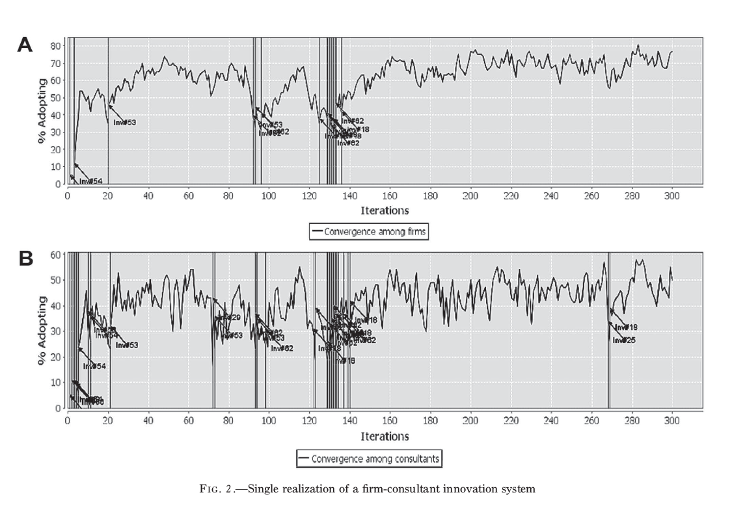

Slide 6
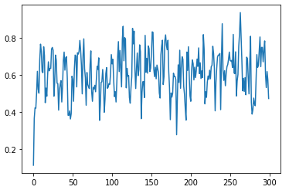
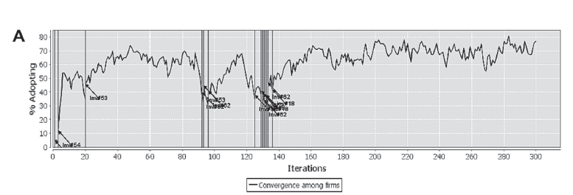

Slide 7
