Slide 1


Multi Vehicle – Multi Target Coordination and Control
Group Members:
J Sandeep Narayan (B17EE035)
Devraj Meena (B17EE023)

Slide 2
Introduction
Lets consider the following situation:
There are many infiltrators entering into a country
We have multiple uav’s at the army base, few km’s away
This project basically deals on automating the tracking of these infiltrators by the UAV’s thus reducing human effort.
After the UAV’s track down the targets they hover around them in circles on a given specified radius.

Slide 3
Motivation
Defence and allied fields
Space Research
Delivery system
Traffic Monitoring
And many other fields in which currently humans are being assigned to perform some operation on a target.

Slide 4

Objective
Given, N-autonomous unicycle-type vehicles that are allowed to travel in the region of $R^{2} \text{And} \text{Number} \text{of} \text{targets}\text{ = }\text{M}\text{. (}\text{N}\text{>=}\text{M}\text{)}$
Our aim is to make all vehicles asymptotically converge to an enclosing pattern
Wherein each vehicle from the vehicle set V is mapped to a target from the target set T, Around which the vehicle revolves in circular orbits
The mapping should be such that the all targets are mapped at least to one vehicle
Let’s say there are n-vehicles
We represent Vehicle-i as $V_{i},$ having varying Cartesian coordinate ($x_{i} , y_{i}$) where I
∈ {1, 2, 3, 4, . . , N} and
Revolves around Target $T_{i}$ having Cartesian coordinate (${x′}_{i} , {y′}_{i}$)
Note: Multiple vehicles can revolve around the same target location.

Slide 5

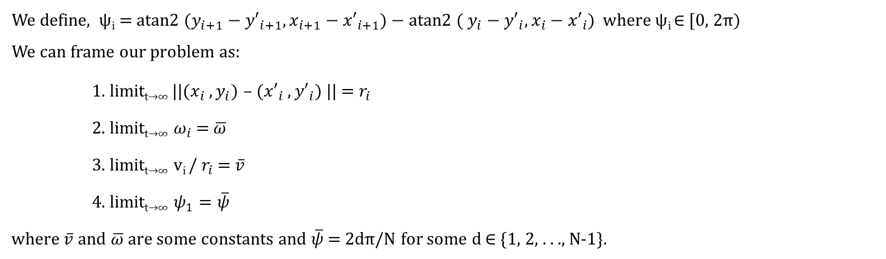


Problem Formulation
We define, ψ_{i} = atan2 ($y_{i+1}−{y′}_{i+1}, x_{i+1}−{x′}_{i+1}$) − atan2 ( $y_{i}−{y′}_{i}, x_{i}−{x′}_{i}$) where ψ_{i} ∈​ [0, 2π)
We can frame our problem as:
1. limit_{t→∞} ||($x_{i} , y_{i}$) – (${x′}_{i} , {y′}_{i}$) || = $r_{i}$
2. limit_{t→∞} $ω_{i}$ = $\overline{ω}$
3. limit_{t→∞} v_{i} / $r_{i}$ = $\overline{v}$
4. limit_{t→∞} $ψ_{1}=\overline{ψ}$
where$\overline{v}$ and $\overline{ω}$ are some constants and $\overline{ψ}$= 2dπ/N for some d ∈​ {1, 2, . . ., N-1}.
($x_{i+1} ,y_{i+1}$)
r_{i+1}
($x_{i} ,y_{i}$)
r_{i}
.
(${x′}_{i} ,{y′}_{i}$)

Slide 6
Why a Control system?
Each time the location of the vehicle is updated it is again fed as the input until it reaches the required state.
Hence, The given is system is perfectly modelled by a control system.
Now that what can be the control law for such a system?
Input
+ -
Controller
Output
Feedback

Slide 7
Schematic Process
Controller Synthesis
Controller Analysis
Enclosing Undetected Targets
Boundedness Analysis
Equilibrium Analysis
Stability Analysis

Slide 8




Idea for control law
$$y_{i}−\tilde{y_{i}}$$
$${(x}_{i},y_{i})$$
$$θ_{i}$$
$$x_{i}−\check{x_{i}}$$
Non-holonomic system: System that is path dependent
The kinematic model for each vehicle V_{i} (of unicycle-type) with nonholonomic constraints:
$\frac{d}{dt}x_{i}=v_{i}{ cosθ}_{i} \frac{d}{dt}y_{i}=v_{i}{ sinθ}_{i}$ $\frac{d}{dt}θ_{i}=v_{i}{ ω}_{i}$
We can see that changes in (x,y) can be controlled using the values of (v,w). Hence we shall consider, v & w as are control parameters.
Viewing the problem one might intuitively say the relative position of the vehicle wrt target becomes a fixed loci (circle) regardless of whether the target is moving or not.
So, one might suggest a control law wherein only the relative position between the target and vehicle matters.
$\left[\begin{aligned}v_{i} \\ ω_{i}\end{aligned}\right]= \left[\begin{matrix}k_{v} & 0 \\ 0 & k_{w}δ_{i}\end{matrix}\right]\left[\left(a\right)μ_{b}^{\left(i\right)}\right]$ where, $μ_{b}^{\left(i\right)}$= $R\left(\tilde{θ_{i}}\right)\left[\begin{aligned}\check{x_{i}}−x_{i} \\ \tilde{y_{i}}−y_{i}\end{aligned}\right] and R\left(\tilde{θ_{i}}\right)=$ $\left[\begin{matrix}\cos{θ_{i}} & \sin{θ_{i}} \\ −sin{θ_{i}} & \cos{θ_{i}}\end{matrix}\right]$
Where $k_{v}$ and $k_{ω}$ are the positive control gains and shall be the same for every vehicle and $δ_{i}$is a positive design parameter used for controlling the radius of vehicle encircling the target.

Slide 9
Idea for control law (contd.)
What will happen if a vehicle is not able to detect its target location?
Using the previous idea we will not be able to cover in such cases.
So, we slightly modify our previous idea.
We consider the location of a target is not just known to the vehicle revolving around it but to its neighbour vehicle as well or in other words each vehicle knows the information about its Target and its neighbours target.
Hence for the vehicle V_{i} , V_{i+1} is called V_{i}’s neighbour and is considered as an information source.
The vehicles interact with each and form a directed ring topology hence we can have knowledge of V_{i+1} in V_{i}.
V₂
V₃
V₁
V₄
V₆
V₅

Slide 10

Controller Synthesis
Therefore the control law can be formulated as,
$$\left[\begin{aligned}v_{i} \\ ω_{i}\end{aligned}\right]= \left[\begin{matrix}k_{v} & 0 \\ 0 & k_{w}δ_{i}\end{matrix}\right]\left[{a_{i}μ}_{+}^{\left(i\right)}+b_{i}μ_{b}^{\left(i\right)}+c_{i}μ_{c}^{\left(i\right)}\right]$$
where,
$R\left(\tilde{θ_{i}}\right)=$ $\left[\begin{matrix}\cos{θ_{i}} & \sin{θ_{i}} \\ −sin{θ_{i}} & \cos{θ_{i}}\end{matrix}\right] , μ_{b}^{\left(i\right)}$= $R\left(\tilde{θ_{i}}\right)\left[\begin{aligned}\check{x_{i}}−x_{i} \\ \tilde{y_{i}}−y_{i}\end{aligned}\right]$
$μ_{+}^{\left(i\right)}$= $R\left(\tilde{θ_{i}}\right)\left[\begin{aligned}x_{i+1}−x_{i} \\ y_{i+1}−y_{i}\end{aligned}\right] , μ_{c}^{\left(i\right)}$= $R\left(\tilde{θ_{i}}\right)\left[\begin{aligned}\check{x_{i+1}}−x_{i+1} \\ \tilde{y_{i+1}}−y_{i+1}\end{aligned}\right]$
And $a_{i}+b_{i}{+ c}_{i} =1$(wlog)

Slide 11

Virtual Vehicle
For solving the uniform circumnavigation problem for different encircling orbits each vehicle-i is required to use different $a_{i}$ and $δ_{i}$ which makes the analysis purpose difficult
Therefore, as a solution to overcome this problem we have mapped all the vehicles to virtual vehicles in the same orbit.
$\hat{x_{i}}={(x}_{i}−x_{b}){/r}_{i}$ $\hat{y_{i}}={(y}_{i}−y_{b})/r_{i}$ $\hat{θ_{i}}=θ_{i}$
Now, each virtual vehicle will be following the same control law if we design $a_{i}$ and $δ_{i}$ properly.
For positive $r_{1}$,$r_{2}$,$r_{3}$…….$r_{N}$
$δ_{i}$= 1/$r_{i}$ and $a_{i}=1−c\frac{r_{i}}{r_{i+1}}$

Slide 12
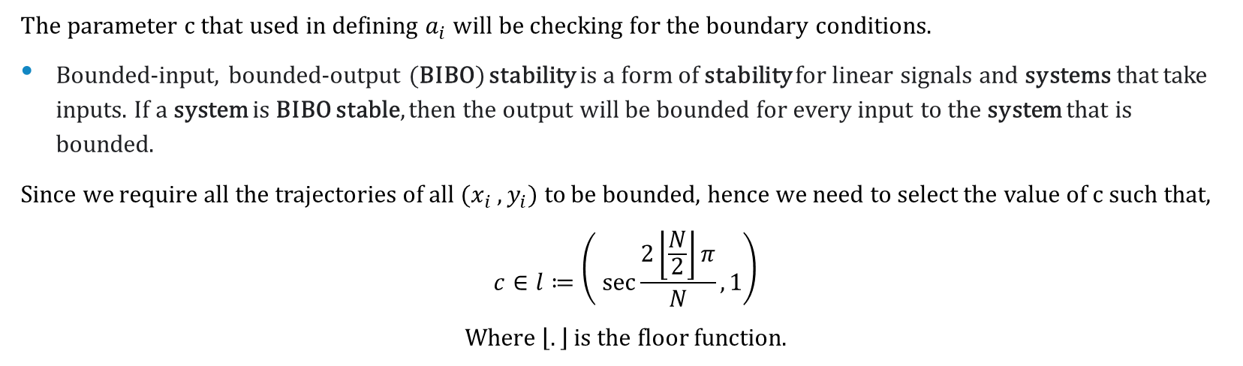
Boundary Analysis
The parameter c that used in defining $a_{i}$will be checking for the boundary conditions.
Bounded-input, bounded-output (BIBO) stability is a form of stability for linear signals and systems that take inputs. If a system is BIBO stable, then the output will be bounded for every input to the system that is bounded.
Since we require all the trajectories of all ${(x}_{i}$, $y_{i})$ to be bounded, hence we need to select the value of c such that,
$$c∈l≔\left( \sec{\frac{2\left\lfloor \frac{N}{2}\right\rfloor π}{N}},1\right)$$
Where $\left\lfloor .\right\rfloor$ is the floor function.

Slide 13

Equilibrium Formations
To satisfy the full collective behaviour, the given uniform circumnavigation problem must satisfy the criteria,
That $\dot{v_{i}}∶=0$, $\dot{ω_{i}}∶=0$ for all vehicle-i.
Further if the vehicles move in concentric circles around the target, then ${(θ}_{i+1}−θ_{i}=)β_{i}$= $ψ_{i}$
Our focus here will be to design the parameters $k_{v}$and $k_{ω}$
We get that, for a group of N vehicles in local control law we can achieve the required circumnavigation in steady state on the concentric orbits of radii $r_{1}$,$r_{2}$,$r_{3}$…….$r_{N}$ if,
$\frac{k_{v}}{k_{w}}=\frac{1−c cos\overline{ψ}}{\left|c sin\overline{ψ}\right|}$ , Where $\overline{ψ}=\frac{2dπ}{N}$

Slide 14

Stability Analysis
We have the criteria for BIBO stability that, $c∈l≔\left( \sec{\frac{2\left\lfloor \frac{N}{2}\right\rfloor π}{N}},1 \right)$
But in the given problem we the vehicles to be asymptotically stable.
Asymptotic stability - solutions that start close enough not only remain close enough but also eventually converge to the equilibrium.
Asymptotic stability => BIBO stability, but converse is not true always.
For checking that whether that each equilibrium formations is asymptotically stable or not,
If all the eigenvalues of the system matrix have negative real parts then the system is asymptotically stable
Else it’s not asymptotically stable
The main result we get is that only 2 equilibria are asymptotically stable in the range of values of c.

Slide 15
Asymptotic Stability Criteria
Consider the following equilibria conditions with d ∈ {1, . . ., N – 1}.
The following situations holds:
There exists an ε > 0 which is very small such that when c = 1 – ε only the equilibria with d = 1 and d = N – 1 are asymptotically stable.
For the odd values of N, when c = −1 only the equilibria with d = ⌊N/2⌋ and d = ⌈N/2⌉ are asymptotically stable. (where, ⌊.⌋ is the floor function and ⌈.⌉ is the ceiling function. )
And for the even values of N, there exists an ε > 0 which is very small such that when c = −1 + ε only the equilibria with the d = N/2 ± 1 are asymptotically stable among the all.

Slide 16

Enclosing undetected targets without actual information exchange
It is possible that not all the vehicles can detect their targets, some can miss their target due to various reasons
Solution
The vehicle-i , can coordinate with vehicle-i+1, to detect target i+1, which was undetected by vehicle-i.
It is same as assuming $\left(\overline{x_{i}} , \overline{y_{i}}\right)=\left(\overline{x_{i+1}} , \overline{y_{i+1}}\right)$, for vehicle-i which cannot detect its specified target.
Also, let’s suppose that vehicle-i cannot detect its targets i and i+1, therefore $μ_{b}^{(i)}$ and $μ_{c}^{(i)}$ are not available to vehicle-i which is same as $b_{i}$ and $c_{i}$are zero in the control law and therefore $a_{i}=1$.
Similarly, we can extend this to K number of vehicles not detecting the target. i.e. $, K⊂N$
By applying these results we get,

Slide 17

Modification in Design
Given $r_{i} and \left(x_{i} , y_{i}\right)$ for all $i∈N , M⊂N.$ We design the parameters $a_{i}$ , $b_{i}$ , $c_{i}$ and $δ_{i}$ for vehicles $i∈N$
$a_{i}=1$ , $r_{i}=\frac{r_{i+1}}{c} \text{and} δ_{i}=1/ r_{i}$
For vehicles $i∈N,$each virtual vehicle is governed by
$$\frac{d}{dt}\left[\begin{aligned}\begin{aligned}\check{x_{i}} \\ \tilde{y_{i}}\end{aligned} \\ \check{θ_{i}}\end{aligned}\right]= \left[\begin{aligned}\begin{matrix}cos\check{θ_{i}} & 0 \\ sin\check{θ_{i}} & 0\end{matrix} \\ 0 1\end{aligned}\right] \left[\begin{aligned}\check{v_{i}} \\ \tilde{ω_{i}}\end{aligned}\right]$$
With the control law,
$\left[\begin{aligned}\check{v_{i}} \\ \tilde{ω_{i}}\end{aligned}\right]= \left[\begin{matrix}k_{v} & 0 \\ 0 & k_{w}\end{matrix}\right]R\left(\tilde{θ_{i}}\right) \{c\left[\begin{aligned}\check{x_{i+1}} \\ \tilde{y_{i+1}}\end{aligned}\right]−\left[\begin{aligned}\check{x_{i}} \\ \tilde{y_{i}}\end{aligned}\right] \}$
For $i∈N$ , where $a^{∗}$ is a constant.
For Vehicles with Undetected targets
For Virtual Vehicles

Slide 18
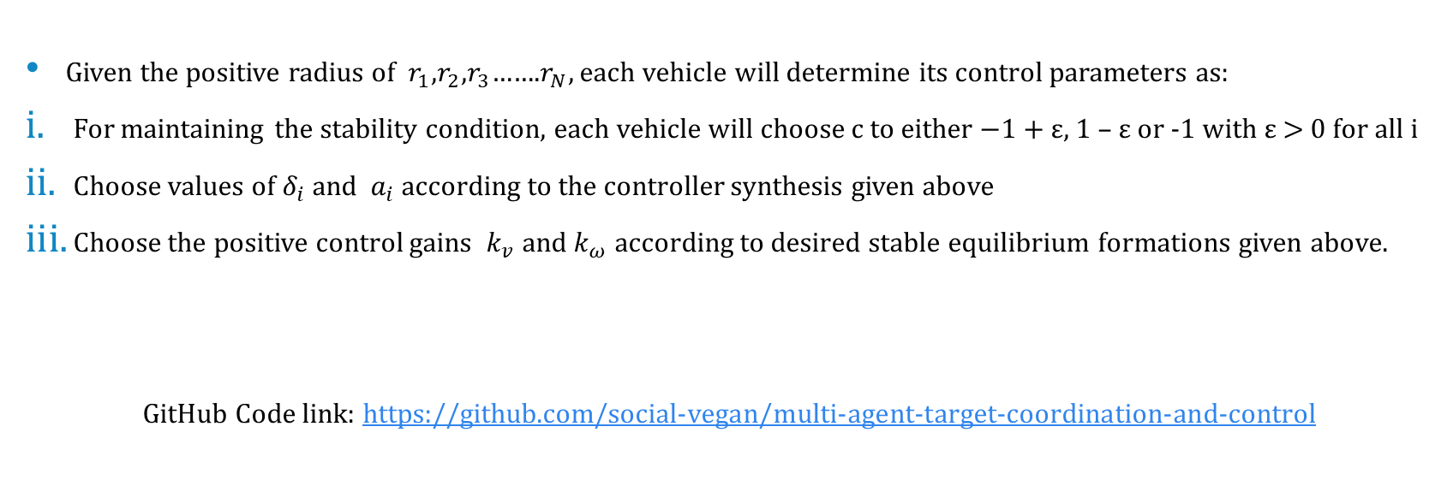
Algorithm for control design
Given the positive radius of $r_{1}$,$r_{2}$,$r_{3}$…….$r_{N}$, each vehicle will determine its control parameters as:
For maintaining the stability condition, each vehicle will choose c to either −1 + ε, 1 – ε or -1 with ε > 0 for all i
Choose values of $δ_{i}$ and $a_{i}$ according to the controller synthesis given above
Choose the positive control gains $k_{v}$and $k_{ω}$ according to desired stable equilibrium formations given above.
GitHub Code link: https://github.com/social-vegan/multi-agent-target-coordination-and-control

Slide 19
RESULTS
Example - 1:
There are 8 vehicles all located at origin initially and 4 targets at (4,4), (4,-4), (-4,-4) and (-4,4). The radius of revolution for the 8 vehicles is r=[1;2;3;4;1;2;3;4] respectively. Plot the movement of vehicles for different possible scenarios.
Example - 2:
There are 8 vehicles all located at origin initially and 4 targets at (1,1), (2,-2), (-3,-3) and (-4,4). The radius of revolution for the 8 vehicles is r=[1;2;3;4;1;2;3;4] respectively. Plot the movement of vehicles for different possible scenarios.

Slide 20
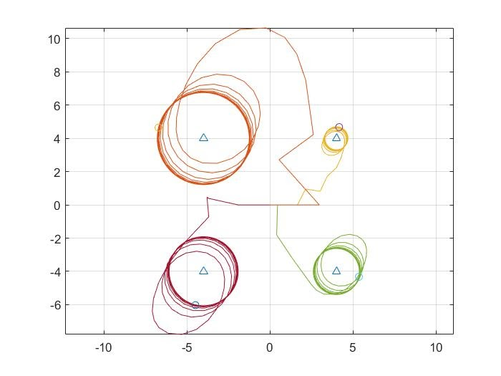
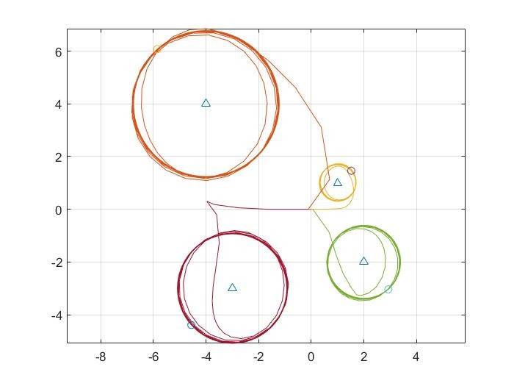
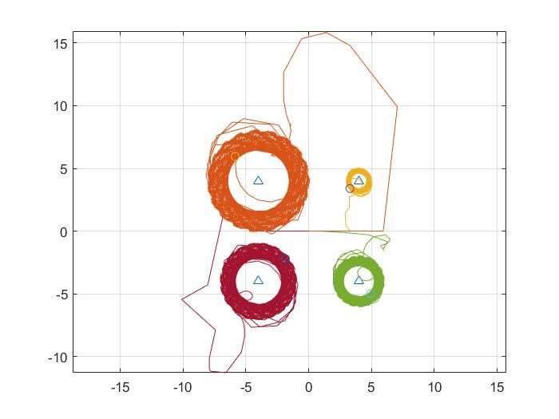
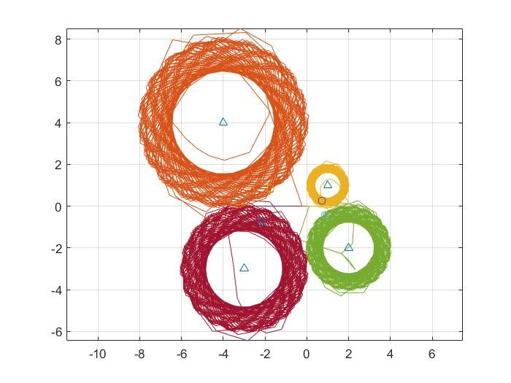
Scenario 1: Plot for stationary Targets using ode45 solver and euler method respectively ;

Slide 21
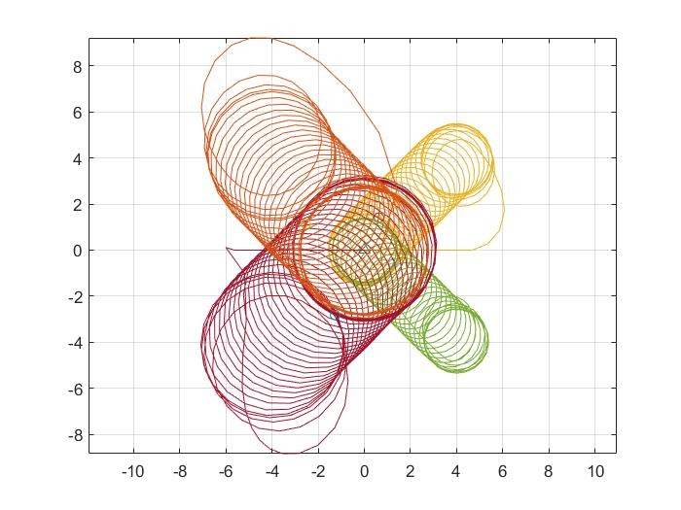
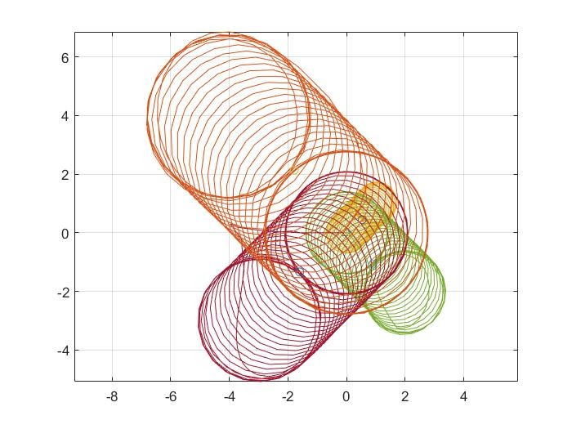
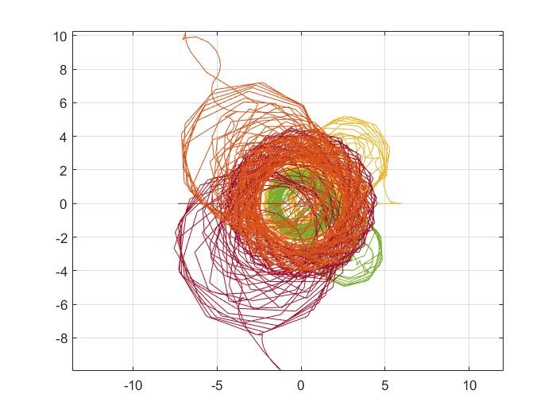
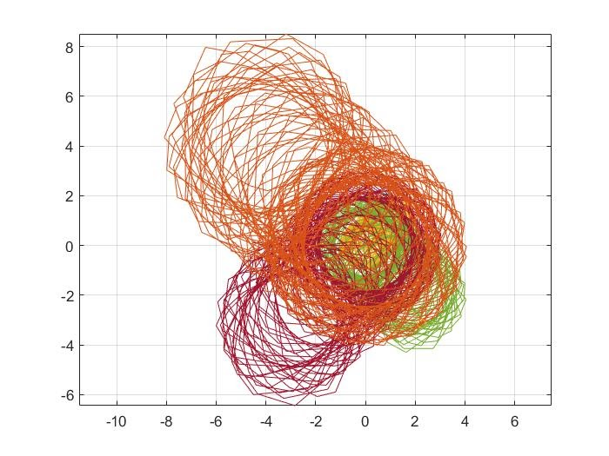
Scenario 2: Plot for moving Targets using ode45 solver and euler method respectively ;

Slide 22
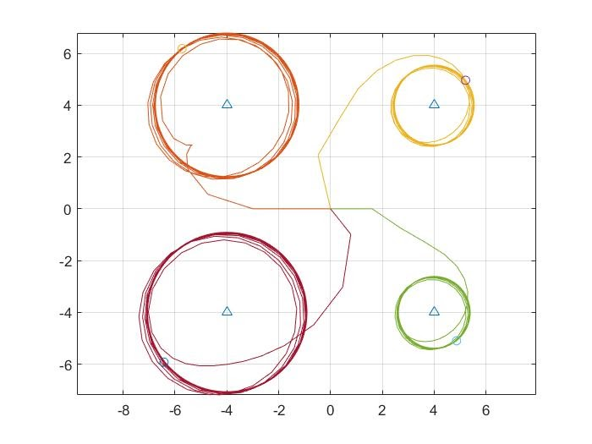
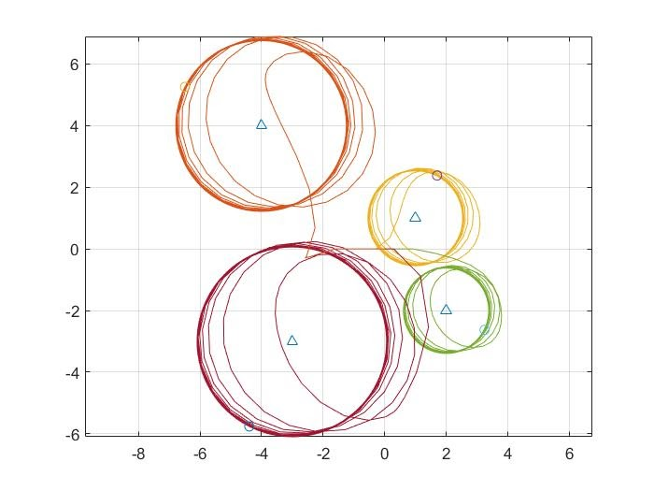
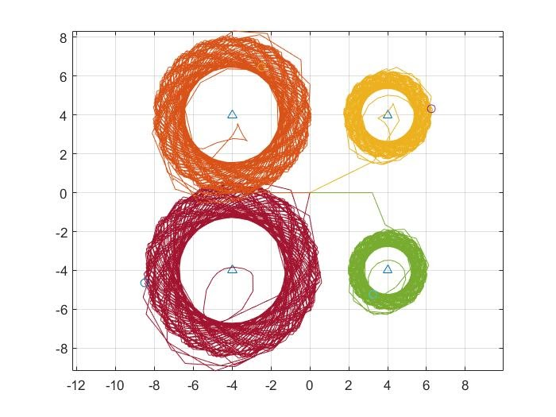
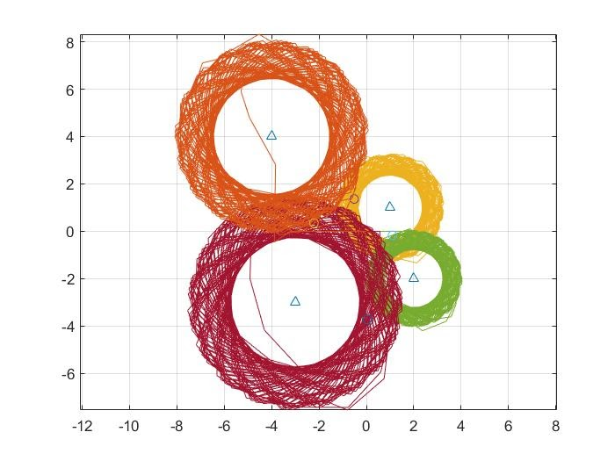
Scenario 3: Plot for stationary Targets with undetected targets in vehicles - 1,3,5,7 using ode45 solver and euler method respectively ;

Slide 23
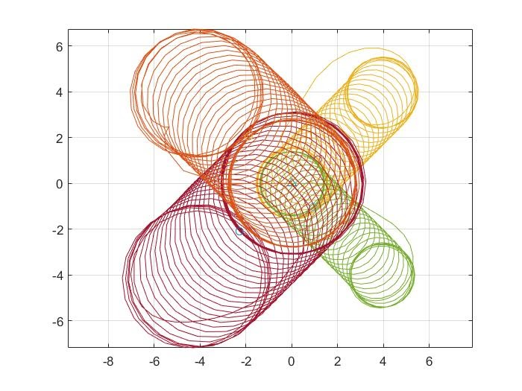
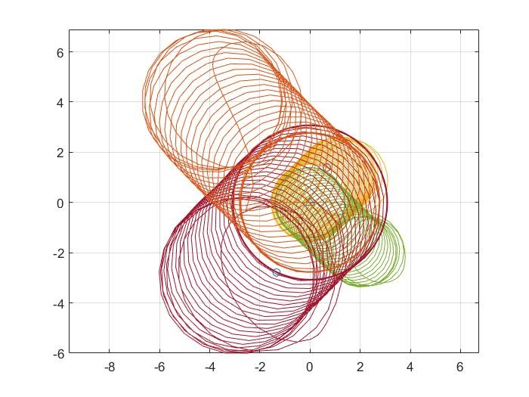
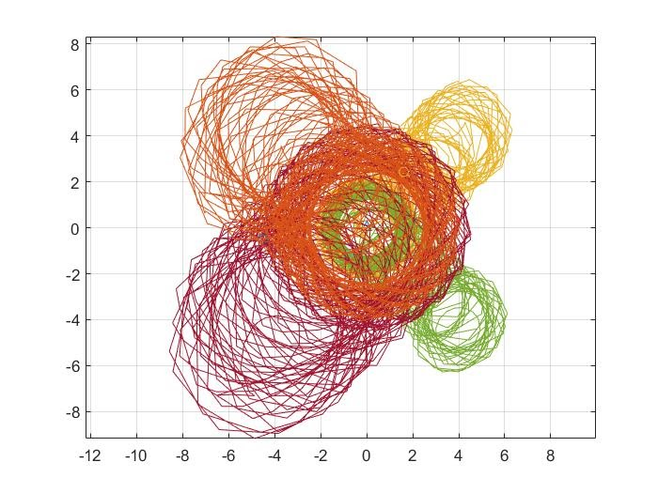
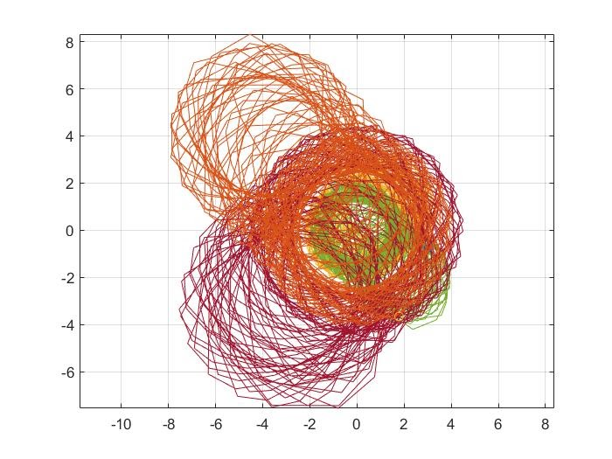
Scenario 4: Plot for moving Targets with undetected targets in vehicles - 1,3,5,7 using ode45 solver and euler method respectively ;

Slide 24
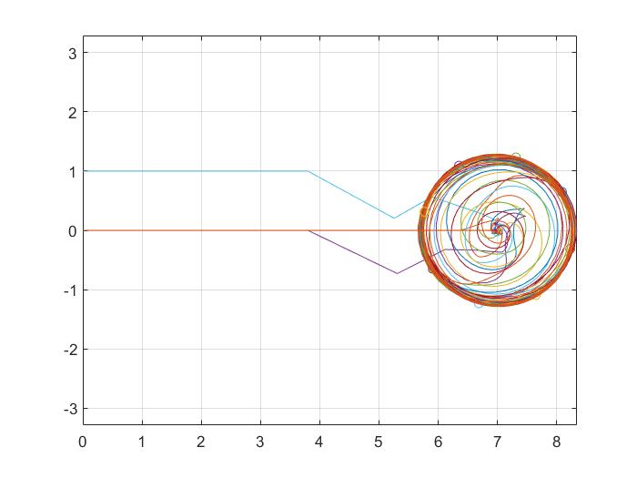
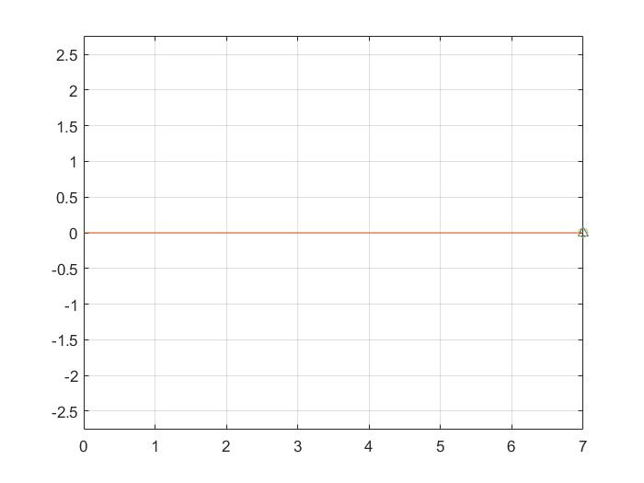
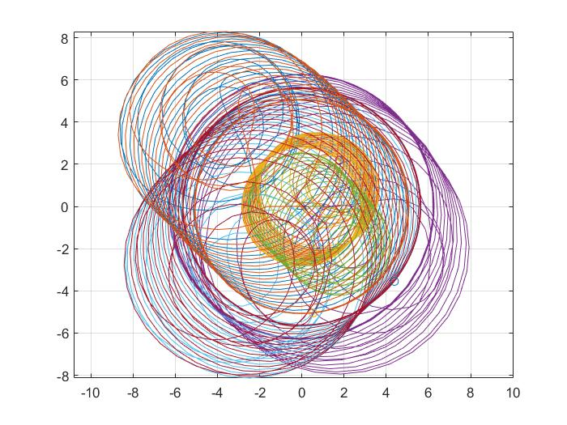
Exceptions:
Case 1: All points and movement collinear
Case 2: Two neighbour vehicles undetected

Slide 25

Future Work
Consideration for objects in the travelling path
Auto adjust height from ground on ad-hoc basis (3-D conversion)
Modify the Topology of information exchange for better coverage of undetected targets
Currently we use info exchange in ring topology which is of complexity O(n) will use O($n^{2}$) so in practical cases we can settle at a midpoint of O(nlogn) or O($n^{1.5}$).

Slide 26
References
L. Shi, R. Zheng, M. Liu and S. Zhang, "Distributed control of cooperative multi-target enclosing by ring-coupled unicycles," 2020 American Control Conference (ACC), Denver, CO, USA, 2020, pp. 3523-3528, doi:10.23919/ACC45564.2020.9147392.
Ronghao Zheng, Zhiyun Lin, Minyue Fu, Dong Sun, Distributed control for uniform circumnavigation of ring-coupled unicycles, Automatica, Volume-53, 2015.

Slide 27
Thank You

