Slide 1
Regular Expressions
Text mining and Natural Language Processing for Computational Social Sciences
July 29, 2022
Ali Hürriyetoğlu, KNAW Humanities Cluster DHLab

Slide 2
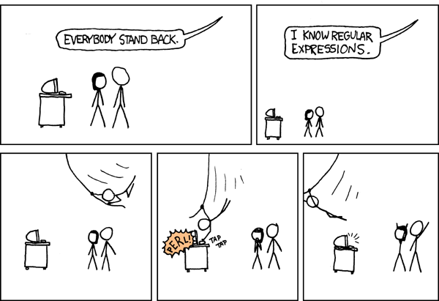

Slide 3
Outline
Introduction
Basic syntax
Advanced syntax
Operations
Flags
Careful!
Conclusion
3

Slide 4
Introduction
Regular expressions are a way to define expressions for text string matching
The regular expressions can be used to search or transform text
It is a well-supported paradigm

Slide 5
Basic syntax
The regular expressions syntax is based on metacharacters and building blocks based on them.
Metacharacters are . ^ $ * + ? { } [ ] \ | ( )
[ ] are used to define a character class using individual characters or range of characters
[0-9] matches characters from 0 to 9
[a-z] lower-case character range from a to z
[abc] will match a, b, or c
None of the metacharacters have any special meaning in []

Slide 6
Basic syntax
You can use ^ character to mean any character other than the ones exist in []
[^5] matches any character except 5
\ enables special meanings (predefined) to some characters
\w is equivalent to [a-zA-Z0-9_] (unicode)
\W is equivalent to [^a-zA-Z0-9_]
\b specifies beginning or end of a word
. matches any character

Slide 7
Basic syntax
* and + allows to use repetition in your definition
a[bcd]*b will match abcb, abbdcb, abbbbbbbdb, ab
a[bcd]+b will match abcb, abbdcb, abbbbbbbdb
? specifies zero or one occurrence for the preceding character
home-?brew matches either 'homebrew' or 'home-brew’
{m,n} specifies that the preceding pattern must occur at least m and at most n times
a/{1,3}b will match 'a/b', 'a//b', and 'a///b'. It won’t match 'ab' or ’a////b'

Slide 8
Basic Syntax
| allows defining alternatives
Crow|Servo will match either 'Crow' or 'Servo’
^ and $ will match beginning and end of a line respectively
() defines a group that can be used separately in the regular expression or from the matching result

Slide 9
Advanced Syntax
Lookahead
Lookbehind
Grouping
Non-capturing group

Slide 10
Operations
Search: find patterns in strings or files
Replace: replace matches of a pattern with a string (normalization)
Split: Split the text in pieces separated by a pattern (tokenization)

Slide 11
Flags
Flags set the way a standard regular expression works
Main flags are:
Case-sensitive search
Locale aware search
Multiline search

Slide 12
Careful!
Do not do it complex or long
Escaping reserved characters may be hard
Repeatition operators * and + will consume as much as possible (greedy), especially if they follow a . Use *? or +?
Locale determines what you get in language specific cases
Compile regular expressions for speed

Slide 13
Conclusion
Regular expressions are supported on almost all platforms
They will help you in any part of text mining
Check the documentation of your tool regularly
Double check what you are doing!!

Slide 14
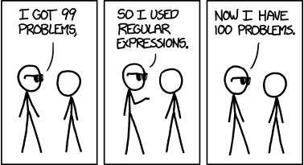

Slide 15
A basic use case – Named entities
Problem: You want to know which named entities are available in a text. You do not have much time or resources. If an approximate result is sufficient for you:
Solution: Find and count all proper-cased token sequences: ([A-Z][a-z]+(\s[A-Z][a-z]+)+)
('Sherlock Holmes', 90),
('United States', 71),
('New York', 54),
('New England', 46),
('Baker Street', 29),
…

Slide 16
A basic use case – Street names
Problem: You have a set of criminality reports. You wonder which street names are mentioned mostly.
Solution: Write a more specific regular expression:
[A-Z][a-z]+ [sS]treet
('Baker Street', 29),
('Leadenhall Street', 5),
('Fresno Street', 2),
('Fenchurch Street', 2),
('Bow Street', 2),
('Oxford Street', 2),
…

Slide 17
Try Regexes
https://regex101.com
https://regexr.com
grep, zgrep
Acrobat reader
Most of the text editors
PyParsing

Slide 18
Exercises
https://github.com/ahurriyetoglu/Splitsville/blob/master/Splitsville.ipynb
Write a regular expression that matches:
Email address
A username in a tweet
A phone number
Numbers
Money mentions
Extract tokens based on your own definition
Remove punctuation in a text

Slide 19
Thanks for listening!
Any questions or comments?
Ali.hurriyetoglu@dh.huc.knaw.nl & ali.hurriyetoglu@gmail.com
@hurrial

