Slide 1



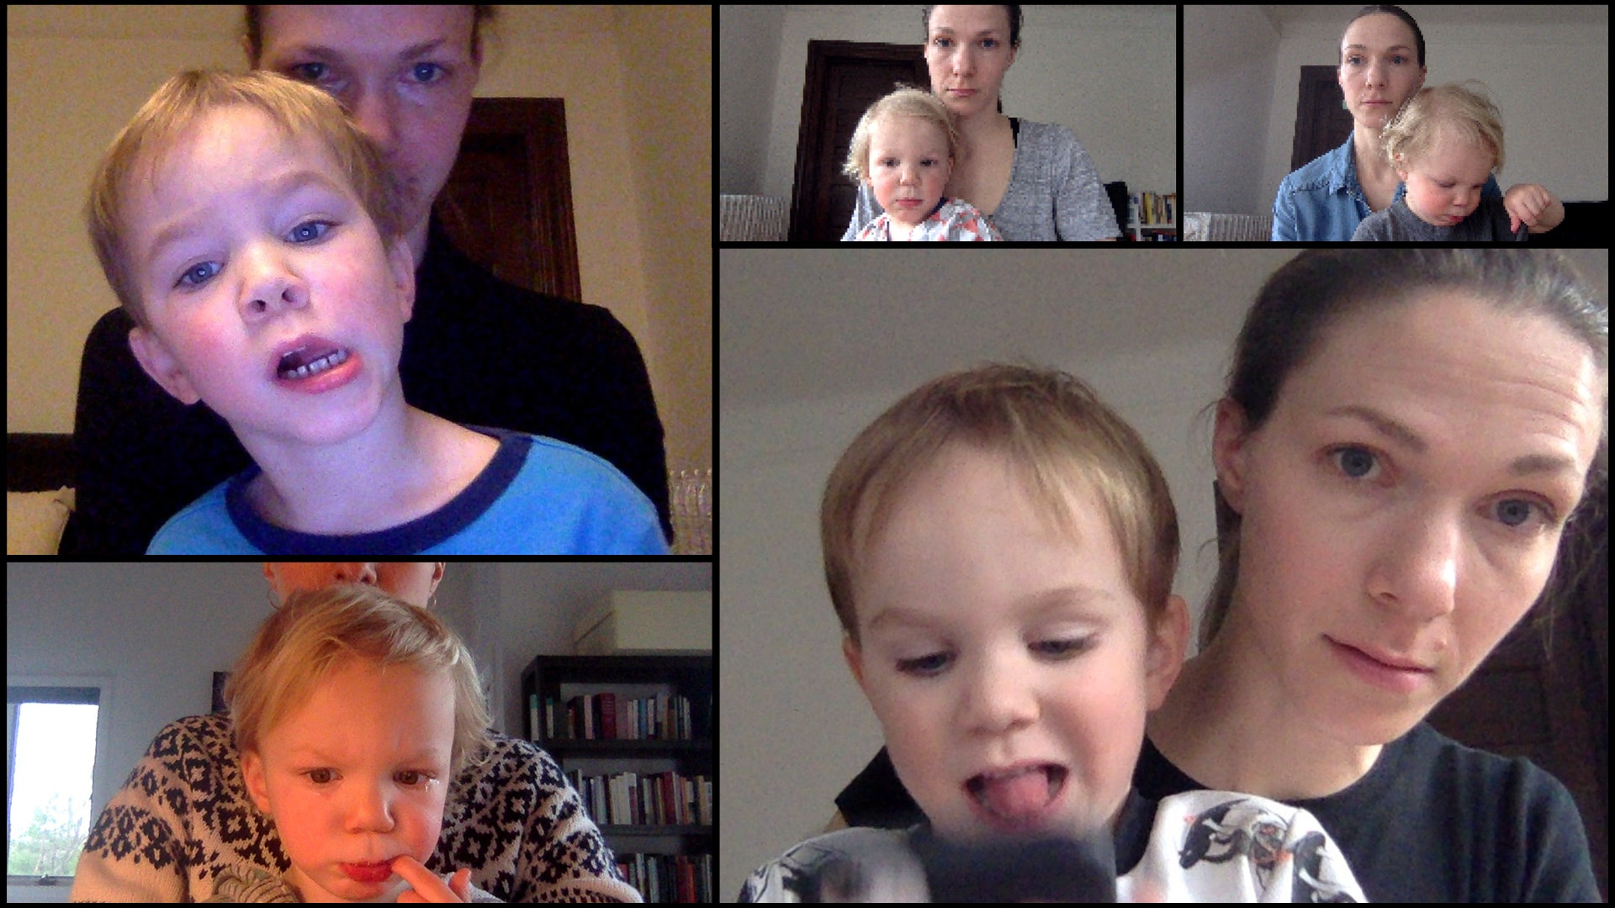
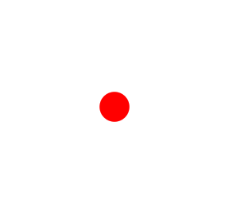



Attention-getter (10 seconds)
Live webcam feed (3 minutes)
~3.5 minutes total (ends automatically)
to stop!
Notes:
Hi there and welcome to our study!
In this study, at the beginning, your child will see an exciting jumping dot moving around the screen, which we call the “attention getter” because we use it to get your child’s attention. Then, you will see a live webcam feed of you and your child appearing on the screen, with some playful music beginning to play in the background. So your child will see themselves on the screen in real-time, and we will record their reactions and behaviors for a total of 3 minutes. The live webcam feed will end automatically after 3 minutes. Altogether, our study will take around 3.5 minutes [show bracket and text saying 3.5 minutes]. If your child is getting too distracted or distressed at any point, you can stop the session by pressing X on your keyboard. Thank you for participating, and we hope you and your child have fun!

Slide 2
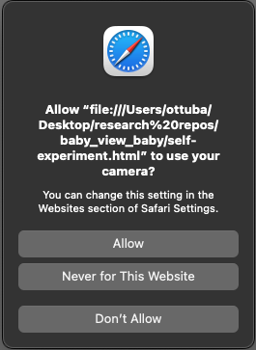
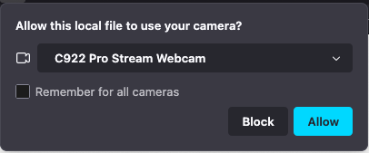
On the next page, you’ll be asked to approve the use of your camera! Please press “allow” so that your child can see themselves on the screen! (Your camera will turn off automatically once the study has concluded!)

Slide 3

Final Instructions
On the next page, you’ll be asked to approve the use of your camera! Please click “allow” so that your child can see themselves on the screen! (Your camera will turn off automatically once the study has concluded)
1
2
Once you’re ready, please click “continue” and say “babies” out loud!
During the experiment, you can press the 'E' key to exit early! You will be asked to confirm your choice before exiting.

