Slide 1
Numpy Tutorial
CSE 5539 - Social Media & Text Analytics
Notes:
Improve OLS
Add instructions on how to install numpy, jupyter
75 mins: do a little bit of time planning
15 mins: installation (max)

Slide 2
Numpy
Core library for scientific computing with Python
Provides easy and efficient implementation of vector, matrix and Tensor (N-dimensional array) operations
Pros:
Automatically parallelize operations on multiple CPUs
Matrix and vector operations implemented in C, abstracted out from the user. Fast slicing and dicing
Easy to learn, the APIs are quite intuitive
Open source, maintained by a large and active community
Cons:
Does not exploit GPUs
Append, concatenate, iteration over individual elements is slow

Slide 3
This Tutorial
Explore numpy package, ndarray object, its attributes and methods
Introduces Linear Regression via Ordinary Least Squares
Implement OLS using numpy
Prerequisites:
Python programming experience
Laptop: with Python, NumPy, Jupyter
Your undivided attention for an hour!!

Slide 4
Part I: Getting Hands Dirty with Numpy

Slide 5
ndarray Object
multidimensional container of items of the same type and size
Operations allowed - indexing, slicing, broadcasting, transposing …
Can be converted to and from list

Slide 6
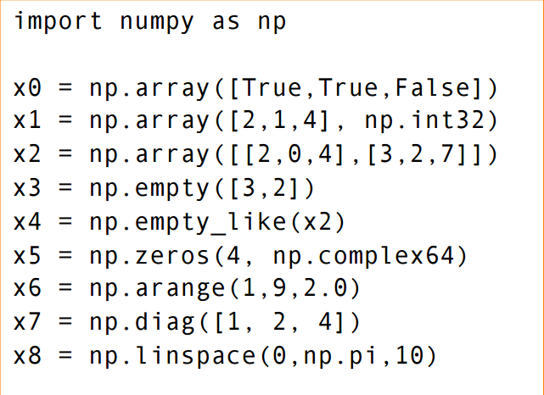
Creating ndarray object
Note: All elements of an ndarray object are of same type
http://web.stanford.edu/~ermartin/Teaching/CME193-Winter15/slides/Presentation5.pdf

Slide 7
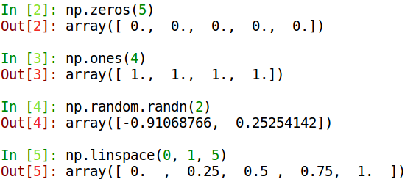
Vectors
Vectors are just 1d arrays
http://nicolas.pecheux.fr/courses/python/intro_numpy.pdf

Slide 8
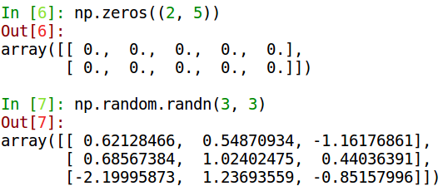
Matrices
Matrices are just 2d arrays
http://nicolas.pecheux.fr/courses/python/intro_numpy.pdf

Slide 9
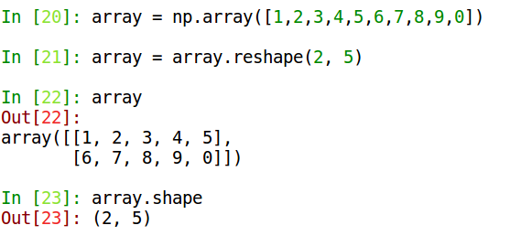
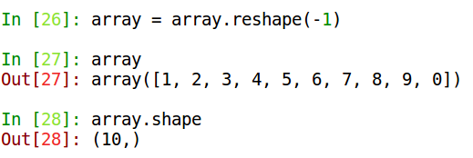
Playing with ndarray Shapes

Slide 10
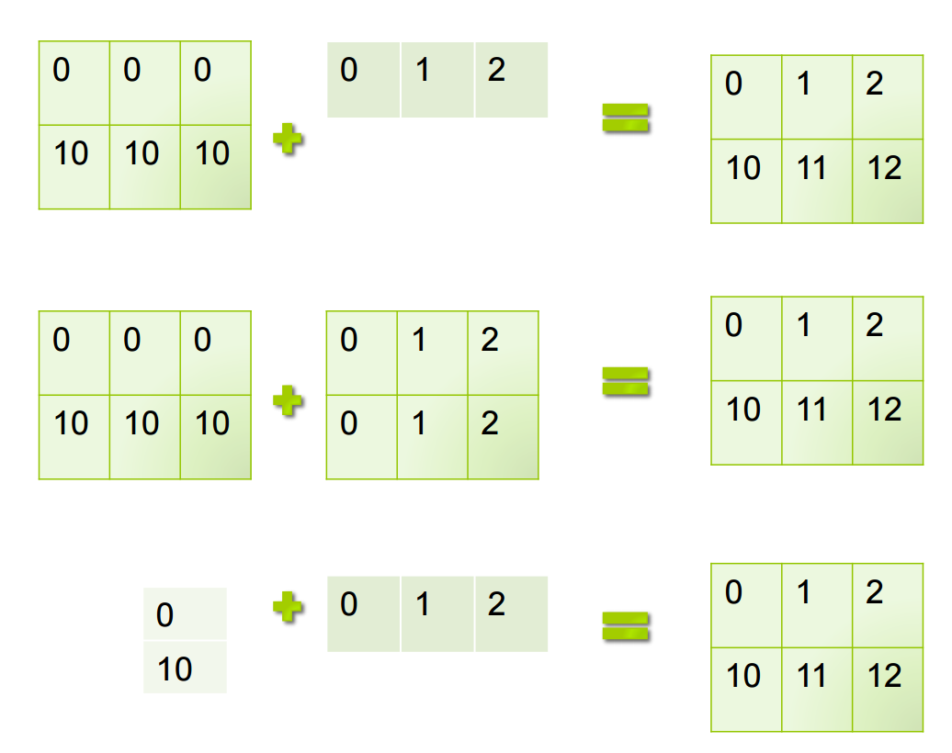
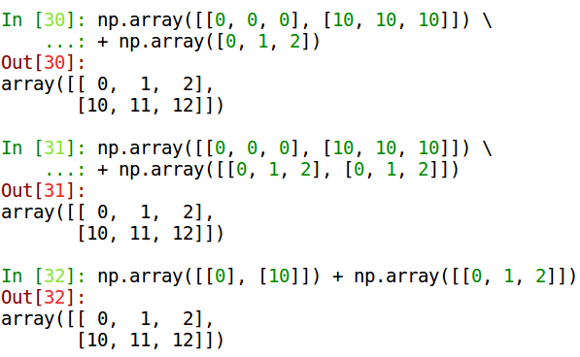
Array Broadcasting
http://web.stanford.edu/~ermartin/Teaching/CME193-Winter15/slides/Presentation5.pdf

Slide 11


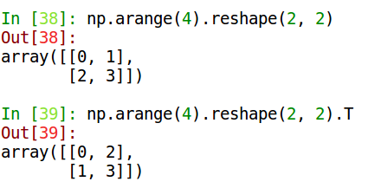
Matrix Operations
Sum
Product
Remember: The usual ‘*’ operator corresponds to element-wise product and not product of matrices as we know it. Use np.dot instead
Logical
Transpose

Slide 12
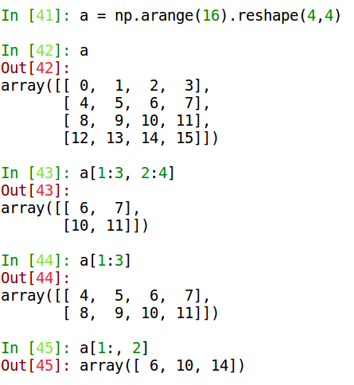
Indexing and Slicing

Slide 13
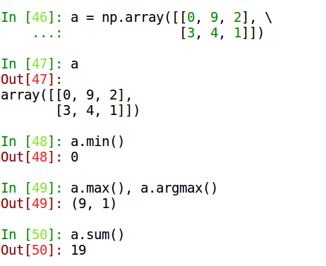
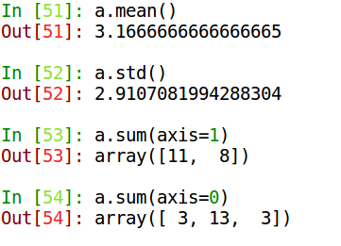
Statistics

Slide 14
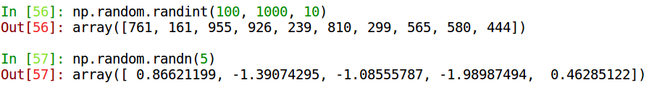
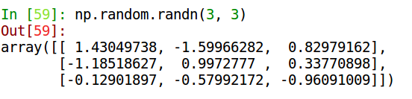
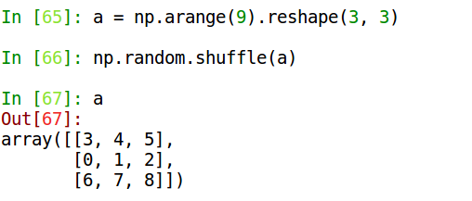
Random Arrays

Slide 15
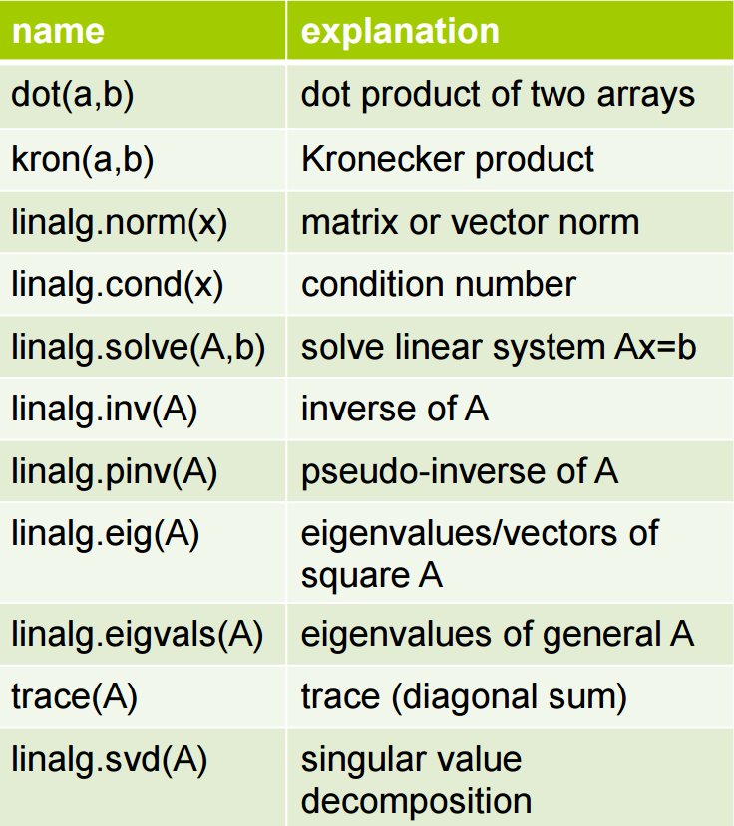
Linear Algebra
Notes:
Add a few examples here

Slide 16
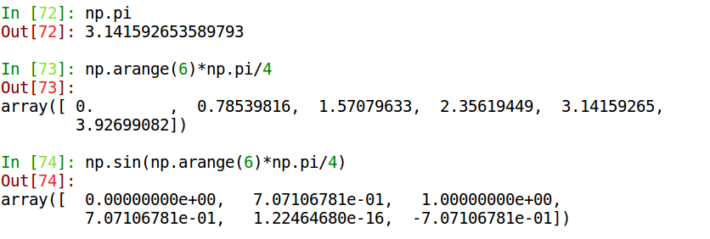
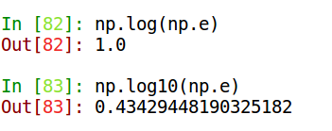
Other Useful Functions

Slide 17
Some useful links
Documentation: https://docs.scipy.org/doc/numpy-dev/reference/
Issues: https://github.com/numpy/numpy/issues
Questions: https://stackoverflow.com/questions/tagged/numpy

Slide 18
Part II: Building a Simple Regression Model

Slide 19
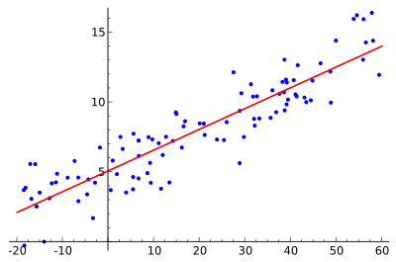
Linear Regression
Regression
Put simply, given Y and X, find F(X) such that Y = F(X)
Linear Y ~ WX + b
Note: Y and X may be multidimensional.

Slide 20
Regression is Useful
Establish relationship between quantities:
Alcohol consumed and blood alcohol content
Market factors and price of stocks
Driving speed and mileage
Prediction:
Accelerometer data in phone and your running speed
Impedance/Resistance and heart rate
Tomorrow’s stock price, given EOD prices and market factors

Slide 21

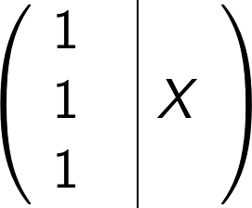

Linear Regression: Analytical Solution
We are using a linear model to approximate F(X) with where,
Error due to this approximation (aka Loss, L)
Let’s define as
=
The loss function can be rewritten as,

Slide 22

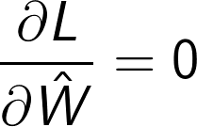

Linear Regression: Analytical Solution
To make our approximation as good as possible, we want to minimize the Loss , by appropriately changing . This can be achieved by:
Solving the above PDE gives:

Slide 23
Analytical Solution: Discussion
Easy to understand and implement
Involves matrix operations which are easy to parallelize
Converges to “true” solution
Involves matrix inversion which is slow and memory intensive
Need entire dataset in the memory
Correlated features lead to inverting a singular matrix.

