Slide 1
NLP Researcher: Diyi Yang
Kun Jin & Xiaohu Zhao

Slide 2
Outline
Brief Intro
Her Work
Research Focuses
Hierarchical Attention Network
Q&A

Slide 3
Brief Intro
4th Year PhD student in CMU
Language Technologies Institute and CS
advised by Eduard Hovy and Robert Kraut

Slide 4
Her Work
bridges Social Computing and NLP
23 Conference Papers^{[1]}
2 Journal Papers
6 Workshops & Posters
Over 1000 citations since 2012^{[2]}
[1] http://www.cs.cmu.edu/~diyiy/publications.html
[2] https://scholar.google.com/citations?user=j9jhYqQAAAAJ&hl=en&oi=ao

Slide 5
Research Focuses
(1) analyzing semantics for language understanding
(2) modeling social roles and relations
(3) building interventions to facilitate social interaction

Slide 6
Analyzing Semantics for Language Understanding
[CSCW 18] Persuading Teammates to Give: Systematic versus Heuristic Cues for Soliciting Loans
[L@S 15] Exploring the Effect of Confusion in Discussion Forums of Massive Open Online Courses
[EMNLP 15] That's So Annoying!!!: A Lexical and Frame-Semantic Embedding Based Data Augmentation Approach to Automatic Categorization of Annoying Behaviors using #petpeeve Tweets
[NAACL 16] Hierarchical Attention Networks for Document Classification

Slide 7
Modeling Social Roles and Relations
[ICWSM 16] Who does What: Editor Role Identification in Wikipedia
[CHI 17] Commitment of Newcomers and Old-timers to Online Health Support Communities
[ACL 15] Weakly Supervised Role Identification in Teamwork Interactions

Slide 8
Building Interventions to Facilitate Social Interaction
[ICWSM 14, EDM 14, NIPS workshop 13] Linguistic Reflections of Student Engagement in Massive Open Online Courses/ Exploring the Effect of Student Confusion in Massive Open Online Courses/ Turn on, Tune in, Drop out: Anticipating student dropouts in Massive Open Online Courses
[RecSys 14, CIKM 14] Question Recommendation with Constraints for Massive Open Online Courses/ Constrained Question Recommendation in MOOCs via Submodularity

Slide 9
Hierarchical Attention Networks for Document Classification
Notes:
Hi, everyone, today, I want to talk about our topic “…”

Slide 10
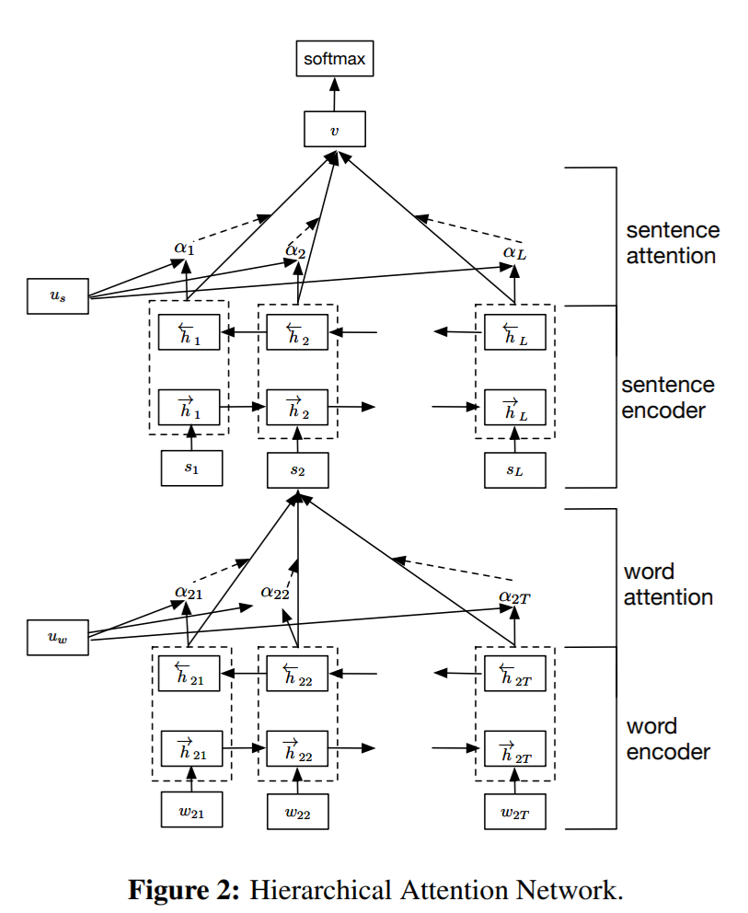
Hierarchical Attention Network
Components
Word Encoder
Word Attention Layer
Sentence Encoder
Sentence Attention Layer

Slide 11
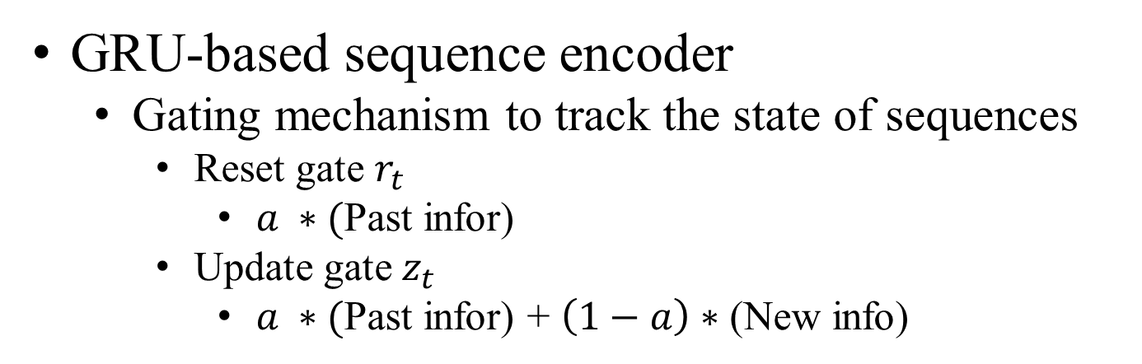
Hierarchical Attention Network
GRU-based sequence encoder
Gating mechanism to track the state of sequences
Reset gate $r_{t}$
$a ∗($Past infor)
Update gate $z_{t}$
$a ∗($Past infor) + $\left(1−a\right)∗$ (New info)
Bahdanau et al., 2014, Neural Machine Translation by Jointly Learning to Align and Translate

Slide 12
Hierarchical Attention Network
Components
Word Encoder
to get annotation of words
Bidirectional state (contextual)
Forward hidden state
Backward hidden state
Word Attention Layer
Attention mechanism
Learned context vector
Current word annotation
Similarity

Slide 13
Hierarchical Attention Network
Components
Sentence Encoder
Sentence Attention Layer

Slide 14
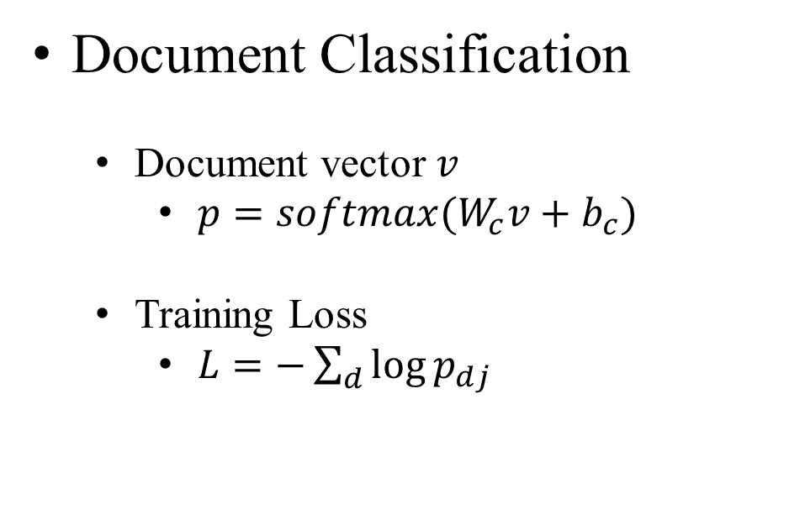
Hierarchical Attention Network
Document Classification
Document vector $v$
$p=softmax(W_{c}v+b_{c})$
Training Loss
$L=−\sum_{d}{\log{p_{dj}}}$

Slide 15
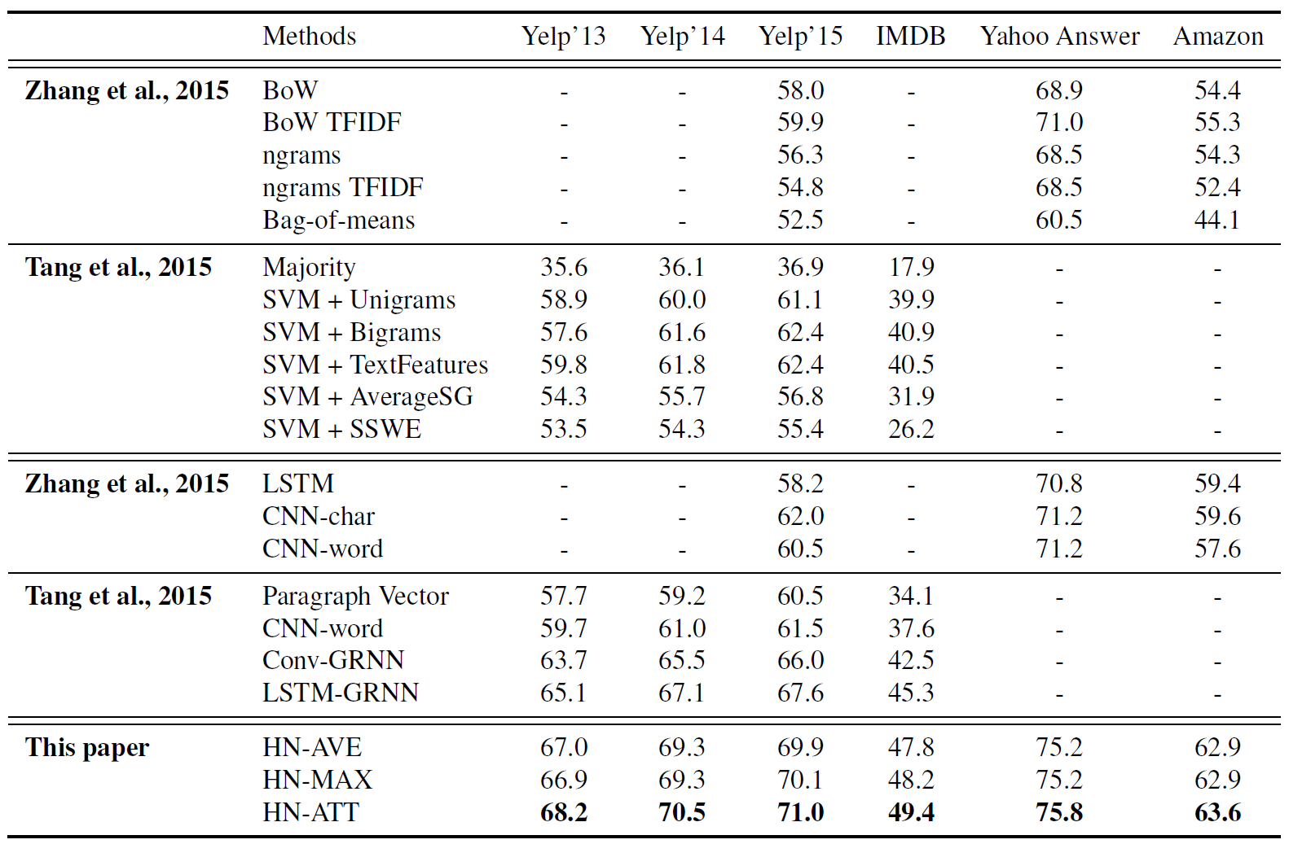
Hierarchical Attention Network

Slide 16
Thank you!
Q&A?

