Slide 1
Non-neural Structured Prediction for Event Detection from News in Indian Languages
Shubhanshu Mishra https://shubhanshu.com
Team: 3Idiots
Code: https://github.com/socialmediaie/EDNIL2020
Presentation at Event Detection from News in Indian Languages (EDNIL) at FIRE 2020 (20st Dec, 2020)
Shubhanshu Mishra, Non-neural Structured Prediction for Event Detection from News in Indian Languages, in: P. Mehta, T. Mandl, P. Majumder, M. Mitra (Eds.), Working Notes of FIRE 2020 - Forum for Information Retrieval Evaluation, Hyderabad, India, December 16-20, 2020, CEUR Workshop Proceedings, CEUR-WS.org, 2020

Slide 2
Overview
Participated in both tasks
Model both tasks as a single Sequence Tagging task
Convert the data into the right format
Model: N-gram + Regex features → CRF
Post-process single model predictions for each task submission
Best performance across all languages on both tasks
Beats neural models by a huge margin
Super easy to implement, very fast to train and perform inference
Open sourced code: https://github.com/socialmediaie/EDNIL2020

Slide 3
Task Overview
Source: https://ednilfire.github.io/ednil/2020/index.html
The goal of this track is to detect events from news articles written in Hindi, Bengali, Marathi, Tamil and English.
Definition of Event: An event can be an occurrence happening in a certain place during a particular interval of time with or without the participation of human agents. It may be part of a chain of occurrences or an outcome or effect of preceding occurrence or a cause of succeeding occurrences. An event can occur naturally or it can be because of human actions.
An event can have a location, time, agents involved (causing agent and on which the effect of the event is felt) etc. The main event can have sub-events as well.
Task 1: Event Identification: Identify a piece of text from news articles that contain an event.
Task 2: Event Frame: Create an event frame from the news article containing the following details:
Type: Type and subtype of the line containing the event
Casualties: No of people is injured or killed/Damages to properties
Time: When the event takes place
Place: Where the event takes place
Reason: Why and how the event takes place

Slide 4
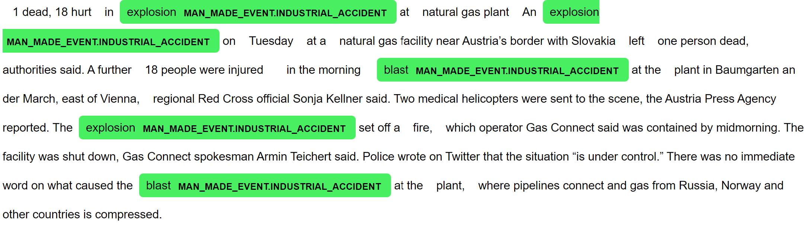
Task 1 Example

Slide 5
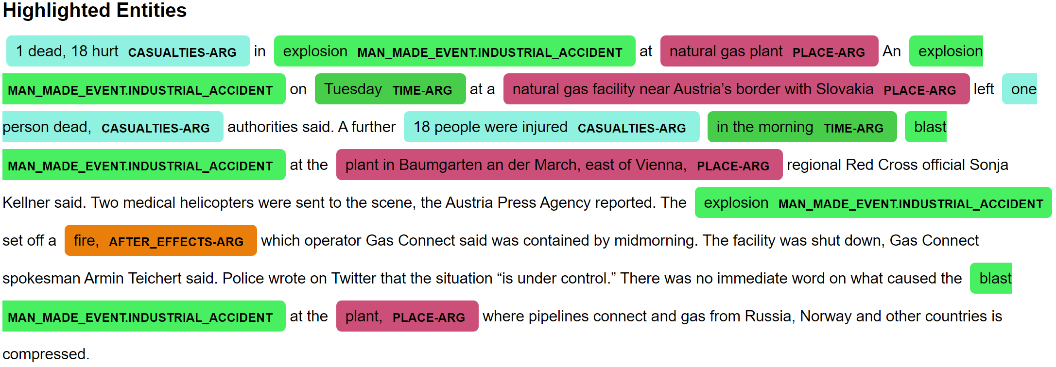
Task 2 Example

Slide 6
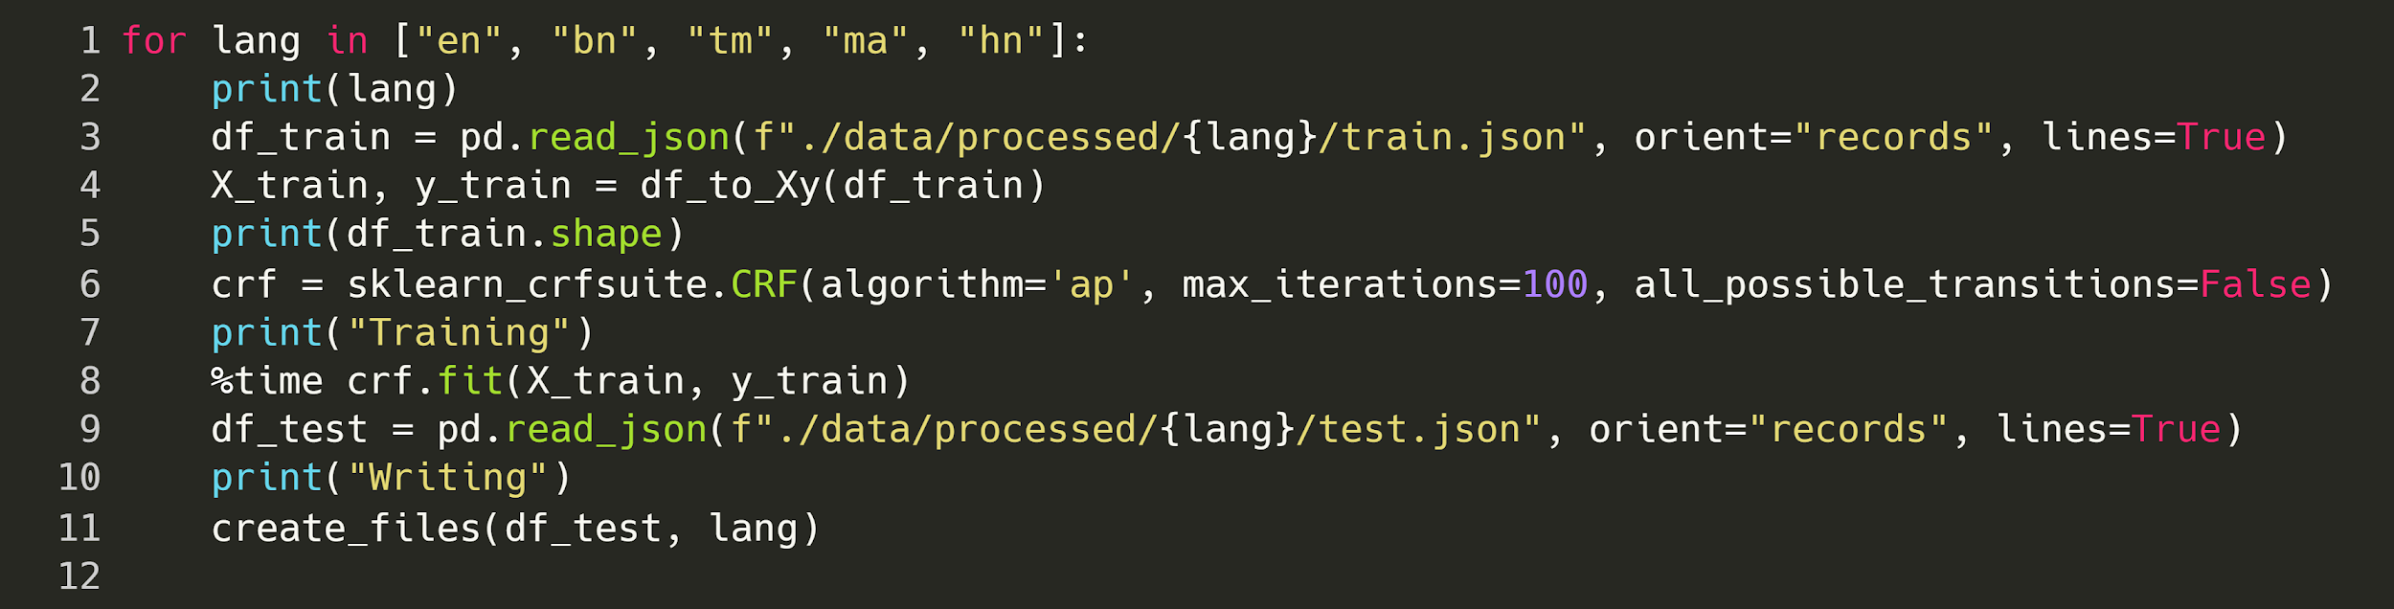
Approach
Single model for both tasks
Same approach for all languages.
Task 1 XML Format
Submit
XML
BIO Format
Model
Task 2 XML Format
Submit
Code: https://github.com/socialmediaie/EDNIL2020/blob/master/Train%20models.ipynb

Slide 7
Pre-processing and Post-processing
1/B-CASUALTIES-ARG dead,/I-CASUALTIES-ARG 18/I-CASUALTIES-ARG hurt/I-CASUALTIES-ARG in/O explosion/B-MAN_MADE_EVENT.INDUSTRIAL_ACCIDENT at/O natural/B-PLACE-ARG gas/I-PLACE-ARG plant/I-PLACE-ARG An/O explosion/B-MAN_MADE_EVENT.INDUSTRIAL_ACCIDENT on/O Tuesday/B-TIME-ARG at/O a/O natural/B-PLACE-ARG gas/I-PLACE-ARG facility/I-PLACE-ARG near/I-PLACE-ARG Austria’s/I-PLACE-ARG border/I-PLACE-ARG with/I-PLACE-ARG Slovakia/I-PLACE-ARG left/O one/B-CASUALTIES-ARG person/I-CASUALTIES-ARG dead,/I-CASUALTIES-ARG authorities/O said./O
Preprocessing
Convert original XML data to BIO format for sequence tagging training.
Post-processing
For sub-task 1 we only restrict the labels to MAN_MADE_EVENT and NATURAL_EVENT. This allows for using the same structured prediction formulation for prediction for this sub-task.
For sub-task 2 we use all the labels as above while stripping out the ARG parts from the BIO labels.
All labels were converted to uppercase to make the labels consistent as few XML labels were lower-cased

Slide 8
Model
Features
Lower-cased token
2 and 3 char suffixes
If the token is upper cased
If the token is title cased
If the token is a digit
If the token is the beginning of sentence or end of sentence.
Same features as above for the previous and next tokens.
Model
Conditional Random Field model (state of the art approach for sequence tagging)
Trained using averaged perceptron algorithm
Training time is around 4 minutes per language.

Slide 9
Results
Lang | Task | Team | Precision | Recall | F1 Score
English | 1 | Ours | 0.793 | 0.703 | 0.745
English | 1 | Other best | 0.611 | 0.645 | 0.628
English | 2 | Ours | 0.504 | 0.447 | 0.474
English | 2 | Other best | 0.201 | 0.248 | 0.222
Bengali | 1 | Ours | 0.705 | 0.553 | 0.620
Bengali | 1 | Other best | 0.379 | 0.391 | 0.385
Bengali | 2 | Ours | 0.548 | 0.411 | 0.469
Bengali | 2 | Other best
Hindi | 1 | Ours | 0.685 | 0.569 | 0.622
Hindi | 1 | Other best | 0.505 | 0.517 | 0.511
Hindi | 2 | Ours | 0.472 | 0.341 | 0.396
Hindi | 2 | Other best
Lang | Task | Team | Precision | Recall | F1 Score
Tamil | 1 | Ours | 0.692 | 0.676 | 0.684
Tamil | 1 | Other best | 0.138 | 0.228 | 0.172
Tamil | 2 | Ours | 0.506 | 0.469 | 0.487
Tamil | 2 | Other best
Marathi | 1 | Ours | 0.609 | 0.434 | 0.507
Marathi | 1 | Other best | 0.124 | 0.417 | 0.191
Marathi | 2 | Ours | 0.387 | 0.278 | 0.324
Marathi | 2 | Other best
Data Statistics
lang | bn | en | hn | ma | tm
test | 204 | 206 | 160 | 265 | 257
train | 800 | 828 | 677 | 1030 | 1013
Our approach performed best across all languages and across all tasks.
The margin compared to the next best team was often >15% F1-score.
Task 1 easier than task 2, because labels of task 1 are subset of task 2.
Marathi with the largest dataset has worst F1 score, but Tamil (2nd largest) is best on task 2.
Model may have an English bias because of regex features.

Slide 10
Closing thoughts
Simple and fast baselines should be tried before implementing more complicated models.
A single model performs both tasks (across languages) by combining it with post-processing of the model output. This is a computationally cheap way to perform multi-task inference.
Other teams seem to have used neural network models but this simple solution sets a strong baseline others can aim to improve upon.
A more principled approach can be investigated for integrating neural models for these tasks which has small datasets.

Slide 11

Thank You / Questions
Contact: Shubhanshu Mishra (@TheShubhanshu)
Code: https://github.com/socialmediaie/EDNIL2020
Citation: Shubhanshu Mishra, Non-neural Structured Prediction for Event Detection from News in Indian Languages, in: P. Mehta, T. Mandl, P. Majumder, M. Mitra (Eds.), Working Notes of FIRE 2020 - Forum for Information Retrieval Evaluation, Hyderabad, India, December 16-20, 2020, CEUR Workshop Proceedings, CEUR-WS.org, 2020
Other tools for information extraction: SocialMediaIE - Social Media Information Extraction | Tools for efficient social media information extraction using advanced machine learning techniques - https://socialmediaie.github.io/

