Slide 1

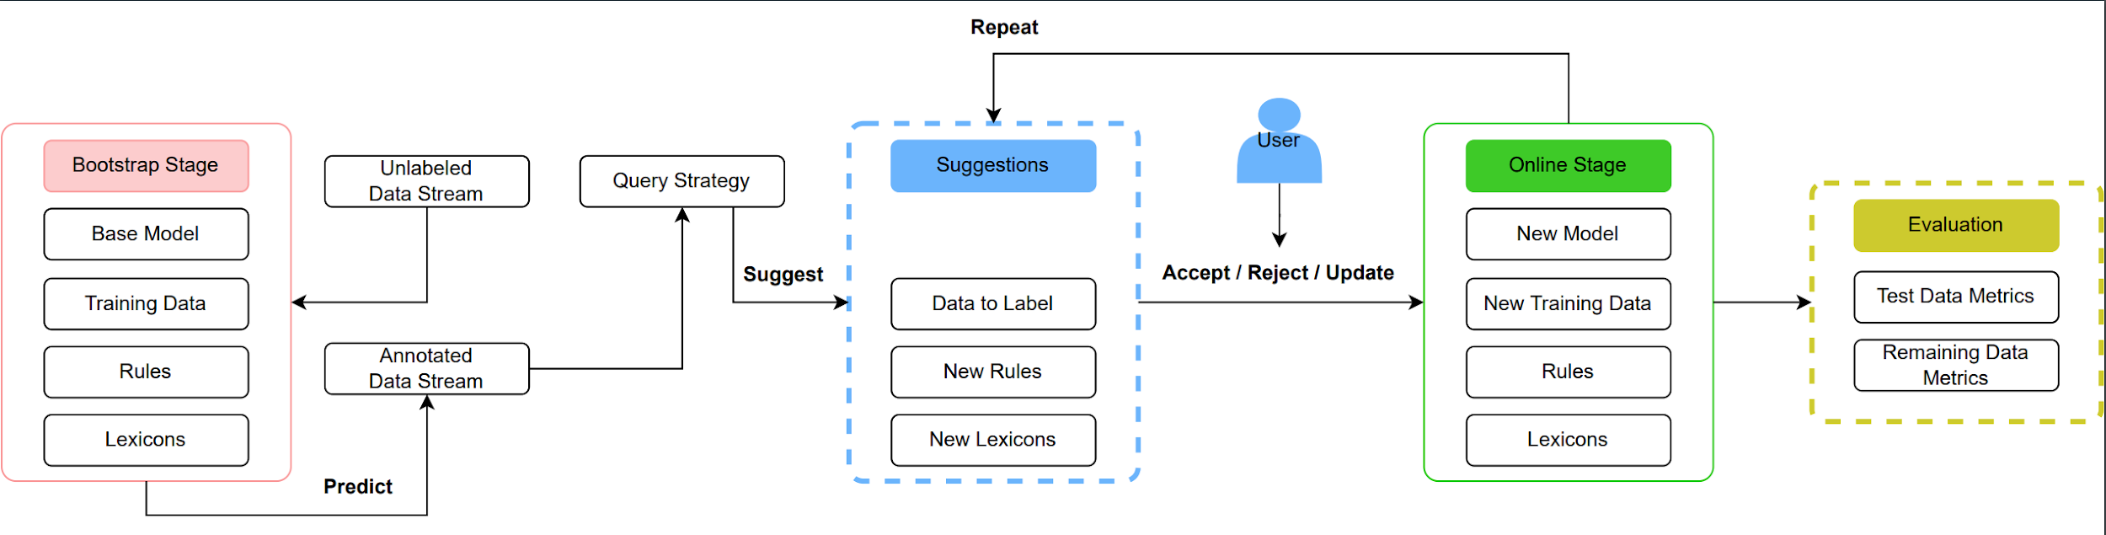
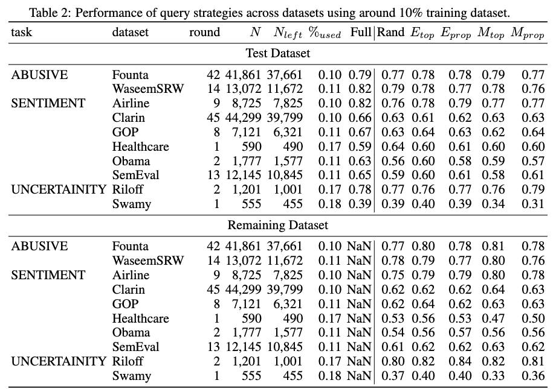
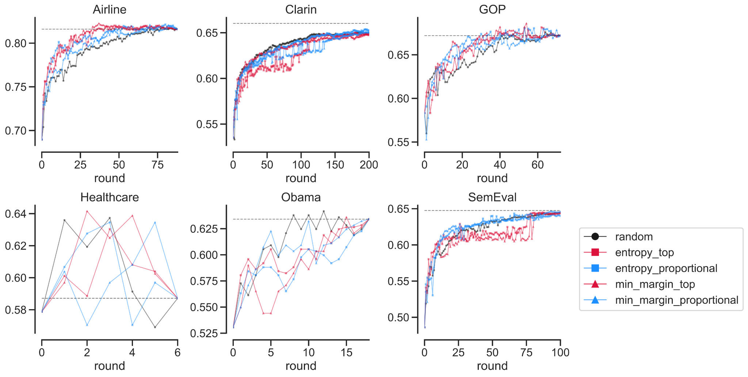
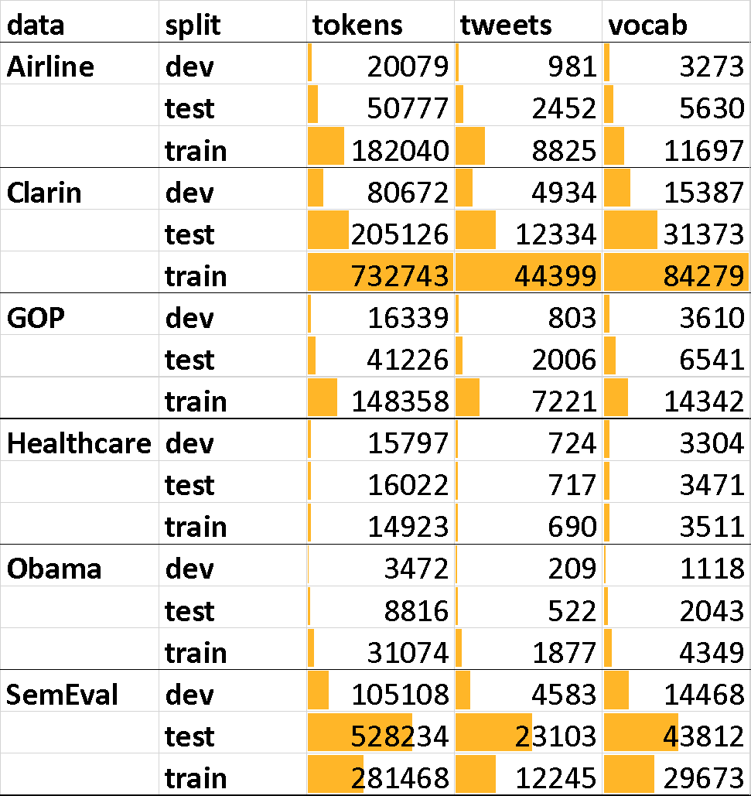
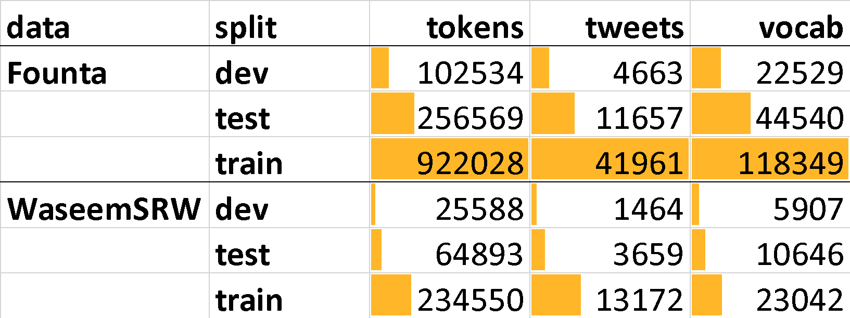
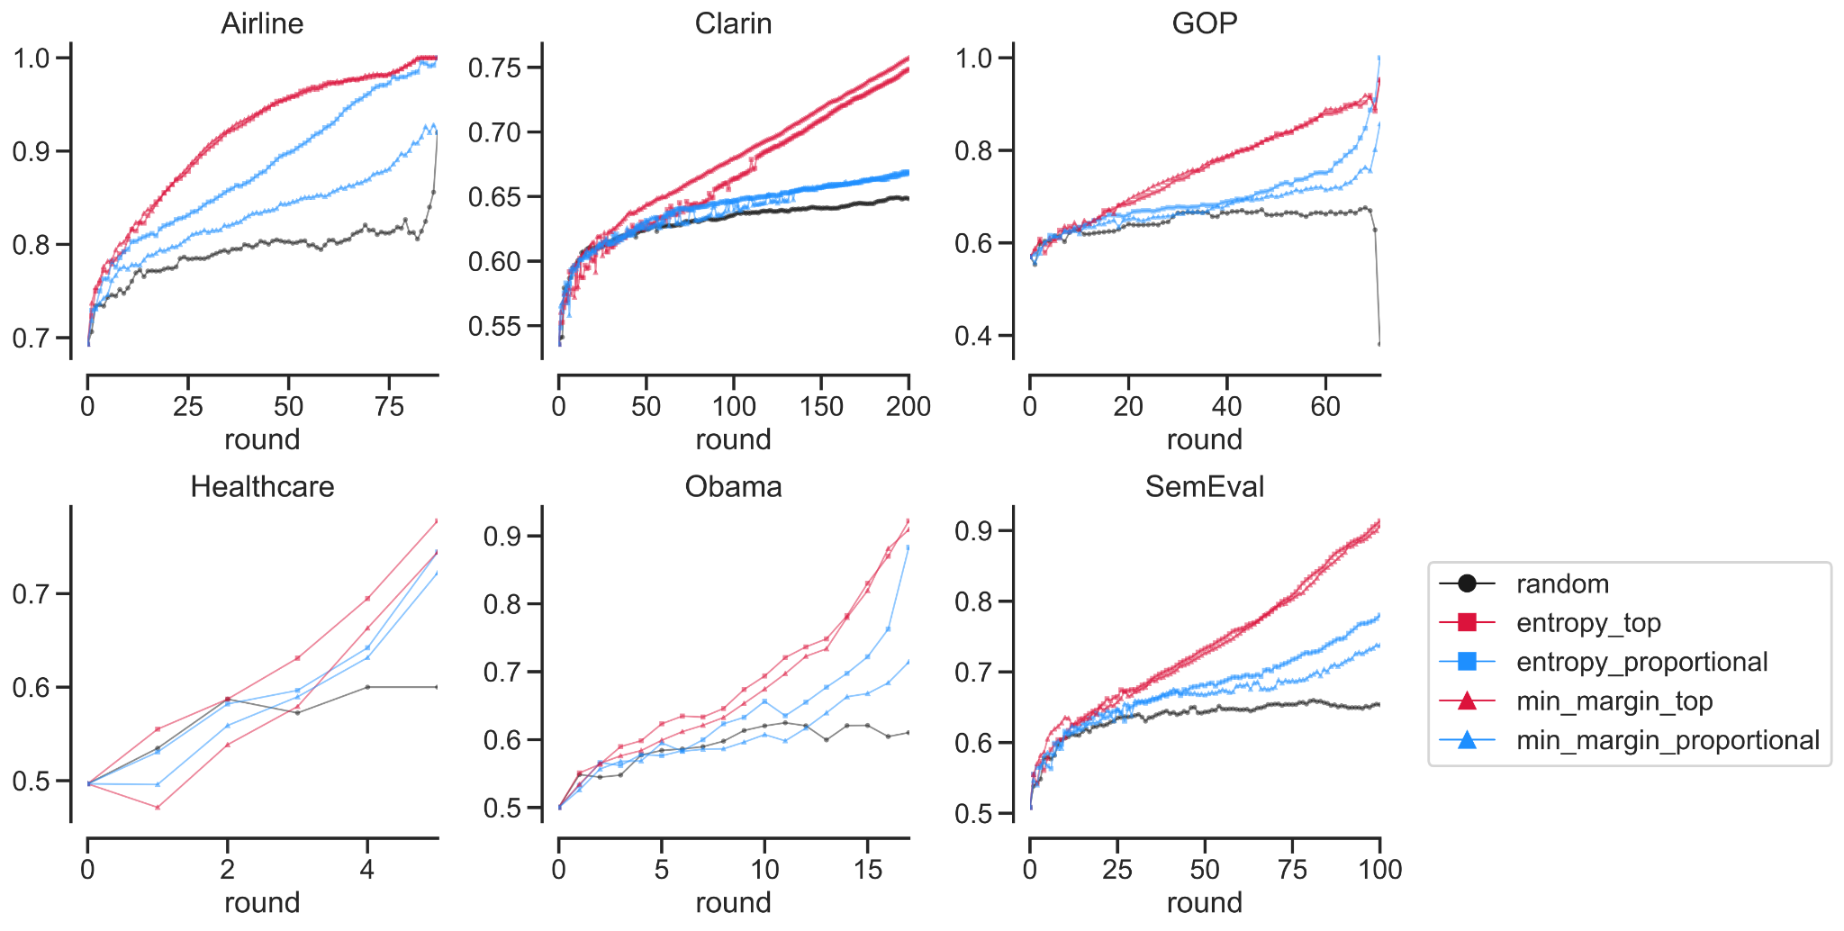
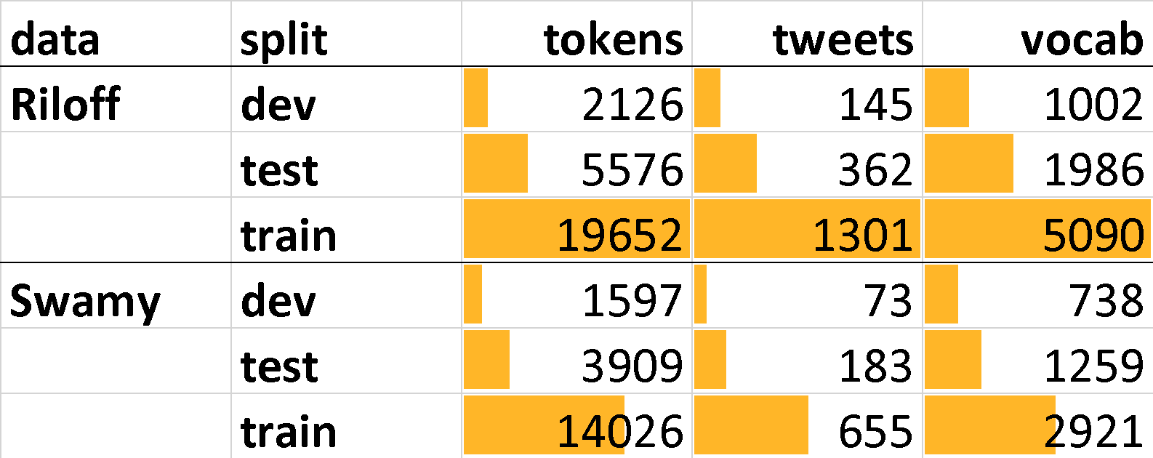
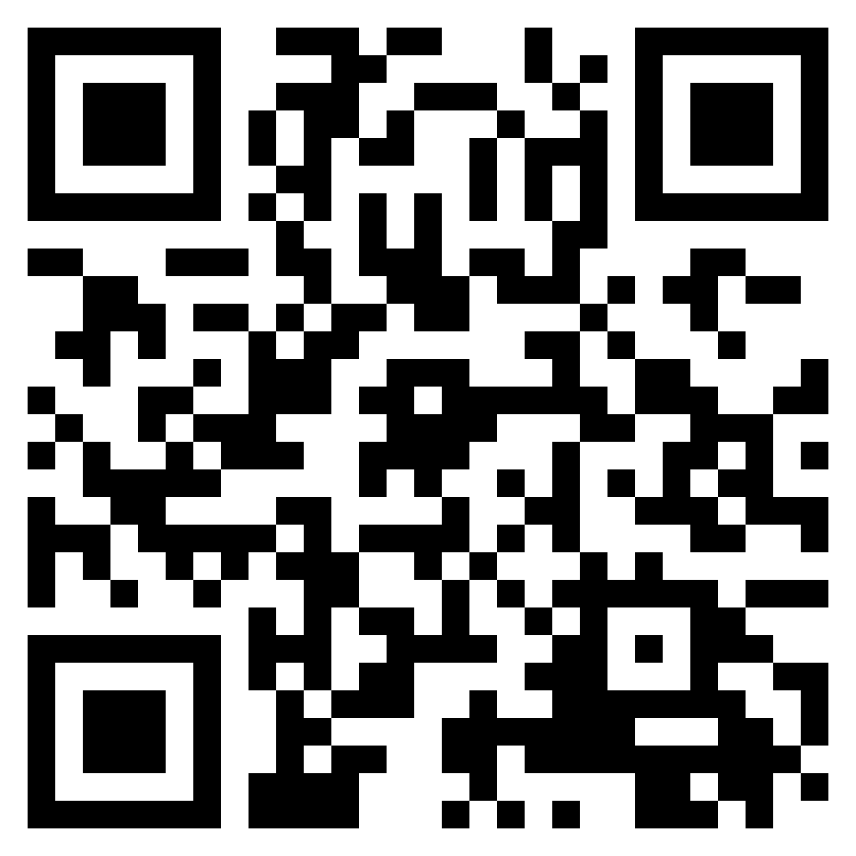
PyTAIL: Interactive and Incremental Learning of NLP Models with Human in the Loop for Online Data
Shubhanshu Mishra* (shubhanshu.com), Jana Diesner (University of Illinois at Urbana-Champaign), *Work done while at UIUC.
https://github.com/socialmediaie/pytail | https://arxiv.org/abs/2211.13786
Evaluation of PyTAIL on benchmark
Problem formulation
PyTAIL Workflow
Given a large unlabeled corpus, can we:
label it efficiently using fewer human annotations?
allow efficient human-in-the-loop injection of rules during the annotation process?
update models efficiently to work with new data?
Proposal:
Use active learning for data labeling
Use interface to surface and inject prominent rules for efficient annotation
Use incremental learning algorithms for model updates
Highly applicable to social media data:
Streaming data
Model should adapt to new data
Build an easy to use interface which allows users to perform human-in-the-loop annotation of data and incremental training of the model
Enable injection of custom lexicons and rules for NLP application, with ability to suggest rules
Support simulation mode to assess performance of active learning techniques
Support human in the loop interface for interactive annotation and rule building
Track performance of remaining data during simulation model to measure time to full annotation.
Support different active learning algorithms
Support different rule suggestion techniques
Each round query 100 samples
Classifier is logistic regression with unigram and lexicon features
Max rounds is 100 (except Clarin)
PyTAIL Benchmark for Social Media Active Learning
Tasks for Social Media Text Classification: Abusive, Sentiment, Uncertainty
10 tasks, 200K social media posts
To be released at: https://doi.org/10.5281/zenodo.7236430
Derived from Social Media IE Multi Task Benchmark – https://doi.org/10.5281/zenodo.5867160
Evaluation Workflow
We evaluated PyTAIL simulation workflow on the PyTAIL benchmark
Using a linear model, a continuously updated lexicon from the data
The goal was the evaluate the performance of different active learning strategies on social media corpus
We considered, random, entropy based, and min margin for candidate scoring.
We used top K and sampling for candidate selection
Our results show that Top K strategies lead to the fastest annotation of a given unlabeled corpora
Random leads to the slowest annotation of the corpora.
In terms of generalization capabilities most approaches are similar
Evaluate only on the data not used for training
Top strategy queries efficiently and can help in labeling full data more quickly.
Abusive content identification
Resources
ArXiv: https://arxiv.org/abs/2211.13786
Dataset: https://doi.org/10.5281/zenodo.7236430
Code: https://github.com/socialmediaie/pytail
Video: https://youtu.be/AwDu64gN8t4
Sentiment classification
Uncertainty indicator classification

