Slide 1
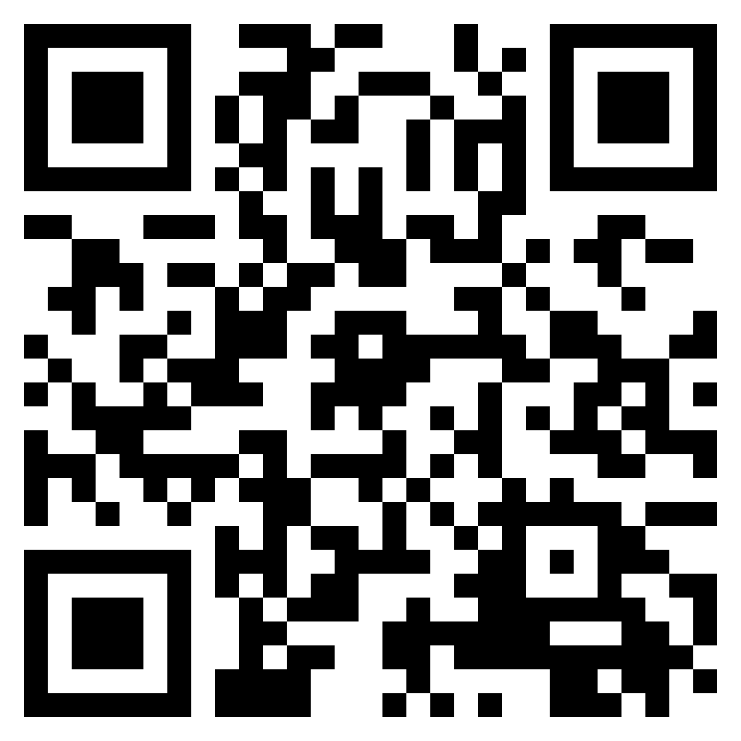
PyTAIL: Interactive and Incremental Learning of NLP Models with Human in the Loop for Online Data
Shubhanshu Mishra* (shubhanshu.com) - @TheShubhanshu
Jana Diesner (University of Illinois at Urbana-Champaign) - @janadiesner
*The work presented here was done during my PhD at UIUC
ArXiv: https://arxiv.org/abs/2211.13786
Dataset: https://doi.org/10.5281/zenodo.7236430
Code: https://github.com/socialmediaie/pytail
Video: https://www.youtube.com/watch?v=AwDu64gN8t4

Slide 2
Problem Formulation
Given a large unlabeled corpus, can we:
label it efficiently using fewer human annotations?
allow efficient human-in-the-loop injection of rules during the annotation process?
update models efficiently to work with new data?
This setting is needed for social media data, where:
Data is available in streaming mode, and
Model should adapt to new data

Slide 3
Proposal
Given a large unlabeled corpus, can we:
label it efficiently using fewer human annotations? ✅Active Learning
allow efficient human-in-the-loop injection of rules during the annotation process? ✅Data and Rule suggestion interface
update models efficiently to work with new data? ✅Online Learning
Notes:
Proposal:
Use active learning for data labeling
Use interface to surface and inject prominent rules for efficient annotation
Use incremental learning algorithms for model updates

Slide 4
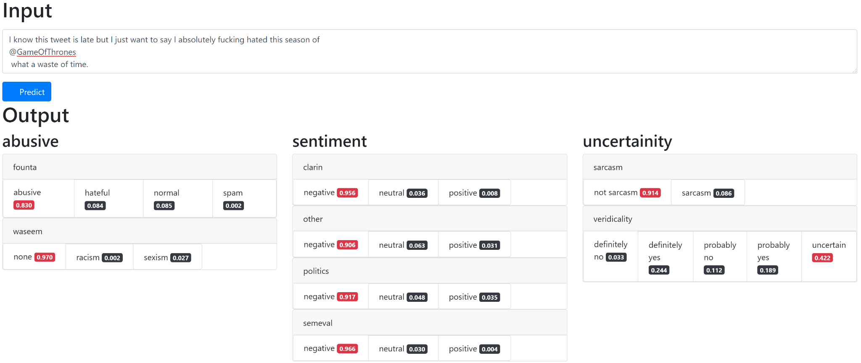
Scope: Classification Tasks for Social Media

Slide 5
PyTAIL Benchmark of Active Learning on Social Media Text Classification
Tasks for Social Media Text Classification: Abusive, Sentiment, Uncertainty
10 tasks, 200K social media posts
To be released at: https://doi.org/10.5281/zenodo.7236430
Derived from Social Media IE Multi Task Benchmark – https://doi.org/10.5281/zenodo.5867160
Notes:
Making some IE tasks practically useful for newcomers

Slide 6
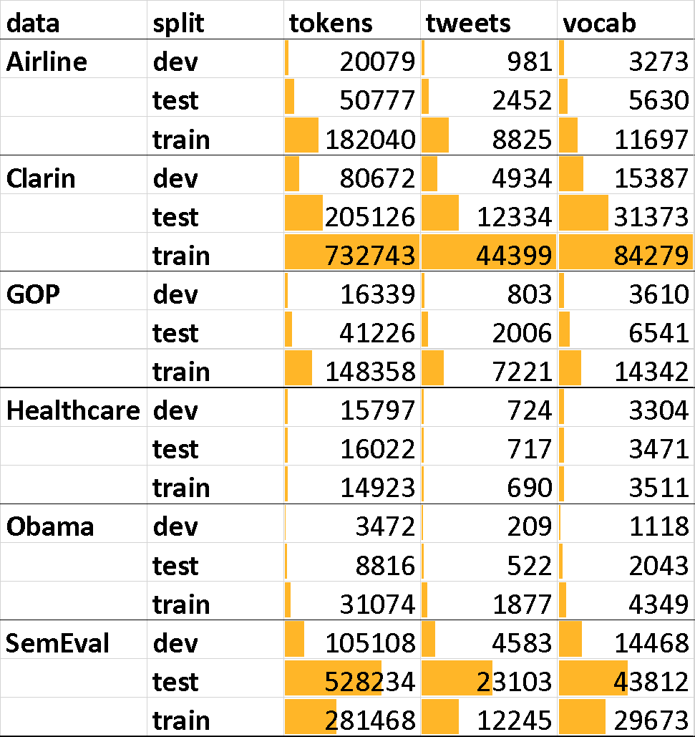
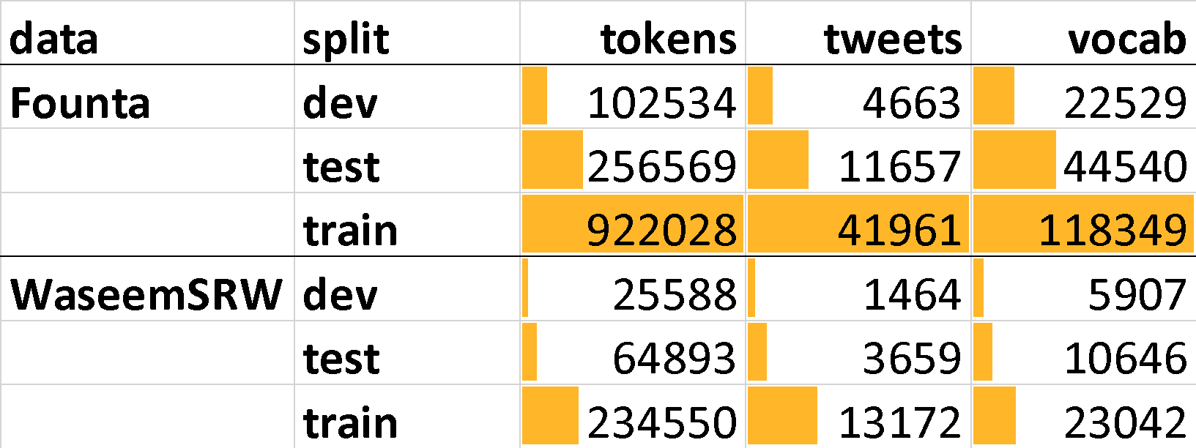
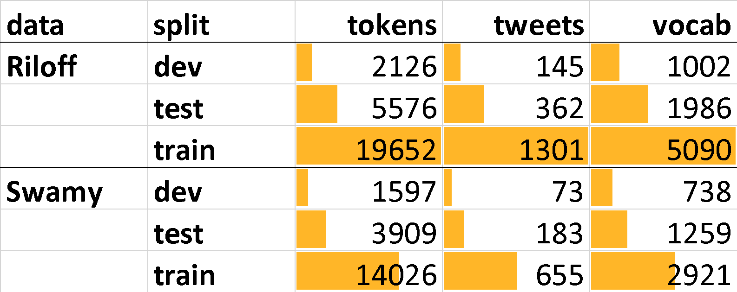
Data Stats
Abusive content identification
Sentiment classification
Uncertainty indicator classification
https://doi.org/10.5281/zenodo.5867160 and https://shubhanshu.com/phd_thesis/
Notes:
Making some IE tasks practically useful for newcomers

Slide 7
SAIL: Sentiment Analysis with Incremental Human-in-the-Loop Learning and Lexical Resource Customization
SAIL was written in Java and serves as a precursor for PyTAIL
SAIL was written specifically for Sentiment Classification tasks and supports active online learning via SGD based updates.
Mishra, Shubhanshu, Jana Diesner, Jason Byrne, and Elizabeth Surbeck. 2015. “Sentiment Analysis with Incremental Human-in-the-Loop Learning and Lexical Resource Customization.” In Proceedings of the 26th ACM Conference on Hypertext & Social Media - HT ’15, 323–25. New York, New York, USA: ACM Press. https://doi.org/10.1145/2700171.2791022.

Slide 8
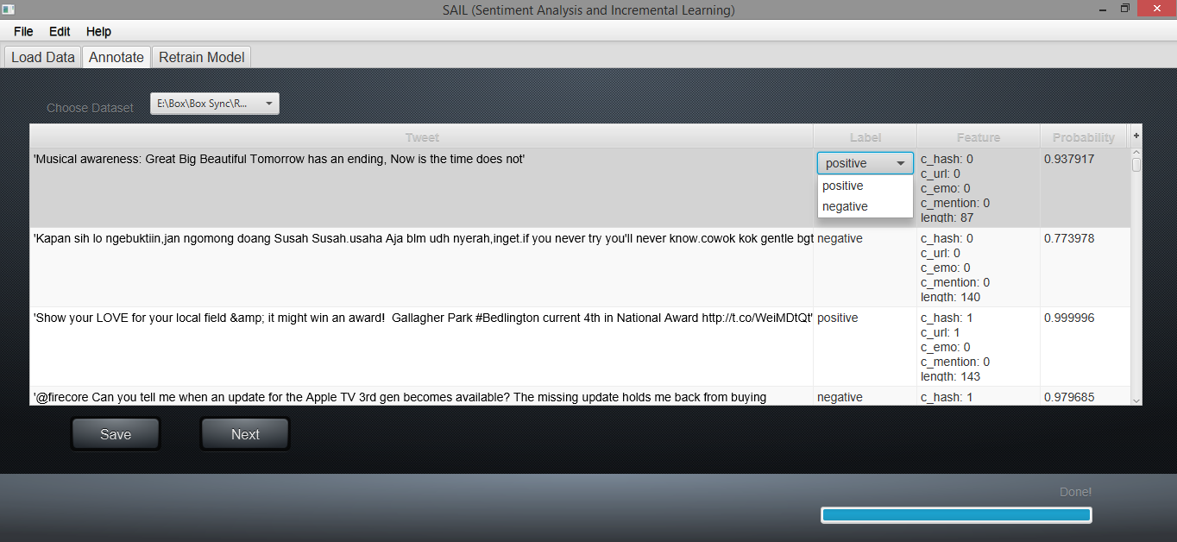
SAIL: Sentiment Analysis with Incremental Human-in-the-Loop Learning and Lexical Resource Customization
Mishra, Shubhanshu, Jana Diesner, Jason Byrne, and Elizabeth Surbeck. 2015. “Sentiment Analysis with Incremental Human-in-the-Loop Learning and Lexical Resource Customization.” In Proceedings of the 26th ACM Conference on Hypertext & Social Media - HT ’15, 323–25. New York, New York, USA: ACM Press. https://doi.org/10.1145/2700171.2791022.

Slide 9
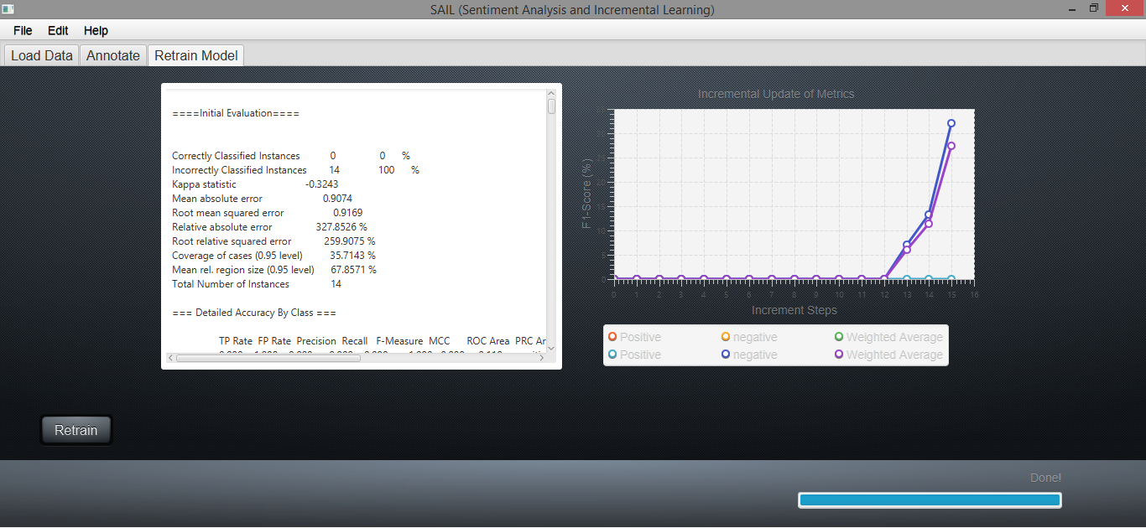
SAIL: Sentiment Analysis with Incremental Human-in-the-Loop Learning and Lexical Resource Customization
Mishra, Shubhanshu, Jana Diesner, Jason Byrne, and Elizabeth Surbeck. 2015. “Sentiment Analysis with Incremental Human-in-the-Loop Learning and Lexical Resource Customization.” In Proceedings of the 26th ACM Conference on Hypertext & Social Media - HT ’15, 323–25. New York, New York, USA: ACM Press. https://doi.org/10.1145/2700171.2791022.

Slide 10
PyTAIL Workflow
Build an easy to use interface which allows users to perform human-in-the-loop annotation of data and incremental training of the model
Enable injection of custom lexicons and rules for NLP application, with ability to suggest rules
Support simulation mode to assess performance of active learning techniques
Support human in the loop interface for interactive annotation and rule building
Track performance of remaining data during simulation model to measure time to full annotation.
Support different active learning algorithms
Support different rule suggestion techniques

Slide 11
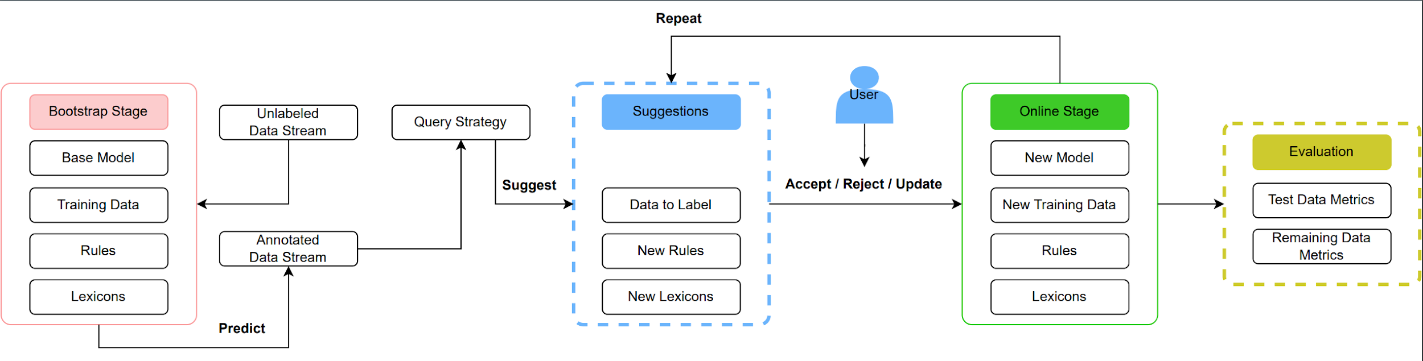
PyTAIL Workflow
Simulation and Human in the loop modes

Slide 12
Active Learning
Given a model and unlabeled data
Select samples from the unlabeled data to be annotated, based on selection criterion
Update model with collected labeled examples
Repeat steps 2 to 3 till desired accuracy is reached or data exhausted
Mishra et al. (2015)

Slide 13
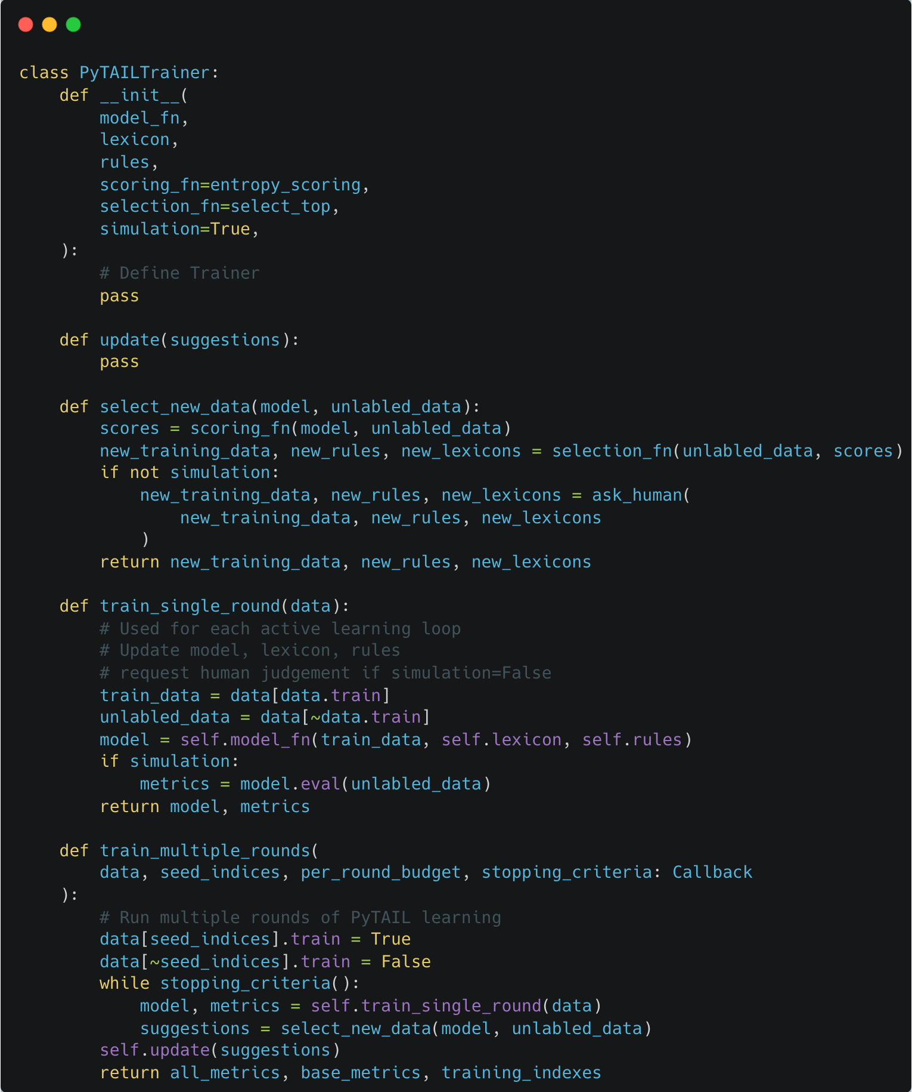
PyTAIL - API

Slide 14
Evaluation Workflow
We evaluated PyTAIL simulation workflow on the PyTAIL benchmark
Using a logistic regression model, and a continuously updated lexicon from the data
The goal was the evaluate the performance of different active learning strategies
We considered, random, entropy based, and min margin for candidate scoring.
We considered top K and K sampled for candidate selection

Slide 15
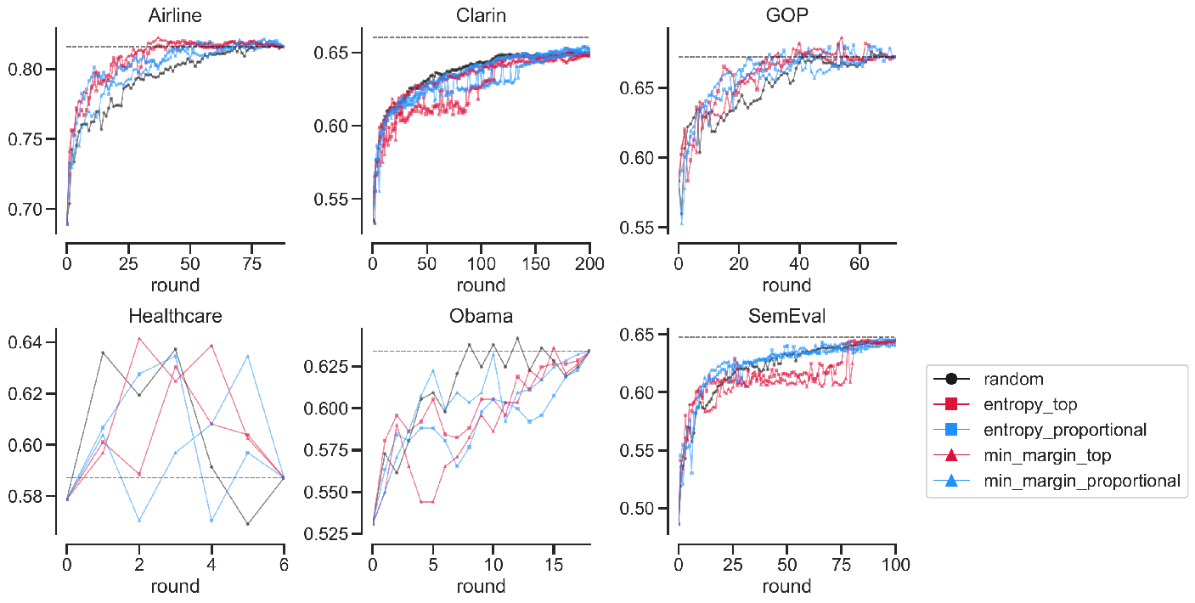
Each round query 100 samples
Classifier is logistic regression with unigram and lexicon features
Max rounds is 100 (except Clarin)
Data ordered alphabetically and X and Y axes are not shared.
https://github.com/socialmediaie/SocialMediaIE

Slide 16
Evaluation on remaining data
Active learning systems only track performance on held out test set
However, often goal is to quickly annotate a large unlabeled data
We should hence track which methods quickly allows us to reach this goal by measuring the performance on the remaining data

Slide 17
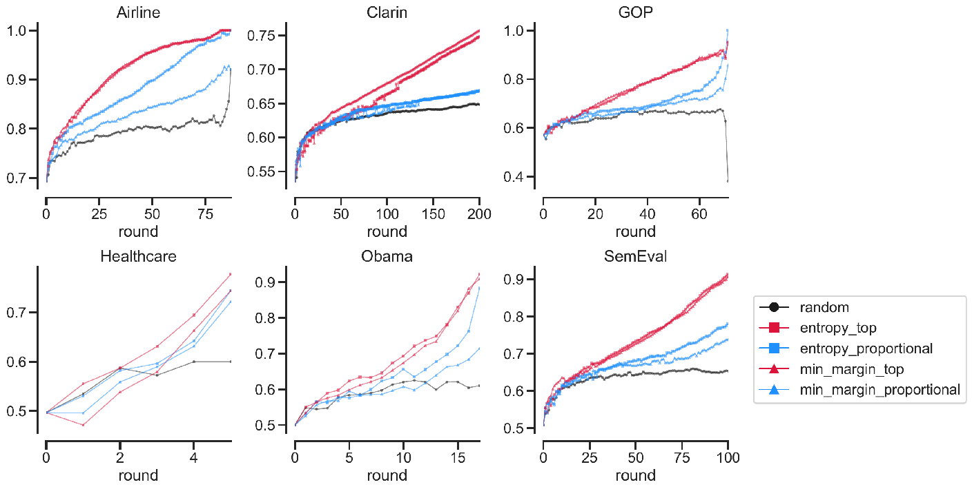
Evaluate only on the data not used for training
Top strategy queries efficiently and can help in labeling full data more quickly.
Data ordered alphabetically and X and Y axes are not shared.
https://github.com/socialmediaie/SocialMediaIE

Slide 18
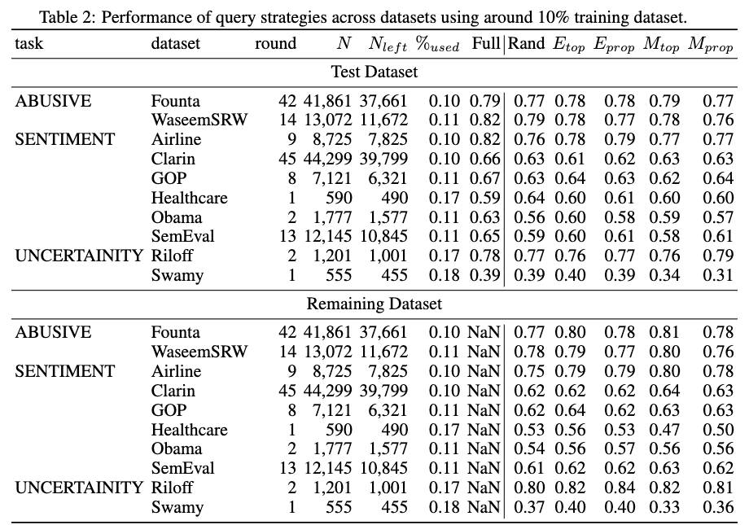
Benchmark Evaluation
Our results show that Top K strategies lead to the fastest annotation of a given unlabeled corpora
Random leads to the slowest annotation of the corpora.
In terms of generalization capabilities most approaches are similar

Slide 19
Thank you
Questions?
Tweet to us at:
Shubhanshu Mishra - @TheShubhanshu
Jana Diesner - @janadiesner @DiesnerLab
PyTAIL will be released soon at: https://github.com/socialmediaie/pytail
Previous version of PyTAIL used for our experiments can be found as part of the SocialMediaIE tool: https://github.com/socialmediaie/SocialMediaIE/tree/master/SocialMediaIE/active_learning
If you have questions or feature requests open an issue on GitHub at: https://github.com/socialmediaie/pytail/issues

Slide 20
References
Mishra, Shubhanshu, Diesner, Jana, Byrne, Jason, & Surbeck, Elizabeth (2015). Sentiment Analysis with Incremental Human-in-the-Loop Learning and Lexical Resource Customization. In Proceedings of the 26th ACM Conference on Hypertext & Social Media - HT ’15 (pp. 323–325). New York, New York, USA: ACM Press. https://doi.org/10.1145/2700171.2791022
Shubhanshu Mishra and Jana Diesner. 2022. PyTAIL: Interactive and Incremental Learning of NLP Models with Human in the Loop for Online Data. arXiv:2211.13786 [cs].

