Slide 1
OEM Configuration Validation – Demo
Automated validation of Android device configuration
against MDM policy schema

Slide 2
Problem
MDM sends policy → Device applies it
How do we prove the device really applied it?

Slide 3
Solution
Schema-driven validation
• API = expected configuration
• Device log = actual state
• Automated comparison

Slide 4
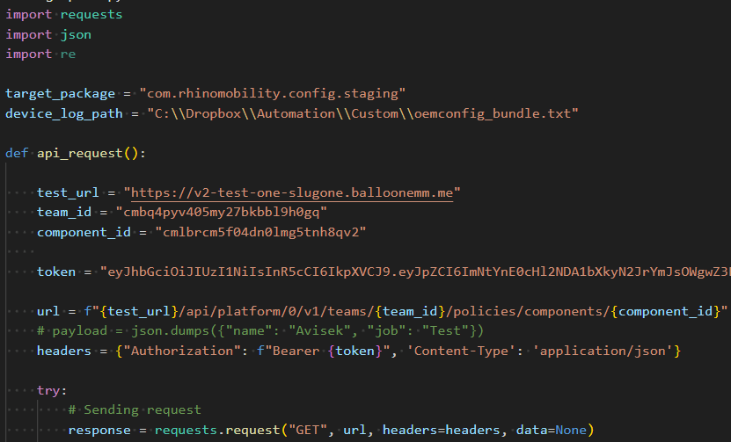
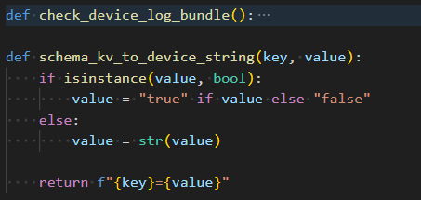
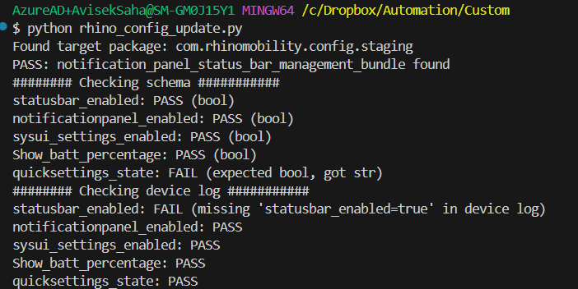
How It Works
1. Fetch policy from API
2. Read device OEM log
3. Convert schema to key=value
4. Verify presence in device log

Slide 5
Example
Schema:
statusbar_enabled = true
Device log:
statusbar_enabled=true

Slide 6
Value to Customer
• Proof of policy enforcement
• No manual verification
• Scalable & auditable

