Slide 1
things we said today
trending topics visualization

Slide 2
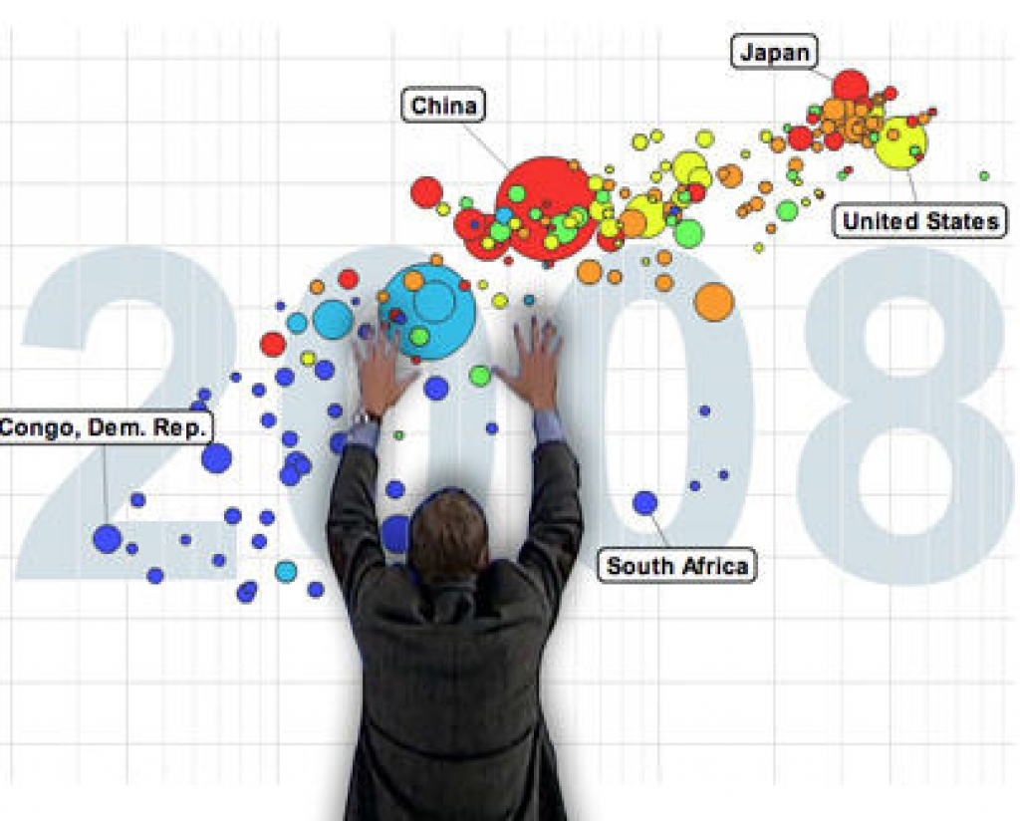
Expectation

Slide 3
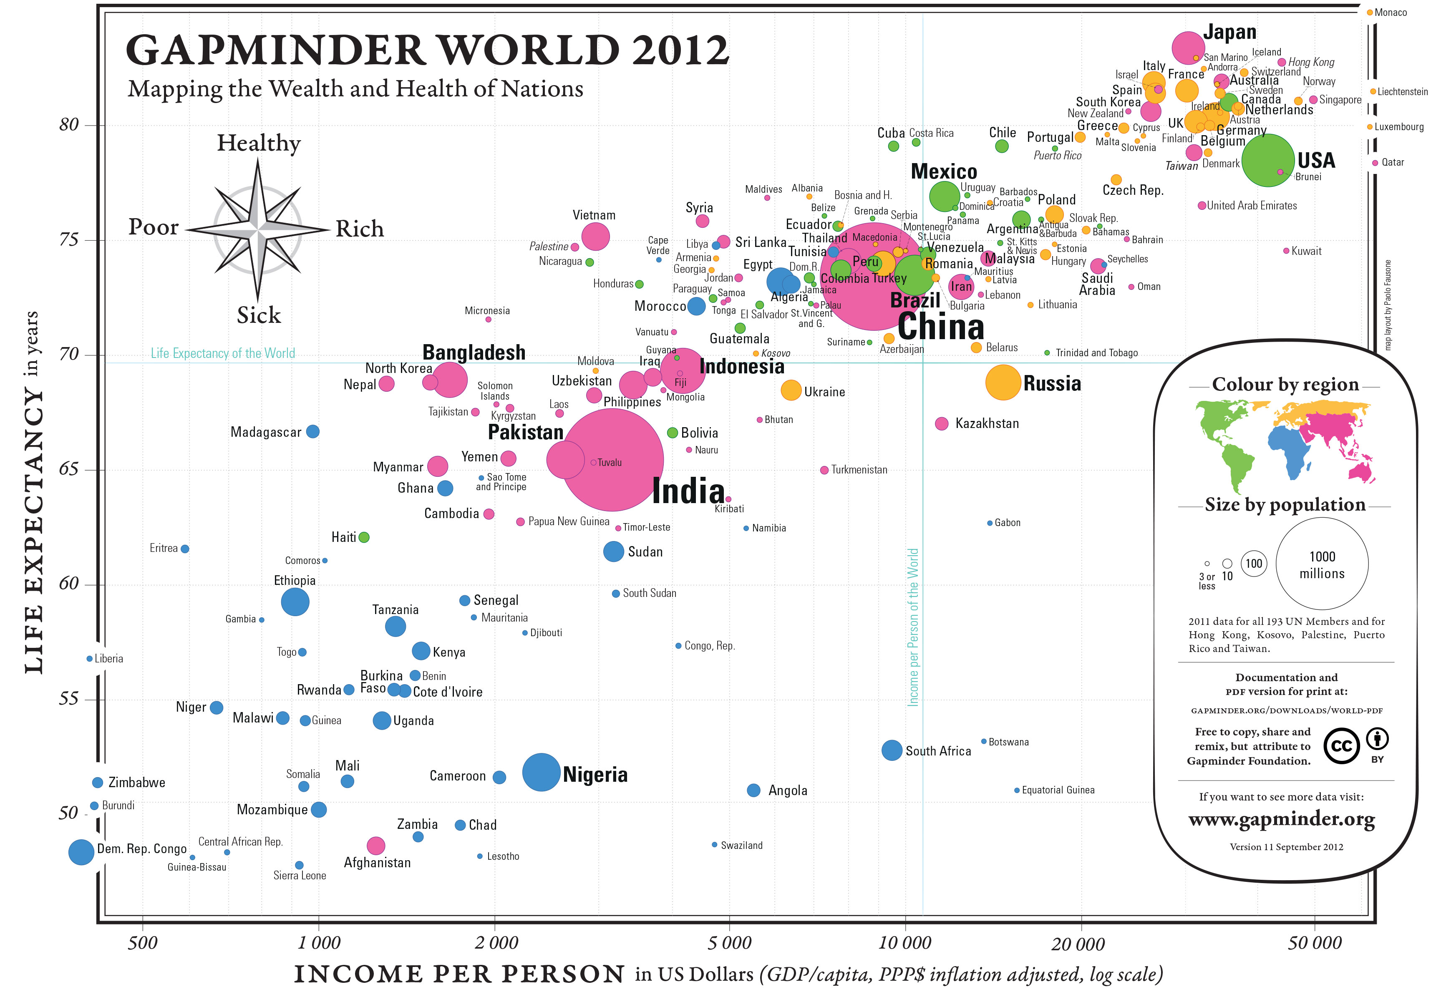
Expectation

Slide 4
Expectation

Slide 5
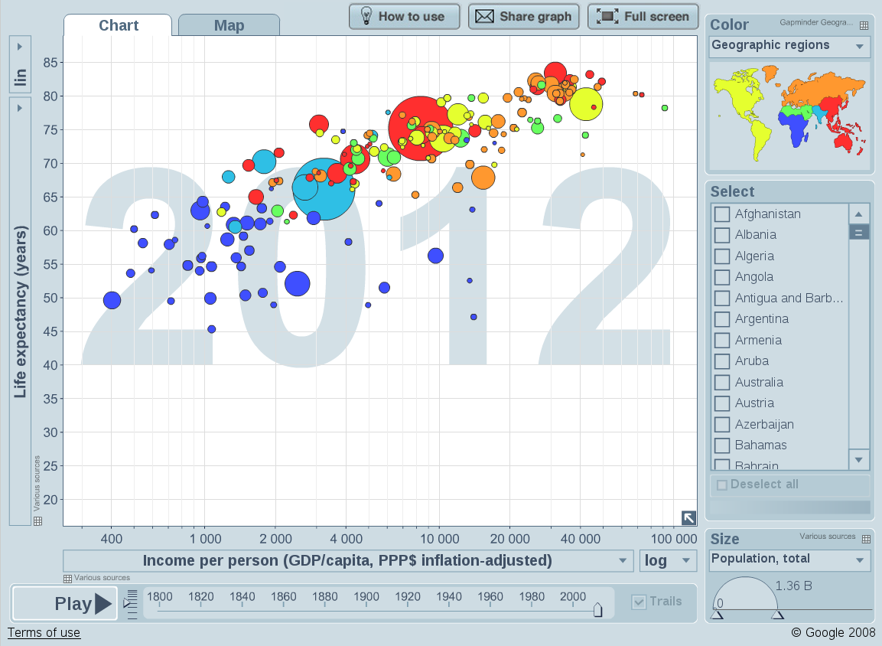
Expectation

Slide 6
Sources (current)
Twitter
Google
Wikipedia
Yahoo (UK & US)
Reddit
Digg
Reuters (UK & US)

Slide 7
Harvesting
Import.io (for now)
5 minutes interval
source, rank, topic, time

Slide 8
Source variations
Presentation
Change interval
Number of topics

Slide 9
Presentation
Twitter: #hashtags
Google, Yahoo: 2-3 words
Wikipedia, Reddit, Digg, Reuters: Article title
US – UK formatting differences

Slide 10
Processing
Basic NLP to detect common topics
sameas service on SOCIAM Pub:
http://sociam-pub.ecs.soton.ac.uk/sociam/closeMatch/pairs/

Slide 11
Result
127703 rows in the db (at 14:35)
http://prov.usewod.org/topservatory/

