Slide 1
APPLICATION Resilience

Slide 2
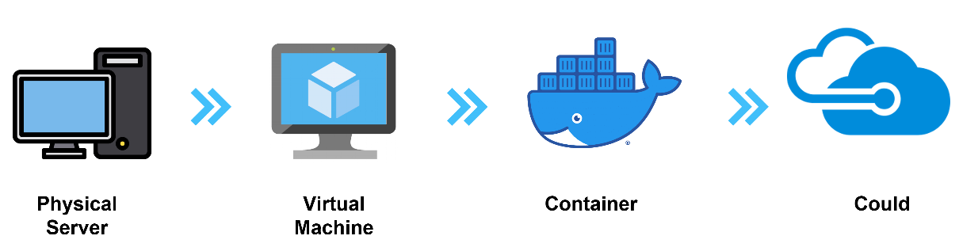

BACKGROUND

Slide 3


CONTEXT
Service
R1
E1
External
S1
S2
R2
APPLICATION
S
Application microservices
R
Referential Services
ORG
E
External Services

Slide 4
CONTEXT
Service
R1
E1
External
S1
S2
R2
APPLICATION
S
Application microservices
R
Referential Services
ORG
E
External Services

Slide 5
CONTEXT
Service
R1
E1
External
S1
S2
R2
APPLICATION
S
Application microservices
R
Referential Services
ORG
E
External Services

Slide 6
CONTEXT
Application does not have any control.
However, they have some influence on the referential service teams
Application Team has full control
Service
R1
E1
External
S1
S2
R2
APPLICATION
S
Application microservices
R
Referential Services
ORG
E
External Services

Slide 7
CONTEXT
Service
R1
E1
External
S1
S2
R2
APPLICATION
S
Application microservices
R
Referential Services
ORG
E
External Services

Slide 8
CONTEXT
Service
R1
E1
External
S1
S2
R2
APPLICATION
S
Application microservices
R
Referential Services
ORG
E
External Services

Slide 9
CONTEXT
Service
R1
E1
External
S1
S2
R2
APPLICATION
S
Application microservices
R
Referential Services
ORG
E
External Services

Slide 10

CONTEXT
Service
R1
E1
External
S1
S2
R2
APPLICATION
S
Application microservices
R
Referential Services
ORG
E
External Services

Slide 11
CONTEXT
Service
R1
E1
External
S1
S2
R2
APPLICATION
S
Application microservices
R
Referential Services
ORG
E
External Services

Slide 12
CONTEXT
Service
R1
E1
External
S1
S2
R2
APPLICATION
S
Application microservices
R
Referential Services
ORG
E
External Services

Slide 13

CONTEXT
When all services are available
When some of the external services are not available
Deal XYZ
Internal Server Error
Please contact support
(DL1001)
Amount : 100 EUR
Tenure : 20 Years
ERROR PAGE
Country : FRANCE
Client : XYZ
Rating : +5|5
Blocking the end user

Slide 14
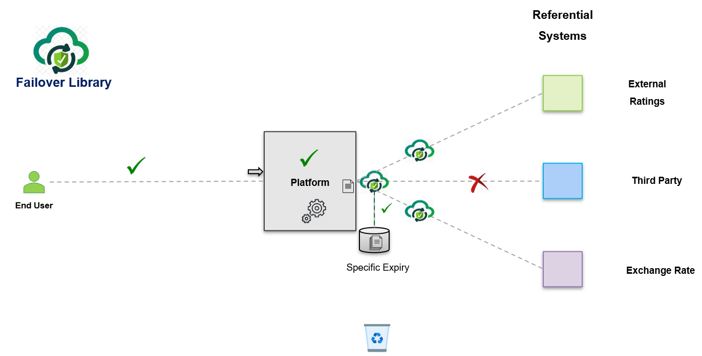
SOLUTION

Slide 15
SOLUTION
Service
R1
E1
External
S1
S2
R2
APPLICATION
S
Application microservices
R
Referential Services
ORG
E
External Services

Slide 16



SOLUTION
Failover
Service
S1
R1 INT
R1
Failover
Store
APPLICATION
S
Application microservices
R
Referential Services
ORG
E
External Services

Slide 17
SOLUTION
Failover
Service
S1
R1 INT
R1
Failover
Store
APPLICATION
S
Application microservices
R
Referential Services
ORG
E
External Services

Slide 18
SOLUTION
The expiry of each referential must be in the acceptable range by the business
Failover
Service
S1
R1 INT
R1
With the defined expiry
Failover
Store
APPLICATION
S
Application microservices
R
Referential Services
ORG
E
External Services

Slide 19
SOLUTION
Failover
Service
S1
R1 INT
R1
Failover
Store
APPLICATION
S
Application microservices
R
Referential Services
ORG
E
External Services

Slide 20
SOLUTION
Failover
Service
S1
R1 INT
R1
Failover
Store
APPLICATION
S
Application microservices
R
Referential Services
ORG
E
External Services

Slide 21
SOLUTION
Failover
Service
S1
R1 INT
R1
If not expired ?
Failover
Store
APPLICATION
S
Application microservices
R
Referential Services
ORG
E
External Services

Slide 22
SOLUTION
Failover
Service
S1
R1 INT
R1
If not expired ?
Failover
Store
APPLICATION
S
Application microservices
R
Referential Services
ORG
E
External Services

Slide 23
SOLUTION
Failover
Service
S1
R1 INT
R1
If expired ?
Failover
Store
APPLICATION
S
Application microservices
R
Referential Services
ORG
E
External Services

Slide 24
SOLUTION
Failover
Service
S1
R1 INT
R1
If expired ?
Failover
Store
APPLICATION
S
Application microservices
R
Referential Services
ORG
E
External Services

Slide 25
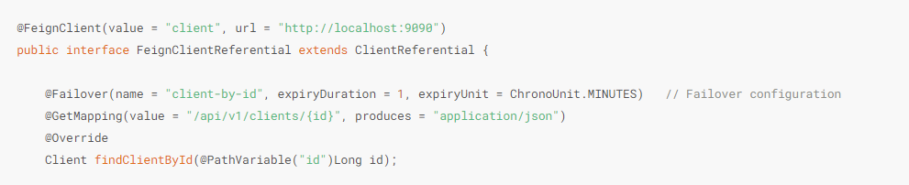
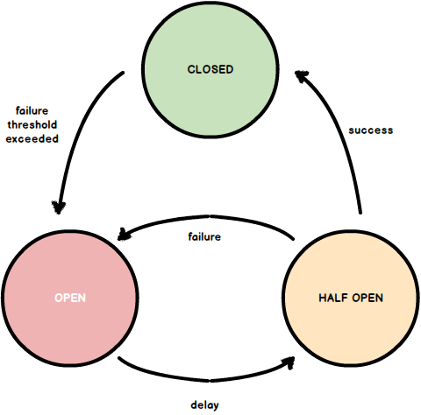


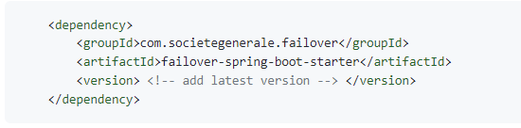

SOLUTION
Easy to integrate with just by adding one annotation
Failover
Failover Store :
In-memory : Not recommended for production
Cache : With caffeine cache ( for very small-scale use case )
JDBC : For any database support ( recommended for most common use cases )
CUSTOM : For any other custom failover store
Failover
Store
Failover Execution Strategy : ( Eliminate tightly coupling with other frameworks )
With simple Try Catch ( No heavy framework )
Support for resilience4j-circuitbreaker
Easily pluggable architecture for custom Failover Execution Strategy
Try {
…
} catch(Exception e) {
…
}
Simple Try Catch
circuit breaker
Monitoring : Various failover metrics are available for effective monitoring
Spring Boot Starter : Support for spring boot starter for easy integration

Slide 26
SOLUTION
When some of the referential is not available
When all referential is available
The solution won’t eliminate the failures 100%.
The solution will help us to reduce the impact by a large extend
Deal XYZ
Internal Server Error
Please contact support
Deal XYZ
(DL1001)
(DL1001)
Amount : 100 EUR
Tenure : 20 Years
Amount : 100 EUR
Tenure : 20 Years
ERROR PAGE
Country : Not Available
Country : FRANCE
As Of : 18-July-2022 10:00 AM
( 5 mins prior )
Client : XYZ
Rating : +5|5
Client : XYZ
Rating : +5|5
Blocking the end user
Able to recover
Unblocking the end user

Slide 27
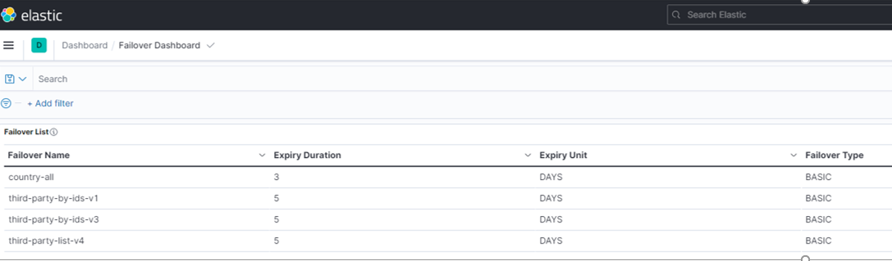
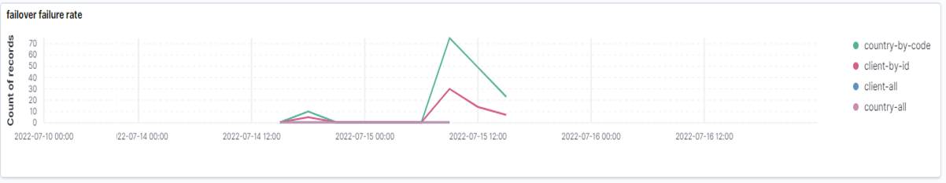
1. Failover Expiry
2. Failover Rates

Slide 28
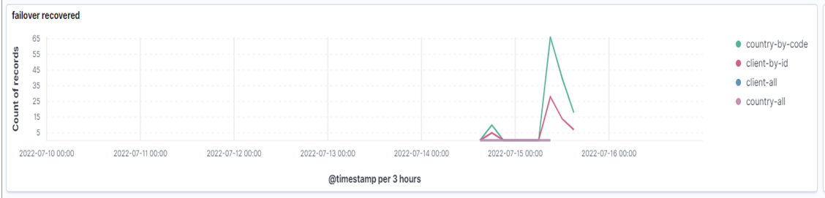
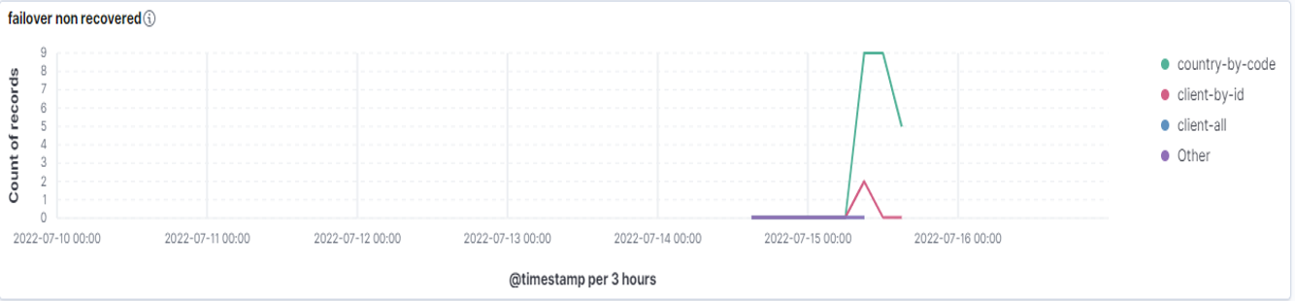
3. Failover Recovery Rates
Failover Non-Recovery Rates (actual failure)

Slide 29
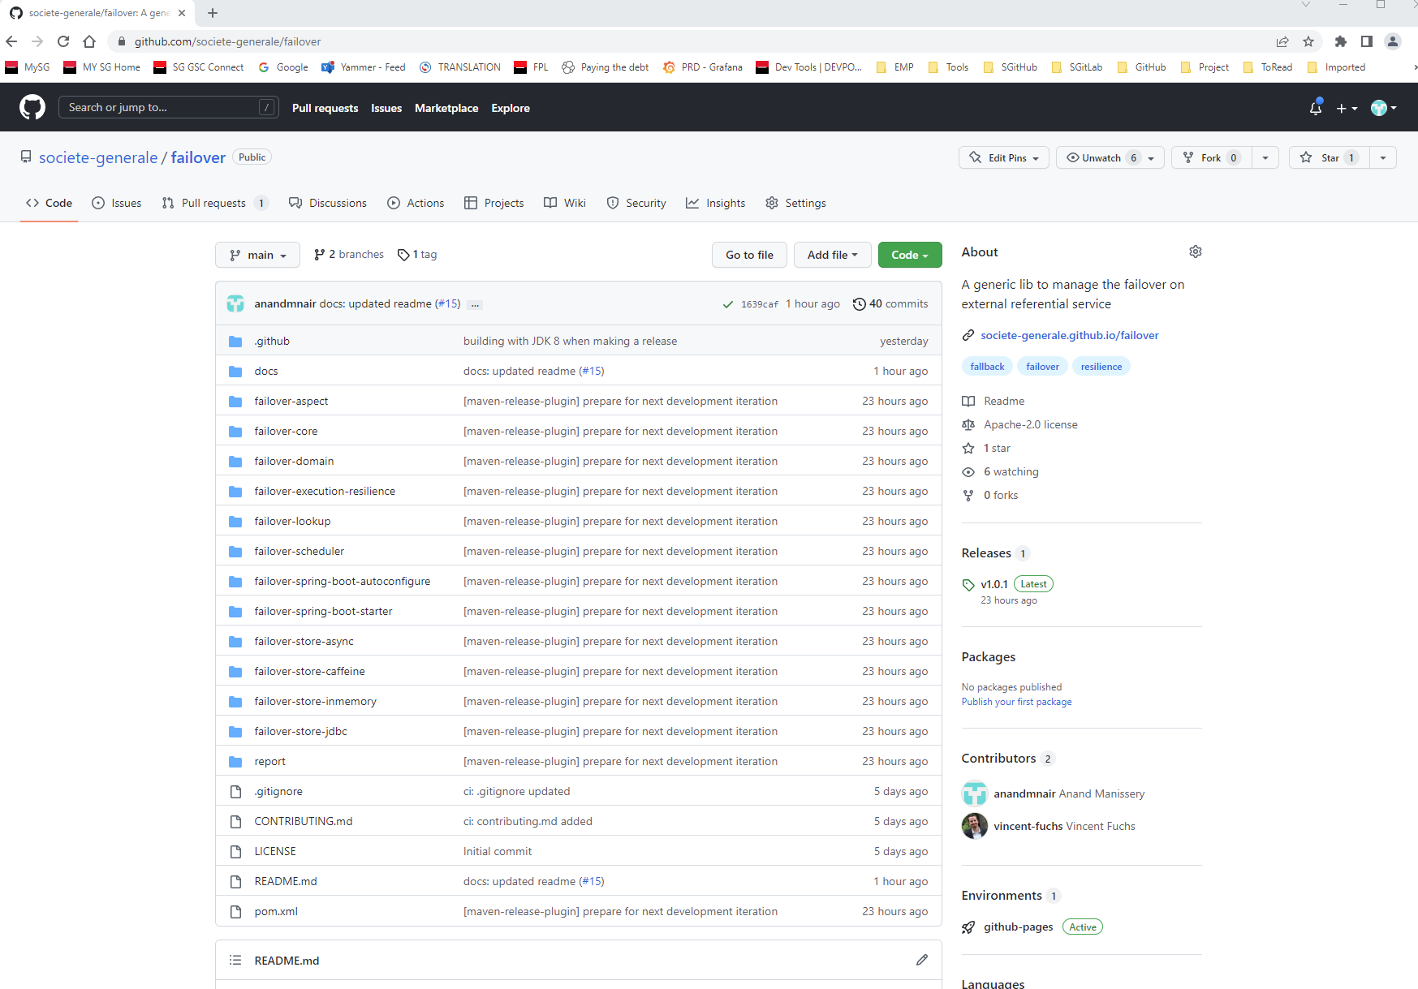

We Opensource it !
https://github.com/societe-generale/failover
We welcome your suggestions and contributions to make it better !

Slide 30
THANK YOU

