Slide 1

Stock Predictions
Using Deep Learning

Slide 2
Problem Statement
We are going to predict Stock Prices for Reliance group(RIL) from the past data

Slide 3
Data
We have data from 27th August,2018 to 25th August,2020 but in reverse order
Data consists of 13 columns including OPEN, HIGH, LOW and CLOSE values on given day.

Slide 4
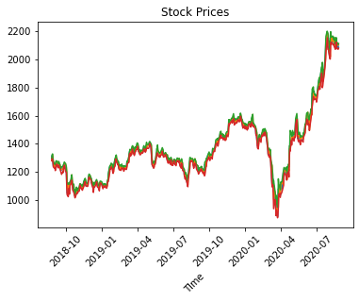
Stock Price Graph

Slide 5
Approach
Our goal is to predict future prices, and obviously we do not need other columns and we cannot predict all the values (OPEN, CLOSE, HIGH, LOW) in a single model.
So our approach will be to select one column(say CLOSE), train the model on that particular column and predict the values
We will repeat the above step for OPEN, HIGH and LOW

Slide 6
Machine Learning Models
As we have Time Series data, obvious choice was to go with RNN which holds the information and pass it to the next input in forward propagation.
We will use 2 types of RNNs : LSTM and GRU

Slide 7
Data Processing Steps
Sort the data date wise
Replace the column name with convenient ones
Select only target variable from given data on which predictions to be made
Scale the data using MinMaxScaler (0 to 1)
Split the data into Train and Validation
Note: We can't randomly select the Train and Validation data. It should be in order.

Slide 8
Models
Simple LSTM (with only one LSTM layer)
Stacked LSTM (with multiple LSTM layers)
Simple GRU (with only one GRU layer)
Stacked GRU (with multiple GRU layers)

Slide 9
Performance
The performace of the model will be calculated using RMSE(Root mean squared error).
First we will run the model using Simple LSTM and set the benchmark.
Then using different models we'll try to improve our RMSE score.

Slide 10
Performance Matrix

