Slide 1



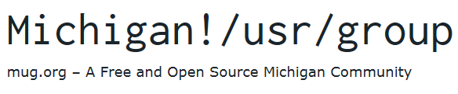
Selenium – Web Automation
James R. Small, Principal Architect

Slide 2
Assumed Background
You are comfortable with Python – this could also be done in the other core/popular languages: C#, Ruby, Java, JavaScript, PHP
You are comfortable with HTML, CSS, and the basics of JavaScript
You are comfortable with Chrome and its DevTools
Experience with web app development and testing a plus
Notes:
Selenium is a fantastic and powerful tool, but it’s not for beginners!

Slide 3
About Selenium
Created at Thoughtworks in 2004
Version 2 released in 2007
Version 3 released in 2016
Version 3 (WebDriver) standardized under the W3C in 2019
Version 4 paint still drying – released October 2021
Version 4 is also W3C standard
WebDriver
WebDriver Protocol also – more powerful
Notes:
In the early aughts, Jason Huggins of Thoughtworks started building an automated web application testing tool
Automated app testing is a core tenet of Thoughtworks
The dominant tool of the time was from Mercury Interactive – Astra Quick Test, was not exactly ideal
Selenium got its name because it’s the antidote for Mercury poisoning
Through a strong community and collaboration, Selenium has become the de facto QA tool for testing with browsers

Slide 4
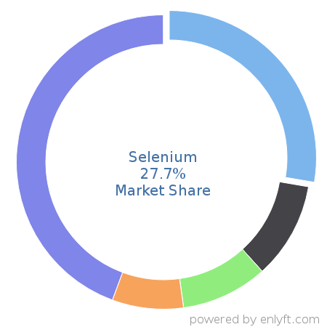
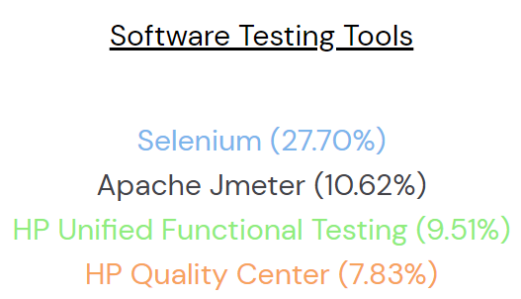
How Popular is Selenium?
According to Enlyft:
Selenium dominates testing tools
Over 54,000 users
Notes:
Over two and half times the market share of next leading testing tool

Slide 5
Why is Selenium so Popular?
Allows controlling browsers through your language of choice
Free and open source
Google became an avid user, created/contributed Grid
Standardized (WebDriver) through the W3C
Portable – Windows, macOS, Linux, iOS/Android (3rd party)
Integrates with CI/CD, development platforms, SaaS options
Notes:
Testing tools used to impose a specific and sometimes proprietary language or DSL
Thoughtworks making the software open-source lead to many trying and contributing to it
Google developed what became Selenium Grid – because of Thoughtworks openness and willingness to collaborate, the two teamed up to build a powerful solution
Not only was Selenium a successful collaboration, but its creators standardized WebDriver through the W3C ensuring it will be supported by all browser vendors
Because its open source and Grid was created by Google for cloud-scale its also popular on CI/CD and SaaS offerings

Slide 6
What Exactly is Selenium?
WebDriver – core of Selenium, allows browser automation
IDE – browser extension (Firefox, Chrome, Edge)
Allows recording and playback, essentially a no/low-code option
Grid – fully distributed testing solution, completely reworked in v4
Notes:
When someone refers to Selenium, it’s typically about WebDriver
Tester speaks to WebDriver using preferred language (e.g., Java, Python, C#, …)
WebDriver controls/interacts with browser
Grid allows testing with diverse browsers across a fleet of diverse systems – test any browser type and version from any platform at scale including allowing massive parallization

Slide 7
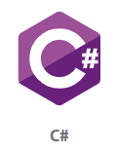


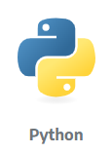

Languages Supported by Selenium WebDriver
Core:
Usage: 17.6% 6.1% 67% 31% 21.4%
3rd Party:
PHP (1.5% Usage, supported by Facebook)
Also Go, Haskell, Perl, R, Dart

Slide 8






Browsers Supported by Selenium WebDriver
Usage: 67% 33% 98%
Usage: ?% 13.5% 29%
Notes:
Chrome is the dominant test browser used by virtually everyone
However, Firefox is still popular and used by most
Edge and Safari see significant use
The undead IE also continues to see use!
I didn’t see any usage stats for Opera, but it is supported

Slide 9
Use Case
Asked to help support web app
App was out of date – components out of support for years
Business unit owner afraid to allow changes – would frequently break app
No tests – basic manual inspection done on demand

Slide 10
Step One
Work with application analyst to define tests
Document tests including screenshots
Whenever changes made to app:
Analyst goes through document to validate functionality
Tedious, slow, manual process…

Slide 11
Problems with Manual Testing
In addition to being tedious and slow:
Error prone
Often skipped for “small” changes
What about testing in multiple browsers and/or versions?
Mobile???
Way to provide fast, consistent feedback?

Slide 12
Step Two
I had heard of Selenium and thought it sounded interesting
Seemed like a good fit, so…
Install Python
pip install selenium

Slide 13
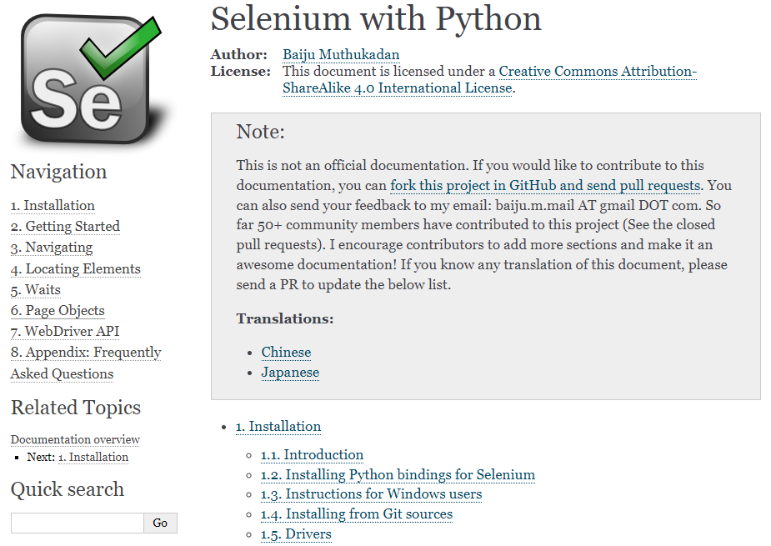
Getting Started with Selenium
Notes:
This is a little dated, but still a great resource on Read-the-docs

Slide 14
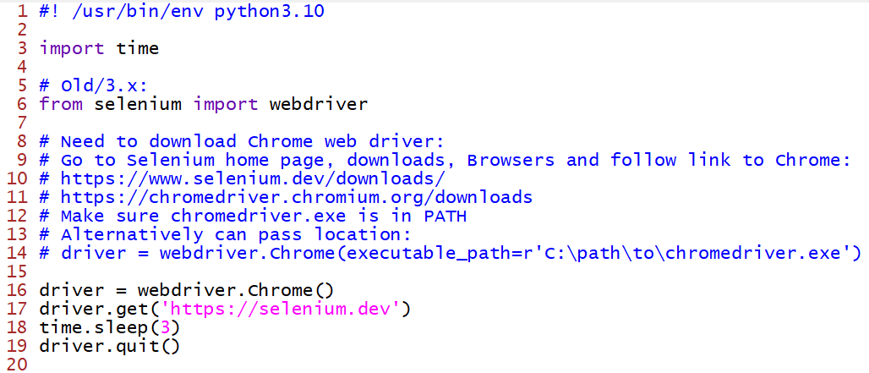
Hello, World – 3.x:
Notes:
You should never use time.sleep() and hard waits – this is just for a hello, world program!

Slide 15
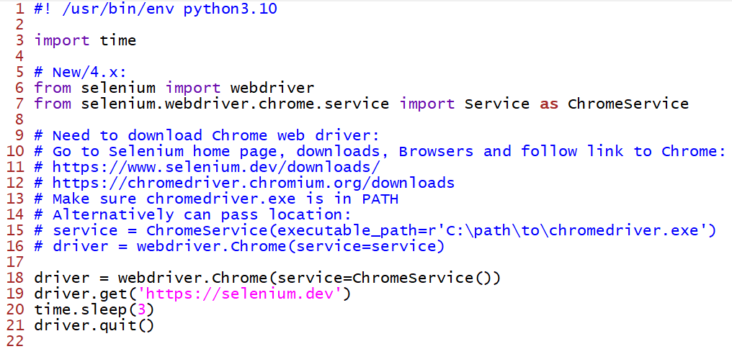
Hello, World – 4.x:

Slide 16

Tedium…
Must download a driver for each browser
Driver must match browser (32/64-bit, version)
Browsers auto-upgrade
If driver doesn’t match browser get strange errors…

Slide 17

Python WebDriver Manager
pip install webdriver-manager
Auto-downloads right driver!
Notes:
Of course, no solution is perfect, and this adds a little complexity, but still seems slick…

Slide 18
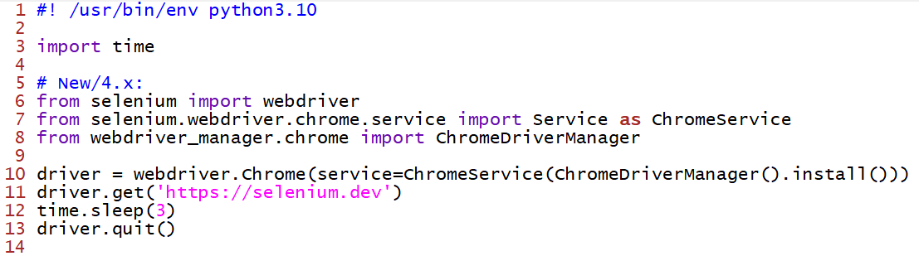
Hello, World – 4.x, improved:

Slide 19
Step Three – Convert Manual Tests into Automated Ones
Test Environment for App:
Login to test site
Login to app
From starting calendar, navigate to specific date
Select specific meeting
Find link to download PDF attachment for meeting
Confirm PDF retrieved and validate it’s the right one

Slide 20
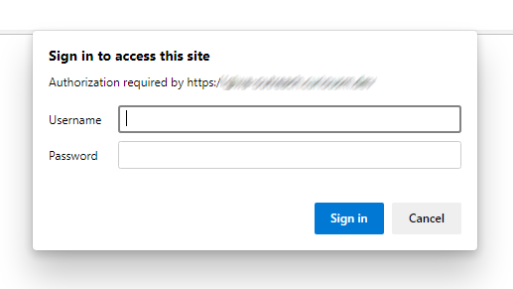
Login to test site

Slide 21
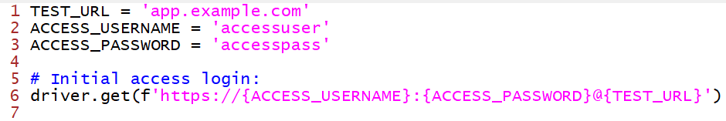
Login to test site
Accessing the test site requires basic authentication – Selenium provides a few options:
Encode into get request: https://<username>:<password>@<URL>
JavascriptExecutor for basic HTTP Authentication (not needed in my use case)
In 4.x, new BiDirectional API – can register basic auth, but couldn’t figure out how to get it to work in Python…
Notes:
The new BiDir API looks cool, and I only played with it a little, but the available documentation for Python is limited

Slide 22
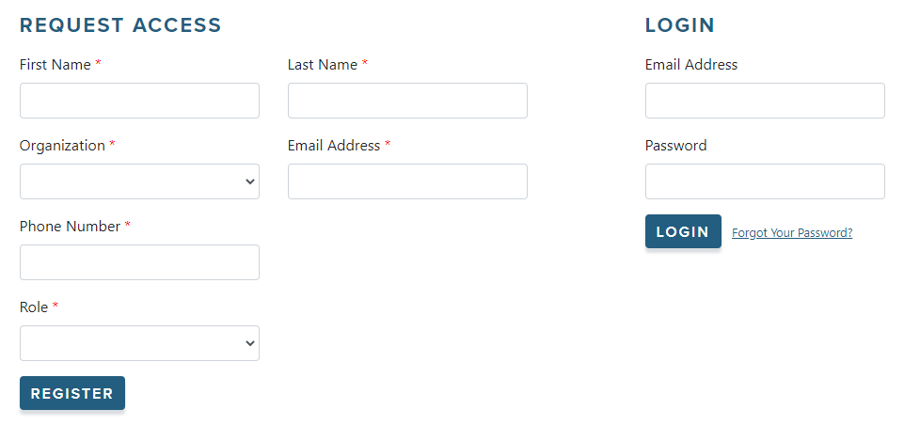
Login to App

Slide 23
Login to App
App Access requires user login:
Enter user Email address
Enter user Password
Click Login
We need to do programmatically:
Finding web elements within the DOM
Simulate user input/interaction

Slide 24
Login to App – Locate/Complete Forms with WebDriver Locators
Locator | Example
Class Name | <p class="content">Site content goes here.</p> driver.find_element(By.CLASS_NAME, 'content')
CSS Selector | <p class="content">Site content goes here.</p> driver.find_element(By.CSS_SELECTOR, ‘p.content')
ID | <form id="loginForm"> driver.find_element(By.ID, ‘loginForm')
Link Text/Partial Link Text | <a href="continue.html">Continue</a> driver.find_element(By.LINK_TEST, ‘Continue’) driver.find_element(By.PARTIAL_LINK_TEST, 'Conti')
Name | <input name="username" type="text" /> driver.find_element(By.NAME, ‘username')
Tag Name | <h1>Welcome</h1> driver.find_element(By.TAG_NAME, ‘h1')
XPath | <input name="username" type="text" /> driver.find_element(By.XPATH, ‘//input[@name=“username”]’)

Slide 25
Which WebDriver Locator(s) to Use?
From the Automation Panda:
ID (if unique)
Name (if unique)
Class Name
CSS Selector
XPath without text or indexing
Link Text / Partial Link Text
XPath with text and/or indexing
Notes:
These are listed best to worst
The ones at the end like XPath are more fragile or more susceptible to breakage due to small changes

Slide 26



Why is XPath at the bottom?
Notes:
Did I mention the book in the middle is 1366 pages?

Slide 27
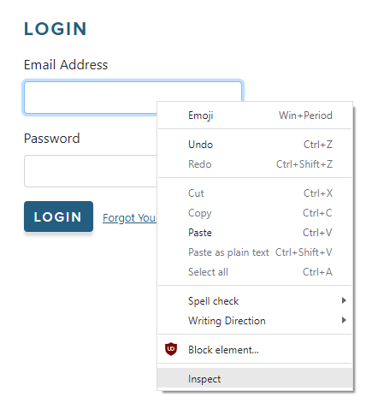
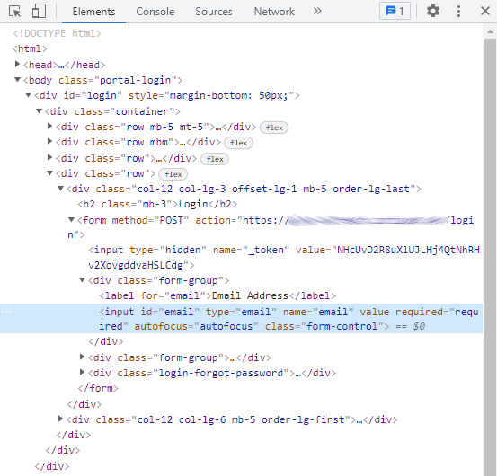
Login to App – Find Web Elements and Appropriate Locators

Slide 28
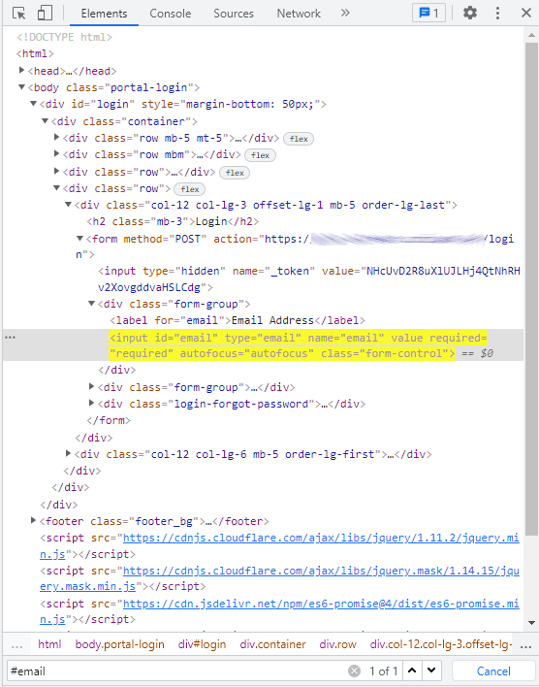
Login to App – Ensure Locator is Unique
From Chrome DevTools:
Use Control-F to search for Locator
Locator: ID=“email”
Search for “#email”
Note: Chrome states 1 of 1 – it’s unique!

Slide 29


Login to App – Find Web Elements and Appropriate Locators
User Email address – Unique ID
User Password – also has Unique ID
Login Button – no unique ID…
<div class="login-button">
<button type="submit" class="btn btn-primary">Login</button>
</div>
Use XPATH: '//*[@class="login-button"]/button'

Slide 30
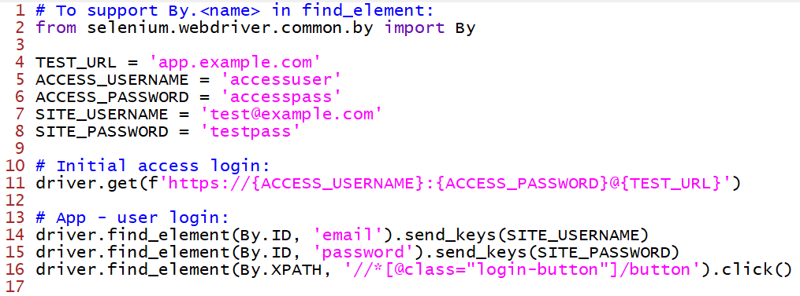
Login to App – Code
Notes:
A note on By…

Slide 31
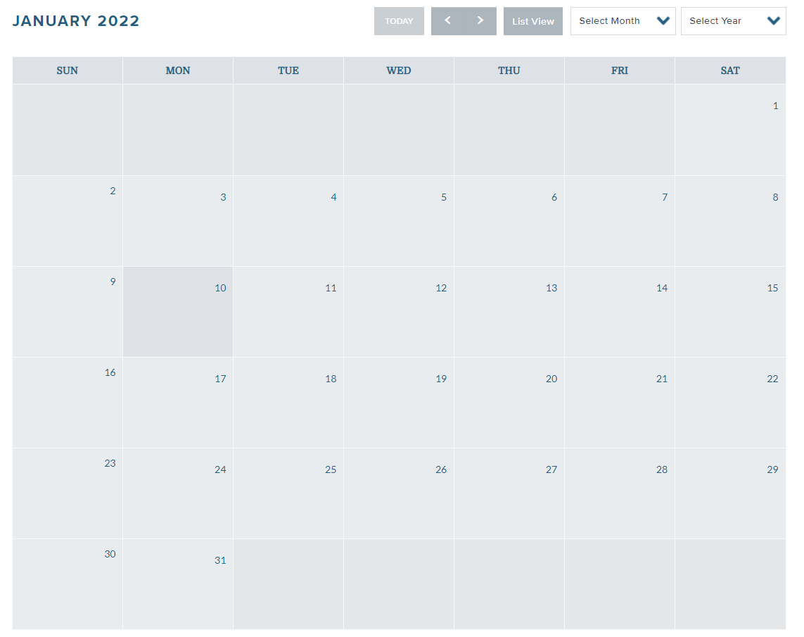
From starting calendar view, navigate to specific date

Slide 32
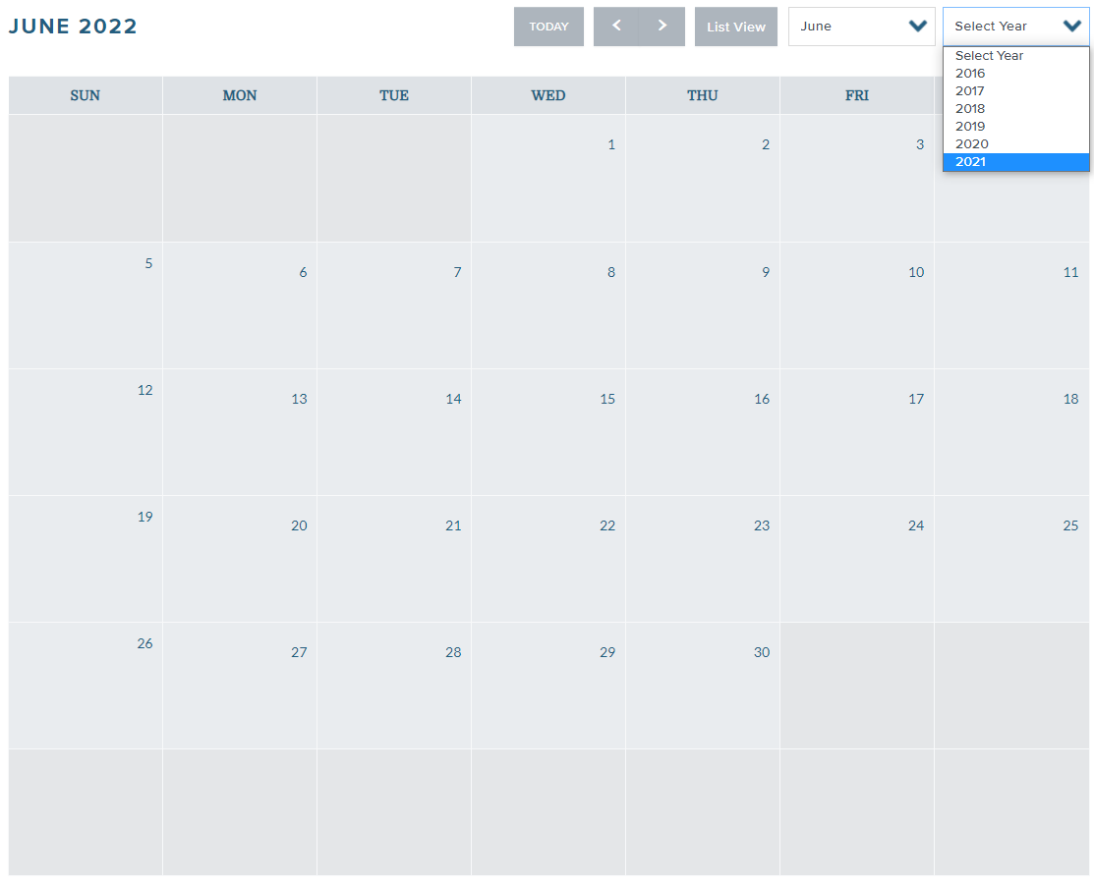
From starting calendar view, navigate to specific date

Slide 33
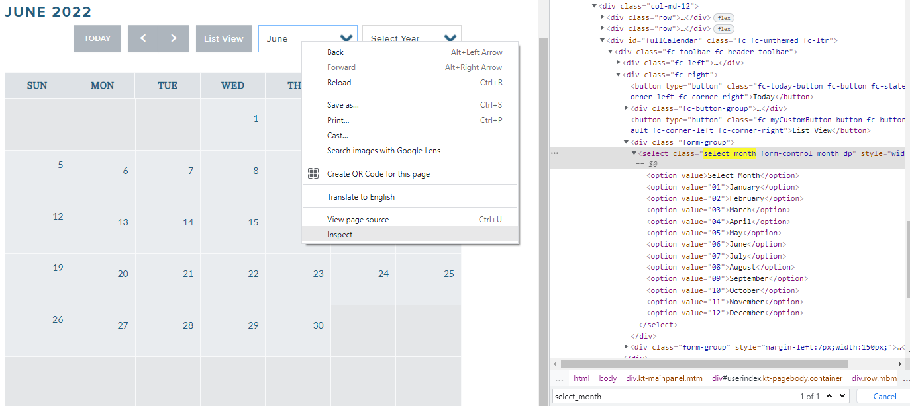
From starting calendar view, navigate to specific date

Slide 34
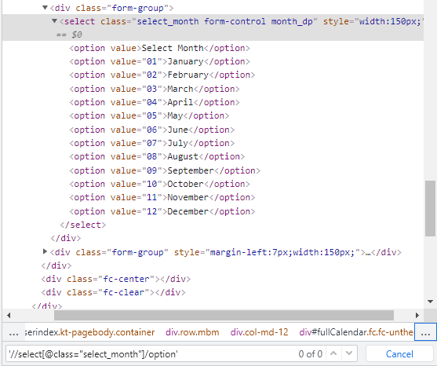
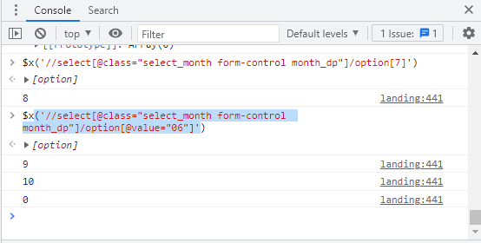
Chrome can help with XPath Expressions

Slide 35
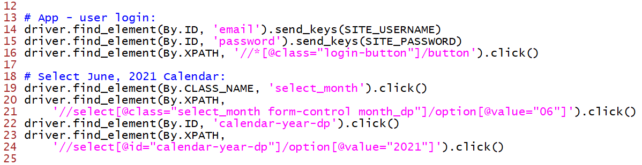
Navigate to Specific Date – Code

Slide 36
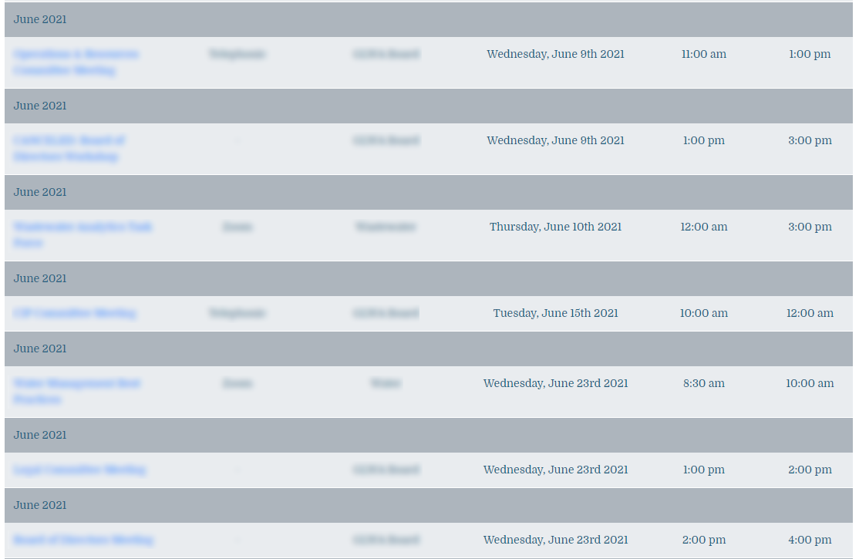
Select Specific Meeting

Slide 37
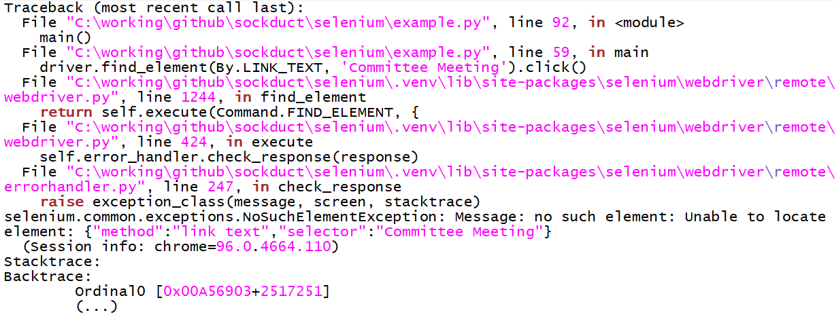
Flakiness and Race Conditions
When try to follow link to specific meeting, sometimes it fails:
Notes:
Now, I know the web element is present. What gives?

Slide 38
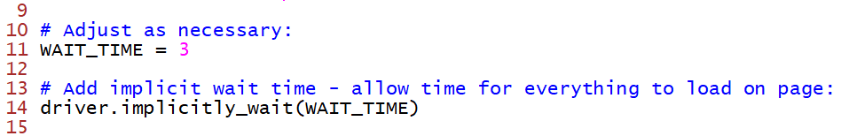
Allowing Time for Web Elements to Load:

Slide 39
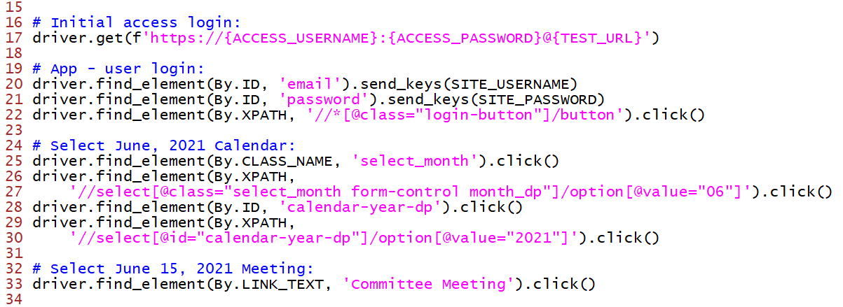
Select Specific Meeting – Code

Slide 40
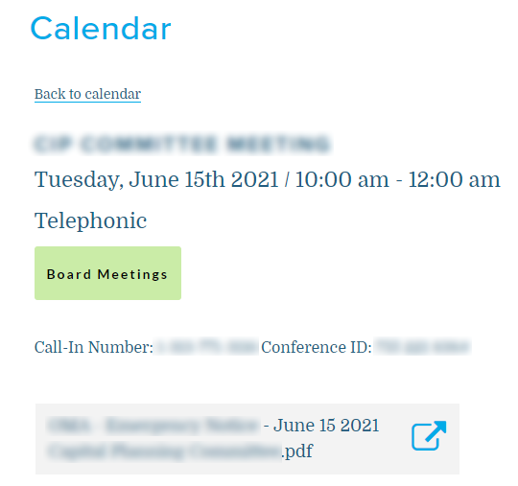
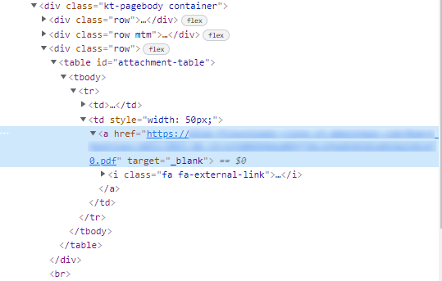
Find Link to Download PDF Attachment
Notes:
Sometimes there’s no great way to locate a particular page/web element

Slide 41
Selenium 4 New Feature – Relative Locators
above
near
Web Element
-or-
Locator
toLeftOf
toRightOf
below

Slide 42
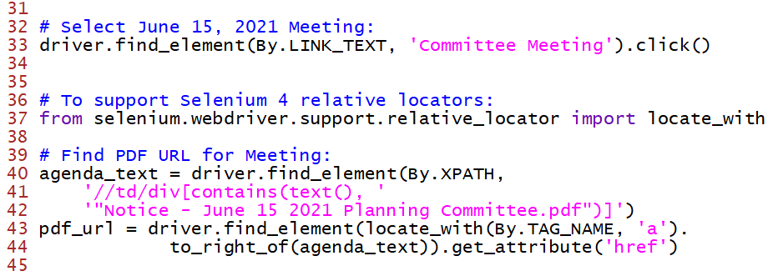
Find Link to Download PDF Attachment – Code

Slide 43
Retrieve, Parse, and Validate PDF
Have URL
Don’t need to save file – retrieve as in-memory byte stream
Use a library to parse the file – PyPDF2
Look for key strings in the file (or however you want to confirm the PDF)

Slide 44
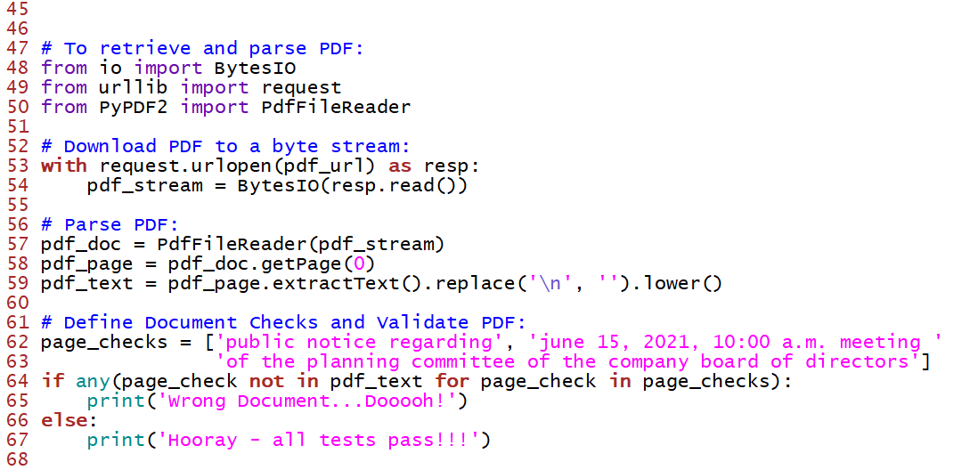
Retrieve and Parse PDF – Code

Slide 45
Next Steps
No Error Handling - Address
This presentation focuses on using Selenium, but…
This is a set of end-to-end tests – need to wrap this code in a test framework:
Each step will be a test
The framework will show where things fail in a report
Recommend using pytest

Slide 46
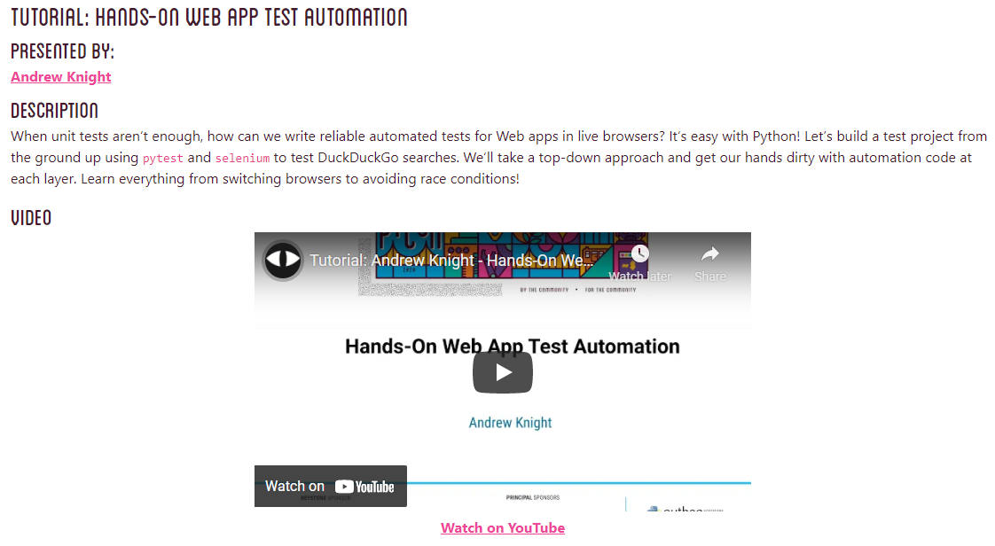
Free Hands-On Web App Test Automation Tutorial (3 hours)

Slide 47

Questions
Image Source: Machine Design

