Slide 1

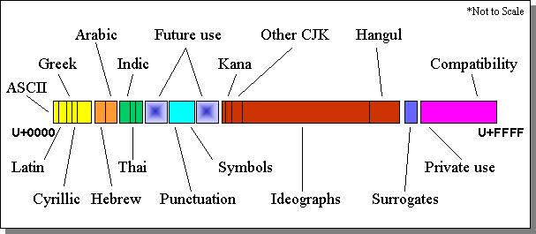

What is Unicode and why do i care?
An overview of character encoding
James R. Small, Principal Architect
Notes:
A brief background on me
A brief background on why I care about Unicode and what precipitated this talk

Slide 2








what is Unicode?
Unicode is a standard to represent the world’s writing systems
Characters used in written languages
Symbols used in mathematics, music, and other domains (e.g., emojis)
Virtually any grapheme (atomic unit of written language/discipline)
Notes:
Many other symbols including popular icons such as the “hamburger” menu icon

Slide 3
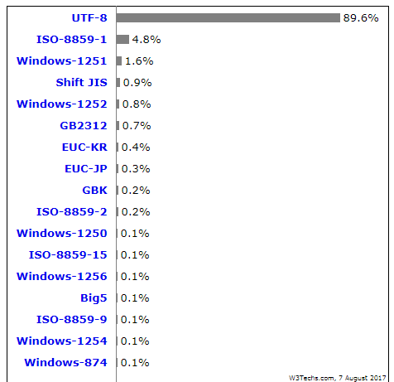

why do i care?
Most web sites use Unicode (UTF-8):
Notes:
UTF-8 is a Unicode format – more to come
As ranked by w3techs.com
They use top 10 million sites from Alexa – good representative sampling

Slide 4


why do i care? (Web Unicode)
Just because most web sites use Unicode, why should I care?
Do you ever copy and paste to/from a web site?
Do you do any web scraping?
Do you use any web APIs?
Do you interact with any web sites?

Slide 5

why do i care?
The preferred format for E-mail is Unicode (UTF-8)
Some E-mail still uses simple ASCII (7 bit text)
A large amount of E-mail is HTML-based and thus uses Unicode (UTF-8)
The clear direction and standards are towards E-mail with native Unicode support (MIME, RFC 6531/6532)
Notes:
Many providers such as Google, Microsoft, and Yahoo natively support Unicode E-mail

Slide 6



why do i care?
Windows, MacOS, and UNIX/Linux all use/support Unicode
Windows only uses Unicode (UTF-16) for internal character representation and defaults to this for file encoding
Unicode is generally not compatible with ASCII*
Some tooling only supports simple ASCII
Notes:
*Some exceptions – e.g., UTF-8 is identical to ASCII if only the first 128 characters (code points) are used

Slide 7




why do i care?
Not understanding Unicode will lead to much suffering:
Garbled input/output/displays
Failed deployments/tooling errors
Data loss/corruption
Painful retrofitting
Notes:
Not understanding character encodings will result in expletives and keyboard smashing

Slide 8
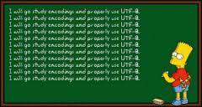

Overview
Prerequisites – A Brief Digression
Serialization
Character Encoding
Unicode, UCS, and ISO/IEC 10646
A Brief Tour
Unicode Encodings
Examples and Avoiding Problems
Notes:
Before discussing Unicode, a little background is first necessary

Slide 9
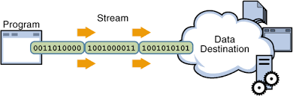
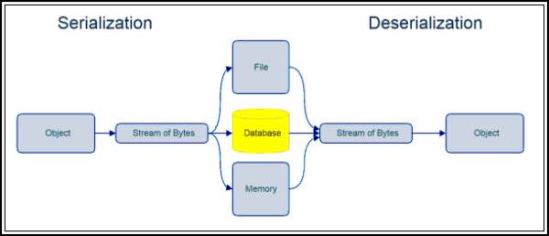
Serialization
Notes:
Serialization, also referred to as marshalling

Slide 10
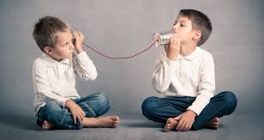


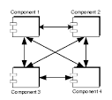
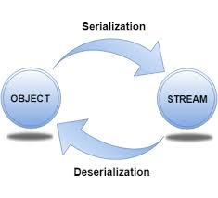
How do Apps Communicate?
Using applications/tools
Copy some text from my web browser to my email client
Save a bookmark to a file
Make a query to a database
Instant message someone
Notes:
The Why
Why is character encoding so complex and why is serialization worth knowing?
To answer those questions we need to look at how applications communicate or share, store, and retrieve data
When you use an application or tool, it’s made up of one or more processes.
The application or tool may be multi-threaded – but threads are really sub-processes and thus a low level detail not relevant to this talk.
Each process has its own protected memory space which can’t be accessed by other processes
In order for processes to communicate or import/export data, they must use serialization
Serialization is the process of taking data internal to the process/app and transforming it into a stream of bytes
This byte stream carries not just the data but also information about how the data is organized
This organization metadata is used by the receiver to correctly interpret the contents of the byte stream

Slide 11
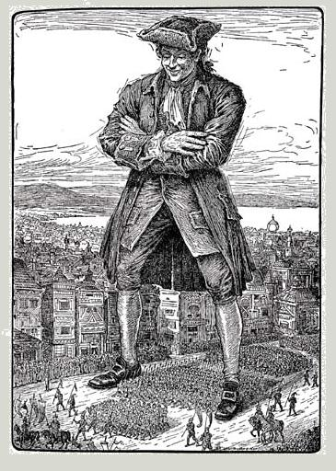
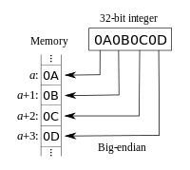
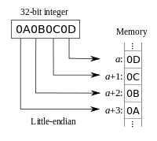
serialization Complications
Byte Order or “Endianness”
Big-Endian – MSB sent first
Little-Endian – LSB sent first
Notes:
Because serialization has to work between different computers and systems, it has to deal with many complications such as byte order
MSB – Most significant byte
LSB – Least significant byte
Endianness comes from Jonathan Swift’s Gulliver’s Travels in which Civil War erupts over whether the big end or the little end of a boiled egg is the proper end to crack open

Slide 12
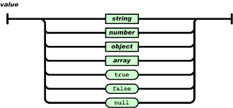

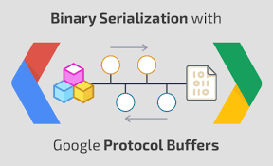
serialization formats
Human Readable
JSON
XML
YAML
Binary
ASN.1/BER
BSON
IDLs
Apache Thrift
Google Protocol Buffers
Notes:
When applications serialize data, they use a format – these are some common ones
Human readable formats are fairly easy to look at – remember though, they are primarily designed for apps and not for you!
JSON is from JavaScript but has become very popular as a serialization format as is frequently used by RESTful applications
XML is the other widely used format and is leveraged by many protocols including SOAP
YAML is fairly popular for things like configuration management
Binary formats are more efficient than human readable ones but can be harder to troubleshoot
IDL or Interface Description or Definition Language – language independent API specification, allows different programming languages to communicate
These are just some of the popular serialization formats – there are many more
Again, serialization formats are a way to represent digital objects or data structures
Either to facilitate inter-process or network communication
Or to allow storage such as in a file or database

Slide 13
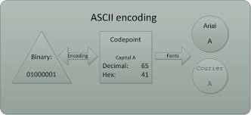
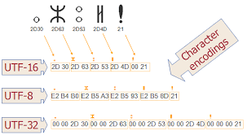
Character Encoding

Slide 14
Character encoding – Terminology
Character Encoding | Means to digitally represent discrete characters
Character | Grapheme or atomic unit of a written language/discipline
(Coded) Character Set | Collection of characters used by one or more languages (each assigned unique name & number)
Code Point | The unique number assigned to a particular character within a character set
Code Unit | The bit sequence used to encode a character or code point, e.g., 7 bits for ASCII, 8 bits for ISO-8859-1, 16 bits for UTF-16, 32 bits for UCS-4
Character Map or Code Map | Legacy systems (pre-Unicode) which directly assign a sequence of characters to a sequence of bytes
Character Encoding Scheme | Mapping of code units to a sequence of bytes/octets, e.g., UTF-8, UTF-16, UTF-32/UCS-4
Notes:
The Why
Character encoding methods such as ASCII, The ISO-8859 family, and Unicode are ways to digitally represent characters and symbols used in languages and various disciplines such as math, science, music, and iconography (in the sense of capturing popular pictographic icons)
This is important because in order to communicate, two apps or systems must agree on some kind of character encoding
The character encoding must handle various details including
How to uniquely identify and represent characters
How to group characters, especially if it can’t represent them all at once
How to serialize characters

Slide 15
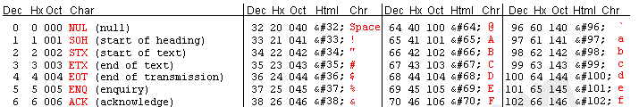
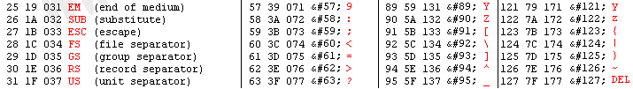
Character encodings
IBM’s Binary Coded Decimal (BCD) – 1959
IBM’s Extended BCD Interchange Code (EBCDIC) – 1963
ASCII – 1963
Only Characters 0-127 are part of the standard! (7-bit encoding)
Notes:
Character encoding has a long history starting with IBM’s BCD and EBCDIC
EBCDIC – EBS-EH-DICK
Even though IBM had its own formats it worked with other vendors to come up with a standard which resulted in ASCII
ASCII was a good start – a combination of 128 upper and lower case American alphabetic characters, numbers, basic punctuation symbols, control codes, and the space
The problem with ASCII though is it was only designed for US English
Even for that limited target it was insufficient – even representing latin-alphabet-based foreign words and names required more characters
As the Internet grew in popularity, ASCII was extended to support other Latin-based alphabets and character sets

Slide 16
“Extended” ASCII
ISO/IEC 8859
Standardized “extended” ASCII
8-bit encoding
Requires out-of-band method to signal which encoding to use
Windows-1252 or CP-1252
Like ISO-8859-1 but replaces control characters with display characters
Part | Name
Part 1 | Latin-1, Western European
Part 2 | Latin-2, Central European
Part 3 | Latin-3, South European
Part 4 | Latin-4, North European
Part 5 | Latin/Cyrillic
Part 6 | Latin/Arabic
Part 7 | Latin/Greek
Part 8 | Latin/Hebrew
Part 9 | Latin-5, Turkish
Part 10 | Latin-6, Nordic
Part 11 | Latin/Thai
Part 12 | Latin/Devanagari (Abandoned)
Part 13 | Latin-7, Baltic Rim
Part 14 | Latin-8, Celtic
Part 15 | Latin-9
Part 16 | Latin-10, South-Eastern European
Notes:
To deal with ASCII’s limitations, many proprietary extensions were developed which transformed 7-bit ASCII into an 8-bit form adding another 128 characters
These extensions added other latin-based characters and other alphabets such as Cyrillic, Greek, and Arabic
An ISO standard came out to help with interoperability – 8859
It has 16 parts which are referred to by adding the part number to the standard
For example, the most common one is part 1 or ISO-8859-1, also known as “Latin-1”
Even with this standard, many vendors would alter or “enhance” it with their own format

Slide 17
Character encoding – Code Pages
ID | Names | Description
37 | CP037, IBM037 | IBM EBCDIC US-Canada
437 | CP437, IBM437 | IBM PC US
1250 | CP1250, Windows-1250 | Latin 2 / Central European
1251 | CP1251, Windows-1251 | Cyrillic
1252 | CP1252, Windows-1252 | Latin 1 / Western European
1253 | CP1253, Windows-1253 | Greek
1254 | CP1254, Windows-1254 | Turkish
1255 | CP1255, Windows-1255 | Hebrew
1256 | CP1256, Windows-1256 | Arabic
1257 | CP1257, Windows-1257 | Baltic
1258 | CP1258, Windows-1258 | Vietnamese
Notes:
Vendors such as IBM, Microsoft, Apple, Xerox, Adobe and others mapped extended ASCII and other character sets to code pages or character maps
Each vendor had their own code pages
Depending on the language you needed to support, you’d pick the appropriate code page or character map
Here is a sample of just some of Microsoft’s Window’s code pages
These code pages or character maps not only vary by vendor but even by vendor application or operating system
As an example, IBM has one list of EBCDIC code pages for mainframes, another set of code pages for AIX, and many others
Code pages make consistent digital representation of various character sets quite complex, especially when interacting with different operating systems/vendors
Even before the web came to the Internet, it was clear to many that code pages weren’t cutting it and some kind of universal character system was needed

Slide 18
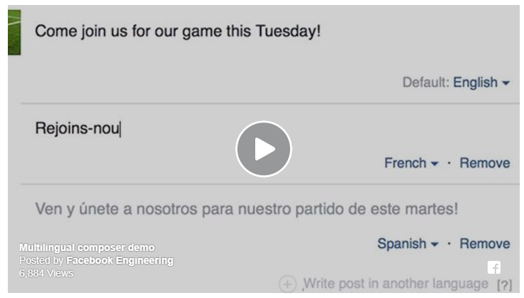

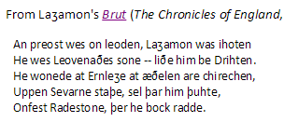

Multiple Languages – code pages
English: The quick brown fox jumps over the lazy dog.
German: Im finſteren Jagdſchloß am offenen Felsquellwaſſer patzte der affig-flatterhafte kauzig-höf‌liche Bäcker über ſeinem verſifften kniffligen C-Xylophon.
Polish: Pchnąć w tę łódź jeża lub osiem skrzyń fig.
Greek: ξεσκεπάζω την ψυχοφθόρα βδελυγμία
Russian: Съешь же ещё этих мягких французских булок да выпей чаю.
Spanish: El pingüino Wenceslao hizo kilómetros bajo exhaustiva lluvia y frío, añoraba a su querido cachorro.
French: Les naïfs ægithales hâtifs pondant à Noël où il gèle sont sûrs d'être déçus en voyant leurs drôles d'œufs abîmés.
Hebrew: כיף סתם לשמוע איך תנצח קרפד עץ טוב בגן.
Japanese: いろはにほへど ちりぬるを わがよたれぞ つねならむ うゐのおくやま けふこえて あさきゆめみじ ゑひもせず
Notes:
We start with pangrams – a sentence containing all letters of the alphabet – to showcase various languages.
As previously mentioned, before Unicode, each language might need it’s own code page – so each pangram would somehow have to be linked to its own code page!
This is painful on many fronts
For example, how do you mark or associate text with its correct code page?
How do you achieve consistent and reliable communication between different systems using different language families?
In addition, while Latin-based languages or other relatively small alphabets may fit into an eight-bit encoding, this doesn’t work for other language types such as Chinese which is logographic. Depending on the Chinese dictionary selected, there are thousands to tens of thousands of (han) characters. Japanese and Korean languages have similar numbers of characters. Sometimes these are referred to as CJK characters and they do not fit within an 8 bit representation format.

Slide 19
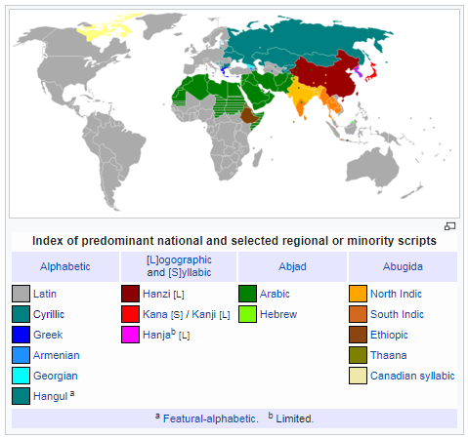

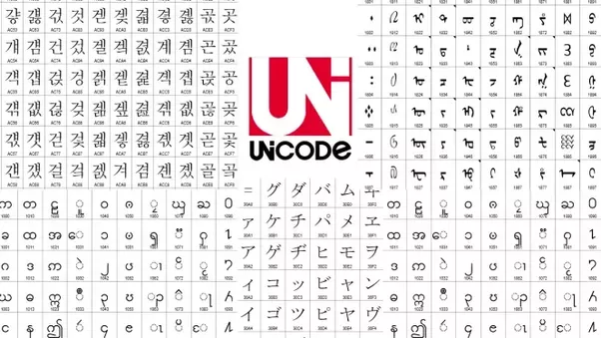
A Brief Tour – Unicode, UCS, and ISO/IEC 10646

Slide 20



Unicode origins
Originally created for the world’s “living” languages
2¹⁶ bits or ~65 thousand code points
ISO created competing standard – 10646, to support all languages
2³¹ bits or ~2.1 billion code points
Unified standard (compromise)
2²¹ bits or ~1.1 million code points
75% unused – plenty of room
Notes:
Originally created by a group of vendors to encode all the world’s “living” languages
At the time, it was thought 65k code points would be plenty
However, with the inclusion of CJK characters or symbols, it became clear that this was insufficient
The revised standard supports 17 planes of 65k characters or 1.1 million code points
This is worth noting because the original and now obsoleted UCS-2 encoding only supports 65k characters and is still used by some systems
The ISO standard was rejected by vendors as too big and wasteful
However, its spirit of being able to capture all languages including historic and rarely used ones was retained
Because the original ISO standard specified 31 bits, UCS-4 made sense
With the revision of only 21 bits, UCS-4 is seldom used for encoding because of all the wasted space (11 bits)
However, it does see some use internally where the unused bits are used for other house keeping

Slide 21
Unicode/ucs – Terminology
Unicode | Industry standard for the consistent encoding, representation, and handling of text expressed in most of the world's writing systems
UCS (Universal Character Set) | Standard set of characters defined by the ISO/IEC 10646 — The Universal Coded Character Set
ISO 10646 | The UCS standard developed by ISO/IEC JTC1/SC2/WG2 working group
UTF | Unicode Transformation Format – Character encoding (serialization) schemes, e.g., UTF-8, UCS-2, UTF-16, UTF-32/UCS-4
Notes:
Note that Unicode and UCS or ISO 10646 are not the same thing
UCS is a standard set of characters with unique names and code points which is harmonized with Unicode and maintained by an ISO working group
It is essentially an extension of standards like ISO 8859 discussed previously – a literal unified set of characters or code pages
Unicode is a distinct standard, a superset of UCS maintained by the Unicode Consortium, a group of vendors
Unicode releases new versions and adds new characters more often
Unicode adds rules for collation, normalization of forms, and the bidirectional algorithm for right-to-left scripts such as Arabic and Hebrew
For interoperability between platforms, especially if bidirectional scripts are used, it is not enough to support ISO 10646; Unicode must be implemented.
UTF-8 is the most popular Unicode encoding scheme with UTF-16 also widely used
UCS-2 is obsolete – it can only support 65 thousand characters or the first Unicode plane, it was replaced by UTF-16

Slide 22
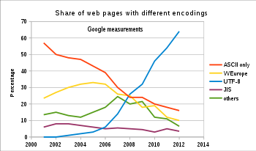
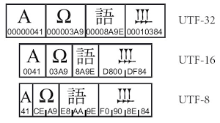
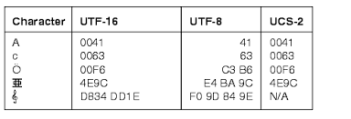
Unicode Encodings –
UTF-8, UCS-2/UTF-16,
UCS-4/UTF-32

Slide 23
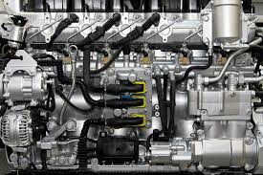
Unicode mechanics
2²¹ Code Points – PPHHHH
PP represents 17 Unicode Planes
00 – 10 Hex (00, 01, …, 0E, 0F, 10)
Each Plane represents 2¹⁶ characters
17 * 65,536 = 1,114,112 code points
HHHH represents characters within the plane
0000 – FFFF Hex
Examples
U+0061 – Latin a
No plane indicator implies plane 0 (BMP)
U+1D120 – Musical Symbol G Clef Ottava Bassa
Plane 1

Slide 24
Unicode Planes
Plane | Description | Allocated Code Pts | Assigned Chars | Special Notes
0 – BMP | Basic Multilingual Plane | 65,424 | 55,294 | Surrogate Pairs – D800-DFFF
1 – SMP | Supplementary Multilingual Plane | 22,240 | 20,265 | Many useful symbols
2 – SPP | Supplementary Ideographic Plane | 60,912 | 60,859 | CJK Characters
3 – 13 | Unassigned Planes | - | -
14 – SSP | Supplementary Special-Purpose Plane | 368 | 337 | Non-graphical characters
15 – SPUA-A | Supplementary Private Use Area A | 65,536 | - | Used by fonts/software
16 – SPUA-B | Supplementary Private Use Area B | 65,536 | - | Used by fonts/software

Slide 25
Unicode – example coded ucs
Char | Code Point | Description | UTF-8 | UCS-2/ UTF-16 | UCS-4/ UTF-32
a | U+0061 | Latin a | 61 | 0061 | 00000061
ä | U+00E4 | a-umlaut | C3 A0 | 00E4 | 000000E4
σ | U+03C3 | Greek sigma | CF 83 | 03C3 | 000003C3
א | U+05D0 | Hebrew alef | D7 90 | 05D0 (BE) D005 (LE)¹ | 000005D0 D0050000¹
٣ | U+0663 | Arabic digit 3 | D9 A3 | 0663 | 00000663
カ | U+30AB | Katakana ka | E3 82 AB | 30AB | 000030AB
退 | U+9000 | Han Ideograph | E9 80 80 | 9000 | 00009000
𡯁 | U+21BC1 | HKSCS Ideograph | F0 A1 AF 81 | NA²/ D846 DFC1 | 00021BC1
Notes:
¹This table is showing Big Endian byte ordering, but keep in mind that the x86 platform uses Little Endian byte ordering
²UCS-2 only supports 65 thousand characters or the first Unicode plane of characters and is therefore obsolete
UTF-16, the UCS-2 replacement uses surrogate pairs to encode characters outside the first plane of 65 thousand characters
Characters outside of the first Unicode plane take two code units or 4 bytes to represent
The sole advantage of UCS-4/UTF-32 (effectively the same) is that all code points can be represented without resorting to a special technique or a variable number of bytes

Slide 26


Examples and
Avoiding Problems

Slide 27



Garbled/Invalid ouTput
Your app is unable to render the Unicode character – typical substitutions:
Replacement Character: �
Blank Box:
Gray/Black Box:
Example:
Arabic Letter Heh Goal (06C1): █ü
Arabic Letter Teh Marbuta Goal (06C3): █â
Arabic Letter Waw with Ring (06C4): █ä
Arabic Letter Kirghiz Oe (06C5): █à
Notes:
In this example, the app is incorrectly interpreting Unicode as two extended-ASCII characters

Slide 28
Fixable Garbled output
Linux man page through ssh (terminal):
(…)
Description Octal latin1 ascii
â”€â”€â”€â”€â”€â”€â”€â”€â”€â”€â”€â”€â”€â”€â”€â”€â”€â”€â”€â”€â”€â”€â”€â”€â”€â”€â”€â”€â”€â”€â”€â”€â”€â”€â”€â”€â”€â”€â”€â”€â”€â”€â”€â”€â”€
continuation hyphen 255 â€ -
bullet (middle dot) 267 Â· o
acute accent 264 Â´ '
multiplication sign 327 Ã— x
(…)
Check Linux locale – probably ends in UTF‐8 (what it’s sending) and local terminal (expects) has wrong character encoding

Slide 29

Fixable Garbled output
Linux man page through ssh (fixed):
(…)
Description Octal latin1 ascii
─────────────────────────────────────────────
continuation hyphen 255 ‐ -
bullet (middle dot) 267 · o
acute accent 264 ´ '
multiplication sign 327 × x
(…)
Local Terminal Session Options, Appearance (SecureCRT) – Changed from Default Character Encoding to UTF-8

Slide 30

Tooling Problems
git, ansible, heroku buildpacks and many tools expect ASCII
If you use Unicode they often act strangely or fail
git typically treats Unicode as a binary file
ansible and heroku buildpacks will throw strange errors
Search for character codes higher than 0x7F (outside simple ASCII range)
e.g., in VIM or using a regular expression:
/[^\x00-\x7F]

Slide 31
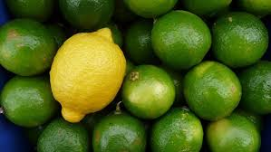
Unicode Encoding Differences
UCS-2 is obsolete but still used by some systems
Predecessor to UTF-16
Doesn’t understand surrogate pairs
e.g., D846 DFC1
These are in the D800-DFFF range:
D800-DBFF – High Surrogate
DC00-DFFF – Low Surrogate
UTF-16 is 2 – 4 bytes (typically 2)
If you get weird output your app probably doesn’t understand Unicode or UTF-16

Slide 32
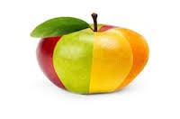
Unicode Encoding Differences
UTF-8 is 1 – 4 bytes
First 128 characters – 1 byte
In other words, simple ASCII = UTF-8
Next 1,920 characters – 2 bytes
Rest of BMP/Plane 0 characters – 3 bytes
Other Planes – 4 bytes
If most of your text is ASCII it will mostly look right with some weird formatting (like garbed man page shown previously)

Slide 33

Unicode Encoding challenges
Opening a file shows gobbledygook
Verify the encoding
You may have to specify the correct encoding – often no great way to embed in the file/data
Make sure you save files with the correct encoding – saving Unicode files as ASCII will corrupt them
You may have to open Unicode files in “binary” or some special mode

Slide 34




Questions
?
GitHub Repo
@sockduct

Slide 35
Appendix

Slide 36
references – 1
The Unicode Consortium
W³Techs - Usage of character encodings for websites
Unicode and E-mail
Multipurpose Internet Mail Extensions (MIME)
RFC 6531 - SMTP Extension for Internationalized Email
RFC 6532 - Internationalized Email Headers
Unicode Overview
Serialization Overview
Comparison of Data Serialization Formats
IDL Overview
Endianness Overview
Character Encoding Overview
Code Page Overview

Slide 37
references – 2
C0 and C1 Control Codes Overview (C0 = ASCII, C1 = ISO 6429)
Windows Code Pages Overview
ASCII Overview
Unicode (UTF-8) Sampler Page
Comparison of Unicode Encodings
UCS/Universal Coded Character Set Overview
UCS Characters Overview
Unicode Planes Overview
Unicode Character Table
UTF-8 Overview
UTF-16 Overview
UTF-32 Overview

Slide 38
references – 3
UTF-8, a transformation format of ISO 10646 (RFC 3629)
UTF-16, an encoding of ISO 10646 (RFC 2781)
Unicode Format for Network Interchange (RFC 5198)
iconv – UNIX/Linux CLI tool/API to convert between character encodings
chardet - Character encoding auto-detection in Python, open source based on auto-detection code from Mozilla browser
Unicode v10.0.0 Announcement and Docs
The Unicode Standard: A Technical Introduction
Unicode Tutorial from Adobe – 79 annotated slides, from 2006 but still good
UnicodeMath - A Nearly Plain-Text Encoding of Mathematics, Version 3.1 (versus application specific encoding like LaTeX)
List of XML and HTML character entity references

Slide 39
references – 4
Mojibake - the garbled text that is the result of text being decoded using an unintended character encoding
Unicode Specials block
An Encoding Primer
8-bit clean overview (related to SMTP/E-mail transmission of Unicode/MIME)
Punycode - a way to represent Unicode within the limited character subset of ASCII used for Internet host names
Operating System Locale (Used by UNIX/Linux to set character encoding)
Unicode font overview
Very basic PowerShell script to detect file character encoding
Binary-to-text encoding (Encoding 8-bit data into 7-bit ASCII streams)

Slide 40
references – 5
Internationalized domain name overview (Internet domain name using non-ASCII characters, e.g., Unicode)
What Every Programmer Absolutely, Positively Needs To Know About Encodings And Character Sets To Work With Text
Programming with Unicode (Open Source Book)
UCS vs UTF-8 as Internal String Encoding
Marshalling (can be same or similar to serialization depending on context/language)

