Slide 1


Slide 2
@socketwench
Tess Flynn

Slide 3
That’s wench, not wrench.
@socketwench
Tess Flynn

Slide 4
That’s wench, not wrench.
Flag
Module Maintainer
Flag Friend
Examples
@socketwench
Tess Flynn

Slide 5

That’s wench, not wrench.
Flag
Drupal Developer
Module Maintainer
Flag Friend
Examples
@socketwench
Tess Flynn

Slide 6
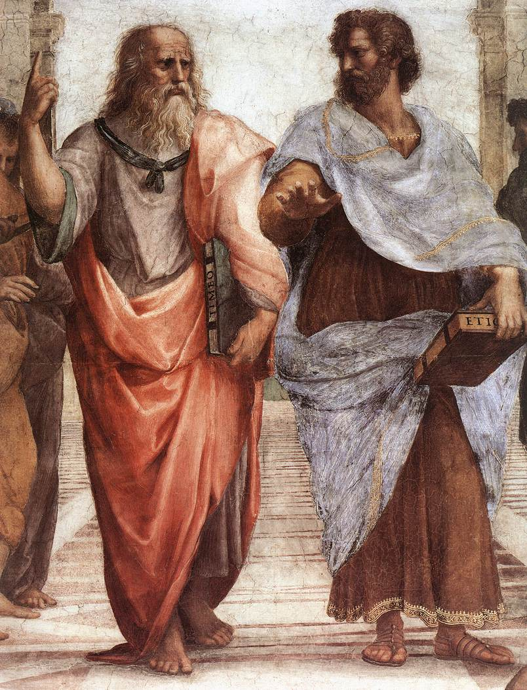

Slide 7
Dude, it’s like all up there, in my realm.

Slide 8
Dude, it’s like all up there, in my realm.
You’re daft, man. It’s all in front of us.
And stop trying to get me into your realm.

Slide 9
What’s all this have to do with OOP?

Slide 15
All of these are just imperfect copies of the ideal!

Slide 21
There’s more than just one type of chair, y’know.

Slide 22
There’s more than just one type of chair, y’know.
But they’re all chairs.

Slide 23
There’s more than just one type of chair, y’know.
But they’re all chairs.
We don’t want to lose “chairness”, just extend.

Slide 24
There’s more than just one type of chair, y’know.
But they’re all chairs.
We don’t want to lose “chairness”, just extend.

Slide 26
But chairs are boring, let’s build something {smarter}.

Slide 28
States and properties

Slide 29
States and properties
Internal logic

Slide 30
States and properties
Internal logic
User Interface

Slide 34
Wait, why do we need getters and setters?

Slide 35
Wait, why do we need getters and setters?
Can’t we just, use the variable?

Slide 36
Page

Slide 37
Page
Page
Page
Page
Page
Page
Page

Slide 38
Page
Page
Page
Page
Page
Page
Page
Page
Page
Page
Page
Page
Page
Page
Page
Page
Page
Page
Page
Page
Page

Slide 39


Slide 40
content
content
content
Content

Slide 41
Blog
Forum
Picture
Page

Slide 42
Content Type

Slide 43
Title
Content Type

Slide 44
Title
Custom Fields
Content Type

Slide 45
Title
Custom Fields
Content Type
Permissions

Slide 46
Title
Custom Fields
Content Type
Permissions
Metadata

Slide 50
There it is!

Slide 52
Tools
Clothes
Games
Cooking

Slide 53
Now I can find what I need and work more effectively.
Tools
Clothes
Games
Cooking

Slide 54
“Lessons from the issue queue”
“Flag module recipes”
“Me by the lake”
“About US”

Slide 55
Blog
Forum
Picture
Page

Slide 56
Blog Type
Forum type
Picture type
Page Type

Slide 57
So, we’re done, right?

Slide 58

So, we’re done, right?
Right?

Slide 59
Unstructured content

Slide 60
Unstructured content
Desktop web

Slide 61
Unstructured content
Desktop web

Slide 62
Unstructured content
Editing Process
Desktop web

Slide 63
Unstructured content
Editing Process
Style Guides
Desktop web

Slide 64
Unstructured content
Editing Process
Style Guides
Desktop web

Slide 65
And then, mobile happened…
Unstructured content
Umm, where’s my site?
Desktop web
Mobile web

Slide 66
This sucks!

Slide 67
Separate sites isn’t enough.
We need separate channels.

Slide 68
Desktop content
MOBILE content
Desktop
Mobile

Slide 69
Desktop content
MOBILE content
developer
Desktop
developer
Mobile

Slide 70
WRITER
WRITER
Desktop content
MOBILE content
developer
Desktop
developer
Mobile

Slide 71
WRITER
WRITER
REVIEW
Desktop content
REVIEW
MOBILE content
developer
Desktop
developer
Mobile

Slide 72
Separate sites breaks sharing links!
And now I have two sites to maintain!

Slide 73
Desktop

Slide 74
Desktop
Mobile

Slide 75
Desktop
Mobile
Watch

Slide 76
Desktop
Mobile
Watch
Appliances

Slide 77
Desktop
Mobile
Watch
Appliances
There are too many channels to separate…

Slide 78
Maybe the problem isn’t the front-end…

Slide 79
Unstructured content
Maybe the problem isn’t the front-end…
What if it’s this?

Slide 80
UNSTRUCTURED content
Desktop
Mobile
Watch
Appliances

Slide 81
I determine my own format! Deal with it!
UNSTRUCTURED content
Desktop
Mobile
Watch
Appliances

Slide 82
I determine my own format! Deal with it!
UNSTRUCTURED content
Desktop
Mobile
Watch
Appliances

Slide 83
I determine my own format! Deal with it!
UNSTRUCTURED content
SPARE US, LORD CONTENT!
Desktop
Mobile
Watch
Appliances

Slide 84
Title:
Body:

Slide 85
Title:
Body:

Slide 86
Title:
Body:

Slide 87
Title:
Body:

Slide 88
Yesssss…
FEED me more WYSIWYG buttons!

Slide 89
Desktop
Smarter content
Mobile

Slide 90
Give me the full content.
I need a short title and Medium summary.
QUEURY
QUEURY
Desktop
Smarter content
Mobile

Slide 91
Give me the full content.
I need a short title and Medium summary.
QUEURY
QUEURY
RETRIEVE
RETRIEVE
Desktop
Smarter content
Mobile

Slide 92
Give me the full content.
I need a short title and Medium summary.
QUEURY
QUEURY
RETRIEVE
RETRIEVE
Desktop
Smarter content
Mobile

Slide 95
Good thing I only need one thing.

Slide 97
I’m never going to find all the pieces I need in this!

Slide 98
“ ”

Slide 99
title
Body
“ ”

Slide 100
title
Gallery
Bio
“ ”
Key quote
“Biggest lesson” section
Author Info

Slide 101
title
Gallery
Bio
Changing the one thing shouldn’t be hard
“ ”
Key quote
“Biggest lesson” section
Author Info

Slide 102
“ ”
“ ”
“ ”
“ ”
“ ”
“ ”
“ ”
“ ”
“ ”

Slide 103
“ ”
“ ”
“ ”
One down, 14567 to go…
“ ”
“ ”
“ ”
“ ”
“ ”
“ ”

Slide 104
“ ”

Slide 105
“ ”

Slide 106
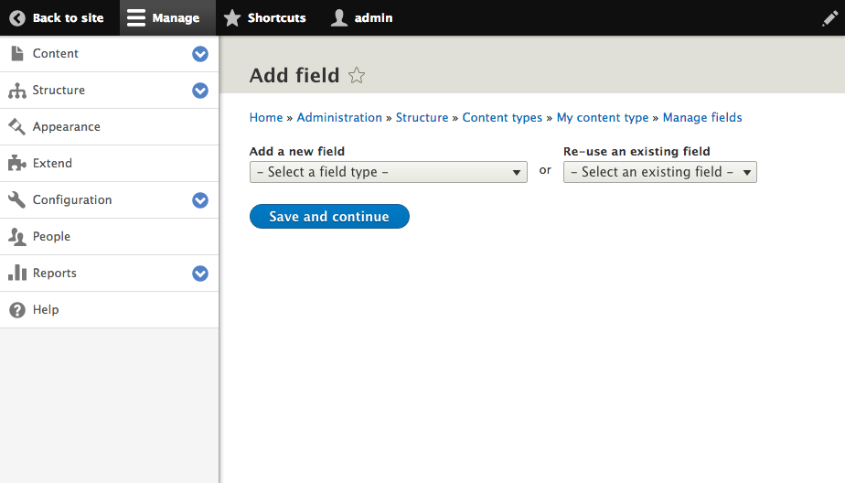
Click here

Slide 107
Files & Images
Numeric
Email*
Field Types
Text
Date*
Boolean
Link*
Reference

Slide 108
“ ”

Slide 109
Title

Slide 110
Title

Slide 111
Title
Fourth “Blob” Film is a hilarious campy romp
Fourth “Blob” Film is a…
Fourth “Blob”…

Slide 112
I’m here for your little fields too!
Crud.
The Blobs are {back}.

Slide 113
Title

Slide 114
Title
Full Title
Medium Title
Short Title

Slide 115
Title
Full Title
Medium Title
Short Title
Fourth “Blob” Film is a hilarious campy romp
“Blob” 4, this time in space.
“Blob” 4 Review

Slide 117
title
Gallery
Bio
“ ”
Key quote
“Biggest lesson” section
Author Info

Slide 118
“ ”

Slide 119
“ ”
Some of these aren’t just the same kind of data…
They {are} the same data.

Slide 122
This “field” is also multi-part.

Slide 123
“ ”

Slide 124
“ ”
Entity Reference

