Slide 1
or
Space

Slide 2
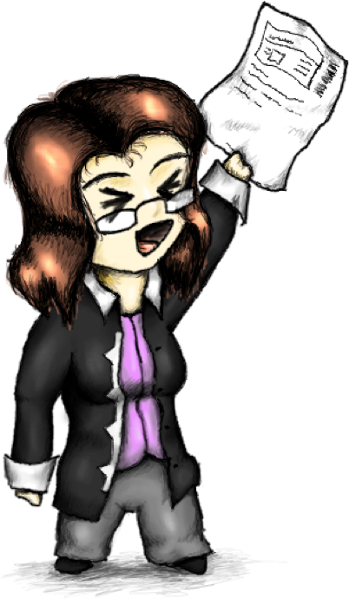

Slide 3
@socketwench
Tess Flynn

Slide 4
That’s wench, not wrench.
@socketwench
Tess Flynn

Slide 5
That’s wench, not wrench.
Flag
Module Maintainer
Flag Friend
Examples
@socketwench
Tess Flynn

Slide 6

That’s wench, not wrench.
Flag
Drupal Developer
Module Maintainer
Flag Friend
Examples
@socketwench
Tess Flynn

Slide 8
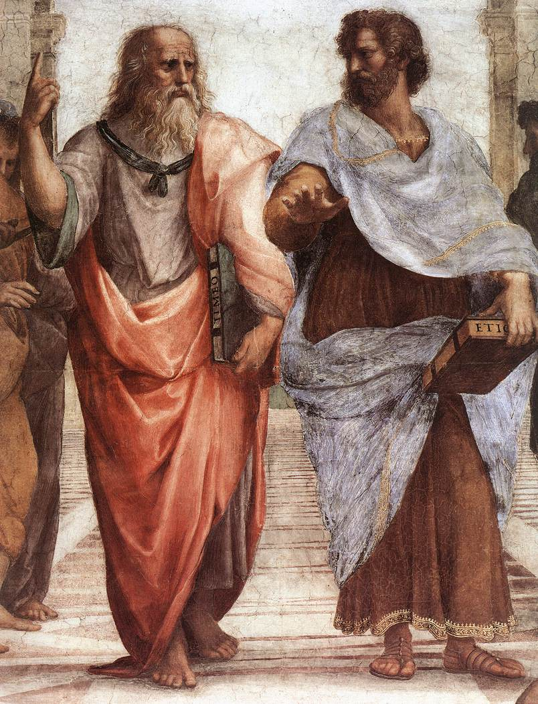

Slide 9
Dude, it’s like all up there, in my realm.

Slide 10
Dude, it’s like all up there, in my realm.
You’re daft, man. It’s all in front of us.
And stop trying to get me into your realm.

Slide 11
What’s all this have to do with OOP?

Slide 17
All of these are just imperfect copies of the ideal!

Slide 23
There’s more than just one type of chair, y’know.

Slide 24
There’s more than just one type of chair, y’know.
But they’re all chairs.

Slide 25
There’s more than just one type of chair, y’know.
But they’re all chairs.
We don’t want to lose “chairness”, just extend.

Slide 26
There’s more than just one type of chair, y’know.
But they’re all chairs.
We don’t want to lose “chairness”, just extend.

Slide 28
Chair
parent
Child
OfficeChair

Slide 29
But chairs are boring, let’s build something {smarter}.

Slide 31
States and properties

Slide 32
States and properties
Internal logic

Slide 33
States and properties
Internal logic
User Interface

Slide 34
protected $myVariable = ‘Initial Value’;

Slide 35
protected $myVariable = ‘Initial Value’;
Variable name

Slide 36
protected $myVariable = ‘Initial Value’;
Variable name
Optional initial value

Slide 37
protected $myVariable = ‘Initial Value’;
Access Specifier
Variable name
Optional initial value

Slide 38
Robot
CleaningRobot
$myVariable: String

Slide 39
housebot
Vacuumbot
autobot

Slide 40
public $houseName;
housebot
Vacuumbot
autobot

Slide 41
public $houseName;
housebot
I have an $houseName too.
Vacuumbot
autobot

Slide 42
public $houseName;
I don’t have it, but I see yours.
housebot
I have an $houseName too.
Vacuumbot
autobot

Slide 43
private $secretWish;
housebot
Vacuumbot
autobot

Slide 44
private $secretWish;
housebot
I don’t have or see that.
Vacuumbot
autobot

Slide 45
private $secretWish;
Me either.
housebot
I don’t have or see that.
Vacuumbot
autobot

Slide 46
protected$isOn;
housebot
Vacuumbot
autobot

Slide 47
protected$isOn;
housebot
I have an $isOn too.
Vacuumbot
autobot

Slide 48
protected$isOn;
What are you two talking about!?
housebot
I have an $isOn too.
Vacuumbot
autobot

Slide 49
Robot
myVariable: string

Slide 50
Robot
myVariable : string
powerCell : Battery
0..1
Battery

Slide 51
Robot
myVariable : string
myMethod(param:string) : int

Slide 55
Base
Class
Child Class

Slide 56
I’m not like you!
Base
Class
Child Class

Slide 57
I’m not like you!
I won’t do things your way, man!
Base
Class
Child Class

Slide 58
But the class knows about itself the most.

Slide 59
But the class knows about itself the most.
I want to call the same method for all classes of the same family.

Slide 60
But I can’t create that! A method is missing!

Slide 61
Drink
fullness: float
fill(amount:float) empty(amount:float)
CoffeeFlavoring
Coffee
flavorings[]
0..*
getRoast(): string addFlavor(flavor)
Cream
Sugar

Slide 62
Drink
fullness: float
fill(amount:float) empty(amount:float)

Slide 63
Drink
fullness: float
fill(amount:float) empty(amount:float)
Coffee
flavorings[]
getRoast(): string addFlavor(flavor)

Slide 64
Drink
fullness: float
fill(amount:float) empty(amount:float)
Coffee
flavorings[]
getRoast(): string addFlavor(flavor)
Cream
Sugar

Slide 65
Drink
fullness: float
fill(amount:float) empty(amount:float)
CoffeeFlavoring
Coffee
flavorings[]
getRoast(): string addFlavor(flavor)
Cream
Sugar

Slide 66
Drink
fullness: float
fill(amount:float) empty(amount:float)
CoffeeFlavoring
Coffee
flavorings[]
0..*
getRoast(): string addFlavor(flavor)
Cream
Sugar

Slide 67
Coder
coffee

Slide 68
Coder
coffee

Slide 69
Coder
coffee
Start work

Slide 70
Coder
coffee
Start work
Make coffee

Slide 71
Coder
coffee
Start work
Make coffee
Add milk

Slide 72
Coder
coffee
Start work
Make coffee
Add milk
Empty

Slide 73
Coder
coffee
Start work
Make coffee
Add milk
Empty
Make coffee

Slide 74
Coder
coffee
Start work
Make coffee
Add milk
Empty
Make coffee
Heart-
burn

Slide 75
Coder
coffee
Start work
Make coffee
Add milk
Empty
Make coffee
Heart-
burn
Leave work

Slide 76
<<interface>>
AstroMech
beepBoop() navigateXwing()
<<interface>>
R2Droid
hide($lightsaber) : boolean

Slide 78
That’s just the library I need!

Slide 79
Date
Date

Slide 80
Hello! I am from an far away repo and my name is…
Date
Date

Slide 81
Hello! I am from an far away repo and my name is…
Then we have a problem, because my name is also…
Date
Date

Slide 82
There can be
only one!
Date
Date

Slide 83
Date
Date
Whoa! Wait! What if we just prefix your names like..

Slide 84
kurgan\Date
macleod\Date
Whoa! Wait! What if we just prefix your names like..

Slide 85
That’d work.
kurgan\Date
macleod\Date
Whoa! Wait! What if we just prefix your names like..

Slide 86
Can we still play swords?
I’ll be “vagrant upping”!
I’ll be “compiling”!
kurgan\Date
macleod\Date

Slide 87
$myDate = new \Really\Long\Namespaced\Class\Name();
But what do I do about this?

Slide 88
Date
Date
What I want to import both of these?

Slide 89
$myDate = new \Movies\Highlander\MacLeod\Date();
Movies
HIGHLANDER
Macleod
date.php

Slide 90
$myDate = new \Movies\Action\Highlander\MacLeod();
Movies
Action
Highlander
Macleod.php

Slide 91
Movies
Action
Highlander
Macleod.php

Slide 92
Are we done yet? Can I play Splatoon now?

