Slide 1
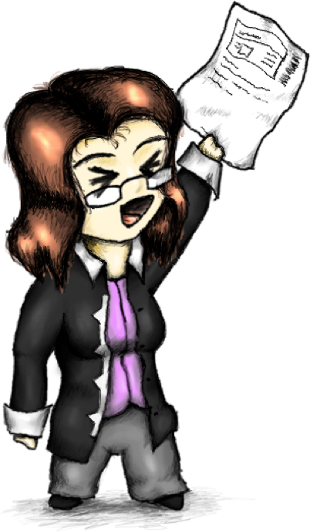

Slide 2
@socketwench
Tess Flynn

Slide 3
That’s wench, not wrench.
@socketwench
Tess Flynn

Slide 4
That’s wench, not wrench.
Flag
Module Maintainer
Flag Friend
Examples
@socketwench
Tess Flynn

Slide 5

That’s wench, not wrench.
Flag
Drupal Developer
Module Maintainer
Flag Friend
Examples
@socketwench
Tess Flynn

Slide 6
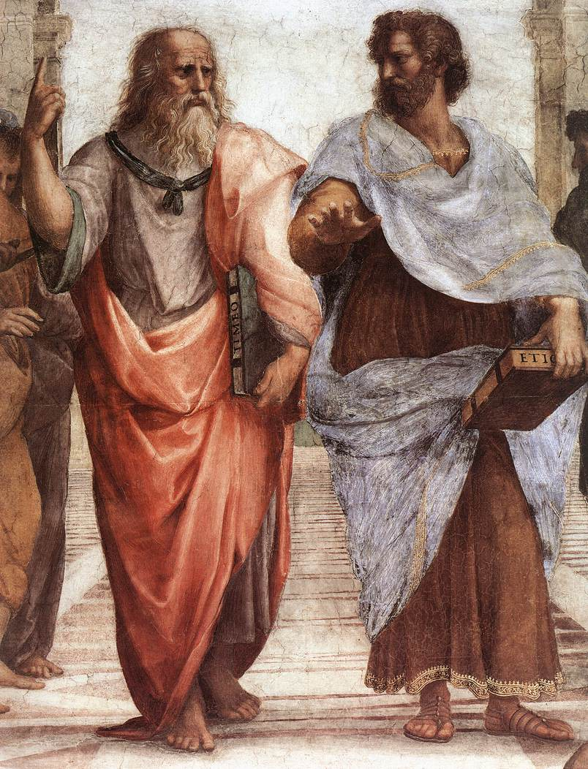

Slide 7
Dude, it’s like all up there, in my realm.

Slide 8
Dude, it’s like all up there, in my realm.
You’re daft, man. It’s all in front of us.
And stop trying to get me into your realm.

Slide 9
What’s all this have to do with OOP?

Slide 15
All of these are just imperfect copies of the ideal!

Slide 21
There’s more than just one type of chair, y’know.

Slide 22
There’s more than just one type of chair, y’know.
But they’re all chairs.

Slide 23
There’s more than just one type of chair, y’know.
But they’re all chairs.
We don’t want to lose “chairness”, just extend.

Slide 24
There’s more than just one type of chair, y’know.
But they’re all chairs.
We don’t want to lose “chairness”, just extend.

Slide 26
Chair
parent
Child
OfficeChair

Slide 27
But chairs are boring, let’s build something {smarter}.

Slide 29
States and properties

Slide 30
States and properties
Internal logic

Slide 31
States and properties
Internal logic
User Interface

Slide 32
protected $myVariable = ‘Initial Value’;

Slide 33
protected $myVariable = ‘Initial Value’;
Variable name

Slide 34
protected $myVariable = ‘Initial Value’;
Variable name
Optional initial value

Slide 35
protected $myVariable = ‘Initial Value’;
Access Specifier
Variable name
Optional initial value

Slide 36
Robot
CleaningRobot
$myVariable: String

Slide 37
housebot
Vacuumbot
autobot

Slide 38
public $houseName;
housebot
Vacuumbot
autobot

Slide 39
public $houseName;
housebot
I have an $houseName too.
Vacuumbot
autobot

Slide 40
public $houseName;
I don’t have it, but I see yours.
housebot
I have an $houseName too.
Vacuumbot
autobot

Slide 41
private $secretWish;
housebot
Vacuumbot
autobot

Slide 42
private $secretWish;
housebot
I don’t have or see that.
Vacuumbot
autobot

Slide 43
private $secretWish;
Me either.
housebot
I don’t have or see that.
Vacuumbot
autobot

Slide 44
protected$isOn;
housebot
Vacuumbot
autobot

Slide 45
protected$isOn;
housebot
I have an $isOn too.
Vacuumbot
autobot

Slide 46
protected$isOn;
What are you two talking about!?
housebot
I have an $isOn too.
Vacuumbot
autobot

Slide 47
Robot
myVariable: string

Slide 48
Robot
myVariable : string
powerCell : Battery
0..1
Battery

Slide 49
Robot
myVariable : string
myMethod(param:string) : int

Slide 53
Base
Class
Child Class

Slide 54
I’m not like you!
Base
Class
Child Class

Slide 55
I’m not like you!
I won’t do things your way, man!
Base
Class
Child Class

Slide 56
But the class knows about itself the most.

Slide 57
But the class knows about itself the most.
I want to call the same method for all classes of the same family.

Slide 58
But I can’t create that! A method is missing!

Slide 59
Drink
fullness: float
fill(amount:float) empty(amount:float)
CoffeeFlavoring
Coffee
flavorings[]
0..*
getRoast(): string addFlavor(flavor)
Cream
Sugar

Slide 60
Drink
fullness: float
fill(amount:float) empty(amount:float)

Slide 61
Drink
fullness: float
fill(amount:float) empty(amount:float)
Coffee
flavorings[]
getRoast(): string addFlavor(flavor)

Slide 62
Drink
fullness: float
fill(amount:float) empty(amount:float)
Coffee
flavorings[]
getRoast(): string addFlavor(flavor)
Cream
Sugar

Slide 63
Drink
fullness: float
fill(amount:float) empty(amount:float)
CoffeeFlavoring
Coffee
flavorings[]
getRoast(): string addFlavor(flavor)
Cream
Sugar

Slide 64
Drink
fullness: float
fill(amount:float) empty(amount:float)
CoffeeFlavoring
Coffee
flavorings[]
0..*
getRoast(): string addFlavor(flavor)
Cream
Sugar

Slide 65
Coder
coffee

Slide 66
Coder
coffee

Slide 67
Coder
coffee
Start work

Slide 68
Coder
coffee
Start work
Make coffee

Slide 69
Coder
coffee
Start work
Make coffee
Add milk

Slide 70
Coder
coffee
Start work
Make coffee
Add milk
Empty

Slide 71
Coder
coffee
Start work
Make coffee
Add milk
Empty
Make coffee

Slide 72
Coder
coffee
Start work
Make coffee
Add milk
Empty
Make coffee
Heart-
burn

Slide 73
Coder
coffee
Start work
Make coffee
Add milk
Empty
Make coffee
Heart-
burn
Leave work

Slide 74
<<interface>>
AstroMech
beepBoop() navigateXwing()
<<interface>>
R2Droid
hide($lightsaber) : boolean

Slide 76
That’s just the library I need!

Slide 77
Date
Date

Slide 78
Hello! I am from an far away repo and my name is…
Date
Date

Slide 79
Hello! I am from an far away repo and my name is…
Then we have a problem, because my name is also…
Date
Date

Slide 80
There can be
only one!
Date
Date

Slide 81
Date
Date
Whoa! Wait! What if we just prefix your names like..

Slide 82
kurgan\Date
macleod\Date
Whoa! Wait! What if we just prefix your names like..

Slide 83
That’d work.
kurgan\Date
macleod\Date
Whoa! Wait! What if we just prefix your names like..

Slide 84
Can we still play swords?
I’ll be “vagrant upping”!
I’ll be “compiling”!
kurgan\Date
macleod\Date

Slide 85
$myDate = new \Really\Long\Namespaced\Class\Name();
But what do I do about this?

Slide 86
Date
Date
What I want to import both of these?

Slide 87
$myDate = new \Movies\Highlander\MacLeod\Date();
Movies
HIGHLANDER
Macleod
date.php

Slide 88
$myDate = new \Movies\Action\Highlander\MacLeod();
Movies
Action
Highlander
Macleod.php

Slide 89
Movies
Action
Highlander
Macleod.php

Slide 90
Are we done yet? Can I play Splatoon now?

