Slide 1


Slide 2
@socketwench
Tess Flynn

Slide 3
That’s wench, not wrench.
@socketwench
Tess Flynn

Slide 4
That’s wench, not wrench.
Flag
Module Maintainer
Flag Friend
Examples
@socketwench
Tess Flynn

Slide 5

That’s wench, not wrench.
Flag
Drupal Developer
Module Maintainer
Flag Friend
Examples
@socketwench
Tess Flynn

Slide 6
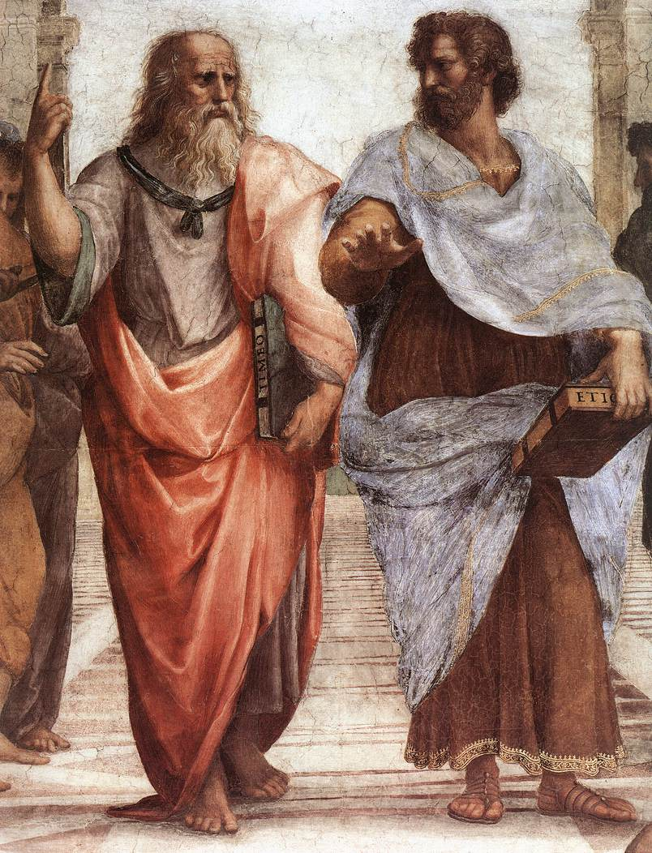

Slide 7
Dude, it’s like all up there, in my realm.

Slide 8
Dude, it’s like all up there, in my realm.
You’re daft, man. It’s all in front of us.
And stop trying to get me into your realm.

Slide 9
What’s all this have to do with OOP?

Slide 15
All of these are just imperfect copies of the ideal!

Slide 21
There’s more than just one type of chair, y’know.

Slide 22
There’s more than just one type of chair, y’know.
But they’re all chairs.

Slide 23
There’s more than just one type of chair, y’know.
But they’re all chairs.
We don’t want to lose “chairness”, just extend.

Slide 24
There’s more than just one type of chair, y’know.
But they’re all chairs.
We don’t want to lose “chairness”, just extend.

Slide 26
Chair
parent
Child
OfficeChair

Slide 27
But chairs are boring, let’s build something {smarter}.

Slide 29
States and properties

Slide 30
States and properties
Internal logic

Slide 31
States and properties
Internal logic
User Interface

Slide 32
protected $myVariable = ‘Initial Value’;

Slide 33
protected $myVariable = ‘Initial Value’;
Variable name

Slide 34
protected $myVariable = ‘Initial Value’;
Variable name
Optional initial value

Slide 35
protected $myVariable = ‘Initial Value’;
Access Specifier
Variable name
Optional initial value

Slide 36
Robot
CleaningRobot
$myVariable: String

Slide 37
housebot
Vacuumbot
autobot

Slide 38
public $houseName;
housebot
Vacuumbot
autobot

Slide 39
public $houseName;
housebot
I have an $houseName too.
Vacuumbot
autobot

Slide 40
public $houseName;
I don’t have it, but I see yours.
housebot
I have an $houseName too.
Vacuumbot
autobot

Slide 41
private $secretWish;
housebot
Vacuumbot
autobot

Slide 42
private $secretWish;
housebot
I don’t have or see that.
Vacuumbot
autobot

Slide 43
private $secretWish;
Me either.
housebot
I don’t have or see that.
Vacuumbot
autobot

Slide 44
protected$isOn;
housebot
Vacuumbot
autobot

Slide 45
protected$isOn;
housebot
I have an $isOn too.
Vacuumbot
autobot

Slide 46
protected$isOn;
What are you talking about!?
housebot
I have an $isOn too.
Vacuumbot
autobot

Slide 47
Robot
myVariable: string

Slide 48
Robot
myVariable : string
powerCell : Battery
0..1
Battery

Slide 49
Robot
myVariable : string
myMethod(param:string) : int

Slide 53
Coder
coffee

Slide 54
Coder
coffee

Slide 55
Coder
coffee
Start work

Slide 56
Coder
coffee
Start work
Make coffee

Slide 57
Coder
coffee
Start work
Make coffee
Add milk

Slide 58
Coder
coffee
Start work
Make coffee
Add milk
Empty

Slide 59
Coder
coffee
Start work
Make coffee
Add milk
Empty
Make coffee

Slide 60
Coder
coffee
Start work
Make coffee
Add milk
Empty
Make coffee
Heart-
burn

Slide 61
Coder
coffee
Start work
Make coffee
Add milk
Empty
Make coffee
Heart-
burn
Leave work

Slide 62
<<interface>>
AstroMech
beepBoop() navigateXwing()
<<interface>>
R2Droid
hide($lightsaber) : boolean

Slide 64
That’s just the library I need!

Slide 65
Date
Date

Slide 66
Hello! I am from an far away repo and my name is…
Date
Date

Slide 67
Hello! I am from an far away repo and my name is…
Then we have a problem, because my name is also…
Date
Date

Slide 68
There can be
only one!
Date
Date

Slide 69
Date
Date
Whoa! Wait! What if we just prefix your names like..

Slide 70
kurgan\Date
macleod\Date
Whoa! Wait! What if we just prefix your names like..

Slide 71
That’d work.
kurgan\Date
macleod\Date
Whoa! Wait! What if we just prefix your names like..

Slide 72
Can we still play swords?
I’ll be “vagrant upping”!
I’ll be “compiling”!
kurgan\Date
macleod\Date

Slide 73
$myDate = new \Really\Long\Namespaced\Class\Name();
But what do I do about this?

Slide 74
Date
Date
What I want to import both of these?

Slide 76
Page

Slide 77
Page
Page
Page
Page
Page
Page
Page

Slide 78
Page
Page
Page
Page
Page
Page
Page
Page
Page
Page
Page
Page
Page
Page
Page
Page
Page
Page
Page
Page
Page

Slide 79


Slide 80
content
content
content
Content

Slide 81
Blog
Forum
Picture
Page

Slide 82
Content Type

Slide 83
Title
Content Type

Slide 84
Title
Custom Fields
Content Type

Slide 85
Title
Custom Fields
Content Type
Permissions

Slide 86
Title
Custom Fields
Content Type
Permissions
Metadata

Slide 90
There it is!

Slide 92
Tools
Clothes
Games
Cooking

Slide 93
Now I can find what I need and work more effectively.
Tools
Clothes
Games
Cooking

Slide 94
“Lessons from the issue queue”
“Flag module recipes”
“Me by the lake”
“About US”

Slide 95
Blog
Forum
Picture
Page

Slide 96
Blog Type
Forum type
Picture type
Page Type

Slide 97
So, we’re done, right?

Slide 98

So, we’re done, right?
Right?

Slide 99
Unstructured content

Slide 100
Unstructured content
Desktop web

Slide 101
Unstructured content
Desktop web

Slide 102
Unstructured content
Editing Process
Desktop web

Slide 103
Unstructured content
Editing Process
Style Guides
Desktop web

Slide 104
Unstructured content
Editing Process
Style Guides
Desktop web

Slide 105
And then, mobile happened…
Unstructured content
Umm, where’s my site?
Desktop web
Mobile web

Slide 106
This sucks!

Slide 107
Separate sites isn’t enough.
We need separate channels.

Slide 108
Desktop content
MOBILE content
Desktop
Mobile

Slide 109
Desktop content
MOBILE content
developer
Desktop
developer
Mobile

Slide 110
WRITER
WRITER
Desktop content
MOBILE content
developer
Desktop
developer
Mobile

Slide 111
WRITER
WRITER
REVIEW
Desktop content
REVIEW
MOBILE content
developer
Desktop
developer
Mobile

Slide 112
Separate sites breaks sharing links!
And now I have two sites to maintain!

Slide 113
Desktop

Slide 114
Desktop
Mobile

Slide 115
Desktop
Mobile
Watch

Slide 116
Desktop
Mobile
Watch
Appliances

Slide 117
Desktop
Mobile
Watch
Appliances
There are too many channels to separate…

Slide 118
Maybe the problem isn’t the front-end…

Slide 119
Unstructured content
Maybe the problem isn’t the front-end…
What if it’s this?

Slide 120
UNSTRUCTURED content
Desktop
Mobile
Watch
Appliances

Slide 121
I determine my own format! Deal with it!
UNSTRUCTURED content
Desktop
Mobile
Watch
Appliances

Slide 122
I determine my own format! Deal with it!
UNSTRUCTURED content
Desktop
Mobile
Watch
Appliances

Slide 123
I determine my own format! Deal with it!
UNSTRUCTURED content
SPARE US, LORD CONTENT!
Desktop
Mobile
Watch
Appliances

Slide 124
Title:
Body:

Slide 125
Title:
Body:

Slide 126
Title:
Body:

Slide 127
Title:
Body:

Slide 128
Yesssss…
FEED me more WYSIWYG buttons!

Slide 129
Desktop
Smarter content
Mobile

Slide 130
Give me the full content.
I need a short title and Medium summary.
QUEURY
QUEURY
Desktop
Smarter content
Mobile

Slide 131
Give me the full content.
I need a short title and Medium summary.
QUEURY
QUEURY
RETRIEVE
RETRIEVE
Desktop
Smarter content
Mobile

Slide 132
Give me the full content.
I need a short title and Medium summary.
QUEURY
QUEURY
RETRIEVE
RETRIEVE
Desktop
Smarter content
Mobile

Slide 135
Good thing I only need one thing.

Slide 137
I’m never going to find all the pieces I need in this!

Slide 138
“ ”

Slide 139
title
Body
“ ”

Slide 140
title
Gallery
Bio
“ ”
Key quote
“Biggest lesson” section
Author Info

Slide 141
title
Gallery
Bio
Changing the one thing shouldn’t be hard
“ ”
Key quote
“Biggest lesson” section
Author Info

Slide 142
“ ”
“ ”
“ ”
“ ”
“ ”
“ ”
“ ”
“ ”
“ ”

Slide 143
“ ”
“ ”
“ ”
One down, 14567 to go…
“ ”
“ ”
“ ”
“ ”
“ ”
“ ”

Slide 144
“ ”

Slide 145
“ ”

Slide 146
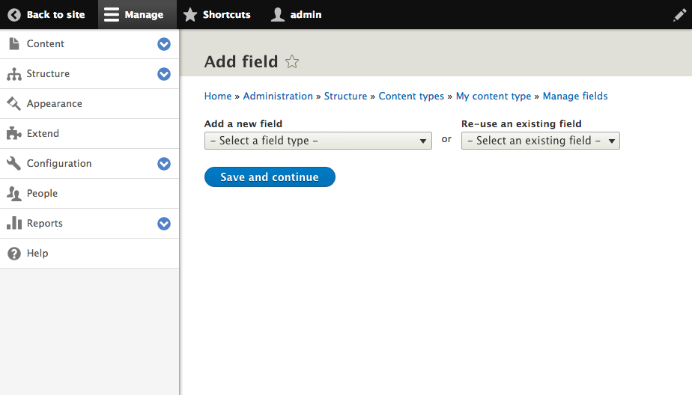
Click here

Slide 147
Files & Images
Numeric
Email*
Field Types
Text
Date*
Boolean
Link*
Reference

Slide 148
“ ”

Slide 149
Title

Slide 150
Title

Slide 151
Title
Fourth “Blob” Film is a hilarious campy romp
Fourth “Blob” Film is a…
Fourth “Blob”…

Slide 152
I’m here for your little fields too!
Crud.
The Blobs are {back}.

Slide 153
Title

Slide 154
Title
Full Title
Medium Title
Short Title

Slide 155
Title
Full Title
Medium Title
Short Title
Fourth “Blob” Film is a hilarious campy romp
“Blob” 4, this time in space.
“Blob” 4 Review

Slide 157
title
Gallery
Bio
“ ”
Key quote
“Biggest lesson” section
Author Info

Slide 158
“ ”

Slide 159
“ ”
Some of these aren’t just the same kind of data…
They {are} the same data.

Slide 162
This “field” is also multi-part.

Slide 163
“ ”

Slide 164
“ ”
Entity Reference

