Slide 1


Slide 2
@socketwench
Tess Flynn

Slide 3
That’s wench, not wrench.
@socketwench
Tess Flynn

Slide 4
That’s wench, not wrench.
Flag
Module Maintainer
Flag Friend
Examples
@socketwench
Tess Flynn

Slide 5

That’s wench, not wrench.
Flag
Drupal Developer
Module Maintainer
Flag Friend
Examples
@socketwench
Tess Flynn

Slide 7
Page

Slide 8
Page
Page
Page
Page
Page
Page
Page

Slide 9
Page
Page
Page
Page
Page
Page
Page
Page
Page
Page
Page
Page
Page
Page
Page
Page
Page
Page
Page
Page
Page

Slide 10


Slide 11
content
content
content
Content

Slide 12
Blog
Forum
Picture
Page

Slide 13
Content Type

Slide 14
Title
Content Type

Slide 15
Title
Custom Fields
Content Type

Slide 16
Title
Custom Fields
Content Type
Permissions

Slide 17
Title
Custom Fields
Content Type
Permissions
Metadata

Slide 18
It’s a thing that does stuff, right?

Slide 22
There it is!

Slide 24
Tools
Clothes
Games
Cooking

Slide 25
Now I can find what I need and work more effectively.
Tools
Clothes
Games
Cooking

Slide 26
“Lessons from the issue queue”
“Flag module recipes”
“Me by the lake”
“About US”

Slide 27
Blog
Forum
Picture
Page

Slide 28
Blog Type
Forum type
Picture type
Page Type

Slide 29
So, we’re done, right?

Slide 30

So, we’re done, right?
Right?

Slide 31
Unstructured content

Slide 32
Unstructured content
Desktop web

Slide 33
Unstructured content
Desktop web

Slide 34
Unstructured content
Editing Process
Desktop web

Slide 35
Unstructured content
Editing Process
Style Guides
Desktop web

Slide 36
Unstructured content
Editing Process
Style Guides
Desktop web

Slide 37
And then, mobile happened…
Unstructured content
Umm, where’s my site?
Desktop web
Mobile web

Slide 38
This sucks!

Slide 39
Separate sites isn’t enough.
We need separate channels.

Slide 40
Desktop content
MOBILE content
Desktop
Mobile

Slide 41
Desktop content
MOBILE content
developer
Desktop
developer
Mobile

Slide 42
WRITER
WRITER
Desktop content
MOBILE content
developer
Desktop
developer
Mobile

Slide 43
WRITER
WRITER
REVIEW
Desktop content
REVIEW
MOBILE content
developer
Desktop
developer
Mobile

Slide 44
Separate sites breaks sharing links!
And now I have two sites to maintain!

Slide 45
Desktop

Slide 46
Desktop
Mobile

Slide 47
Desktop
Mobile
Watch

Slide 48
Desktop
Mobile
Watch
Appliances

Slide 49
Desktop
Mobile
Watch
Appliances
There are too many channels to separate…

Slide 50
Maybe the problem isn’t the front-end…

Slide 51
Unstructured content
Maybe the problem isn’t the front-end…
What if it’s this?

Slide 52
UNSTRUCTURED content
Desktop
Mobile
Watch
Appliances

Slide 53
I determine my own format! Deal with it!
UNSTRUCTURED content
Desktop
Mobile
Watch
Appliances

Slide 54
I determine my own format! Deal with it!
UNSTRUCTURED content
Desktop
Mobile
Watch
Appliances

Slide 55
I determine my own format! Deal with it!
UNSTRUCTURED content
SPARE US, LORD CONTENT!
Desktop
Mobile
Watch
Appliances

Slide 56
Title:
Body:

Slide 57
Title:
Body:

Slide 58
Title:
Body:

Slide 59
Title:
Body:

Slide 60
Yesssss…
FEED me more WYSIWYG buttons!

Slide 61
Desktop
Smarter content
Mobile

Slide 62
Give me the full content.
I need a short title and Medium summary.
QUEURY
QUEURY
Desktop
Smarter content
Mobile

Slide 63
Give me the full content.
I need a short title and Medium summary.
QUEURY
QUEURY
RETRIEVE
RETRIEVE
Desktop
Smarter content
Mobile

Slide 64
Give me the full content.
I need a short title and Medium summary.
QUEURY
QUEURY
RETRIEVE
RETRIEVE
Desktop
Smarter content
Mobile

Slide 67
Good thing I only need one thing.

Slide 69
I’m never going to find all the pieces I need in this!

Slide 70
“ ”

Slide 71
title
Body
“ ”

Slide 72
title
Gallery
Bio
“ ”
Key quote
“Biggest lesson” section
Author Info

Slide 73
title
Gallery
Bio
Changing the one thing shouldn’t be hard
“ ”
Key quote
“Biggest lesson” section
Author Info

Slide 74
“ ”
“ ”
“ ”
“ ”
“ ”
“ ”
“ ”
“ ”
“ ”

Slide 75
“ ”
“ ”
“ ”
One down, 14567 to go…
“ ”
“ ”
“ ”
“ ”
“ ”
“ ”

Slide 76
“ ”

Slide 77
“ ”

Slide 78
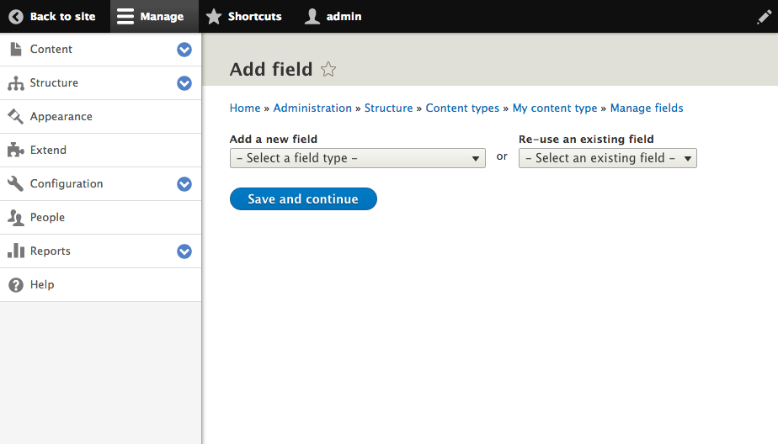
Click here

Slide 79
Files & Images
Numeric
Email*
Field Types
Text
Date*
Boolean
Link*
Reference

Slide 80
“ ”

Slide 81
Title

Slide 82
Title

Slide 83
Title
Fourth “Blob” Film is a hilarious campy romp
Fourth “Blob” Film is a…
Fourth “Blob”…

Slide 84
I’m here for your little fields too!
Crud.
The Blobs are {back}.

Slide 85
Title

Slide 86
Title
Full Title
Medium Title
Short Title

Slide 87
Title
Full Title
Medium Title
Short Title
Fourth “Blob” Film is a hilarious campy romp
“Blob” 4, this time in space.
“Blob” 4 Review

Slide 89
title
Gallery
Bio
“ ”
Key quote
“Biggest lesson” section
Author Info

Slide 90
“ ”

Slide 91
“ ”
Some of these aren’t just the same kind of data…
They {are} the same data.

Slide 94
This “field” is also multi-part.

Slide 95
“ ”

Slide 96
“ ”
Entity Reference

