Slide 1


Slide 2
@socketwench
Tess Flynn

Slide 3
That’s wench, not wrench.
@socketwench
Tess Flynn

Slide 4
That’s wench, not wrench.
Flag
Module Maintainer
Flag Friend
Examples
@socketwench
Tess Flynn

Slide 5

That’s wench, not wrench.
Flag
Drupal Developer
Module Maintainer
Flag Friend
Examples
@socketwench
Tess Flynn

Slide 6
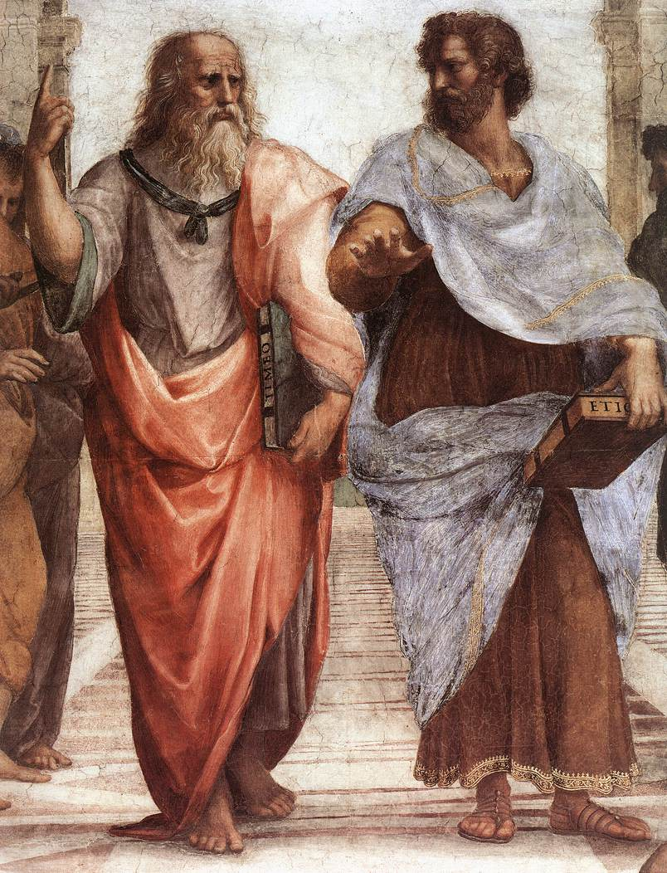

Slide 7
Dude, it’s like all up there, in my realm.

Slide 8
Dude, it’s like all up there, in my realm.
You’re daft, man. It’s all in front of us.
And stop trying to get me into your realm.

Slide 14
All of these are just imperfect copies of the ideal!

Slide 18
What’s all this have to do with OOP?

Slide 19
Human

Slide 20
Page

Slide 21
Page
Page
Page
Page
Page
Page
Page

Slide 22
Page
Page
Page
Page
Page
Page
Page
Page
Page
Page
Page
Page
Page
Page
Page
Page
Page
Page
Page
Page
Page

Slide 23


Slide 24
content
content
content
Content

Slide 25
Blog
Forum
Picture
Page

Slide 26
Content Type

Slide 27
Title
Content Type

Slide 28
Title
Custom Fields
Content Type

Slide 29
Title
Custom Fields
Content Type
Permissions

Slide 30
Title
Custom Fields
Content Type
Permissions
Metadata

Slide 34
There it is!

Slide 36
Tools
Clothes
Games
Cooking

Slide 37
Now I can find what I need and work more effectively.
Tools
Clothes
Games
Cooking

Slide 38
“Lessons from the issue queue”
“Flag module recipes”
“Me by the lake”
“About US”

Slide 39
Blog
Forum
Picture
Page

Slide 40
Blog Type
Forum type
Picture type
Page Type

Slide 41
So, we’re done, right?

Slide 42

So, we’re done, right?
Right?

Slide 43
Unstructured content

Slide 44
Unstructured content
Desktop web

Slide 45
Unstructured content
Desktop web

Slide 46
Unstructured content
Editing Process
Desktop web

Slide 47
Unstructured content
Editing Process
Style Guides
Desktop web

Slide 48
Unstructured content
Editing Process
Style Guides
Desktop web

Slide 49
And then, mobile happened…
Unstructured content
Umm, where’s my site?
Desktop web
Mobile web

Slide 50
This sucks!

Slide 51
Separate sites isn’t enough.
We need separate channels.

Slide 52
Desktop content
MOBILE content
Desktop
Mobile

Slide 53
Desktop content
MOBILE content
developer
Desktop
developer
Mobile

Slide 54
WRITER
WRITER
Desktop content
MOBILE content
developer
Desktop
developer
Mobile

Slide 55
WRITER
WRITER
REVIEW
Desktop content
REVIEW
MOBILE content
developer
Desktop
developer
Mobile

Slide 56
Separate sites breaks sharing links!
And now I have two sites to maintain!

Slide 57
Desktop

Slide 58
Desktop
Mobile

Slide 59
Desktop
Mobile
Watch

Slide 60
Desktop
Mobile
Watch
Appliances

Slide 61
Desktop
Mobile
Watch
Appliances
There are too many channels to separate…

Slide 62
Maybe the problem isn’t the front-end…

Slide 63
Unstructured content
Maybe the problem isn’t the front-end…
What if it’s this?

Slide 64
UNSTRUCTURED content
Desktop
Mobile
Watch
Appliances

Slide 65
I determine my own format! Deal with it!
UNSTRUCTURED content
Desktop
Mobile
Watch
Appliances

Slide 66
I determine my own format! Deal with it!
UNSTRUCTURED content
Desktop
Mobile
Watch
Appliances

Slide 67
I determine my own format! Deal with it!
UNSTRUCTURED content
SPARE US, LORD CONTENT!
Desktop
Mobile
Watch
Appliances

Slide 68
Title:
Body:

Slide 69
Title:
Body:

Slide 70
Title:
Body:

Slide 71
Title:
Body:

Slide 72
Yesssss…
FEED me more WYSIWYG buttons!

Slide 73
Desktop
Smarter content
Mobile

Slide 74
Give me the full content.
I need a short title and Medium summary.
QUEURY
QUEURY
Desktop
Smarter content
Mobile

Slide 75
Give me the full content.
I need a short title and Medium summary.
QUEURY
QUEURY
RETRIEVE
RETRIEVE
Desktop
Smarter content
Mobile

Slide 76
Give me the full content.
I need a short title and Medium summary.
QUEURY
QUEURY
RETRIEVE
RETRIEVE
Desktop
Smarter content
Mobile

Slide 79
Good thing I only need one thing.

Slide 81
I’m never going to find all the pieces I need in this!

Slide 82
“ ”

Slide 83
title
Body
“ ”

Slide 84
title
Gallery
Bio
“ ”
Key quote
“Biggest lesson” section
Author Info

Slide 85
title
Gallery
Bio
Changing the one thing shouldn’t be hard
“ ”
Key quote
“Biggest lesson” section
Author Info

Slide 86
“ ”
“ ”
“ ”
“ ”
“ ”
“ ”
“ ”
“ ”
“ ”

Slide 87
“ ”
“ ”
“ ”
One down, 14567 to go…
“ ”
“ ”
“ ”
“ ”
“ ”
“ ”

Slide 88
“ ”

Slide 89
“ ”

Slide 90
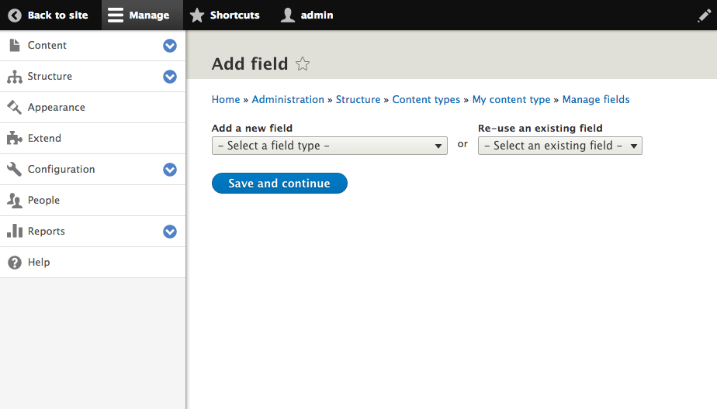
Click here

Slide 91
Files & Images
Numeric
Email*
Field Types
Text
Date*
Boolean
Link*
Reference

Slide 92
“ ”

Slide 93
Title

Slide 94
Title

Slide 95
Title
Fourth “Blob” Film is a hilarious campy romp
Fourth “Blob” Film is a…
Fourth “Blob”…

Slide 96
I’m here for your little fields too!
Crud.
The Blobs are {back}.

Slide 97
Title

Slide 98
Title
Full Title
Medium Title
Short Title

Slide 99
Title
Full Title
Medium Title
Short Title
Fourth “Blob” Film is a hilarious campy romp
“Blob” 4, this time in space.
“Blob” 4 Review

Slide 101
title
Gallery
Bio
“ ”
Key quote
“Biggest lesson” section
Author Info

Slide 102
“ ”

Slide 103
“ ”
Some of these aren’t just the same kind of data…
They {are} the same data.

Slide 106
This “field” is also multi-part.

Slide 107
“ ”

Slide 108
“ ”
Entity Reference

