Slide 1
Example Module Ain’t Core
But it ain’t contrib neither

Slide 2

This here ‘con ain’t big enough for the both of our hats, crell!

Slide 3
This here ‘con ain’t big enough for the both of our hats, crell!

Slide 4

No core
No code
No Example

Slide 5
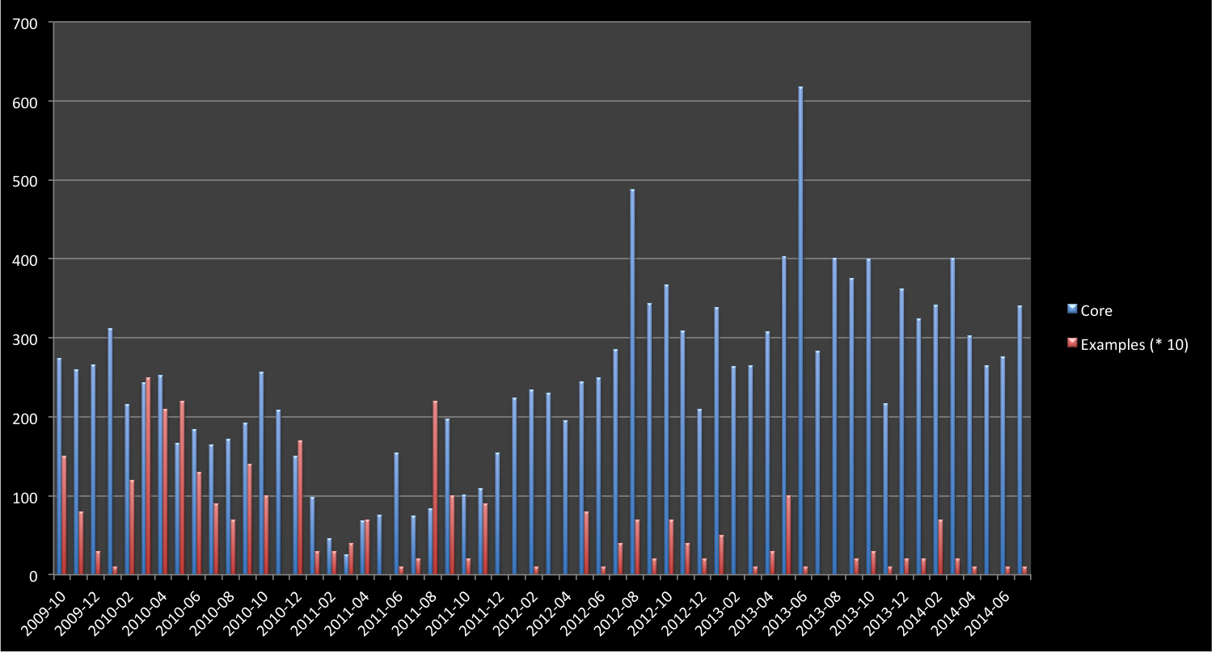
Drupal 8.0-Alpha-1
Drupal 7.0-alpha-1
Tablesort & Pager Example
Simpletest 8.x Example
Drupal 7.0-RC-1

Slide 6
Initial work
Drupal 7
Pre-release
Drupal 7
Post-release
Drupal 8
Example Modules Commits
Time

Slide 7
Initial work
Drupal 7
Pre-release
Drupal 7
Post-release
Drupal 8
Yikes!
Example Modules Commits
Time

Slide 8
Where do I even start?

Slide 9
Monetary investment
Paid Training
Educational prose
Community Documentation
Source code
Experience Required

Slide 10
Should I be fast?
Should I be easy to expand?
Should I be easy to understand?

Slide 11
Information
Knowledge

Slide 13
If you can’t port, then rewrite!

Slide 14
If you can’t port, then rewrite!
I canna do it, the core’s too diffn’t!

Slide 15
Plugins
YAML
Code standards
Routing
OOP
Simpletest
Symphony
FORM API
git

Slide 16
Entity System
Field API

Slide 17
Field API
Entity System
Form API
DBTNG
Time to understand
Hooks
Core contributors
Example Contributors

Slide 18
Routing
Plugins
CMI
OOP
Symphony
Time to understand
Simpletest
YAML
Form API
Hooks?
Core contributors
Example Contributors

Slide 19
Routing
Shadow of Doubt
Plugins
CMI
OOP
Symphony
Time to understand
Simpletest
YAML
Form API
Hooks?
Core contributors
Example Contributors

Slide 20
…How it connects to everything has.
This API is “largely unchanged”, but..

Slide 21
What if it goes away in the next alpha?
Should I even be using this?
How can I make any decision here!?

Slide 22
Maybe core devs should do this?
Then at least Examples would keep up with core…

Slide 23
Example Modules Commits (Ideal)
Core Beta
Stable core
Core Alpha
Time

Slide 24
Critical examples updated/created
Example Modules Commits (Ideal)
Core Beta
Stable core
Core Alpha
Time

Slide 25
Critical examples updated/created
Critical examples Ready, non-criticals started
Example Modules Commits (Ideal)
Core Beta
Stable core
Core Alpha
Time

Slide 26
Critical examples updated/created
Critical examples Ready, non-criticals started
Non-critical examples ready
Example Modules Commits (Ideal)
Core Beta
Stable core
Core Alpha
Time

Slide 27
Critical examples updated/created
Critical examples Ready, non-criticals started
Non-critical examples ready
Minor fixes only!!!
Example Modules Commits (Ideal)
Core Beta
Stable core
Core Alpha
Time

Slide 28
New Developer

Slide 29
New Developer
Drupal.org

Slide 30

New Developer
Drupal.org
Download link

Slide 31
New Developer
Drupal.org
Download link
Install on Web server

Slide 32
New Developer
Drupal.org
Download link
?
Install on Web server
Find no examples

Slide 33
New Developer
Drupal.org
Download link
?
Install on Web server
Find no examples
Search for examples

Slide 34

New Developer
Drupal.org
Download link
?
Install on Web server
Find no examples
Search for examples
Download Examples!

Slide 35
New Developer
Drupal.org
Download link
?
Install on Web server
Find no examples
Search for examples
Download Examples!
What the heck is a module?

Slide 36
New Developer
Drupal.org
Download link
?
Install on Web server
Find no examples
Search for examples
*headdesk*
*headdesk*
Download Examples!
What the heck is a module?

Slide 37
New Developer
Drupal.org
Download link
Install on Web server
Enable Examples

Slide 38
New Developer
Drupal.org
Download link
Install on Web server
Enable Examples
{Happiness}

Slide 40
I’ve got some shiny new code for you.

Slide 41
I’ve got some shiny new code for you.
Cool, I’ll test it.

Slide 43
Dude, I think there’s a bug in here.

Slide 44
Dude, I think there’s a bug in here.
But…shiny?

Slide 45
Actual bugs

Slide 46
Actual bugs
Developer experience
(DX)

Slide 47
Actual bugs
Developer experience
(DX)
Feature gaps
(Entity API?)

Slide 48
Actual bugs
Developer experience
(DX)
Feature gaps
(Entity API?)
Unexpected use

Slide 49
Shouldn’t I live over there?
Routing
Plugins
CMI
OOP
Symphony
Time to understand
Simpletest
YAML
Form API
Hooks?
Core contributors
Example Contributors

Slide 50
New Developer

Slide 51
New Developer
Bug found in Core Examples

Slide 52
New Developer
Bug found in Core Examples
New issue on Drupal.org

Slide 53
New Developer
Bug found in Core Examples
New issue on Drupal.org
Submitted Patch

Slide 54
New Developer
Bug found in Core Examples
New issue on Drupal.org
Submitted Patch
New commit!

Slide 55
New Developer
Bug found in Core Examples
New issue on Drupal.org
Submitted Patch
New commit!
{Happiness}

Slide 57
This makes core better, easier, faster.

Slide 58
This makes core better, easier, faster.
But does it work for contrib?

Slide 60
I’m core isolated

Slide 61
I’m core isolated
I test DX {before} core is frozen.

Slide 62

/

Slide 63
(

