Slide 1
Example Module Ain’t Core
But it ain’t contrib neither

Slide 2

This here ‘con ain’t big enough for the both of our hats, crell!

Slide 3
This here ‘con ain’t big enough for the both of our hats, crell!

Slide 4

No core
No code
No Example

Slide 5

/

Slide 6

/

Slide 7
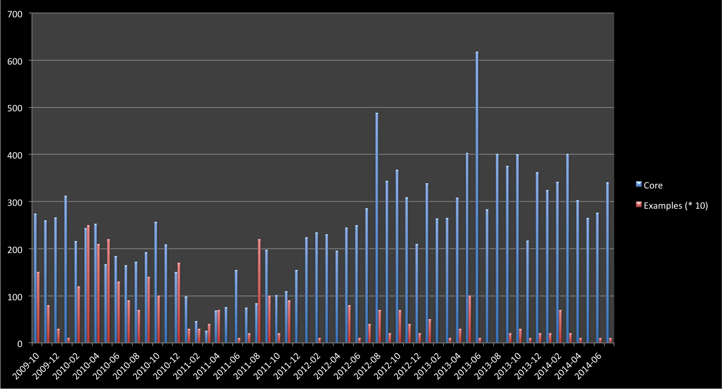
Drupal 8.0-Alpha-1
Drupal 7.0-alpha-1
Tablesort & Pager Example
Simpletest 8.x Example
Drupal 7.0-RC-1

Slide 8
Initial work
Drupal 7
Pre-release
Drupal 7
Post-release
Drupal 8
Example Modules Commits
Time

Slide 9
Initial work
Drupal 7
Pre-release
Drupal 7
Post-release
Drupal 8
Yikes!
Example Modules Commits
Time

Slide 10
Where do I even start?

Slide 11
Monetary investment
Paid Training
Educational prose
Community Documentation
Source code
Experience Required

Slide 12
Should I be fast?
Should I be easy to expand?
Should I be easy to understand?

Slide 13
Information
Knowledge

Slide 15
If you can’t port, then rewrite!

Slide 16
If you can’t port, then rewrite!
I canna do it, the core’s too diffn’t!

Slide 17
Plugins
YAML
Code standards
Routing
OOP
Simpletest
Symphony
FORM API
git

Slide 18
Entity System
Field API

Slide 19
Field API
Entity System
Form API
DBTNG
Time to understand
Hooks
Core contributors
Example Contributors

Slide 20
Routing
Plugins
CMI
OOP
Symphony
Time to understand
Simpletest
YAML
Form API
Hooks?
Core contributors
Example Contributors

Slide 21
Routing
Shadow of Doubt
Plugins
CMI
OOP
Symphony
Time to understand
Simpletest
YAML
Form API
Hooks?
Core contributors
Example Contributors

Slide 22
…How it connects to everything has.
This API is “largely unchanged”, but..

Slide 23
What if it goes away in the next alpha?
Should I even be using this?
How can I make any decision here!?

Slide 24
Maybe core devs should do this?
Then at least Examples would keep up with core…

Slide 25
Example Modules Commits (Ideal)
Core Beta
Stable core
Core Alpha
Time

Slide 26
Critical examples updated/created
Example Modules Commits (Ideal)
Core Beta
Stable core
Core Alpha
Time

Slide 27
Critical examples updated/created
Critical examples Ready, non-criticals started
Example Modules Commits (Ideal)
Core Beta
Stable core
Core Alpha
Time

Slide 28
Critical examples updated/created
Critical examples Ready, non-criticals started
Non-critical examples ready
Example Modules Commits (Ideal)
Core Beta
Stable core
Core Alpha
Time

Slide 29
Critical examples updated/created
Critical examples Ready, non-criticals started
Non-critical examples ready
Minor fixes only!!!
Example Modules Commits (Ideal)
Core Beta
Stable core
Core Alpha
Time

Slide 30
New Developer

Slide 31
New Developer
Drupal.org

Slide 32

New Developer
Drupal.org
Download link

Slide 33
New Developer
Drupal.org
Download link
Install on Web server

Slide 34
New Developer
Drupal.org
Download link
?
Install on Web server
Find no examples

Slide 35
New Developer
Drupal.org
Download link
?
Install on Web server
Find no examples
Search for examples

Slide 36

New Developer
Drupal.org
Download link
?
Install on Web server
Find no examples
Search for examples
Download Examples!

Slide 37
New Developer
Drupal.org
Download link
?
Install on Web server
Find no examples
Search for examples
Download Examples!
What the heck is a module?

Slide 38
New Developer
Drupal.org
Download link
?
Install on Web server
Find no examples
Search for examples
*headdesk*
*headdesk*
Download Examples!
What the heck is a module?

Slide 39
New Developer
Drupal.org
Download link
Install on Web server
Enable Examples

Slide 40
New Developer
Drupal.org
Download link
Install on Web server
Enable Examples
{Happiness}

Slide 42
I’ve got some shiny new code for you.

Slide 43
I’ve got some shiny new code for you.
Cool, I’ll test it.

Slide 45
Dude, I think there’s a bug in here.

Slide 46
Dude, I think there’s a bug in here.
But…shiny?

Slide 47
Actual bugs

Slide 48
Actual bugs
Developer experience
(DX)

Slide 49
Actual bugs
Developer experience
(DX)
Feature gaps
(Entity API?)

Slide 50
Actual bugs
Developer experience
(DX)
Feature gaps
(Entity API?)
Unexpected use

